Slide 1



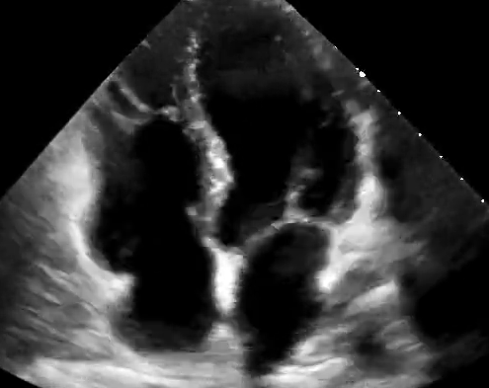











Stage 0
Stage 1
Stage 2
Stage 3
Stage 4
Normal BMI
Waist circumference
Normoglycemia
Normotension
Normal lipid profile
Overweight/obesity
Abdominal obesity
Impaired glucose tolerance
Metabolic risk factors
(hypertriglyceridemia,
hypertension,
MetS,
Diabetes)
Subclinical ASCVD
Subclinical HF
Clinical ASCVD
Clinical HF
Assessment
Assessment
Assessment
Assessment
status
summary
status
summary
status
summary
status
summary
Stage 0: No CKM risk factors
Stage 1: Excess or dysfunctional adiposity
Stage 2: Metabolic risk factors and CKD
Stage 3: Subclinical CVD in CKM
Stage 4: Clinical CVD in CKM

