Slide 1



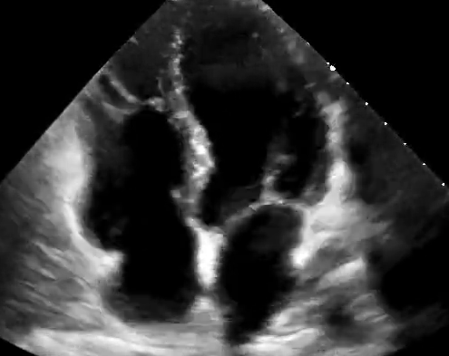











Stage 0
Stage 1
Stage 2
Stage 3
Stage 4
Stage
Normal BMI
Waist circumference
Normoglycemia
Normotension
Normal lipid profile
Overweight/obesity
Abdominal obesity
Impaired glucose tolerance
Metabolic risk factors
(hypertriglyceridemia,
hypertension,
MetS,
Diabetes)
Subclinical ASCVD
Subclinical HF
Clinical ASCVD
Clinical HF
Evidence
Evaluation
Stage 0: No CKM risk factors
Stage 1: Excess or dysfunctional adiposity
Stage 2: Metabolic risk factors and CKD
Stage 3: Subclinical CVD in CKM
Stage 4: Clinical CVD in CKM
represents evaluation score and treatment suggestions

