Slide 1



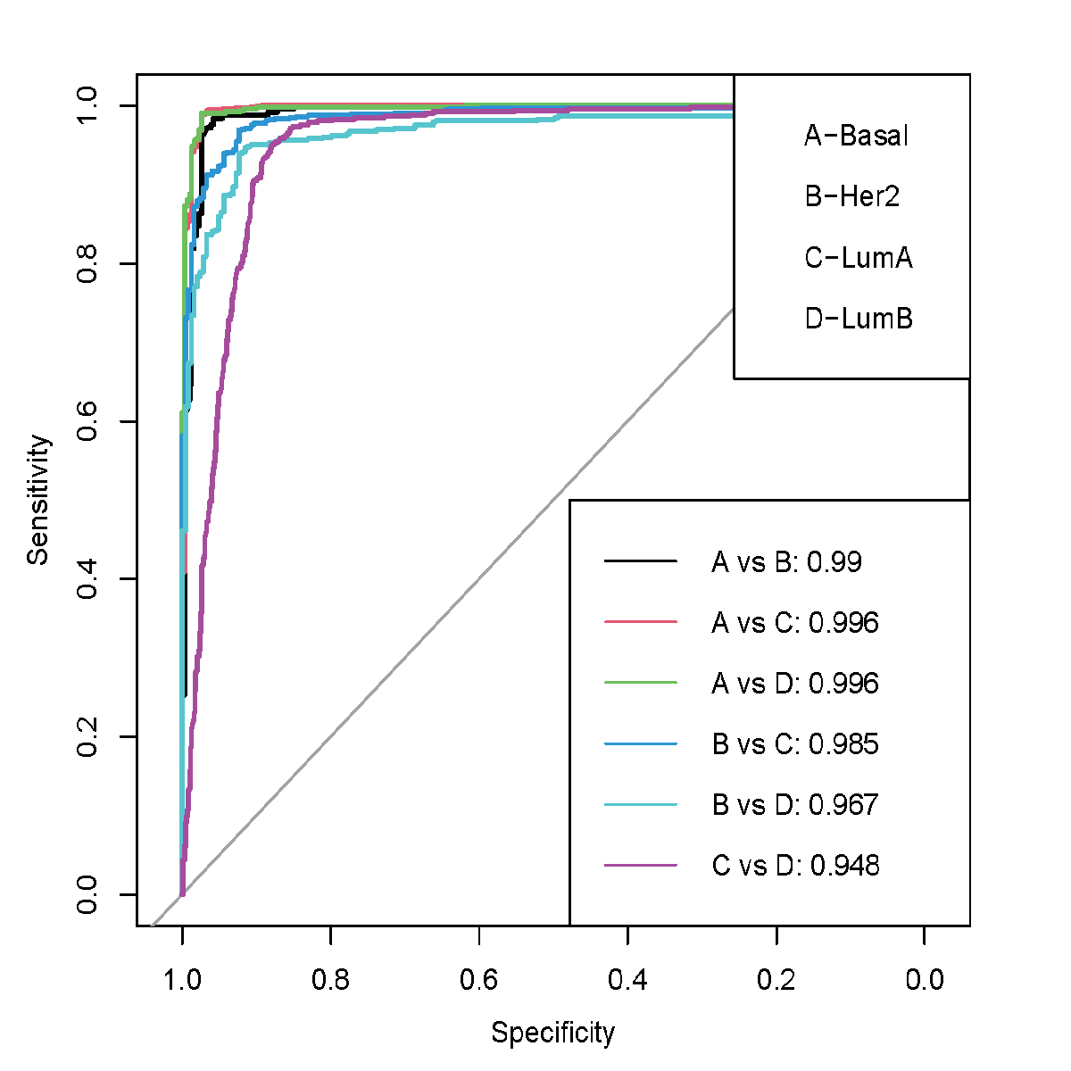
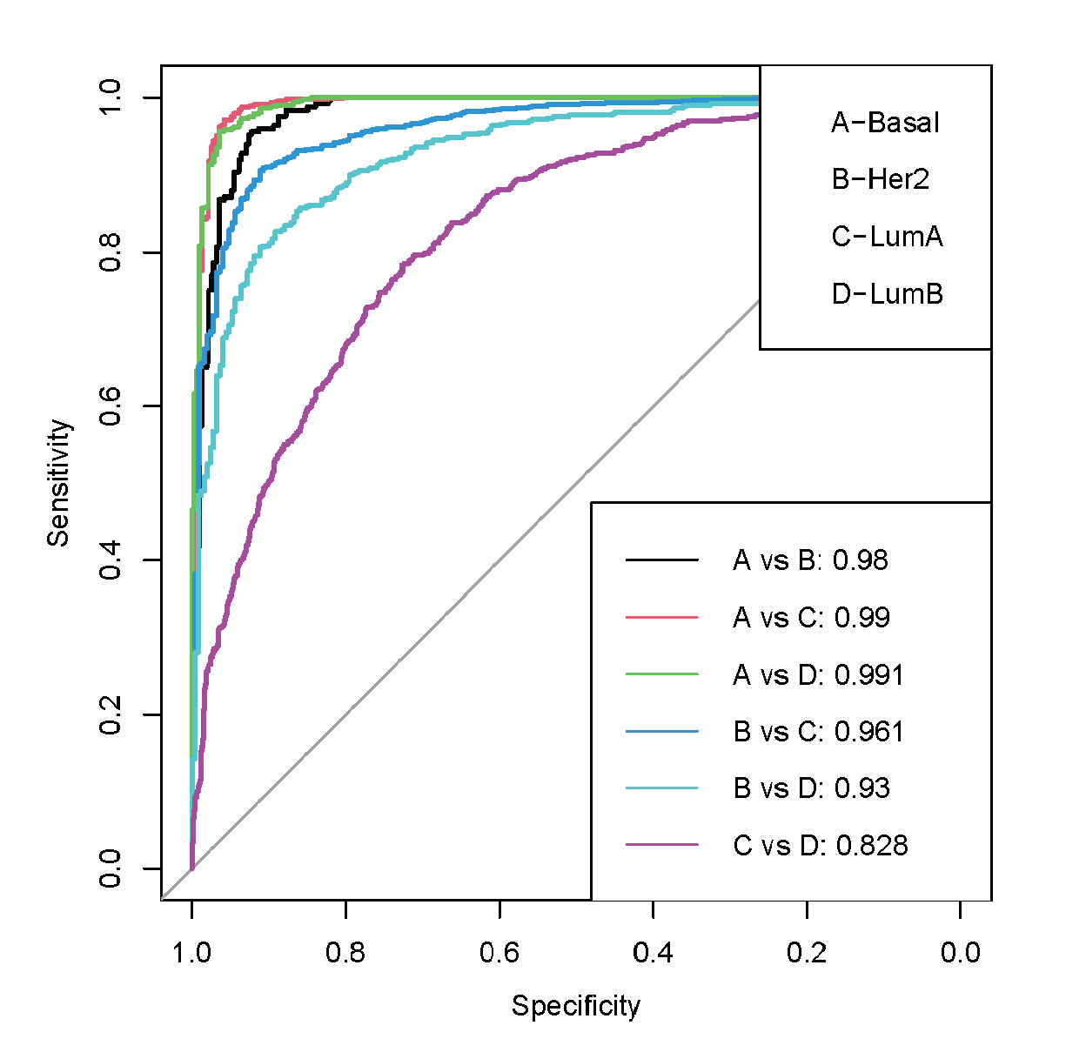


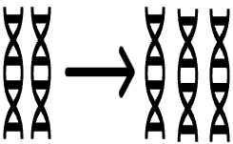
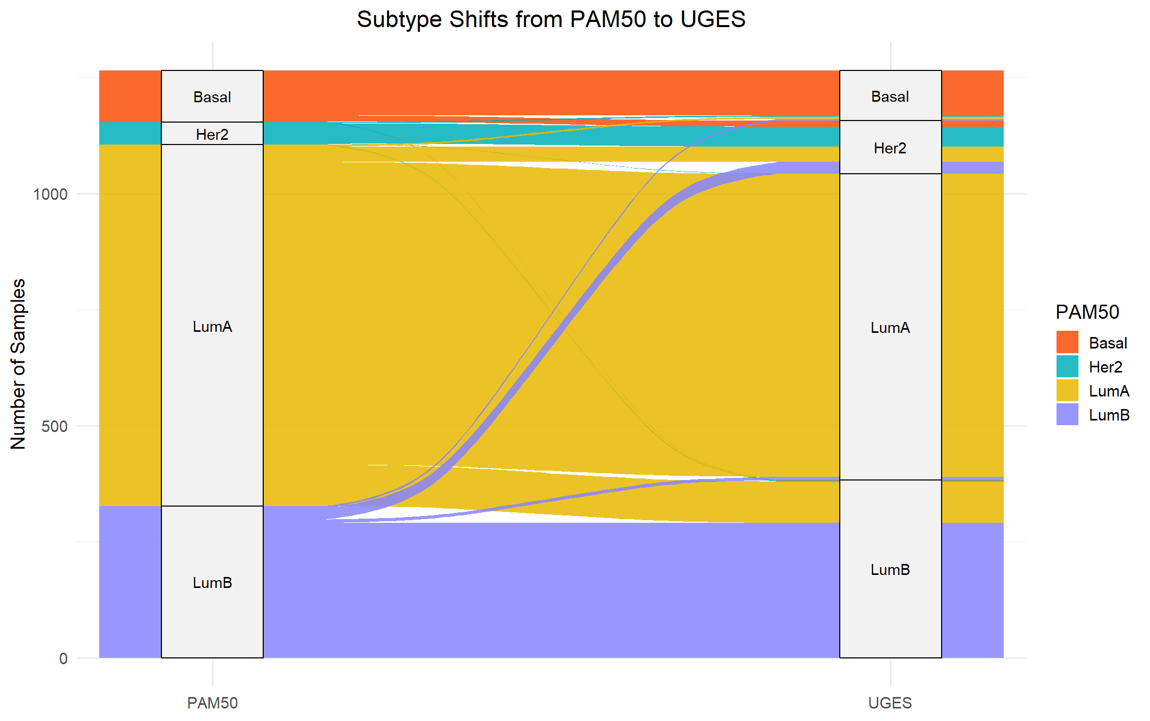




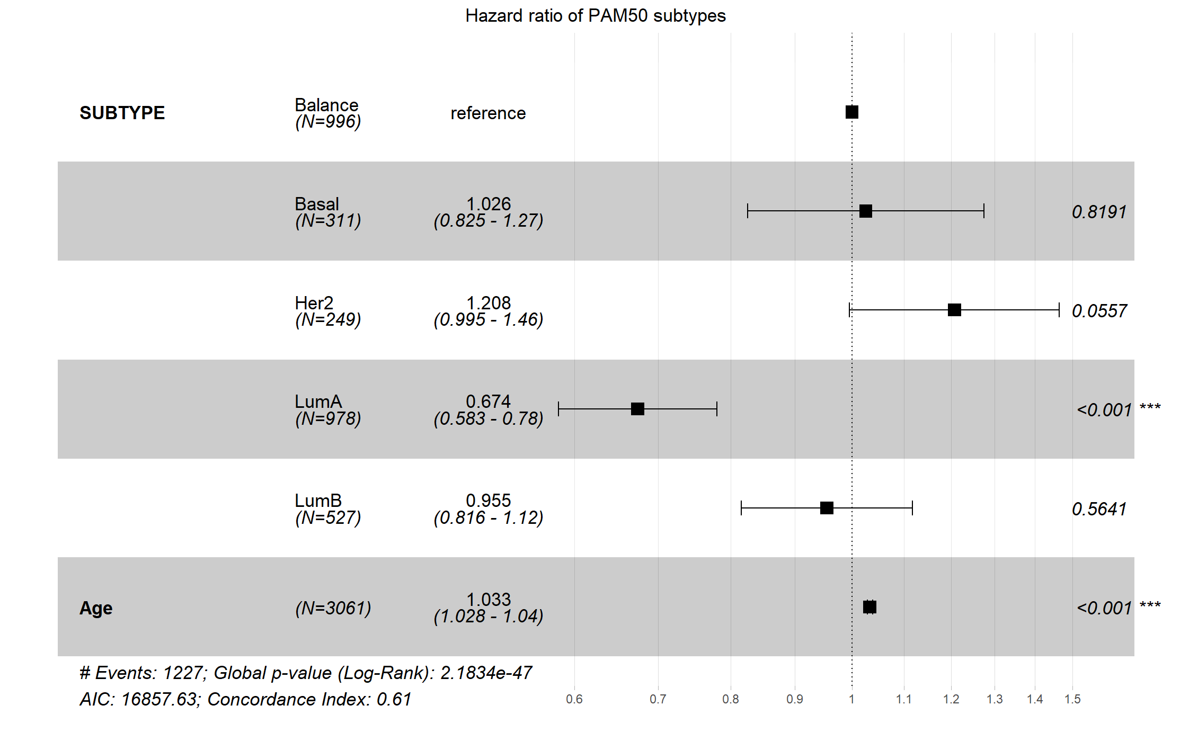
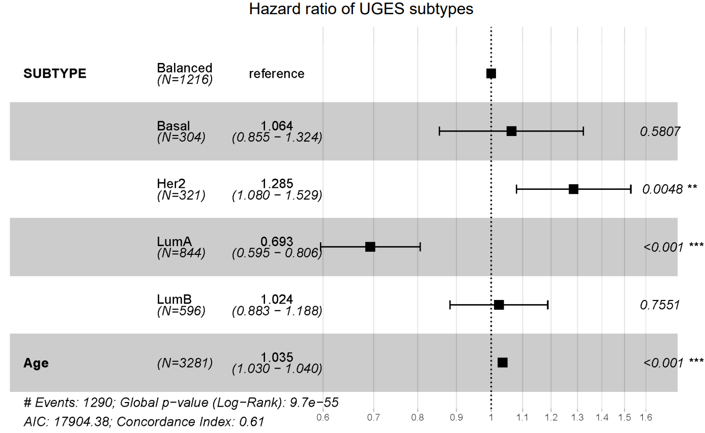
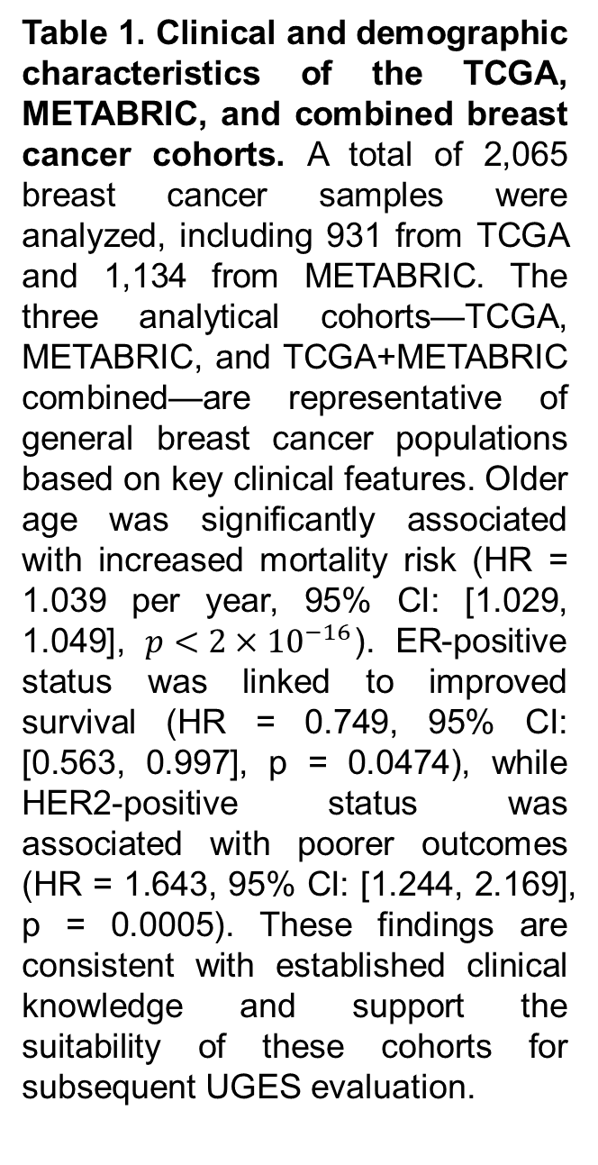
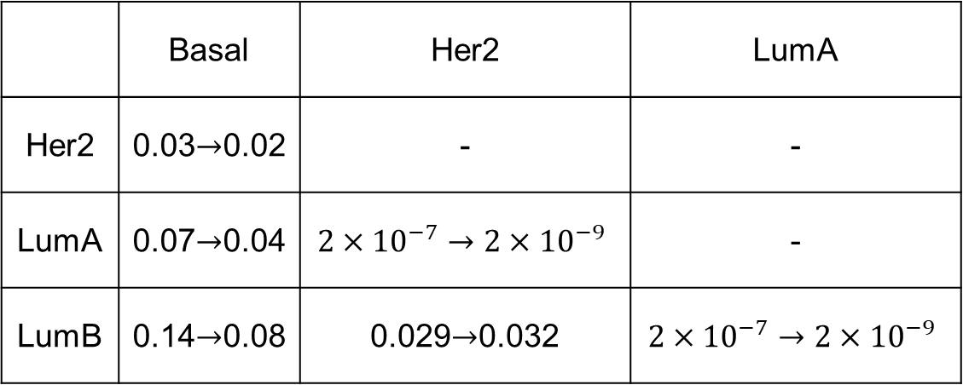
Accurate breast cancer intrinsic subtyping using DNA-only biomarkers with applications to multi-cohorts
Xintong Chang¹, Linping Wang¹, Hongyu Duan¹, Li C. Xia¹*
¹School of Mathematics, South China University of Technology, Guangzhou 510000, Guangdong, China
Email: lcxia@scut.edu.cn
AIM:
Breast cancer intrinsic subtyping is fundamental for precision treatment and prognosis. We developed UGES (Unified Genetic and Epigenetic Subtyping) [1], a DNA-level hierarchical classifier integrating somatic mutations, copy number aberrations, and DNA methylation, addressing inconsistencies in expression-based methods such as PAM50. In this study, we report the performance and clinical utility of UGES using real-world multi-cohort data.
METHODS:
1. Data
RESULTS :
1. UGES Outperforms One-Step Classification in Subtype Discrimination
TCGA
N=931
197
488
mutation
n=16770
(B,(H,(LA,LB)))
(B,H,LA,LB)
78
168
330
Methylation
n=25594
METABRIC
N=1134
171
490
CNA
n=8467
PAM50 subtype
143
Basal-like
Her2
Luminal A
Luminal B
Figure 1. Cohort Overview and Multi-Omics Feature Composition.
2. Cohort Characteristics and Clinical Profile Assessment
Cohort |  | Sample Size (Missing) |  |  | Events¹
TCGA |  | 931 (5) |  |  | 122
METABRIC |  | 1134 (309) |  |  | 487
Combined |  | 2065 (314) |  |  | 609
Multivariable Cox Regression Results
Clinical Feature |  | Dataset | Count (%) / Mean (Range) | Hazard Ratio | 95%CI | P value | Significance²
Age | at diagnosis | TCGA | 58.4 (26-90) | 1.038 | (1.024, 1.053) | 2.3e-07 | ***
 |  | METABRIC | 61.6 (21-96) | 1.041 | (1.033, 1.050) | < 2e-16 | ***
 |  | Combined | 60.1 (21-96) | 1.038 | (1.031, 1.045) | < 2e-16 | ***
ER Status | Negative (reference) | METABRIC | 218 (19.22%)
 | Positive |  | 916 (80.78%) | 0.749 | (0.563, 0.997) | 0.0474 | *
PR Status | Negative (reference) | METABRIC | 506 (44.62%)
 | Positive |  | 628 (55.38%) | 0.917 | (0.737, 1.140) | 0.4340 | n.s.
Her2 Status | Negative (reference) | METABRIC | 981 (86.51%)
 | Positive |  | 153 (13.49%) | 1.643 | (1.244, 2.169) | 0.0005 | ***
Table 1. Clinical and demographic characteristics of the TCGA, METABRIC, and combined breast cancer cohorts. A total of 2,065 breast cancer samples were analyzed, including 931 from TCGA and 1,134 from METABRIC. The three analytical cohorts—TCGA, METABRIC, and TCGA+METABRIC combined—are representative of general breast cancer populations based on key clinical features. Older age was significantly associated with increased mortality risk (HR = 1.039 per year, 95% CI: [1.029, 1.049], $p<2×{10}^{−16}$). ER-positive status was linked to improved survival (HR = 0.749, 95% CI: [0.563, 0.997], p = 0.0474), while HER2-positive status was associated with poorer outcomes (HR = 1.643, 95% CI: [1.244, 2.169], p = 0.0005). These findings are consistent with established clinical knowledge and support the suitability of these cohorts for subsequent UGES evaluation.
Figure 4. Discrimination performance of UGES under different hierarchical classification strategies. Pairwise one-vs-one ROC analysis was applied across all six subtype comparisons (Basal–Her2, Basal–LumA, Basal–LumB, Her2–LumA, Her2–LumB, LumA–LumB) on the combined test cohort (TCGA + METABRIC). The proposed hierarchical structure (B,(H,(LA,LB))) (left) achieved the highest discrimination performance, especially for the clinically challenging Luminal A vs. Luminal B classification (AUC = 0.948), outperforming the alternative one-step structure (B,H,LA,LB) (right; AUC = 0.828). All UGES subtype pairings demonstrated excellent AUC values, supporting the effectiveness and robustness of the hierarchical design.
2. Subtype Reclassification: UGES vs. PAM50
Figure 5. Alluvial plot of subtype reassignment between PAM50 and UGES. This alluvial plot visualizes the transitions in intrinsic subtype assignments when applying UGES compared with PAM50 across 2,065 breast cancer samples. A total of 11.57% of tumors (239/2,065) were reassigned by UGES. The most notable shift occurred within the Luminal-like group, where 11.25% of Luminal A tumors defined by PAM50 were reclassified as Luminal B by UGES. This pattern aligns with the well-recognized genomic and epigenetic similarity between Luminal A and Luminal B subtypes, which makes them challenging to distinguish.
¹The event refers to patient death or censoring during follow-up.
²Statistical significance is based on the fitted multivariable Cox regression model. n.s. = not significant; *p < 0.05; **p < 0.01; *p < 0.001.
3. Evaluation of hierarchical strategies using one-vs-one ROC analysis
True
subtype
Predicted
subtype
Basal
Her2
LumA
LumB
Basal
Her2
LumA
LumB
class confusion matrix
3. Enhanced Prognostic Stratification Using UGES Subtyping
UGES strategy
(B,(H,(LA,LB)))
ROC
&
AUC
Hazard ratio of PAM50 subtypes
Hazard ratio of UGES subtypes
TCGA
Metabric
(B,H,LA,LB)
Figure 2. Performance comparison between the hierarchical UGES model and the one-step multiclass strategy. Subtype prediction was conducted on the combined test set (TCGA + METABRIC). UGES was evaluated under the proposed hierarchical architecture (B,(H,(LA,LB))) and compared with a one-step multiclass approach (B,H,LA,LB). To assess subtype discrimination capability, one-vs-one ROC analyses were performed across six intrinsic subtype pairs (Basal–Her2, Basal–LumA, Basal–LumB, Her2–LumA, Her2–LumB, LumA–LumB), and ROC curves with corresponding AUC values were derived from predicted probabilities.
4. Survival Analysis: Comparison Between UGES and PAM50 Subtypes
Figure 6. Multivariable survival analysis comparing prognostic stratification between UGES and PAM50 subtypes. Multivariable Cox proportional hazards models were constructed to evaluate subtype-specific prognostic value while adjusting for age. UGES subtyping provided significantly improved stratification of overall survival (p = 9.7×10⁻⁵⁵), outperforming PAM50 (p = 2.2×10⁻⁴⁷). Under UGES classification, survival differences among intrinsic subtypes became more statistically significant — particularly for Her2, which transitioned from borderline significance under PAM50 to a clearly poorer-outcome subtype. LumA consistently showed the most favorable prognosis (HR < 1).
Univariate Survival Model
• Kaplan–Meier estimation
• Log-rank test
 | Basal | Her2 | LumA
Her2 | 0.03$→$0.02 | - | -
LumA | 0.07$→$0.04 | $$2×{10}^{−7}→2×{10}^{−9}$$ | -
LumB | 0.14$→$0.08 | 0.029$→$0.032 | $$2×{10}^{−7}→2×{10}^{−9}$$
Subtype Group Assignment
Balanced comparison dataset
Multiple Testing Adjustment
• Benjamini-Hochberg method
• FDR < 0.05
Multivariable Cox Regression
• coxph() + Age Covariate
• Forest Plot Visualization
Figure 3. Workflow of Survival Analysis Comparing UGES and PAM50 Subtypes.
Table 2. Pairwise log-rank p-value comparisons of subtype-specific survival outcomes between PAM50 and UGES. Pairwise survival testing shows that in 5 of 6 subtype comparisons, UGES yields more statistically significant separation of overall survival than PAM50, indicating improved clinical discriminative ability. Notably, the difference between LumA and Basal becomes statistically significant only under UGES reassignment.
CONCLUSION :
UGES provides a robust and clinically applicable framework for multi-cohort breast cancer subtyping.
UGES is freely available at: https://ieeexplore.ieee.org/abstract/document/11176992.
References
Chang X., Xie J., Duan H., Li K., Liu X., Xiong Y., Bai X., Ning K., Xia L.C. "A unified genetic and epigenetic model to predict breast cancer intrinsic subtypes using large DNA-level multi-omics data and hierarchical learning." IEEE Transactions on Computational Biology and Bioinformatics 2025; early access. doi:10.1109/TCBBIO.2025.3613591.Friedman J & al.: Regularization paths for generalized linear models via coordinate descent . J Stat Softw. 2010, 33: 1-22.
Department of Statistics & Financial Mathematics School of Mathematics
South China University of Technology
Guangzhou, Guangdong 510640, China

