Slide 1



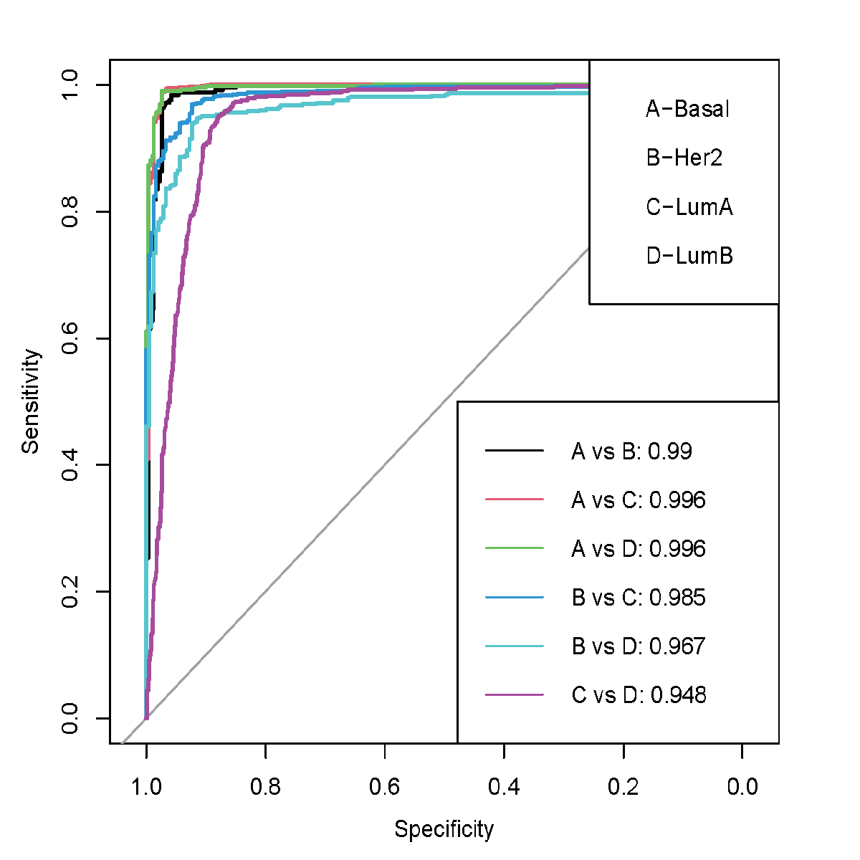
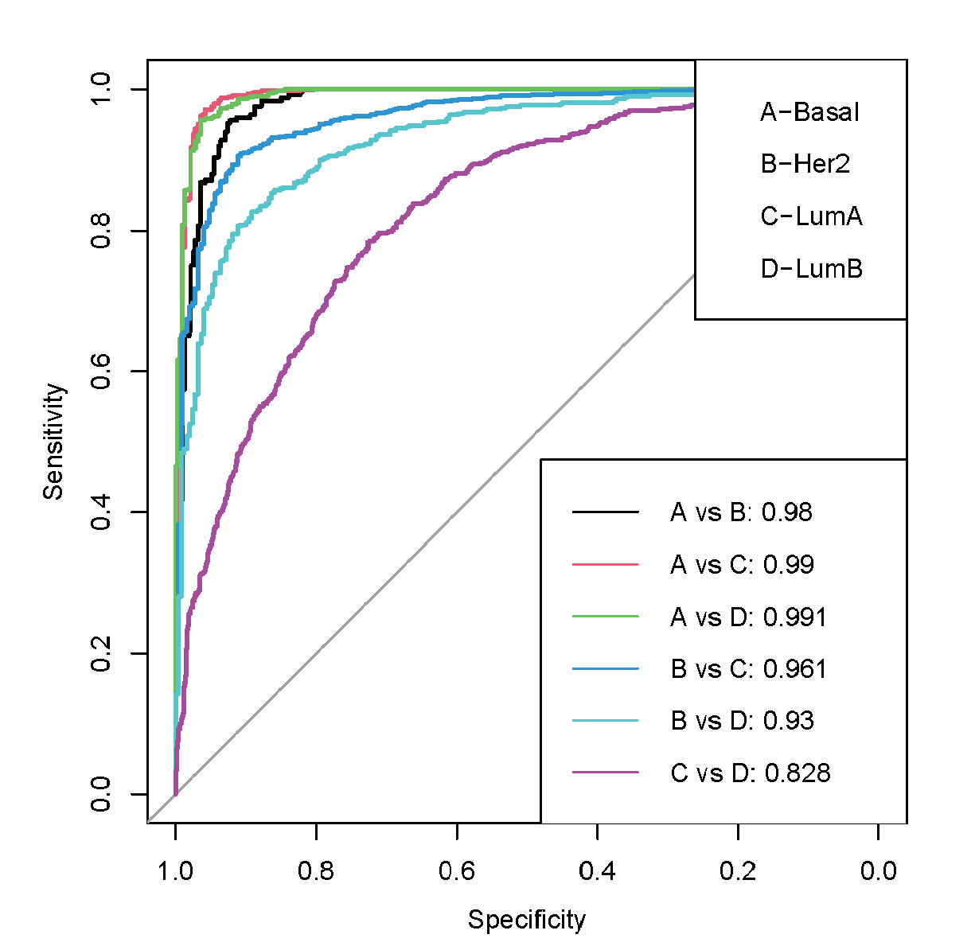


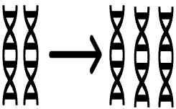
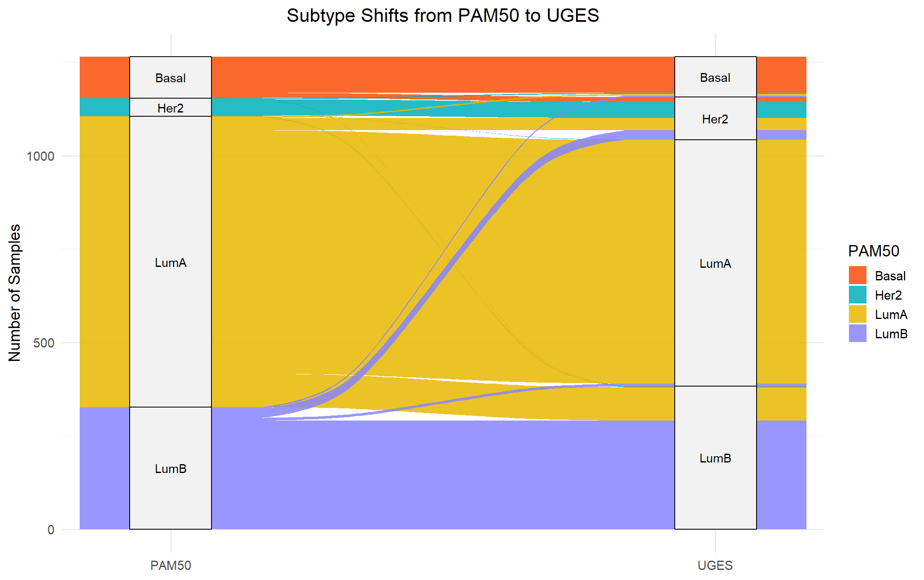



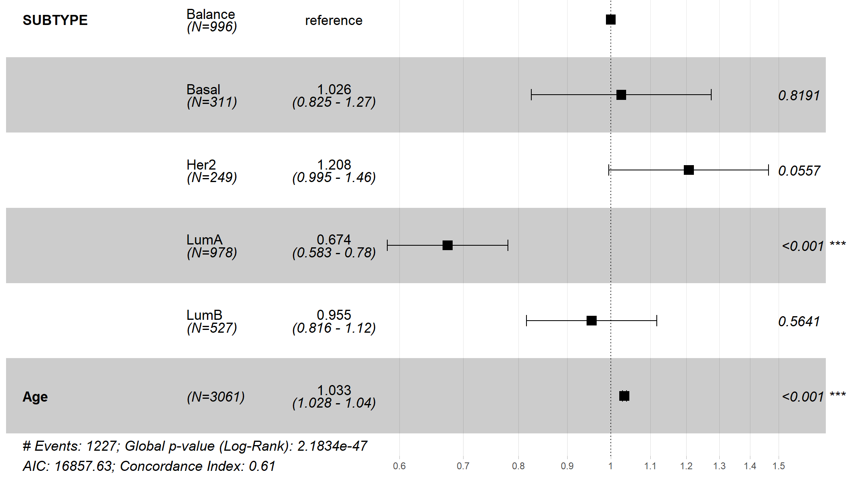
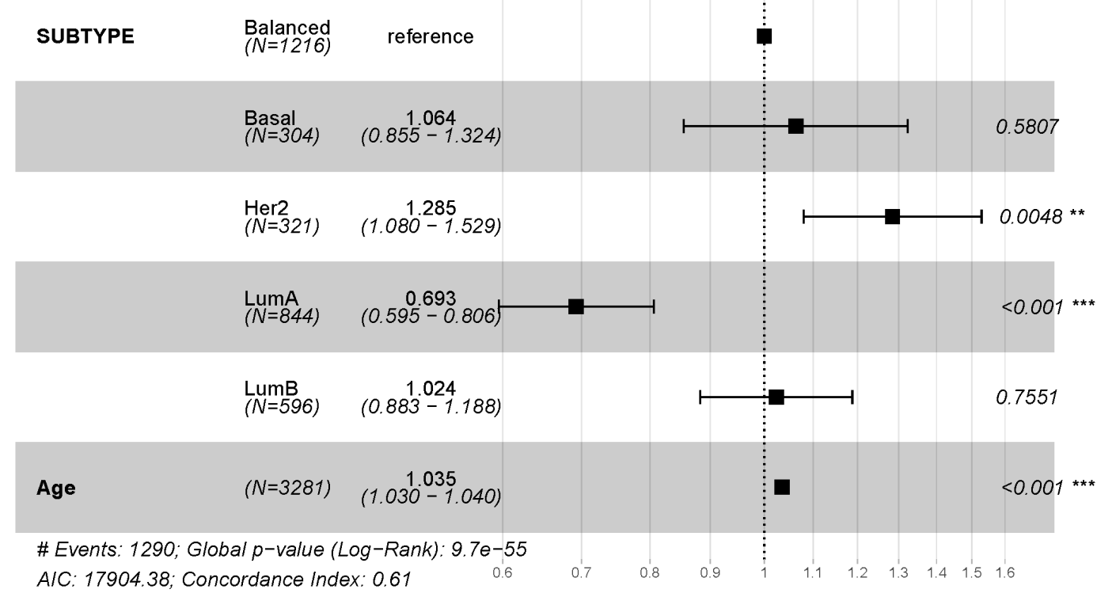
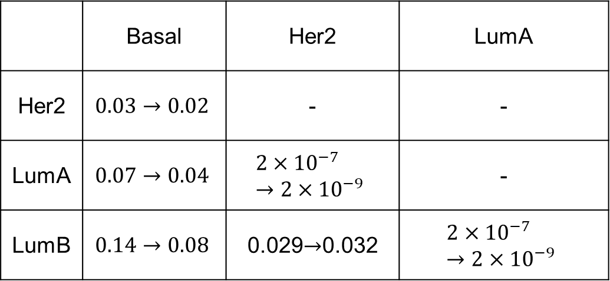
Accurate breast cancer intrinsic subtyping using DNA-only biomarkers with applications to multi-cohorts
Xintong Chang¹, Linping Wang¹, Hongyu Duan¹, Li C. Xia¹*
¹School of Mathematics, South China University of Technology, Guangzhou 510000, Guangdong, China
Email: lcxia@scut.edu.cn
BACKGROUND and MOTIVATION:
Breast cancer intrinsic subtyping is fundamental for precision treatment and prognosis. We developed UGES (Unified Genetic and Epigenetic Subtyping) [1], a DNA-level hierarchical classifier integrating somatic mutations, copy number aberrations and DNA methylation, addressing inconsistencies in expression-based methods such as PAM50. In this study, we report the performance and clinical utility of UGES using real-world multi-cohort data.
DATA:
RESULTS :
1. UGES Outperforms One-Step Classification in Subtype Discrimination
1. Cohort Overview and Feature Composition
TCGA
N=931
197
488
mutation
n=16770
(B,(H,(LA,LB)))
(B,H,LA,LB)
78
168
330
Methylation
n=25594
METABRIC
N=1134
171
490
CNA
n=8467
PAM50 subtype
143
Basal-like
Her2
Luminal A
Luminal B
Figure 1. Cohort Overview and Multi-Omics Feature Composition.
2. Cohort Characteristics and Clinical Profile Assessment
Multivariable Cox Regression Results
Clinical Feature |  | Dataset | Count (%) / Mean (Range) | Hazard Ratio | 95%CI | P value
Age | at diagnosis | TCGA | 58.4 (26-90) | 1.038 | (1.024, 1.053) | 2.3e-07
 |  | METABRIC | 61.6 (21-96) | 1.041 | (1.033, 1.050) | < 2e-16
 |  | Combined | 60.1 (21-96) | 1.038 | (1.031, 1.045) | < 2e-16
ER Status | Negative (reference) | METABRIC | 218 (19.22%)
 | Positive |  | 916 (80.78%) | 0.749 | (0.563, 0.997) | 0.0474
PR Status | Negative (reference) | METABRIC | 506 (44.62%)
 | Positive |  | 628 (55.38%) | 0.917 | (0.737, 1.140) | 0.4340
Her2 Status | Negative (reference) | METABRIC | 981 (86.51%)
 | Positive |  | 153 (13.49%) | 1.643 | (1.244, 2.169) | 0.0005
Table 1. Multivariable Cox Regression Results. The three analytical cohorts—TCGA, METABRIC, and TCGA+METABRIC combined—are representative of general breast cancer populations based on key clinical features. Older age was significantly associated with increased mortality risk. ER-positive status was linked to improved survival, while HER2-positive status was associated with poorer outcomes. These findings are consistent with established clinical knowledge and support the suitability of these cohorts for subsequent UGES evaluation.
Figure 4. Discrimination performance of UGES under different hierarchical classification strategies. Pairwise one-vs-one ROC analysis results showed that proposed hierarchical structure (B,(H,(LA,LB))) (left) achieved the highest discrimination performance, especially for the clinically challenging Luminal A vs. Luminal B classification (AUC = 0.948), outperforming the alternative one-step structure (B,H,LA,LB) (right; AUC = 0.828). All UGES subtype pairings demonstrated excellent AUC values, supporting the effectiveness and robustness of the hierarchical design.
2. Subtype Reclassification: UGES vs. PAM50
Figure 5. Alluvial plot of subtype reassignment between PAM50 and UGES. This alluvial plot shows how subtype assignments change between PAM50 and UGES across 2,065 breast cancer samples. Overall, 11.57% of tumors were reassigned.
METHODS:
1. Evaluation of hierarchical strategies using one-vs-one ROC analysis
True
subtype
Predicted
subtype
Basal
Her2
LumA
LumB
Basal
Her2
LumA
LumB
class confusion matrix
3. Enhanced Prognostic Stratification Using UGES Subtyping
UGES strategy
(B,(H,(LA,LB)))
ROC
&
AUC
Hazard ratio of PAM50 subtypes
Figure 6. Multivariable survival analysis comparing prognostic stratification between UGES and PAM50 subtypes. UGES subtyping provided significantly improved stratification of overall survival. Under UGES classification, survival differences among intrinsic subtypes became more statistically significant — particularly for Her2. LumA consistently showed the most favorable prognosis.
TCGA
METABRIC
(B,H,LA,LB)
Figure 2. Performance comparison between the hierarchical UGES model and the one-step multiclass strategy. Subtype prediction was performed on the combined test set, comparing the UGES hierarchical architecture (B,(H,(LA,LB))) with the one-step multiclass strategy (B,H,LA,LB). To assess subtype discrimination capability, one-vs-one ROC analyses were performed across six intrinsic subtype, and ROC curves with corresponding AUC values were derived from predicted probabilities.
 | Basal | Her2 | LumA
Her2 | $$0.03→0.02$$ | - | -
LumA | $$0.07→0.04$$ | $$2×{10}^{−7}→2×{10}^{−9}$$ | -
LumB | $$0.14→0.08$$ | 0.029$→$0.032 | $$2×{10}^{−7}→2×{10}^{−9}$$
2. Survival Analysis: Comparison Between UGES and PAM50 Subtypes
Hazard ratio of UGES subtypes
Univariate Survival Model
• Kaplan–Meier estimation
• Log-rank test
Subtype Group Assignment
Balanced comparison dataset
Multiple Testing Adjustment
• Benjamini-Hochberg method
• FDR < 0.05
Table 2. Pairwise log-rank p-value comparisons of subtype-specific survival outcomes between PAM50 and UGES. In 5 of 6 subtype comparisons, UGES yields more statistically significant separation of overall survival. The difference between LumA and Basal becomes statistically significant only under UGES reassignment.
Multivariable Cox Regression
• coxph() + Age Covariate
• Forest Plot Visualization
Figure 3. Workflow of Survival Analysis Comparing UGES and PAM50 Subtypes.
CONCLUSION :
UGES provides a robust and clinically applicable framework for multi-cohort breast cancer subtyping.
UGES is freely available at: https://ieeexplore.ieee.org/abstract/document/11176992.
References
Chang X., Xie J., Duan H., Li K., Liu X., Xiong Y., Bai X., Ning K., Xia L.C. "A unified genetic and epigenetic model to predict breast cancer intrinsic subtypes using large DNA-level multi-omics data and hierarchical learning." IEEE Transactions on Computational Biology and Bioinformatics 2025; early access. doi:10.1109/TCBBIO.2025.3613591.
Department of Statistics & Financial Mathematics School of Mathematics
South China University of Technology
Guangzhou, Guangdong 510640, China

