Slide 1

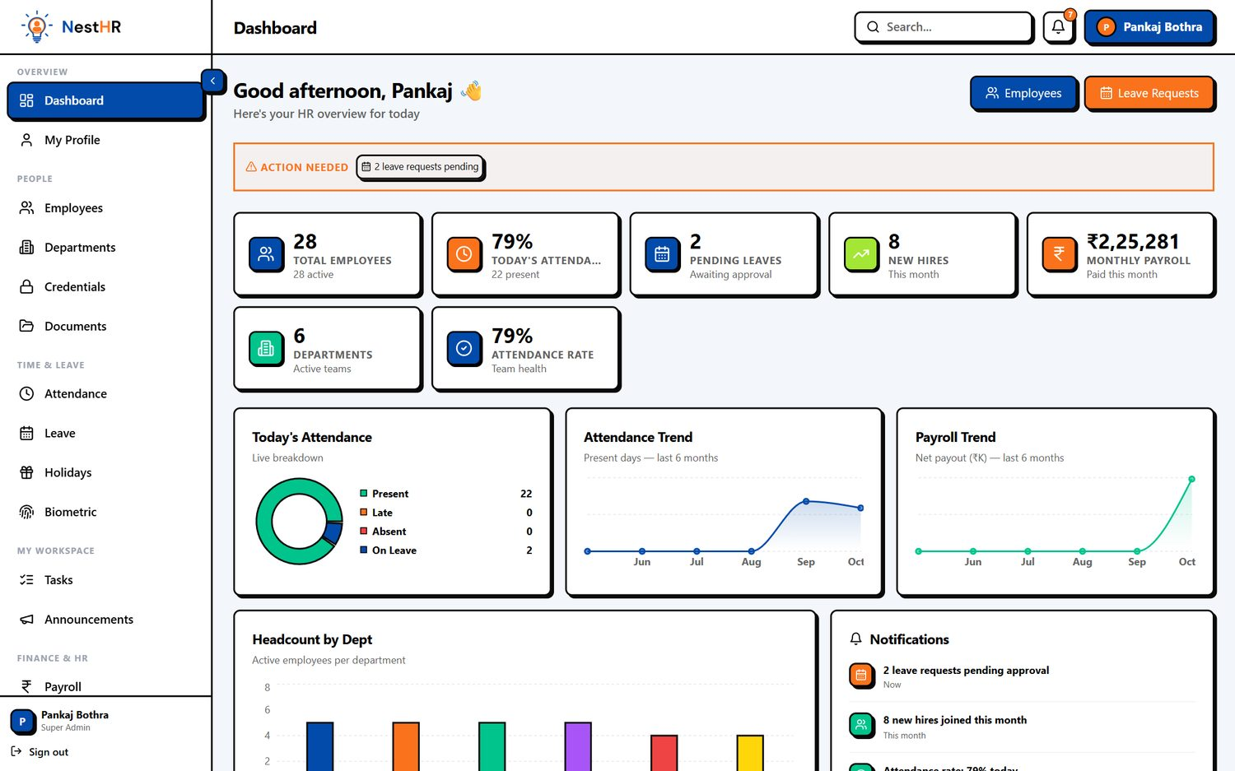
HR, attendance & payroll for 2,000+ employees
Product presentation for tender submission
Pixelate Nest
Notes:
Introduce NestHR by Pixelate Nest: one platform for employees, attendance (including biometric devices), leave, payroll and performance. This deck shows the real product and then proves how it behaves at 2,000 employees.

Slide 2
Proven at 2,000 employees
2,000
2.0 s
0.19 s
155/s
employees loaded and tested end to end
to run payroll for 1,881 employees
to load one day's attendance for 1,881 staff
biometric punches ingested (peak need is about 3/s)
Employee search, pages and dashboards answer in well under a second
60 people using heavy screens at the same time: no errors, 49 requests/second on a 4-worker server
Storage for 2,000 employees: about 160 MB of attendance data per year
Measured on a single local test machine; production adds only network latency.
Notes:
Headline slide. All figures were measured on a test copy with 2,000 employees and about 112,000 attendance records (60 days). Details and test conditions are in the scalability section.

Slide 3












One platform, every HR workflow
Employees & onboarding
Attendance & shifts
Biometric devices
Leave & holidays
Payroll & loans
Performance
Documents vault
Tasks
Announcements
Departments & roles
Security & audit
Mobile access
Notes:
Walk through the modules quickly; each one has its own slide next.

Slide 4
Live dashboard
Today's present, late, absent and on-leave counts at a glance
Six-month attendance and payroll trends
Updates for the whole company in under a second
Notes:
The dashboard is what HR opens first. Counts are computed in one pass and cached for 30 seconds, so many HR users can keep it open.

Slide 5
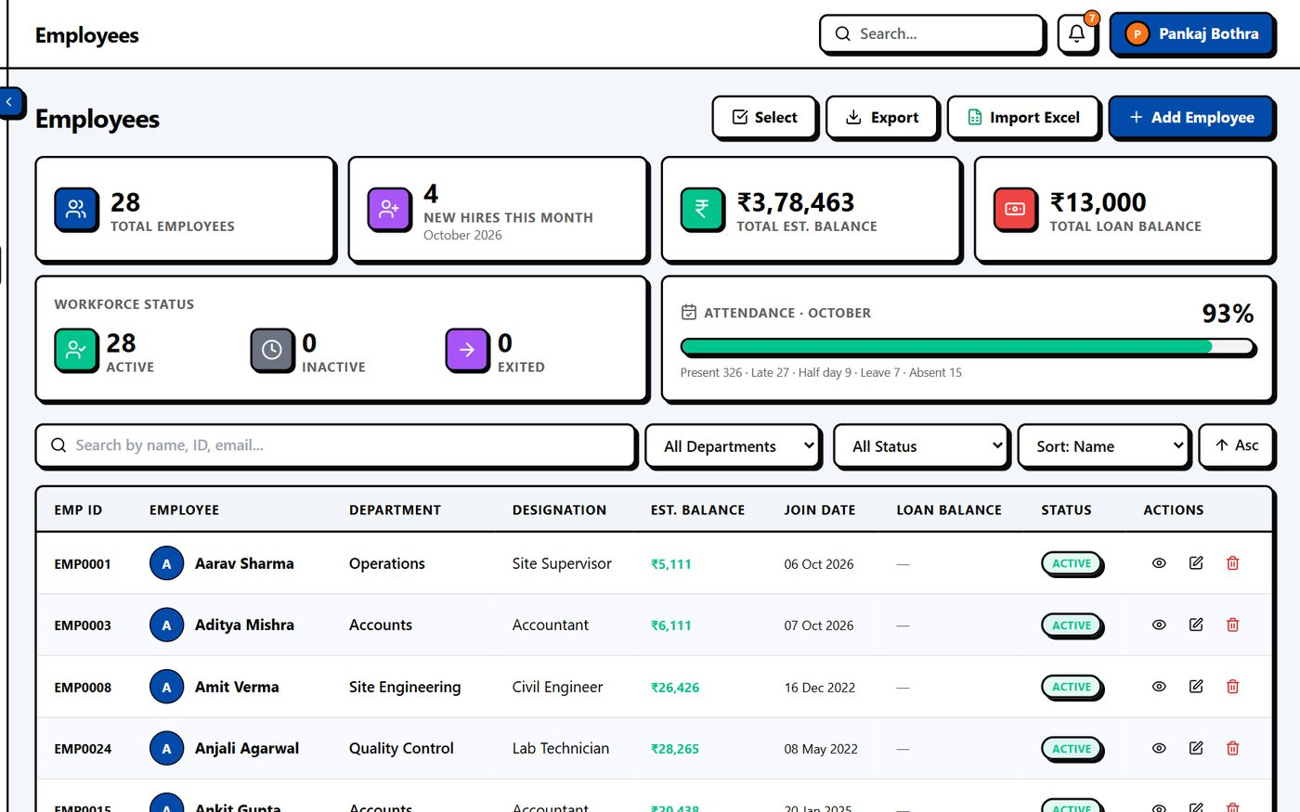
Employee directory
Search, filter and paginate thousands of staff
Department, designation, shift and status on one screen
Profile with documents, bank and salary structure
Notes:
Employees page loads 50 at a time in about 27 ms, search in 28 ms. Loading all 2,000 at once takes about 0.3 s.

Slide 6
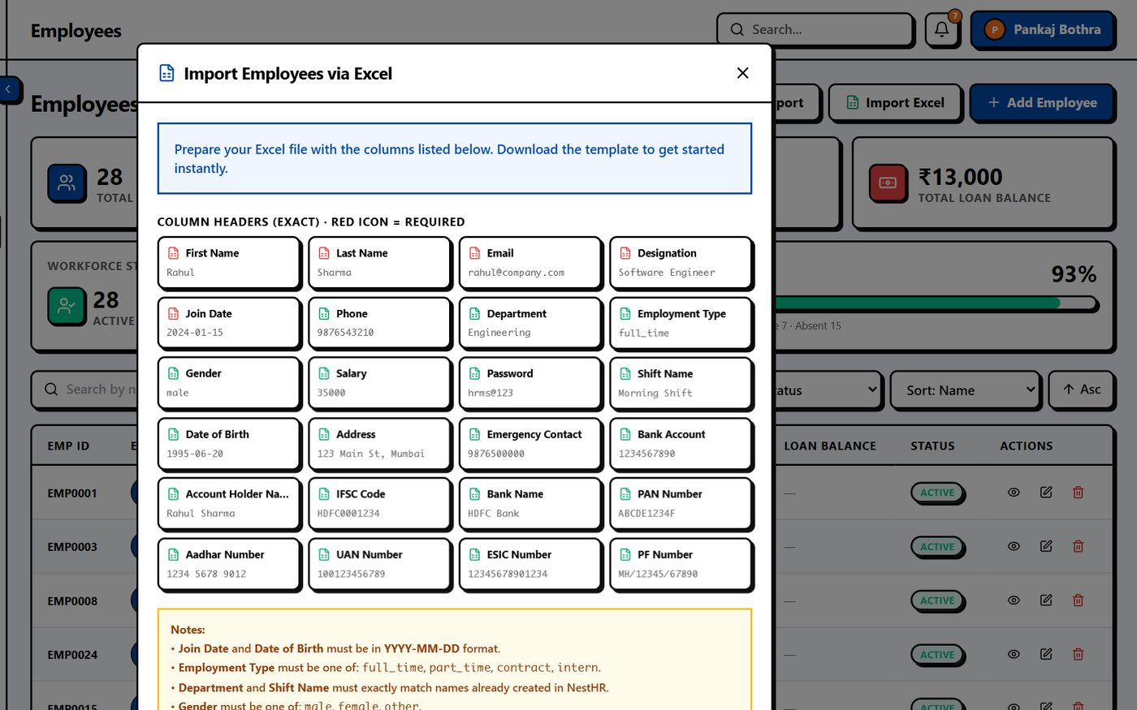
Onboarding & bulk import
Add one employee with the full form, or import from Excel
Validation and duplicate checks before anything is saved
Credentials and welcome message sent automatically
Notes:
Bulk import is limited to 200 rows per upload for safety; for the initial 2,000 we load data in batches or via a one-time migration which we handle.

Slide 7
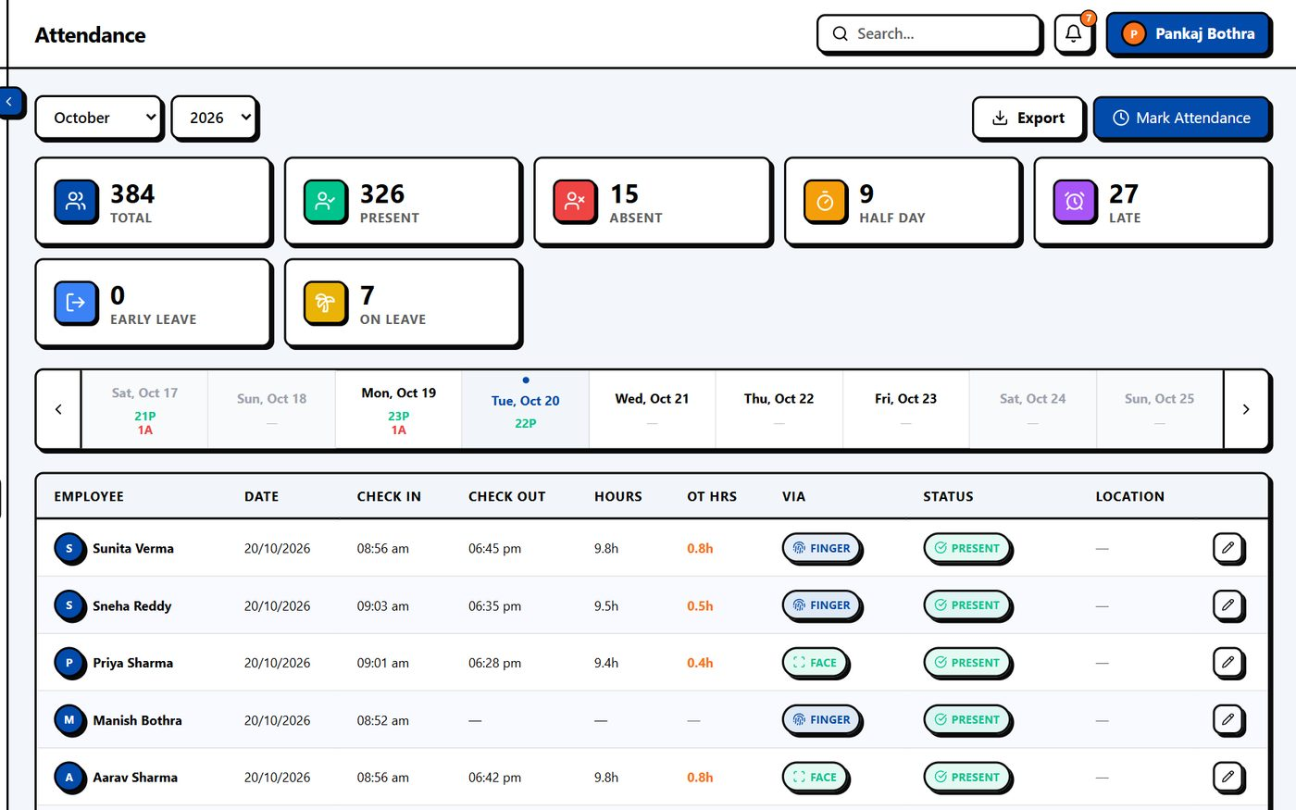
Attendance management
One-day view with present, late, absent and leave counts
Mark or correct attendance, bulk-mark absent
Month summary and per-day counts for any month
Notes:
The attendance screen loads one day at a time, so it stays fast regardless of company size: 1,881 rows in 0.19 s.

Slide 8
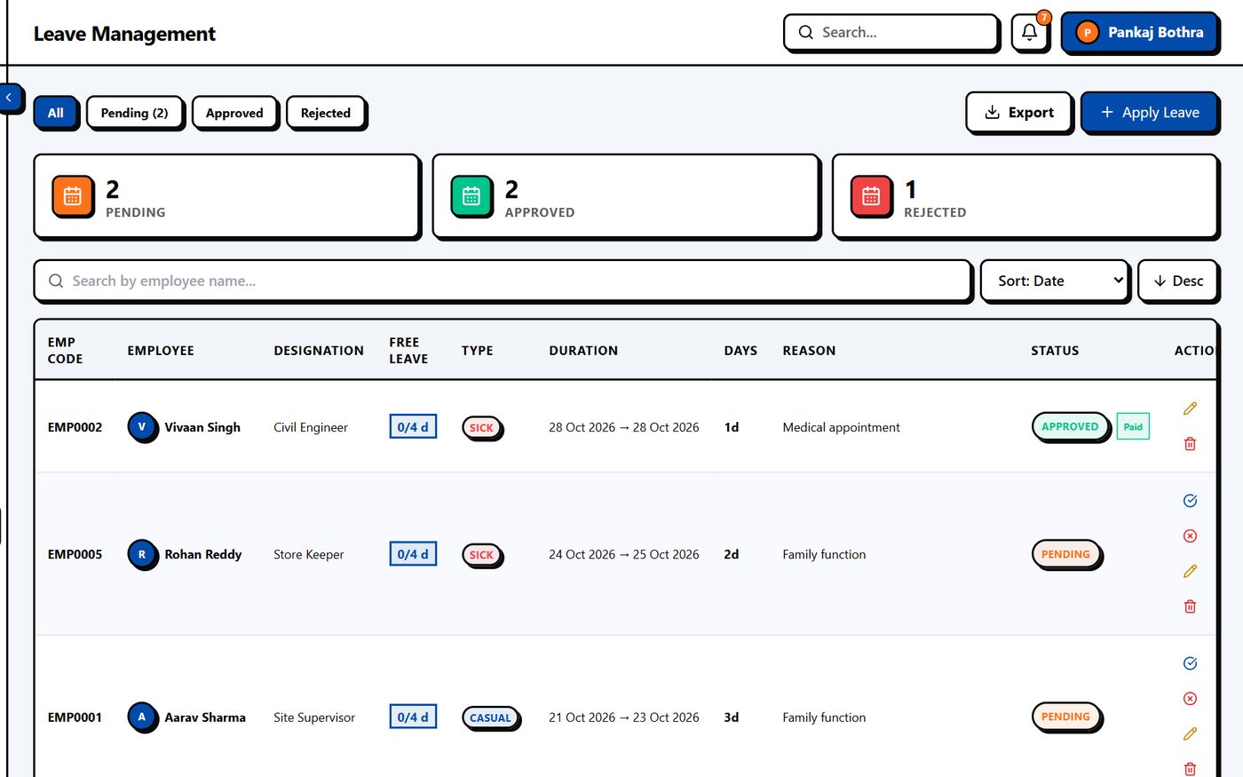
Leave management
Leave types, balances and approval workflow
Balances created automatically each month
Employees apply from web or mobile
Notes:
Leave balances for all 2,000 take about 0.7 s; the very first call of a month takes about 3 s because balances are created.

Slide 9
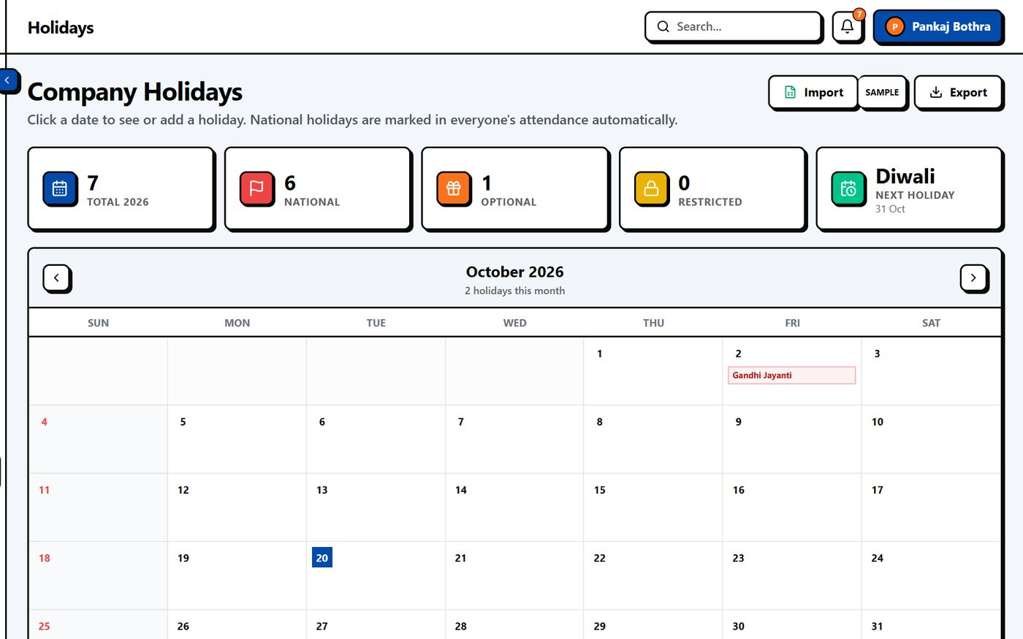
Holidays & calendar
Company holiday calendar by year
Holidays automatically excluded from attendance and payroll
Visible to every employee
Notes:
Holidays feed the attendance and payroll calculations so nobody is marked absent on a holiday.

Slide 10
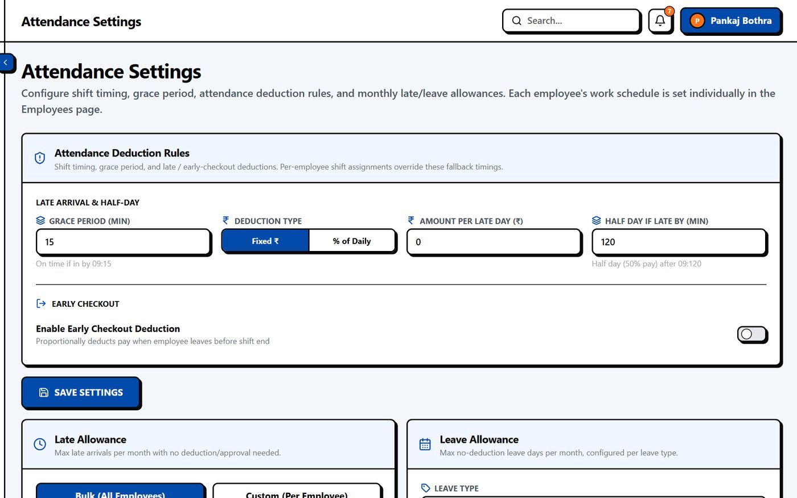
Attendance rules
Shift timings, grace period and half-day rules
Weekly offs and late-mark policy
Applied automatically to every punch
Notes:
Rules are configured once and applied to all employees automatically.

Slide 11
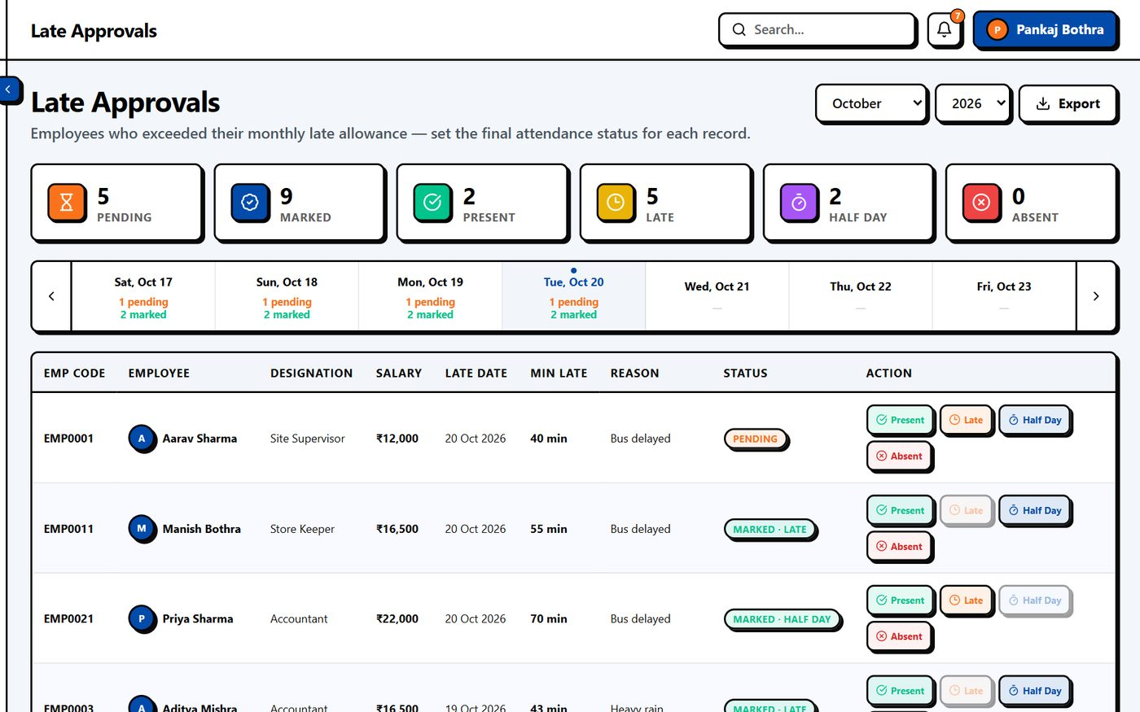
Late-arrival approvals
Managers approve or reject late marks with a reason
Monthly late allowance per employee
Approved items flow into payroll
Notes:
Late approvals keep payroll deductions fair and auditable.

Slide 12
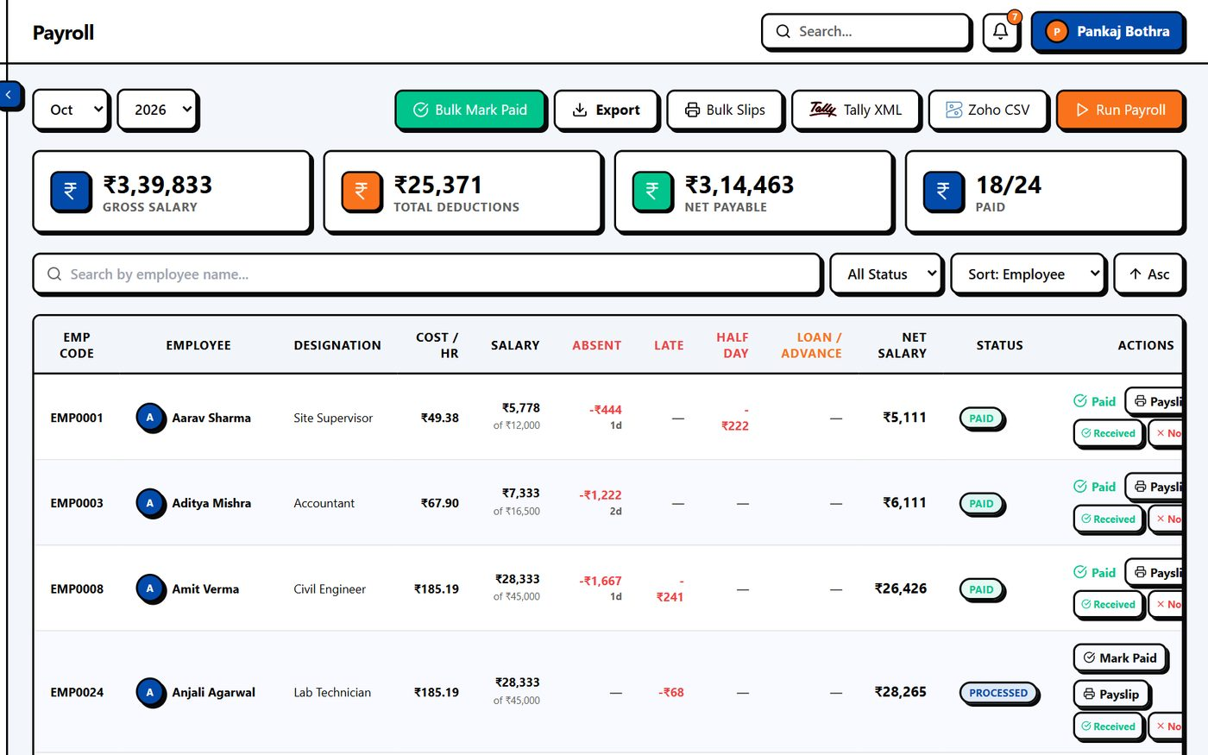
Payroll
Run payroll for the whole company in one click
Attendance, leave, loans and deductions included
Payslips and bank-ready summary
Notes:
Payroll for 1,881 employees ran in about 2.0 seconds in the test.

Slide 13
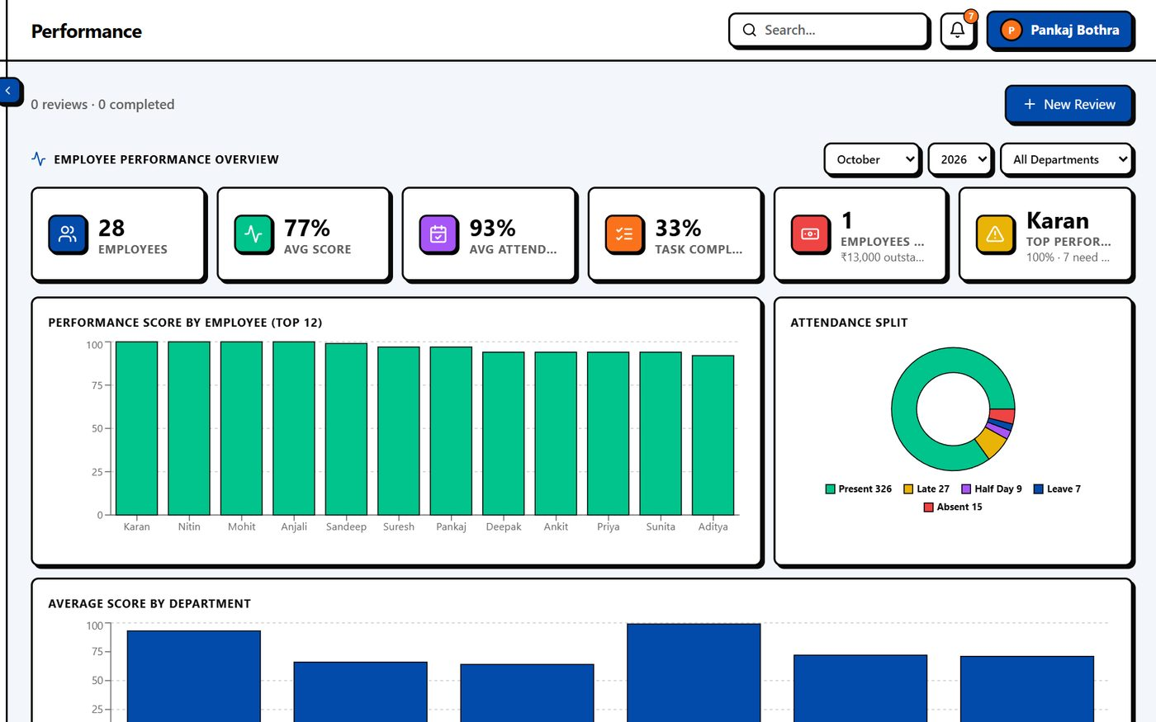
Performance & reports
Ratings, goals and review cycles
Company-wide performance overview
Exportable reports for management
Notes:
Performance overview for 1,952 staff returns in about 0.36 s.

Slide 14
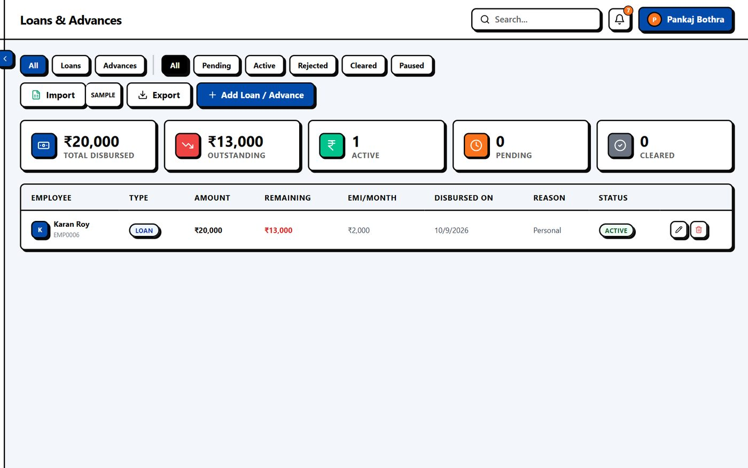
Loans & advances
Employee loan requests, approvals and EMI schedule
EMI deducted automatically in payroll
Outstanding balance always visible
Notes:
Loans link directly to payroll so EMIs are never missed.

Slide 15
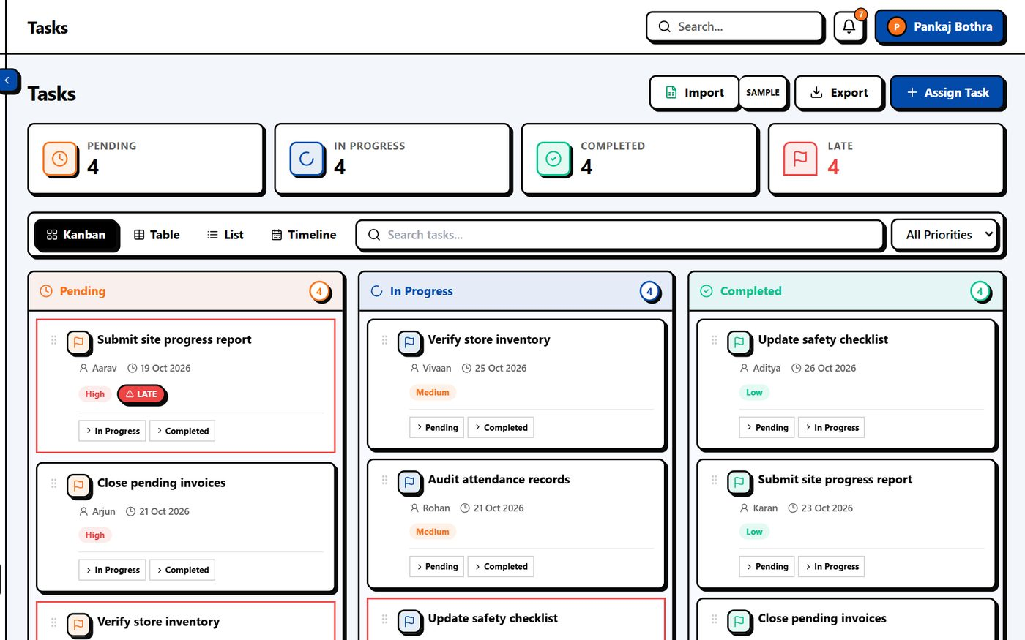
Tasks & announcements
Assign tasks with due dates and track completion
Company-wide announcements to all staff
Everything in one place, no separate tool
Notes:
Lightweight task tracking and broadcast announcements.

Slide 16
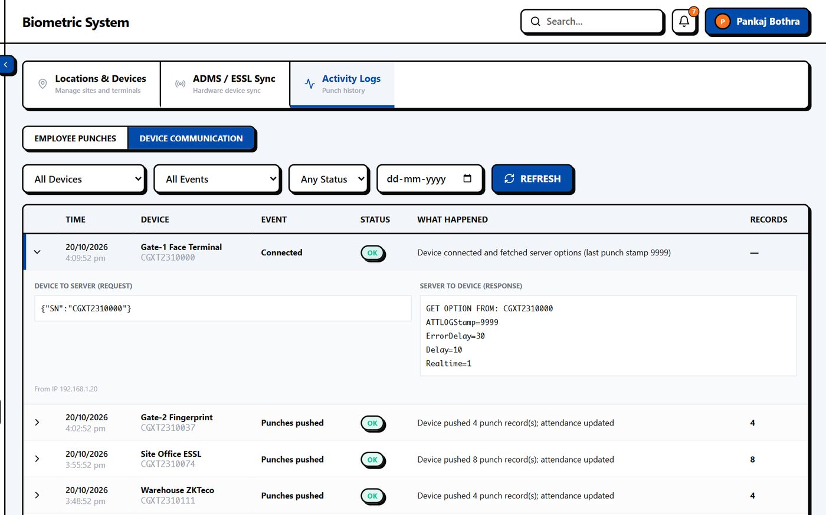
Biometric device integration
Fingerprint / face terminals push punches over the network
Multiple locations and devices per company
Every device communication is logged for audit
Tested: 1,952 punches ingested in 12.6 s
Notes:
Biometric terminals push punches to the server (ADMS). Punches are matched to employees and become attendance automatically. Device logs show every communication for troubleshooting.

Slide 17
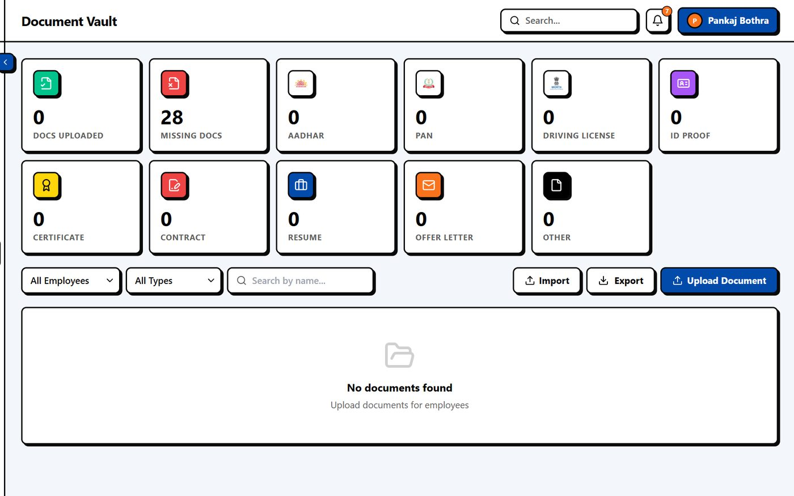

Security and documents
Documents encrypted at rest (AES-256-GCM)
WhatsApp OTP and 2-factor login
Role-based access: admin, HR, manager, employee
Audit log of who changed what
3-strike login lock
Company data isolated per tenant
Notes:
Security basics for HR data: encryption at rest for documents, OTP and 2FA login, login lock after repeated failures, audit trail and role-based access.

Slide 18
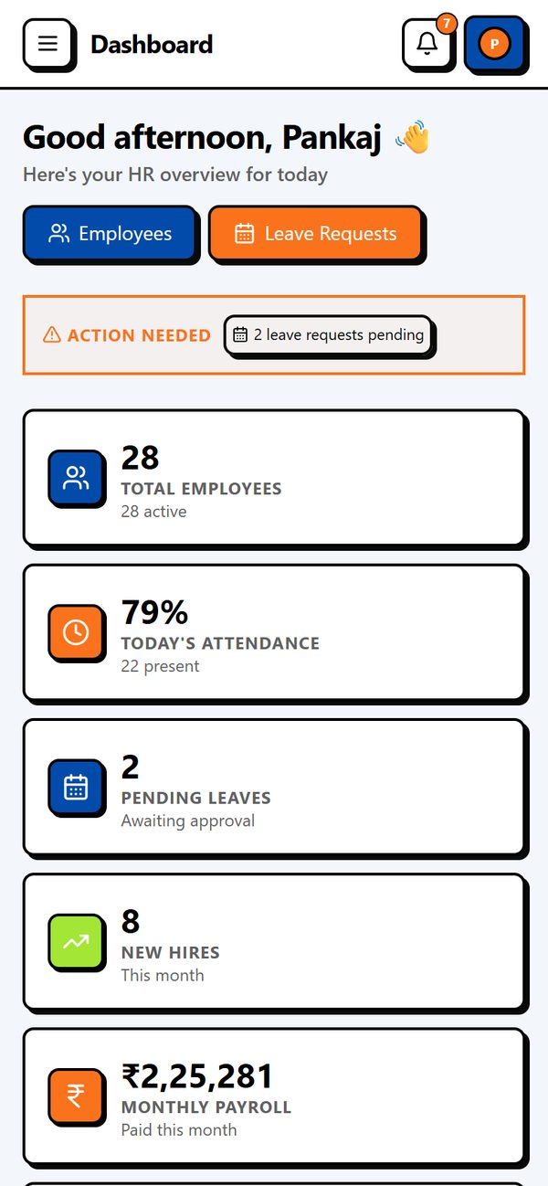
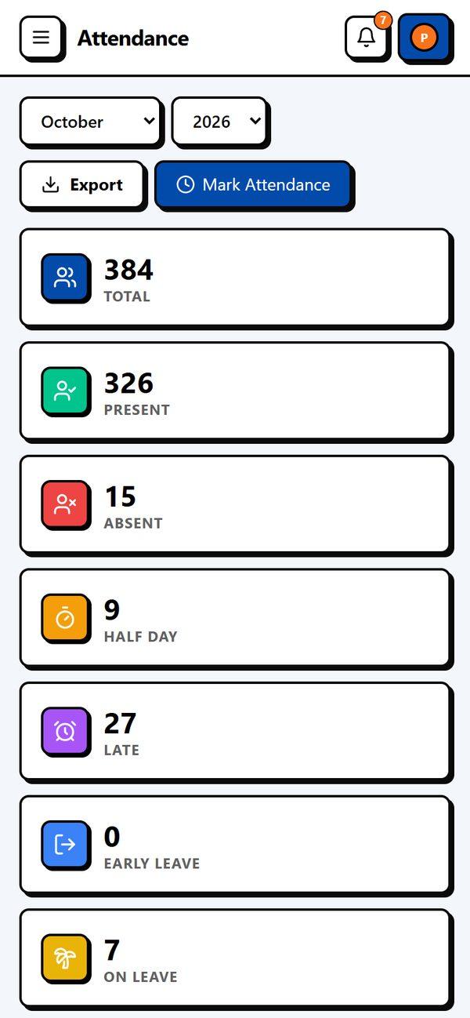
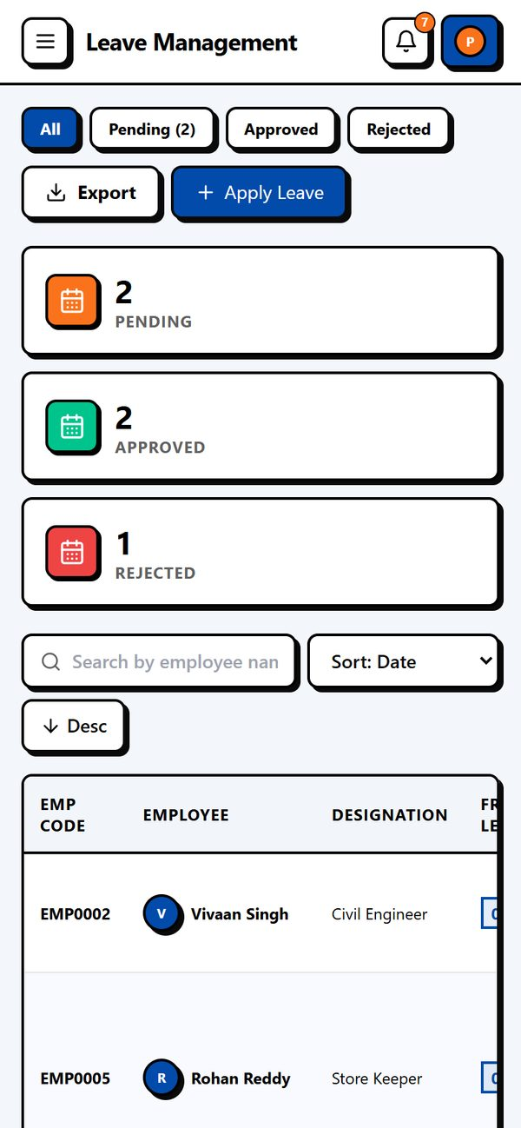
Works on your phone
Responsive web at 390 px width
Notes:
These are the responsive web screens at phone width. A native NestHR mobile app (React Native) is also available for employees.

Slide 19
How NestHR handles 2,000 employees
Data, attendance and payroll: measured, not promised
Notes:
Now the part the tender cares about most: what happens when the company has 2,000 employees.

Slide 20
How we tested
Test company: 2,000 employees, 6 departments
112,409 attendance records over 60 days, plus leaves, loans, tasks and biometric logs
Real NestHR backend and the real web screens in Chrome
Isolated test database. No customer data was used
Conservative setup: one server process, local machine
Test caveats
Numbers are from a single process with an in-memory database on one machine. Production runs a 4-worker cluster against a dedicated MongoDB; expect network latency on top.
Notes:
Be transparent: this is a lab test on a local machine. Real servers add network latency but also have dedicated resources.

Slide 21

What the test found, and we fixed
Month-wide attendance load
Now one day at a time (0.19 s)
List caps of 100 rows
Raised to 5,000 with paging
Dashboard ran many queries
One aggregate + 30 s cache (562 ms, then 4 ms)
Per-IP rate limit
Configurable for offices sharing one IP
Single server process
PM2 cluster, 4 workers
Slow attendance lookups
Covered database index added
Notes:
We deliberately looked for weak spots and fixed them in the product before this submission.

Slide 22





Architecture built for scale
Web & mobile
HR, managers, employees
MongoDB
indexed · encrypted vault
Node.js API
PM2 cluster · 4 workers
Biometric devices
ADMS push
WhatsApp & push
OTP, alerts, documents
Horizontally scalable: add workers or servers as headcount grows
Notes:
Clients and devices talk to a clustered Node.js API. MongoDB holds data with indexes on the hot paths. Documents are encrypted. WhatsApp and push notifications are sent asynchronously.

Slide 23
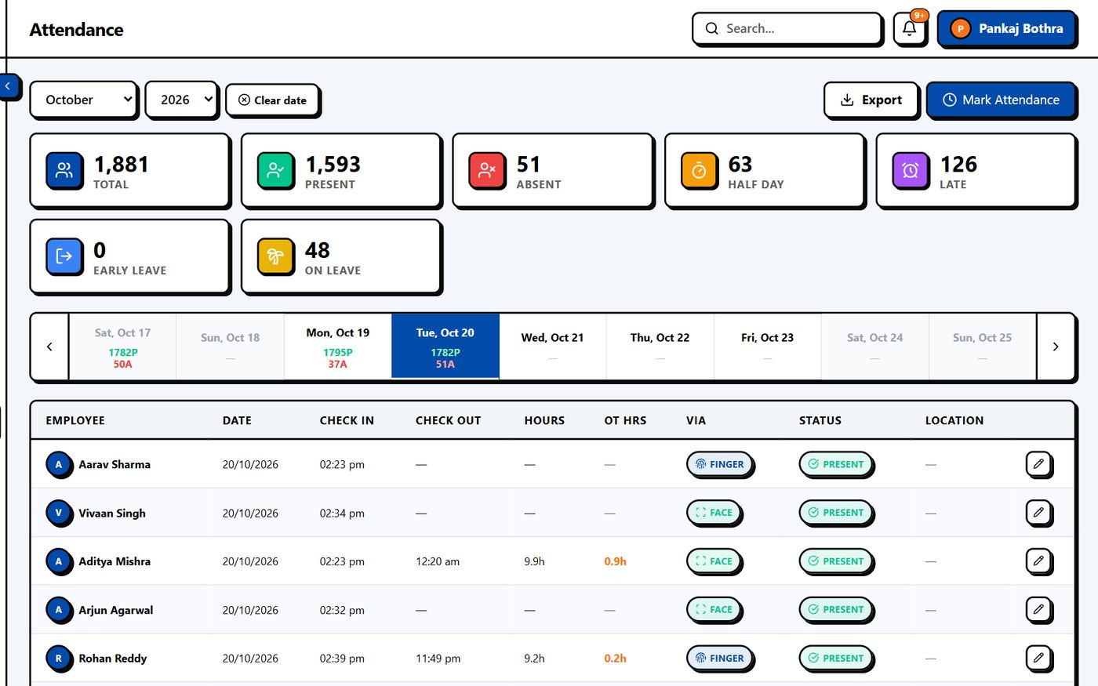
Attendance at 2,000 employees
1,881 attendance rows for a day load in 0.19 s (40 KB compressed)
Per-day counts for a whole month: 0.12 s
Biometric ingest: 155 punches/s vs ~3/s needed at peak (about 47× headroom)
Attendance cron runs once, not per worker
Notes:
Explain the morning rush: 2,000 people punch within about 10 minutes, roughly 3 punches per second. The system ingests 155 per second.

Slide 24
Response times (2,000 employees)
Notes:
Milliseconds, lower is better. Employee list of 50 is 27 ms. Dashboard cold is 562 ms and 4 ms when cached.

Slide 25
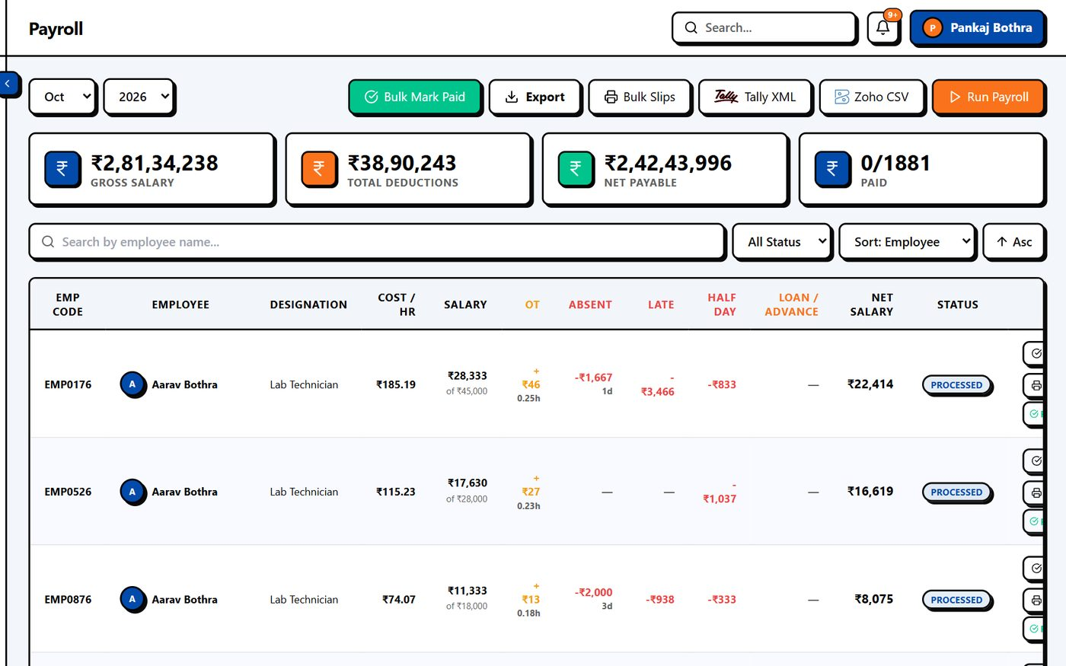
Payroll for 2,000 in seconds
2.0 s
full payroll run, 1,881 employees
Payroll summary for this month: 9 ms
Page with all 1,881 rows ready in 2.7 s
Re-runs are safe: already-processed months are not duplicated
Notes:
Payroll processed 1,881 active employees in about 2 seconds, including attendance, leave, loans and deductions.

Slide 26
60 people using it at once
0 errors in both runs · 60 concurrent users on heavy screens
Notes:
60 simulated users hammering heavy screens at the same time. One worker: 17 req/s, p50 3.3 s. Four workers: 49 req/s, p50 0.88 s, p95 2.4 s. Zero errors in both.

Slide 27
Data growth and storage
680k
160 MB
19 MB
0.9 GB
attendance records per year
attendance data + indexes per year
payroll per year
everything over 5 years
Small enough that an ordinary managed database handles it with room to spare
Daily backups and archival of old years are straightforward
Indexes keep today's screens fast even as history grows
Notes:
Attendance is about 182 bytes per record plus index. 2,000 employees produce roughly 680k records a year, around 160 MB with indexes. Payroll about 19 MB a year. About 0.9 GB over five years.

Slide 28
Rollout plan
1
2
3
4
5
Setup
Data import
Devices
Training
Go-live
Company, departments, shifts, rules
Employees migrated in batches
Biometric terminals connected
HR, managers, employees
Parallel run, then switch
Dedicated onboarding support from the Pixelate Nest team throughout.
Notes:
Typical timeline; adjust per the tender.

Slide 29




Let's get your team on NestHR
+91 84069 12345 (WhatsApp)
support@pixelatenest.com
www.pixelatenest.com
Kala Bhawan, Akharaghat Road, Muzaffarpur, Bihar 842001
Notes:
Close: offer a live demo and a pilot with a subset of employees.

