Slide 1
Generation of In-Bounds Inputs for Arrays in Memory-Unsafe Languages
Marcus Rodrigues
Breno Guimarães
Fernando Quintão
Notes:
Good morning. I am Fernando, and I will present this work that I did with students that I advise at the Federal University of Minas Gerais.

Slide 2
The goal of this work is to develop techniques to support the dynamic analysis of program parts
Notes:
The goal of our work is to provide you with techniques that let you perform dynamic analysis on parts of a program.

Slide 3
The goal of this work is to develop techniques to support the dynamic analysis of program parts
We want to produce inputs that will not cause out-of-bounds memory accesses during testing
Notes:
And, to this, we want to produce inputs to test this program part. But these inputs cannot cause any invalid memory access.

Slide 4
The goal of this work is to develop techniques to support the dynamic analysis of program parts
Our insight is the observation that many array accesses in actual programs can be grouped into a category of expressions that are easy to bound
We want to produce inputs that will not cause out-of-bounds memory accesses during testing
Notes:
And most of our contribution comes from the fact that most of the memory accesses in actual programs follow a format that's easy to analyze and bound. So, the techniques that I shall introduce in this talk don't work in general, but work for most of the programs.

Slide 5
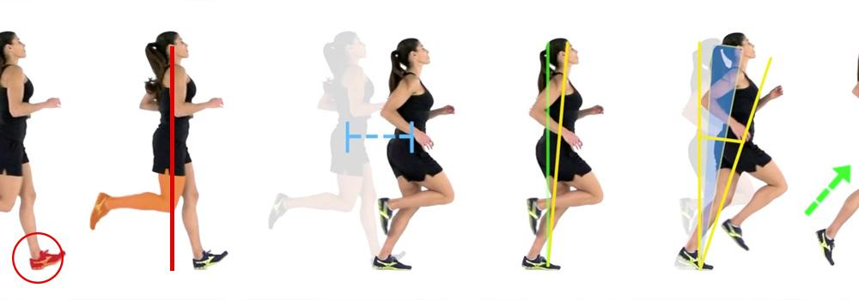
Dynamic Program Analysis
Notes:
To motivate this work, I would like to talk a bit about dynamic analyses. These are analyses that involve running the program.

Slide 6

Valgrind
Valgrind: a framework for heavyweight dynamic binary instrumentation, PLDI'07
Notes:
There are several dynamic analysis frameworks, such as valgrind, for instance.

Slide 7
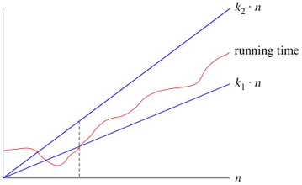
Aprof
Input-sensitive profiling, PLDI'12
Notes:
Another interesting tool is aprof. It let us infer the complexity of code empirically. For that, we need to run the same function several times, on different inputs.

Slide 8


Modus Operandi: Compile
Program
Notes:
Usually, all these tools and techniques revolve around the same method. First, we compile the program. In this case, we can instrument it or not.

Slide 9

Modus Operandi: Run
Analyzer
Notes:
Then we run the program in a controlled environment.

Slide 10
Modus Operandi: Analyze
Result
Notes:
And then we collect results. We can analyze these results during the execution of the program, or after it stops.

Slide 11
void kernel_2mm(int ni, int nj,
int nk, int nl, int alpha,
int beta, float **tmp, float **A, float **B, float **C, float **D) {
int i, j, k;
for (i = 0; i < ni; i++)
for (j = 0; j < nj; j++) {
tmp[i][j] = 0;
for (k = 0; k < nk; ++k)
tmp[i][j] += alpha * A[i][k] * B[k][j];
}
for (i = 0; i < ni; i++)
for (j = 0; j < nl; j++) {
D[i][j] *= beta;
for (k = 0; k < nj; ++k)
D[i][j] += tmp[i][k] * C[k][j];
}
}
void initMatrix(int **v, int n) {
int i, j;
for (i = 0; i < n; i++) {
for (j = 0; j < n; j++) {
v[i][j] = 0;
}
}
}
void kernel_trmm(int m, int n, float alpha, float **A, float **B)
{
int i, j, k;
float temp;
for (i = 0; i < m; i++)
for (j = 0; j < n; j++) {
for (k = i+1; k < m; k++)
B[i][j] += A[k][i] * B[k][j];
B[i][j] = alpha * B[i][j];
}
}
void kernel_seidel_2d(int n, int tsteps, float **A)
{
int t, i, j;
for (t = 0; t <= tsteps - 1; t++)
for (i = 1; i <= n - 2; i++)
for (j = 1; j <= n - 2; j++)
A[i][j] = (A[i-1][j-1] + A[i-1][j] + A[i-1][j+1]
+ A[i][j-1] + A[i][j] + A[i][j+1]
+ A[i+1][j-1] + A[i+1][j] + A[i+1][j+1])/9.0;
}
void kernel_trisolv(int n, float **L, float *x, float *b)
{
int i, j;
for (i = 0; i < n; i++)
{
x[i] = b[i];
for (j = 0; j <i; j++)
x[i] -= L[i][j] * x[j];
x[i] = x[i] / L[i][i];
}
}
float sqrt(float);
void kernel_gramschmidt(int m, int n, float **A, float **R, float **Q)
{
int i, j, k;
float nrm;
for (k = 0; k < n; k++) {
nrm = 0.0;
for (i = 0; i < m; i++)
nrm += A[i][k] * A[i][k];
R[k][k] = sqrt(nrm);
for (i = 0; i < m; i++)
Q[i][k] = A[i][k] / R[k][k];
for (j = k + 1; j < n; j++) {
R[k][j] = 0.0;
for (i = 0; i < m; i++)
R[k][j] += Q[i][k] * A[i][j];
for (i = 0; i < m; i++)
A[i][j] = A[i][j] - Q[i][k] * R[k][j];
}
}
}
void kernel_floyd_warshall(int **path, int n)
{
int i, j, k;
for (k = 0; k < n; k++) {
for (i = 0; i < n; i++)
for (j = 0; j < n; j++)
path[i][j] = path[i][j] < path[i][k] + path[k][j] ?
path[i][j] : path[i][k] + path[k][j];
}
}
double sqrt(double x);
void kernel_cholesky(int n, float **A)
{
int i, j, k;
for (i = 0; i < n; i++) {
//j<i
for (j = 0; j < i; j++) {
for (k = 0; k < j; k++) {
A[i][j] -= A[i][k] * A[j][k];
}
A[i][j] /= A[j][j];
}
// i==j case
for (k = 0; k < i; k++) {
A[i][i] -= A[i][k] * A[i][k];
}
A[i][i] = sqrt(A[i][i]);
}
}
int main () {
return 0;
}
Notes:
One problem with such analyses is that programs are very large, and sometimes we don't care about analyzing it completely.

Slide 12
void kernel_2mm(int ni, int nj,
int nk, int nl, int alpha,
int beta, float **tmp, float **A, float **B, float **C, float **D) {
int i, j, k;
for (i = 0; i < ni; i++)
for (j = 0; j < nj; j++) {
tmp[i][j] = 0;
for (k = 0; k < nk; ++k)
tmp[i][j] += alpha * A[i][k] * B[k][j];
}
for (i = 0; i < ni; i++)
for (j = 0; j < nl; j++) {
D[i][j] *= beta;
for (k = 0; k < nj; ++k)
D[i][j] += tmp[i][k] * C[k][j];
}
}
void initMatrix(int **v, int n) {
int i, j;
for (i = 0; i < n; i++) {
for (j = 0; j < n; j++) {
v[i][j] = 0;
}
}
}
void kernel_trmm(int m, int n, float alpha, float **A, float **B)
{
int i, j, k;
float temp;
for (i = 0; i < m; i++)
for (j = 0; j < n; j++) {
for (k = i+1; k < m; k++)
B[i][j] += A[k][i] * B[k][j];
B[i][j] = alpha * B[i][j];
}
}
void kernel_seidel_2d(int n, int tsteps, float **A)
{
int t, i, j;
for (t = 0; t <= tsteps - 1; t++)
for (i = 1; i <= n - 2; i++)
for (j = 1; j <= n - 2; j++)
A[i][j] = (A[i-1][j-1] + A[i-1][j] + A[i-1][j+1]
+ A[i][j-1] + A[i][j] + A[i][j+1]
+ A[i+1][j-1] + A[i+1][j] + A[i+1][j+1])/9.0;
}
void kernel_trisolv(int n, float **L, float *x, float *b)
{
int i, j;
for (i = 0; i < n; i++)
{
x[i] = b[i];
for (j = 0; j <i; j++)
x[i] -= L[i][j] * x[j];
x[i] = x[i] / L[i][i];
}
}
float sqrt(float);
void kernel_gramschmidt(int m, int n, float **A, float **R, float **Q)
{
int i, j, k;
float nrm;
for (k = 0; k < n; k++) {
nrm = 0.0;
for (i = 0; i < m; i++)
nrm += A[i][k] * A[i][k];
R[k][k] = sqrt(nrm);
for (i = 0; i < m; i++)
Q[i][k] = A[i][k] / R[k][k];
for (j = k + 1; j < n; j++) {
R[k][j] = 0.0;
for (i = 0; i < m; i++)
R[k][j] += Q[i][k] * A[i][j];
for (i = 0; i < m; i++)
A[i][j] = A[i][j] - Q[i][k] * R[k][j];
}
}
}
void kernel_floyd_warshall(int **path, int n)
{
int i, j, k;
for (k = 0; k < n; k++) {
for (i = 0; i < n; i++)
for (j = 0; j < n; j++)
path[i][j] = path[i][j] < path[i][k] + path[k][j] ?
path[i][j] : path[i][k] + path[k][j];
}
}
double sqrt(double x);
void kernel_cholesky(int n, float **A)
{
int i, j, k;
for (i = 0; i < n; i++) {
//j<i
for (j = 0; j < i; j++) {
for (k = 0; k < j; k++) {
A[i][j] -= A[i][k] * A[j][k];
}
A[i][j] /= A[j][j];
}
// i==j case
for (k = 0; k < i; k++) {
A[i][i] -= A[i][k] * A[i][k];
}
A[i][i] = sqrt(A[i][i]);
}
}
int main () {
return 0;
}
Notes:
However, it's difficult to analyze only the part, like the function or the loop, that is interesting to us.

Slide 13
void kernel_2mm(int ni, int nj,
int nk, int nl, int alpha,
int beta, float **tmp, float **A, float **B, float **C, float **D) {
int i, j, k;
for (i = 0; i < ni; i++)
for (j = 0; j < nj; j++) {
tmp[i][j] = 0;
for (k = 0; k < nk; ++k)
tmp[i][j] += alpha * A[i][k] * B[k][j];
}
for (i = 0; i < ni; i++)
for (j = 0; j < nl; j++) {
D[i][j] *= beta;
for (k = 0; k < nj; ++k)
D[i][j] += tmp[i][k] * C[k][j];
}
}
void initMatrix(int **v, int n) {
int i, j;
for (i = 0; i < n; i++) {
for (j = 0; j < n; j++) {
v[i][j] = 0;
}
}
}
void kernel_trmm(int m, int n, float alpha, float **A, float **B)
{
int i, j, k;
float temp;
for (i = 0; i < m; i++)
for (j = 0; j < n; j++) {
for (k = i+1; k < m; k++)
B[i][j] += A[k][i] * B[k][j];
B[i][j] = alpha * B[i][j];
}
}
void kernel_seidel_2d(int n, int tsteps, float **A)
{
int t, i, j;
for (t = 0; t <= tsteps - 1; t++)
for (i = 1; i <= n - 2; i++)
for (j = 1; j <= n - 2; j++)
A[i][j] = (A[i-1][j-1] + A[i-1][j] + A[i-1][j+1]
+ A[i][j-1] + A[i][j] + A[i][j+1]
+ A[i+1][j-1] + A[i+1][j] + A[i+1][j+1])/9.0;
}
void kernel_trisolv(int n, float **L, float *x, float *b)
{
int i, j;
for (i = 0; i < n; i++)
{
x[i] = b[i];
for (j = 0; j <i; j++)
x[i] -= L[i][j] * x[j];
x[i] = x[i] / L[i][i];
}
}
float sqrt(float);
void kernel_gramschmidt(int m, int n, float **A, float **R, float **Q)
{
int i, j, k;
float nrm;
for (k = 0; k < n; k++) {
nrm = 0.0;
for (i = 0; i < m; i++)
nrm += A[i][k] * A[i][k];
R[k][k] = sqrt(nrm);
for (i = 0; i < m; i++)
Q[i][k] = A[i][k] / R[k][k];
for (j = k + 1; j < n; j++) {
R[k][j] = 0.0;
for (i = 0; i < m; i++)
R[k][j] += Q[i][k] * A[i][j];
for (i = 0; i < m; i++)
A[i][j] = A[i][j] - Q[i][k] * R[k][j];
}
}
}
void kernel_floyd_warshall(int **path, int n)
{
int i, j, k;
for (k = 0; k < n; k++) {
for (i = 0; i < n; i++)
for (j = 0; j < n; j++)
path[i][j] = path[i][j] < path[i][k] + path[k][j] ?
path[i][j] : path[i][k] + path[k][j];
}
}
double sqrt(double x);
void kernel_cholesky(int n, float **A)
{
int i, j, k;
for (i = 0; i < n; i++) {
//j<i
for (j = 0; j < i; j++) {
for (k = 0; k < j; k++) {
A[i][j] -= A[i][k] * A[j][k];
}
A[i][j] /= A[j][j];
}
// i==j case
for (k = 0; k < i; k++) {
A[i][i] -= A[i][k] * A[i][k];
}
A[i][i] = sqrt(A[i][i]);
}
}
int main () {
return 0;
}
Notes:
The problem is that we cannot run this part without running the rest of the program. And, even when we run the program, the part that we want might not execute.

Slide 14
It's hard to analyze individual program parts
Notes:
And, up to today, there is not really a systematic approach to extract part of a program, and run it without the rest of the program.

Slide 15
Goal
Notes:
And, that's what we want: to be able to test some program parts, without having to execute the entire program.

Slide 16
Pick the part of the program that you want
Notes:
So, to this end, we want to let the user extract some text from a source code.

Slide 17


Fill in the holes, so that it compiles
psyche-c
Inference of Static Semantics for Incomplete C Programs, POPL'18
Notes:
Compile it. To do that for C, at least, we can use a type reconstructor, like psyche-c, which we have published in POPL last year.

Slide 18
Build a driver to run the individual part
psyche-c
Notes:
Then we want to build a driver, that lets us run the part that we want in a controlled environment.

Slide 19
The driver must generate valid inputs
Notes:
What the driver does is to generate inputs for the program part.

Slide 20
Driver + Program part = Testable program
Notes:
And so, once we plug the program part that we care about into the driver, we get a running program, which we can test.

Slide 21
Perform the dynamic analysis on this ensemble
Notes:
We can run the target function as often as we want it. We found that this possibility is very useful, for instance, once we are doing performance tests.

Slide 22
Example: Initializing a Matrix
void initMatrix(int **v, int n) {
int i, j;
for (i = 0; i < n; i++) {
for (j = 0; j < n; j++) {
v[i][j] = 0;
}
}
}
Notes:
Let me use matrix initialization as a concrete example of what we want to do. Imagine that this is the program part that we want to test.

Slide 23
void initMatrix(int **v, int n) {
int i, j;
for (i = 0; i < n; i++) {
for (j = 0; j < n; j++) {
v[i][j] = 0;
}
}
}
Notes:
This function receives two inputs: the matrix v and its side n.

Slide 24
?
?
?
?
?
?
?
?
?
void initMatrix(int **v, int n) {
int i, j;
for (i = 0; i < n; i++) {
for (j = 0; j < n; j++) {
v[i][j] = 0;
}
}
}
Notes:
To test this program, we can generate random inputs for it.

Slide 25
?
?
?
?
?
?
3
?
?
?
void initMatrix(int **v, int n) {
int i, j;
for (i = 0; i < n; i++) {
for (j = 0; j < n; j++) {
v[i][j] = 0;
}
}
}
Notes:
That will work, for instance, if we produce a 3 x 3 matrix v, and assign 3 to n. Every memory access will be within bounds.

Slide 26
?
?
?
?
?
?
2
?
?
?
void initMatrix(int **v, int n) {
int i, j;
for (i = 0; i < n; i++) {
for (j = 0; j < n; j++) {
v[i][j] = 0;
}
}
}
Notes:
If we keep the 3 x 3 matrix, and say that n is 2, then we are still fine: some parts of v will not be used, but no invalid memory access will happen.

Slide 27
?
?
?
?
?
?
4
?
?
?
void initMatrix(int **v, int n) {
int i, j;
for (i = 0; i < n; i++) {
for (j = 0; j < n; j++) {
v[i][j] = 0;
}
}
}
?
Notes:
But, what will happen if I still keep v as a 3 x 3 matrix, but let n be 4?

Slide 28

?
?
?
?
?
?
?
?
4
?
?
?
?
?
?
?
?
void initMatrix(int **v, int n) {
int i, j;
for (i = 0; i < n; i++) {
for (j = 0; j < n; j++) {
v[i][j] = 0;
}
}
}
Notes:
Some of the memory accesses will be out-of-bounds. Because we are testing C, we might not even get an error to know that something bad happened.

Slide 29


?
?
?
?
?
?
?
?
4
?
?
?
?
?
?
?
?
Out of bounds accesses cause undefined behavior
Notes:
Essentially, the program under test will be in an invalid state, and we will not be able to conclude anything about it.

Slide 30
There is no contract between v and n
void initMatrix(int **v, int n) {
int i, j;
for (i = 0; i < n; i++) {
for (j = 0; j < n; j++) {
v[i][j] = 0;
}
}
}
Notes:
The fact is that there is no contract between v and n: implicitly, we know that n^2 is the size of v. But the programming language does not have any syntax to indicate this relation.

Slide 31
We will show how to create such contracts
void initMatrix(int **v, int n) {
int i, j;
for (i = 0; i < n; i++) {
for (j = 0; j < n; j++) {
v[i][j] = 0;
}
}
}
Notes:
In this paper, we show how to create these contracts. We cannot create them always, but we can do it for many different programs.

Slide 32
Symbolic Interval Analysis
Notes:
And a key technology to do that is what we call the symbolic interval analysis

Slide 33
R(i) = [0, N - 1]
A technique that finds conservative approximations for the upper and lower values of each variable
Notes:
What the symbolic range analysis does is to find conservative estimates for the lower and upper values of each integer variable in a program.

Slide 34
We build contracts between variables using a Symbolic Interval Analysis
A technique that finds conservative approximations for the upper and lower values of each variable
Notes:
This analysis lets us build such contracts between the inputs of functions.

Slide 35
We build contracts between variables using a Symbolic Interval Analysis
void foo(int *v) {
int i = 0;
while (i < N) {
v[i] = 0;
i++;
}
}
void foo(int *v) {
int i = 0;
// R(i) = [0, 0]
while (i < N) {
// R(i) = [0, N-1]
v[i] = 0;
i++;
// R(i) = [1, N]
}
// R(i) = [0, N]
}
A technique that finds conservative approximations for the upper and lower values of each variable
Notes:
As an example, on the left I have a program, and on the right I have the intervals for the variables in that program.

Slide 36
int main
function call
int j = 10;
if-then-else
tipos
for (i = 0; i < n; i++)
do while
expression
if
expression
function call
while
statement
expression
variable
number
Notes:
this kind of interval analysis works by traversing the program's abstract syntax tree.

Slide 37

int main
function call
int j = 10;
j = 10
if-then-else
tipos
for (i = 0; i < n; i++)
do while
expression
if
expression
function call
while
statement
expression
variable
number
Notes:
At each node of the tree, we might learn something about the interval covered by some variable.

Slide 38
int main
function call
int j = 10;
j = 10
if-then-else
tipos
for (i = 0; i < n; i++)
do while
expression
if
0 ≤ j < 10
expression
function call
while
statement
expression
variable
number
Notes:
And we can combine informatino learnt at different places, to know more about a variable.

Slide 39
Symbolic Interval Analysis works by applying rules on the nodes of the program's AST
Notes:
So, basically, at each node of the program's abstract syntax tree, we apply some rule to learn more information.

Slide 40
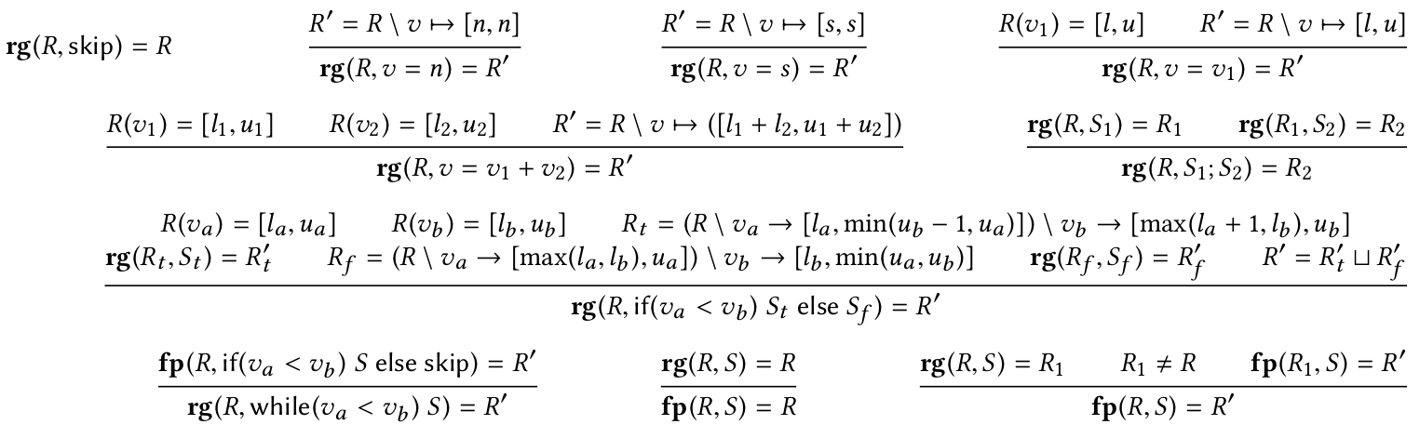

Abstract Interpretation
Abstract interpretation: a unified lattice model for static analysis of programs by construction or approximation of fixpoints, POPL'77
Notes:
These rules, when put together, gives us a way to interpret the program. That's what we call abstract interpretation.

Slide 41
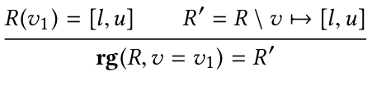
Visitors and Pattern Matching
a = b;
Notes:
So, to solve symbolic interval analysis, we traverse the program, using the visitor design pattern, for instance, and at each node, based on the syntactic format of that node, we apply some rule, updating a table that assigns intervals to variables.

Slide 42
Symbolic Summations
Notes:
Interval analysis is not a contribution of this paper. We use it just as a tool, to place bounds on expressions that we call symbolic summations.

Slide 43
Most memory accesses in actual programs have a structure that is simple to analyze and bound
void initMatrix(int **v, int n) {
int i, j;
for (i = 0; i < n; i++) {
for (j = 0; j < n; j++) {
v[i][j] = 0;
}
}
}
e = x₁ + x₂ + ... + x_{n} + c
Notes:
Symbolic summation is the name that we give to most of the expressions used to index arrays.

Slide 44
Most memory accesses in actual programs have a structure that is simple to bound
e = x₁ + x₂ + ... + x_{n} + c
e ::=
c
x
e + e
e × e
constants
traceable variables
summations
multiplications
Notes:
Essentially, they are just a combination of sums and multiplications, following this grammar on the bottom of the figure. They are very simple, actually.

Slide 45
Most memory accesses in actual programs have a structure that is simple to bound
The values assigned to symbolic summations grow monotonically
e ::=
c
x
e + e
e × e
constants
traceable variables
summations
multiplications
Notes:
Because symbolic summations do not contain subtraction nor division, they are monotonic functions. We shall use this fact to test the programs

Slide 46
Most memory accesses in actual programs have a structure that is simple to bound
Formal arguments
Unambiguous global variables
No aliasing
Return value of functions
constants
traceable variables
summations
multiplications
Notes:
Symbolic summations only use traceable variables. These are variables that we can reconstruct as functions of program inputs.

Slide 47
Most memory accesses in actual programs have a structure that is simple to bound
float* get_vector(int Width);
float* convol(float* mm, int row, int col, int N) {
int i, j;
float* v = get_vector(N);
for (i = 0; i < N; i++) {
v[i] = mm[(1+row) * (N+1) + i + 1] * mm[1 + col + (i+1) * (N+1)];
}
return v;
}
Formal arguments
Unambiguous global variables
No aliasing
Return value of functions
First order traceable variables
Notes:
So traceable variables are like formal arguments, global variables that do not alias other pointers, etc. In this example, we have five such variables.

Slide 48
Most memory accesses in actual programs have a structure that is simple to bound
float* get_vector(int Width);
float* convol(float* mm, int row, int col, int N) {
int i, j;
float* v = get_vector(N);
for (i = 0; i < N; i++) {
v[i] = mm[(1+row) * (N+1) + i + 1] * mm[1 + col + (i+1) * (N+1)];
}
return v;
}
Formal arguments
Unambiguous global variables
No aliasing
Return value of functions
Second order traceable variables
Notes:
Variables created as functions of traceable variables are also traceable.

Slide 49
Most memory accesses in actual programs have a structure that is simple to bound
float* get_vector(int Width);
float* convol(float* mm, int row, int col, int N) {
int i, j;
float* v = get_vector(N);
for (i = 0; i < N; i++) {
v[i] = mm[(1+row) * (N+1) + i + 1] * mm[1 + col + (i+1) * (N+1)];
}
return v;
}
Symbolic summations
Notes:
Many memory accesses are symbolic summations. In this example, the two accesses on matrix mm are symbolic summations.

Slide 50
Most memory accesses in actual programs have a structure that is simple to bound
float* get_vector(int Width);
float* convol(float* mm, int row, int col, int N) {
int i, j;
float* v = get_vector(N);
for (i = 0; i < N; i++) {
v[i] = mm[(1+row) * (N+1) + i + 1] * mm[1 + col + (i+1) * (N+1)];
}
return v;
}
"He who controls the traceable variables controls the function to be tested"
Notes:
And, the insight of the paper is that if we can assign values to the traceable variables, we can control the memory accesses. And it is easy to place bounds on the symbolic summations, to avoid out-of-bounds accesses.

Slide 51
Occurences of symbolic summations in GNU BinUtils
Binutils | Instrs. | Memory | Traceable | Monotonic
base64 | 412 | 15 | 6 | 6
basename | 197 | 9 | 6 | 6
chgrp | 278 | 32 | 31 | 31
chroot | 533 | 24 | 22 | 22
chmod | 551 | 64 | 62 | 62
cksum | 235 | 7 | 4 | 2
cat | 678 | 44 | 42 | 41
chown | 301 | 45 | 44 | 44
comm | 751 | 246 | 212 | 212
chcon | 507 | 30 | 29 | 29
chowncore | 647 | 118 | 118 | 118
Notes:
One of our results is that most of the programs contain arrays that are only indexed by symbolic summations. Like, in the ten first programs in gnu core utils, we found only three accesses which were not symbolic summations, out of 118.

Slide 52
If we replace program variables by their upper limits (as found by the interval analysis)§, then the resulting expression is still a symbolic summation
Theorem 3.6 (Preservation)
§: Unless the upper range is infinite
Notes:
If we replace the variables in a symbolic summation by its upper limits, as found by range analysis, then we still have a symbolic summation

Slide 53

If we replace program variables by their upper limits (as found by the interval analysis), then the resulting expression is still a symbolic summation
Theorem 3.6 (Preservation)
1 + col + (i+1) * (N+1)
1 + col + N*N + N
R(col) = [col, col]
R(N) = [N, N]
R(i) = [0, N-1]
Notes:
An example: the upper limit of i is N-1. On the right, we can see the expression after substitution. It's still a symbolic summation.

Slide 54
If we replace program variables by their upper limits (as found by the interval analysis), then the resulting expression is still a symbolic summation
Theorem 3.6 (Preservation)
1 + col + (i+1) * (N+1)
1 + col + N*N + N
After this substitution, we get a symbolic summation that is a function only of first-order traceable variables (which we control)
Notes:
This substitution lets us get an expression that is function only of variables that we control.

Slide 55
If an array is only indexed by symbolic summations, then we know how to replace traceable variables by concrete values, so that the array is only accessed by indices within its allocated bounds
float* get_vector(int Width);
float* convol(float* mm, int row, int col, int N) {
int i, j;
float* v = get_vector(N);
for (i = 0; i < N; i++) {
v[i] = mm[(1+row) * (N+1) + i + 1] * mm[1 + col + (i+1) * (N+1)];
}
return v;
}
Notes:
If an array is only indexed by symbolic summations, which we can bound using range analysis, then we can create contracts between this array, and the first-order traceable variables.

Slide 56
If an array is only indexed by symbolic summations, then we know how to replace traceable variables by concrete values, so that the array is only accessed by indices within its allocated bounds
float* get_vector(int Width);
float* convol(float* mm, int row, int col, int N) {
int i, j;
float* v = get_vector(N);
for (i = 0; i < N; i++) {
v[i] = mm[(1+row) * (N+1) + i + 1] * mm[1 + col + (N) * (N*N)];
}
return v;
}
Details are in the paper, but the key idea is that we can recursively divide the task of creating valid indices among each sum in the symbolic summation
Notes:
How we do this requires some algebra. But the key idea is that we can split an array among the sums of the symbolic summation, recursively, and then we can solve each part of the summation separately.

Slide 57
Experiments
Notes:
We have used our techniques to implement a tool: griffinC. It lets us test program parts written in C. I will present some experiments to demonstrate how it is useful

Slide 58
Correctly analyzed kernels (checked with Valgrind)
30
Performance test on Polybench: Cuda Unified Memory vs Manual Transfer Annotations
Notes:
We could analyze the kernels in the polybench suite, for instance.

Slide 59
Changes
1
Performance test on Polybench: Cuda Unified Memory vs Manual Transfer Annotations
Notes:
There was only one kernel that we could not analyze. It was using the contents of an array in a division. We fill arrays with zeros, so we were getting a division by zero.

Slide 60
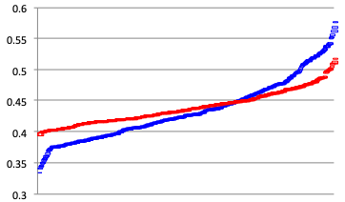
The Result Changes Depending on the Input Size
Kernel: ATAX
Time (secs)
Manual copy annotations
Cuda Unified Memory
Input size
Performance test on Polybench: Cuda Unified Memory vs Manual Transfer Annotations
Notes:
In our experiments, we compared two ways to run polybench in a GPU. Using automatic memory management or using manual annotations to copy data. What's curious is that depending on the size of the input, we have a very different relation between these two ways to run programs in the GPU. Papers that only use one data point might provide a misleading figure to readers.

Slide 61
Number of distinctic array accesses analyzed
99
Performance test on Polybench: Cuda Unified Memory vs Manual Transfer Annotations
Notes:
In total, polybench had 99 array accesses. They were all symbolic summations that we could bound.

Slide 62
Kernels analyzed with Aprof
30
Notes:
We also run experiments using the Aprof input sensitive profiler.

Slide 63
kernel_trisolv
void kernel_trisolv(int n,
float **L,
float *x,
float *b)
{
int i, j;
for (i = 0; i < n; i++)
{
x[i] = b[i];
for (j = 0; j <i; j++)
x[i] -= L[i][j] * x[j];
x[i] = x[i] / L[i][i];
}
}
Notes:
Aprof tries to infer the complexity of programs. But it requires the same function to run many times, to get points to perform this inference.

Slide 64
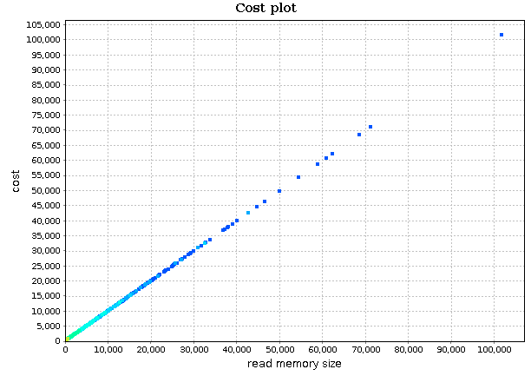
kernel_trisolv
void kernel_trisolv(int n,
float **L,
float *x,
float *b)
{
int i, j;
for (i = 0; i < n; i++)
{
x[i] = b[i];
for (j = 0; j <i; j++)
x[i] -= L[i][j] * x[j];
x[i] = x[i] / L[i][i];
}
}
Notes:
Once it has a good number of inputs, it produces a curve like this one.

Slide 65
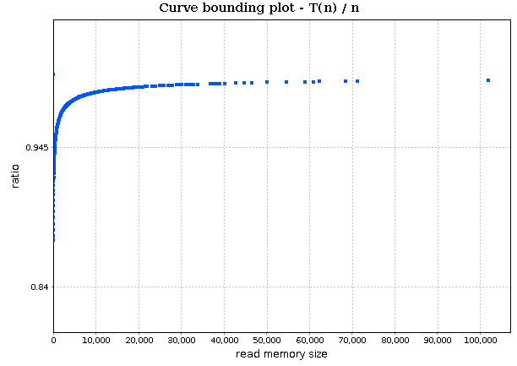
kernel_trisolv
void kernel_trisolv(int n,
float **L,
float *x,
float *b)
{
int i, j;
for (i = 0; i < n; i++)
{
x[i] = b[i];
for (j = 0; j <i; j++)
x[i] -= L[i][j] * x[j];
x[i] = x[i] / L[i][i];
}
}
Notes:
And then we can use trial and error to get the complexity of the curve. In this example, we have a linear program that runs a constant number of operations for each memory cell it receives.

Slide 66
kernel_trmm
void kernel_trmm(int m, int n,
float alpha, float **A, float **B)
{
int i, j, k;
float temp;
for (i = 0; i < m; i++)
for (j = 0; j < n; j++) {
for (k = i+1; k < m; k++)
B[i][j] += A[k][i] * B[k][j];
B[i][j] = alpha * B[i][j];
}
}
Notes:
Another example, based on matrix multiplication.

Slide 67
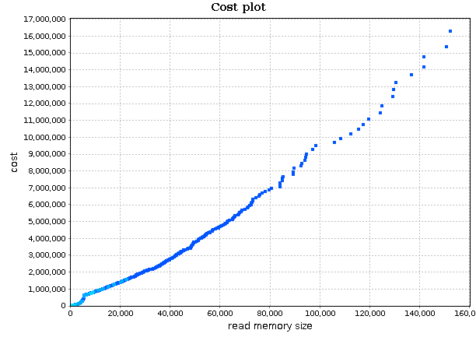
kernel_trmm
void kernel_trmm(int m, int n,
float alpha, float **A, float **B)
{
int i, j, k;
float temp;
for (i = 0; i < m; i++)
for (j = 0; j < n; j++) {
for (k = i+1; k < m; k++)
B[i][j] += A[k][i] * B[k][j];
B[i][j] = alpha * B[i][j];
}
}
Notes:
Each dot was produced by a different input that griffinC could generate.

Slide 68
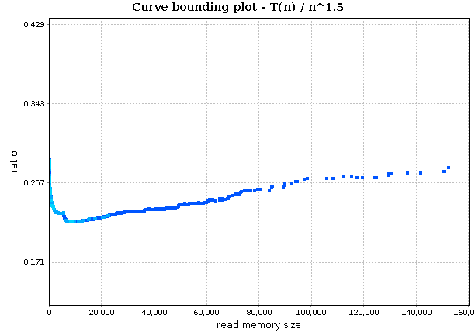
kernel_trmm
void kernel_trmm(int m, int n,
float alpha, float **A, float **B)
{
int i, j, k;
float temp;
for (i = 0; i < m; i++)
for (j = 0; j < n; j++) {
for (k = i+1; k < m; k++)
B[i][j] += A[k][i] * B[k][j];
B[i][j] = alpha * B[i][j];
}
}
Notes:
In this case, the algorithm is super linear.

Slide 69
Floyd-Warshall
void kernel_floyd_warshall(int **path, int n)
{
int i, j, k;
for (k = 0; k < n; k++) {
for (i = 0; i < n; i++)
for (j = 0; j < n; j++)
path[i][j] = path[i][j] < path[i][k] + path[k][j] ?
path[i][j] : path[i][k] + path[k][j];
}
}
Notes:
We have applied our tool in other programs outside the polybench collection too. For instance, this is an implementation of the floyd warshall algorithm.

Slide 70
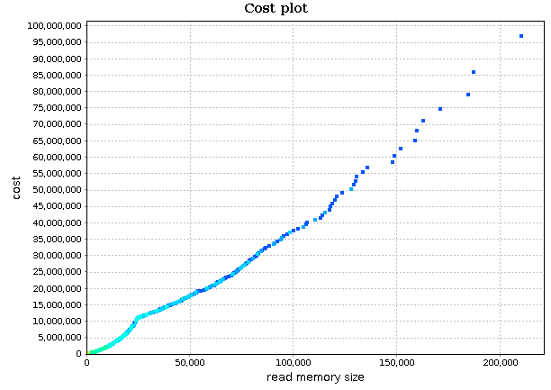
Floyd-Warshall
void kernel_floyd_warshall(int **path, int n)
{
int i, j, k;
for (k = 0; k < n; k++) {
for (i = 0; i < n; i++)
for (j = 0; j < n; j++)
path[i][j] = path[i][j] < path[i][k] + path[k][j] ?
path[i][j] : path[i][k] + path[k][j];
}
}
Notes:
That's the curve that we get.

Slide 71
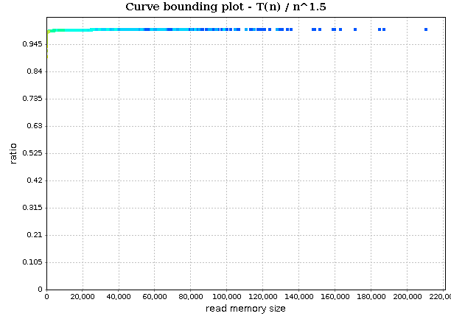
Floyd-Warshall
void kernel_floyd_warshall(int **path, int n)
{
int i, j, k;
for (k = 0; k < n; k++) {
for (i = 0; i < n; i++)
for (j = 0; j < n; j++)
path[i][j] = path[i][j] < path[i][k] + path[k][j] ?
path[i][j] : path[i][k] + path[k][j];
}
}
Notes:
And that's the complexity: if we read n^2 memory cells, then we run n^3 operations.

Slide 72
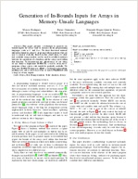

Generation of In-Bounds Inputs for Arrays in Memory-Unsafe Languages
A technique to test parts of a program without generating out-of-bounds accesses in arrays
https://github.com/maroar/griffin-TG
http://lac.dcc.ufmg.br/
fernando@dcc.ufmg.br
Notes:
So, that was a rather brief presentation. I jumped over a few details, which you can find in the paper.

