Slide 1


Modelling of adaptive stress pathway activation (Nrf2-Srxn1) for repeated dose exposure

Slide 2
Project Plan
Modelling of adaptive stress pathway activation for repeated dose exposure and application for chemical safety assessment.
Compounds:
Sulforaphane
Andrographolide
CDDO-me (Bardoxolone methyl)
Ethacrynic acid
Cell line:
HepG2 2D and 3D cell line
Experiment type:
Continuous/single dosing and repeated dosing

Slide 3
Experimental design
3 Oxidative stress HepG2 BAC-GFP reporters:
SRXN1-GFP, NRF2-GFP, HMOX1-GFP
4 Compounds:
Andrographolide, CDDO-me, Ethacrynic acid, Sulforaphane
Dose matrix:
8 concentrations (total 64 conditions)
3 Exposure scenarios (Live imaging: every hour an image)
Scenario 1
8h + 24h repeated exposure
32h single exposure
Scenario 2
24h + 24h repeated exposure
48h single exposure
Scenario 3
24h exposure+ 24h recovery + 24h exposure
72h single exposure

Slide 4
Modeling design (ideal scenario)
1
Drug
2
5
k_{1s}
Nrf2
4
SRXN1
3
1. Chemical Kinetics inside the in-vitro systems
2. Chemical induced Nrf2 expression
3. Nrf2 bio kinetics
4. Nrf2 induced Srxn1 response
5. Srxn1 bio kinetics

Slide 5
Modeling design (ideal scenario)
1
Drug
2
5
k_{1s}
Nrf2
4
SRXN1
3
1. Chemical kinetics inside the in-vitro systems



☑
☑
2. Chemical induced Nrf2 expression
3. Nrf2 bio kinetics
4. Nrf2 induced Srxn1 response
5. Srxn1 bio kinetics

Slide 6
Indirect mechanisms found in literature
P300/CBP?
Maf?
X?
Maf_ Nrf2 ?
X_Nrf2?
Nrf2*
k_{1s}
Nrf2
SRXN1

Slide 7
Modeling Design (Simplified Version)
Dynamic fractional of Nrf2 mediated recruitment of X
Fraction
k_{1s}
Nrf2
SRXN1
1-Fraction
Input via Spline interpolation
Note: Only mean Nrf2 data as an input is used.

Slide 8
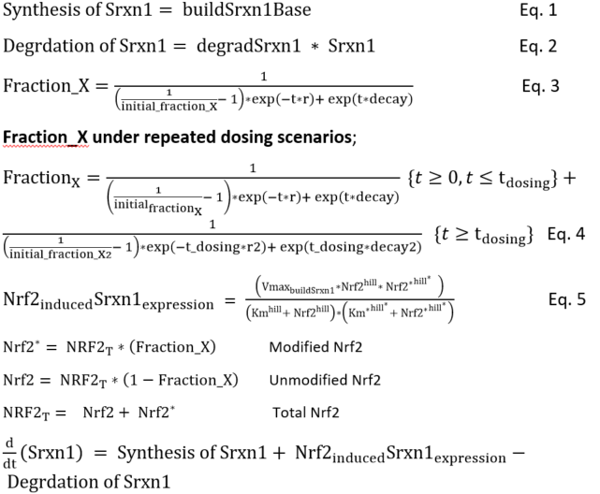
Mathematical modeling

Slide 9
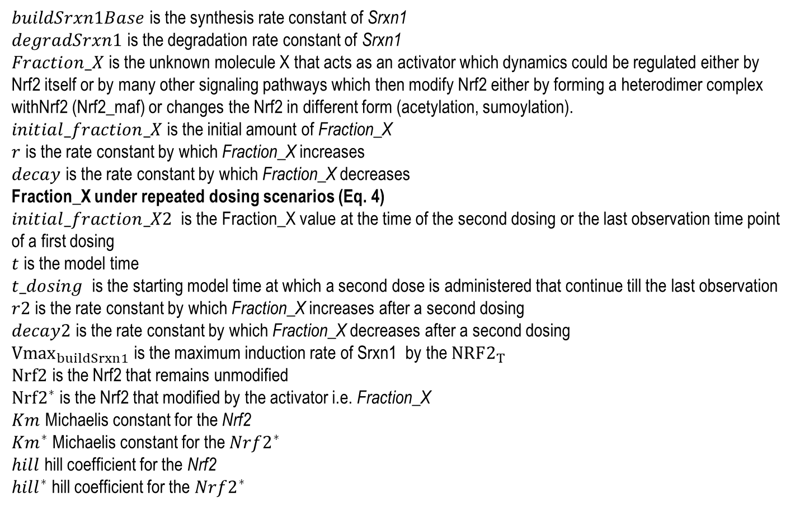
Parameter descriptions
$buildSrxn1Base$ is the synthesis rate constant of Srxn1
$degradSrxn1$ is the degradation rate constant of Srxn1
$Fraction_X$ is the unknown molecule X that acts as an activator which dynamics could be regulated either by Nrf2 itself or by many other signaling pathways which then modify Nrf2 either by forming a heterodimer complex withNrf2 (Nrf2_maf) or changes the Nrf2 in different form (acetylation, sumoylation).
$initial_fraction_X$ is the initial amount of Fraction_X
$r$ is the rate constant by which Fraction_X increases
$decay$ is the rate constant by which Fraction_X decreases
Fraction_X under repeated dosing scenarios (Eq. 4)
$initial_fraction_X2$ is the Fraction_X value at the time of the second dosing or the last observation time point of a first dosing
$t$ is the model time
$t_dosing$ is the starting model time at which a second dose is administered that continue till the last observation
$r2$ is the rate constant by which Fraction_X increases after a second dosing
$decay2$ is the rate constant by which Fraction_X decreases after a second dosing
${Vmax}_{buildSrxn1}$ is the maximum induction rate of Srxn1 by the $NRF2_{T}$
$Nrf2$ is the Nrf2 that remains unmodified
$Nrf2^{∗}$ is the Nrf2 that modified by the activator i.e. Fraction_X
$Km$ Michaelis constant for the Nrf2
${Km}^{∗}$ Michaelis constant for the $Nrf2^{∗}$
$hill$ hill coefficient for the Nrf2
${hill}^{∗}$ hill coefficient for the $Nrf2^{∗}$

Slide 10
Modeling Steps
Design Ideal mechanistic model
Simplified version model: Establishing the mechanistic relationship between Nrf2 and Srxn1.
Sulforaphane continuous exposure case study: Independent Model fitting for individual doses (MM equations)
a new simplified mechanism “dynamic fraction of Nrf2 mediated recruitment of X”
Model fitting utilizing the Sulforaphane 24+24 continuous data (48 hrs. single exposure)
Prediction for both repeated 8+24 and 24+24 exposure scenarios (total of 48 dosing combinations for each scenario) for four different chemicals.
Hierarchical non linear mixed modeling approach for Model fitting

Slide 11
Hierarchical Modeling to estimate the parameters
Assumptions:
Generic Mechanism: Nrf2 activates Srxn1 directly and can be generalized for all considered chemicals.
Specific Mechanism: Nrf2 itself/other pathways can potentiate the Srxn1 activation via an indirect mechanism that modifies the Nrf2 which can act as an activator and the degree of activation can be chemical specific.
Bayesian approach with mixed-effects modeling techniques to estimate both generic and chemical specific dynamic parameters

Slide 12
Hierarchical Modeling to estimate the parameters
Hierarchical Modeling
Data used for Model fitting :
24_24 single dose/continuous exposure
Sul, Andro, EA, CDDO-me
(Total 10 parameters)
Generic mechanism related parameters
(7 + 3 parameters)
Chemical specific related parameters
(3 parameters)
Repeated Dosing Srxn1 Prediction

Slide 13
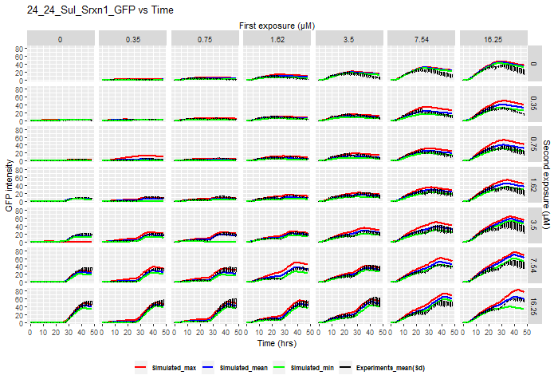
Modelling of adaptive stress pathway

Slide 14
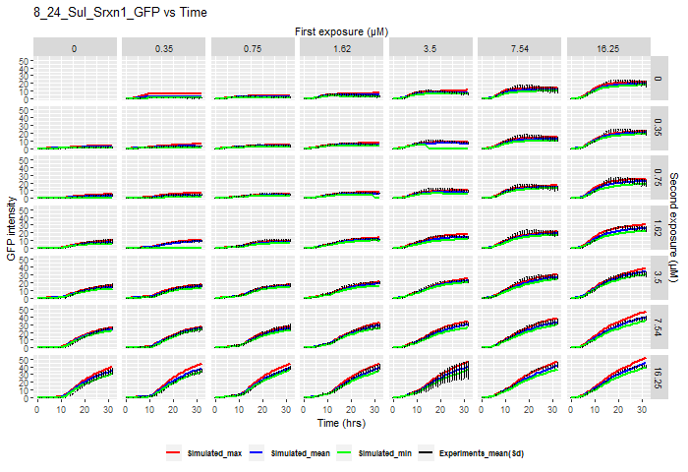
Modelling of adaptive stress pathway

Slide 15
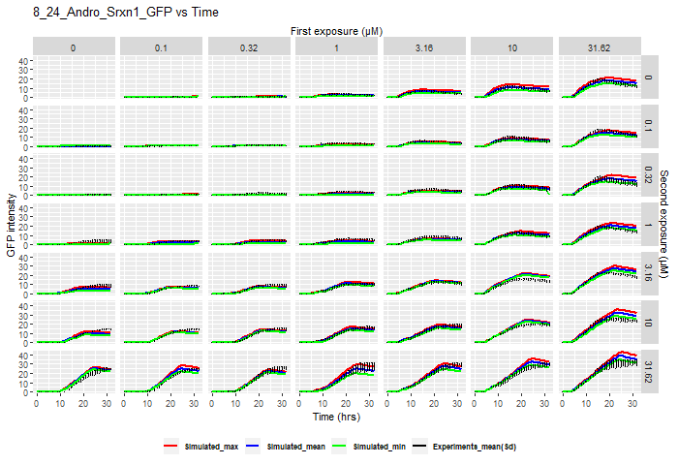
Modelling of adaptive stress pathway

Slide 16
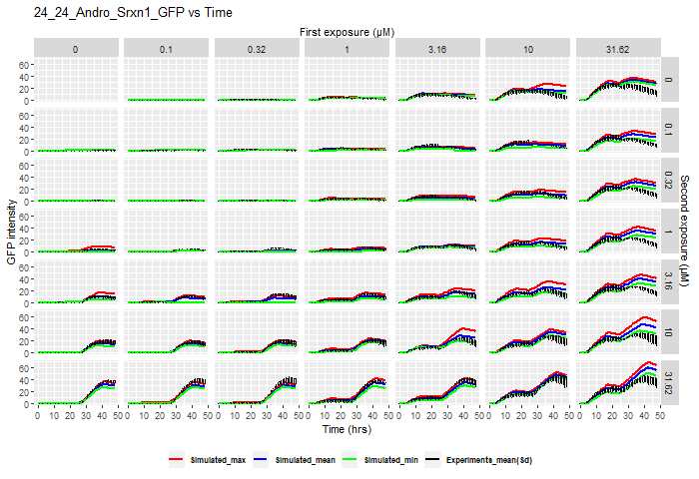
Modelling of adaptive stress pathway

Slide 17
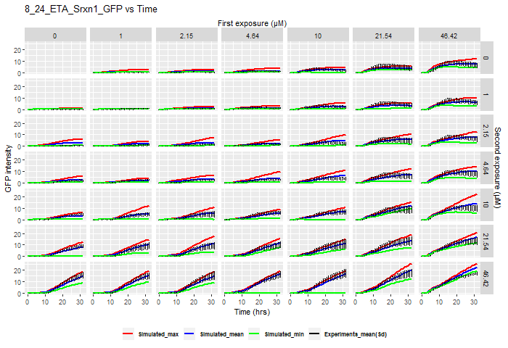
Modelling of adaptive stress pathway

Slide 18
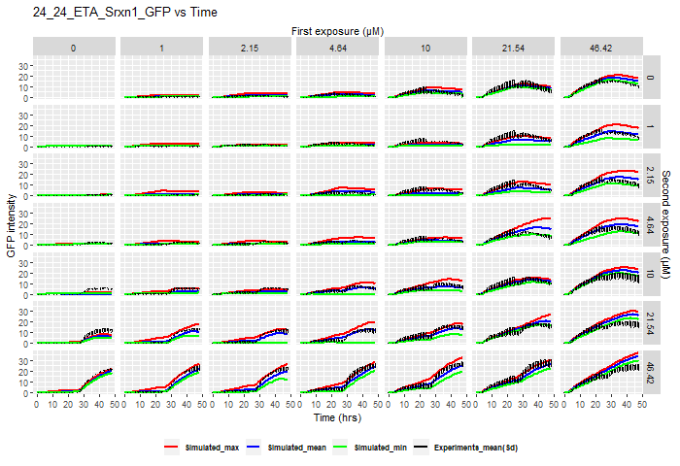
Modelling of adaptive stress pathway

Slide 19
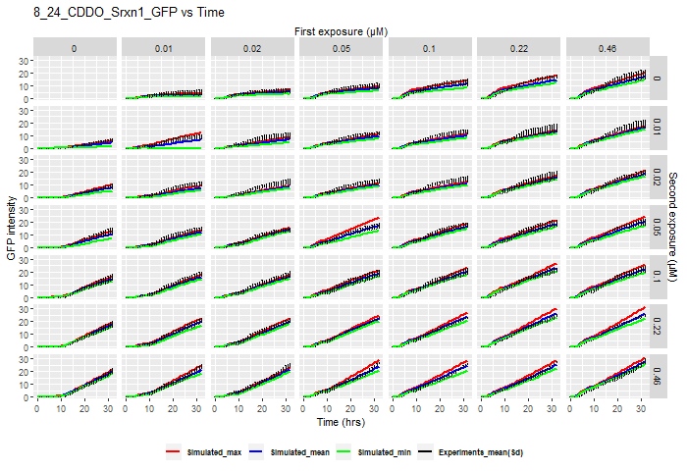
Modelling of adaptive stress pathway

Slide 20
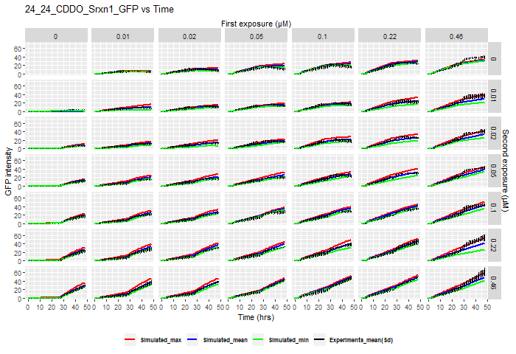
Modelling of adaptive stress pathway

Slide 21
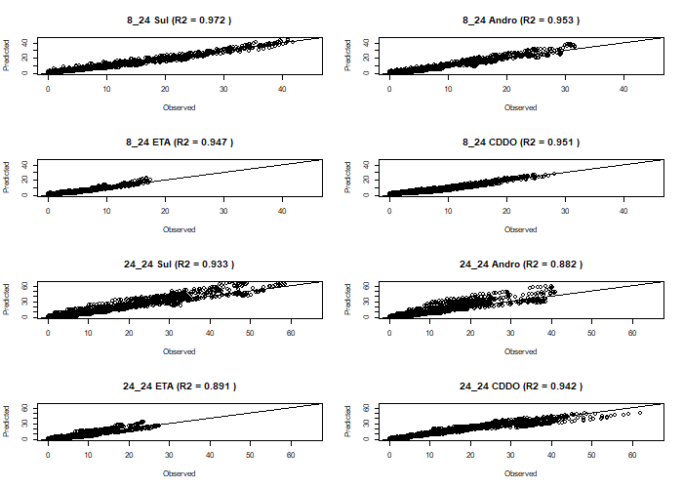
Modelling of adaptive stress pathway

Slide 22
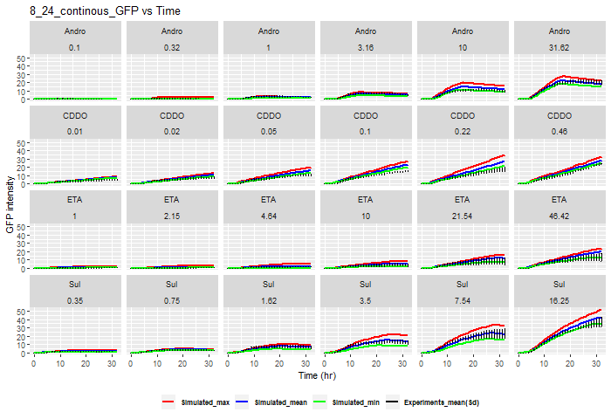
Modelling of adaptive stress pathway

Slide 23
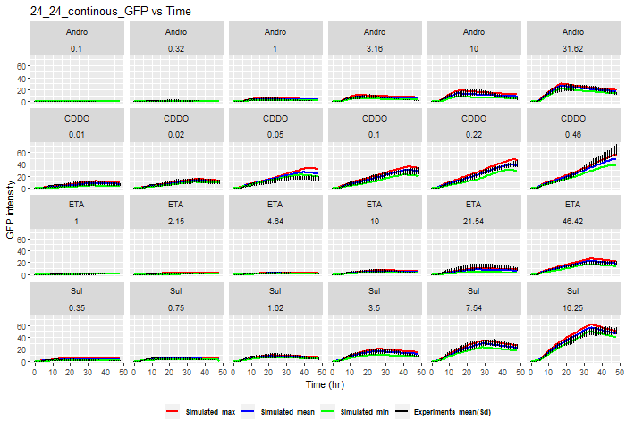
Modelling of adaptive stress pathway

Slide 24
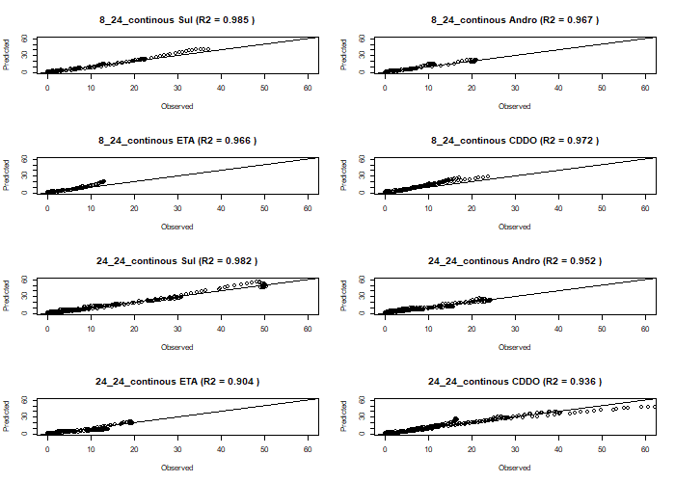
Modelling of adaptive stress pathway

Slide 25
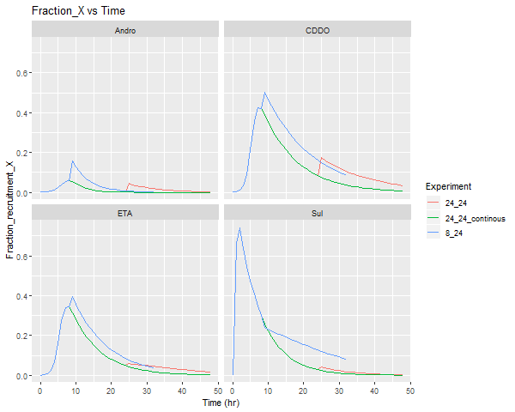
Modelling of adaptive stress pathway

