Slide 1
MagicWand Milestone 1 -Gruppe I
Shubham Kharbanda,
Denise Schulte Eppendorf,
Lara Kassmann

Slide 2

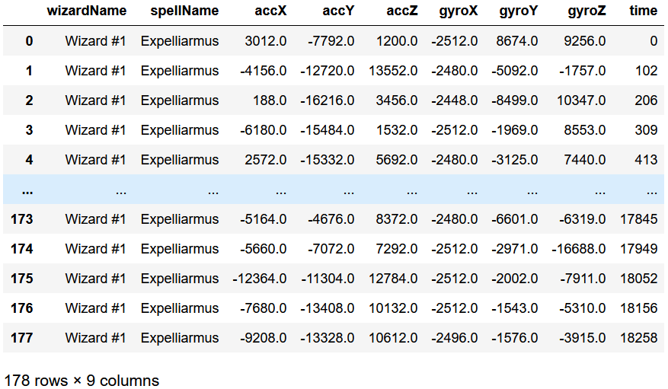
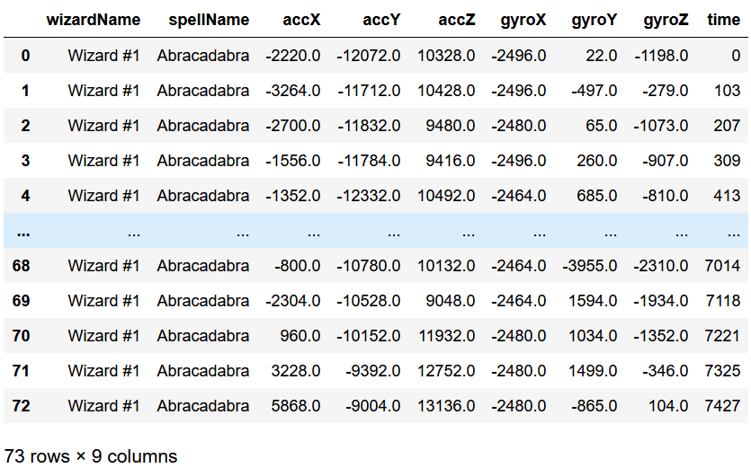
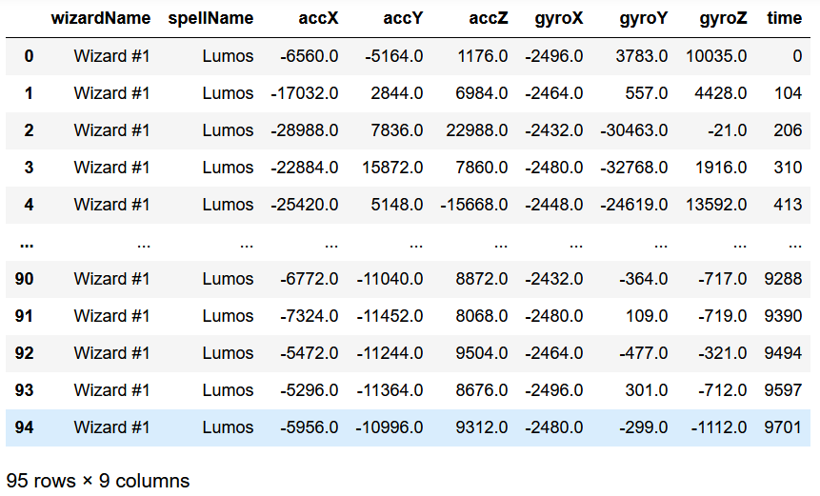
Milestone 1
Follow getting started -done
Import an example CSV file -done
Zaubersprüche: Expelliarmus, Abracadabra und Lumos

Slide 3
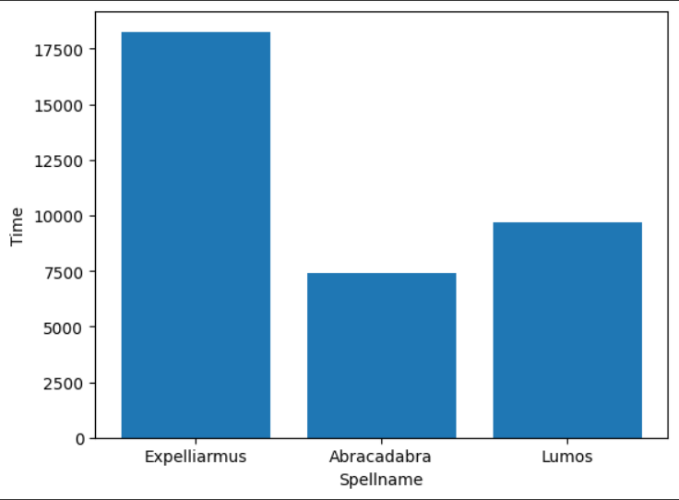

Slide 4
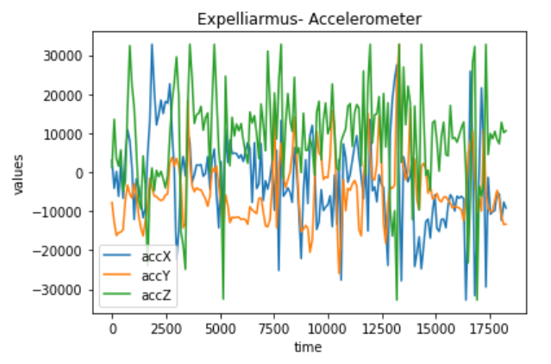
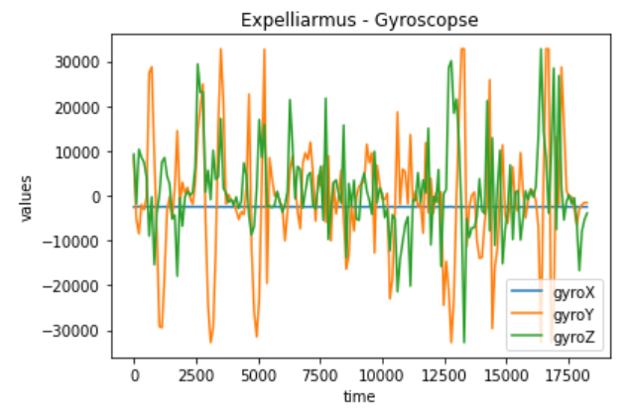
Plot example File
2D Diagrams for Expelliarmus

Slide 5
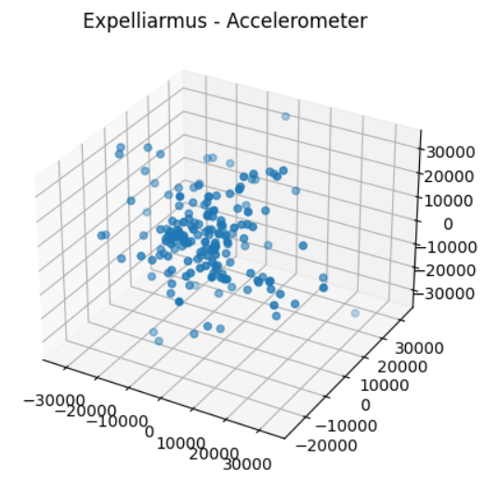
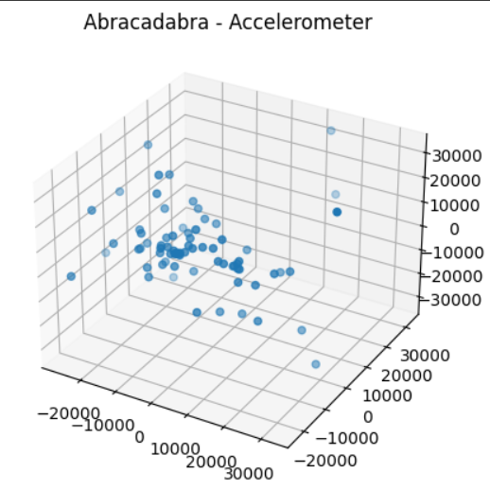
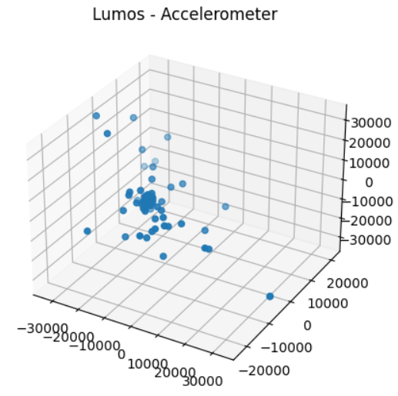
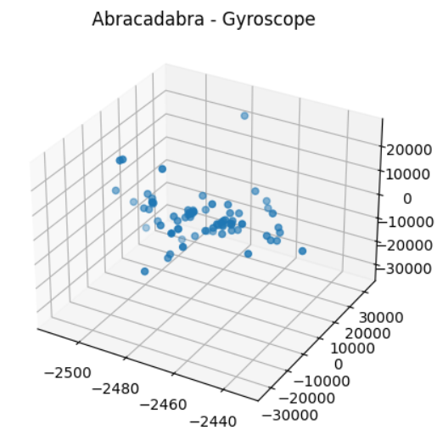
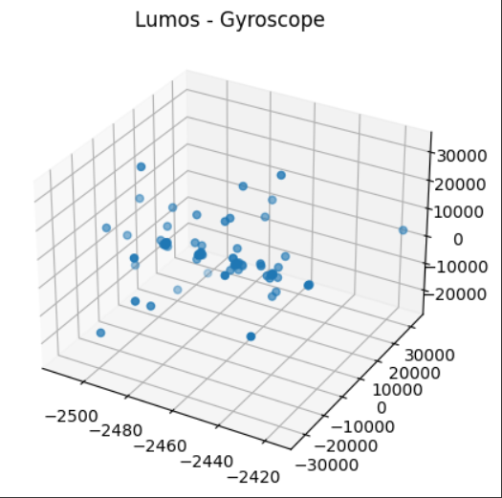
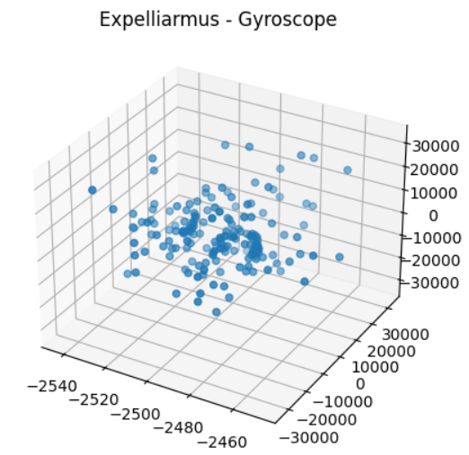
Expelliarmus
Abracadabra
Lumos
Accelerometer
Gyroscope

