Slide 1
Temporal-Orchestrated Automation
NetBox ↔ Event Router ↔ Temporal ↔ GitLab CI ↔ Ansible | Human‑Gated Approvals

Slide 2
Objectives
• Replace script-chaining with durable orchestration (Temporal)
• Keep execution where it fits: GitLab runners + Ansible
• Human‑gated approvals at key points (CAB/Peer Review)
• Drift detection, staged rollouts, compensating rollbacks
• End‑to‑end audit trail (Jira/ServiceNow + artifacts)

Slide 3
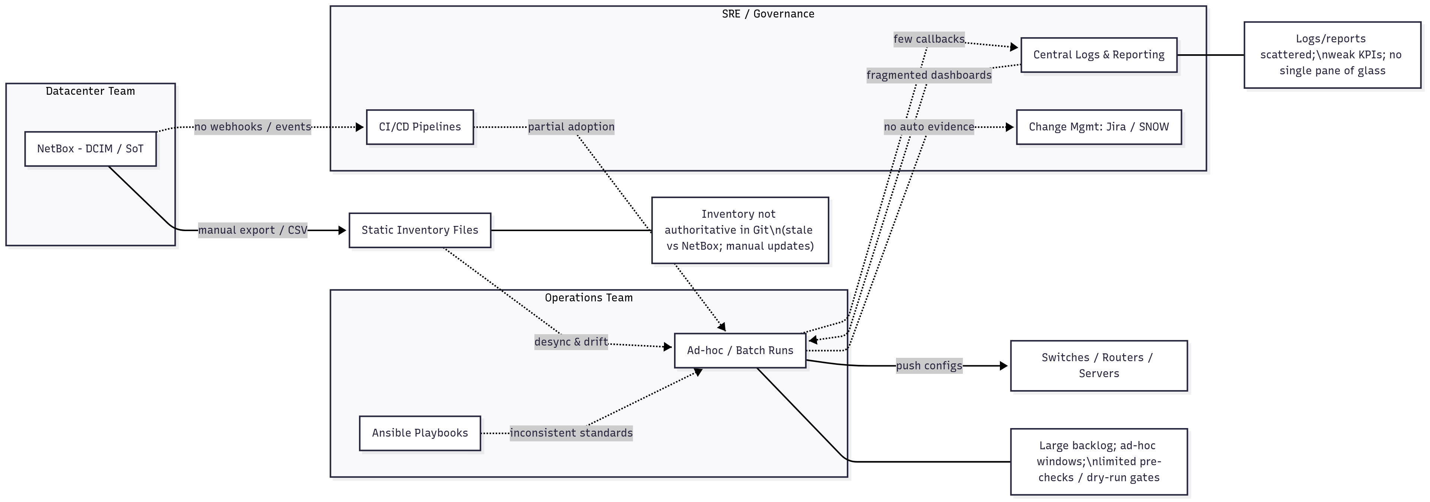
Network Current State

Slide 4
Reference Architecture
• NetBox → Webhooks → Event Router (enrich + correlate)
• Event Router → Temporal (start/signal workflows)
• Temporal → GitLab CI (trigger pipelines with variables)
• GitLab CI → Ansible/Python/Bash (do the work)
• Artifacts/logs → S3/Filesystem; metadata → DB
• Notifications → Slack/Teams; Tickets → Jira/ServiceNow

Slide 5
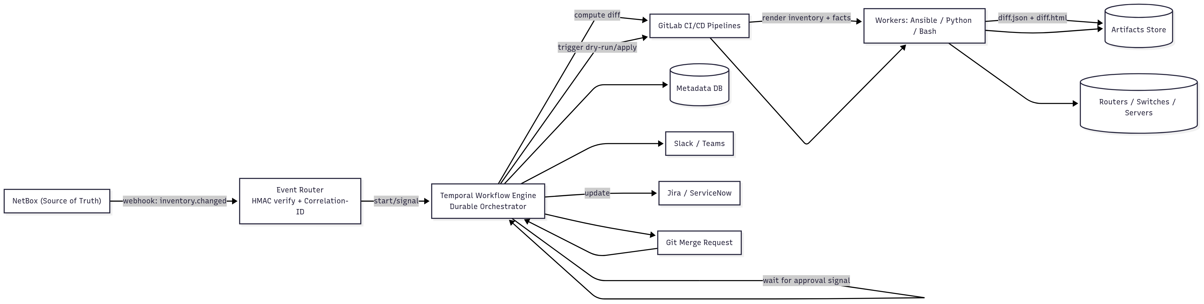
Solution Architect

Slide 6
Human‑Gated Workflow (Stages)
1) NetBox change → inventory.changed webhook
2) Temporal computes diff & opens/updates Git MR with diff
3) Wait for human approval (Temporal signal) from MR/CAB
4) Temporal triggers GitLab pipeline: dry‑run → apply (cohorts)
5) Verify post‑state; if fail → run compensation (rollback)
6) Post results, artifacts, and update ticketing; emit KPIs

Slide 7
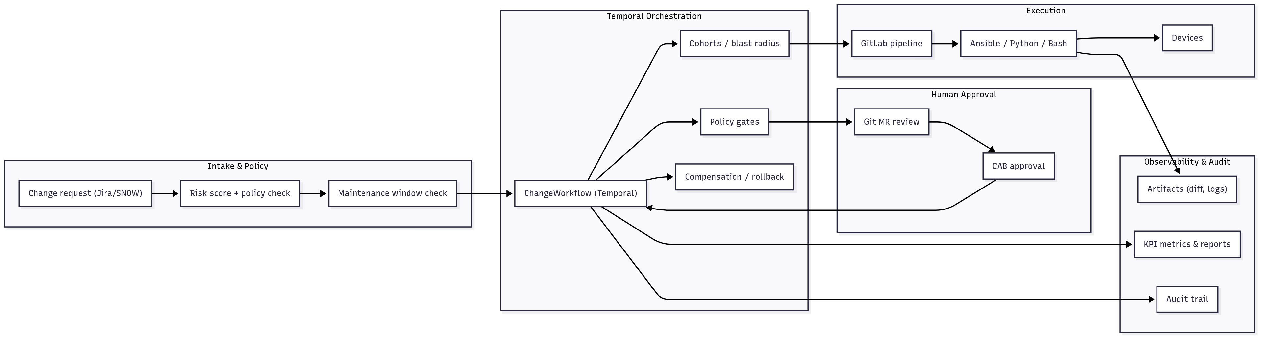
Governance Workflow (policy → approvals → rollout → audit)

Slide 8
Responsibilities Split
• Temporal: orchestration, retries, timers, approvals, saga/rollback
• GitLab CI: runners, artifacts, logs, env variables
• Ansible/Python/Bash: device changes, data collection, diffs
• Event Router: webhook intake, signature verify, correlation IDs
• NetBox: source of truth; MR context; inventory for Ansible
• Jira/ServiceNow & Slack: approval + notifications

Slide 9
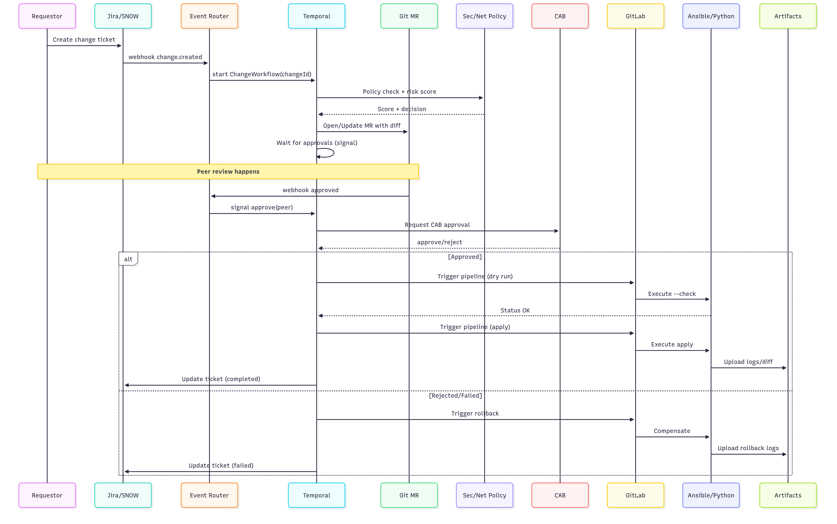
Approval-Gated Sequence (signals + gates)

Slide 10
Security & Audit
• HMAC‑signed webhooks; OAuth2 for API; mTLS internal services
• Idempotency keys and replay protection (5‑min window)
• Correlation‑ID on every event/log; append to MR and tickets
• Least‑privilege tokens for GitLab/NetBox/Jira APIs
• Immutable artifacts (S3/WORM) + retention policy

Slide 11
Rollout Strategy (6–12 Months)
• 0–2 mo: Event Router + Temporal skeleton + single cohort
• 2–4 mo: Diff engine, MR gating, Slack/Jira approvals
• 4–7 mo: Cohorts by site/role, compensation playbooks
• 7–12 mo: Drift schedules, KPI dashboards, scale-out

Slide 12
KPIs to Track
• Change success rate; MTTR; drift %; approval lead time
• Backlog burn rate; deployment frequency; rollback success
• Review coverage; inventory accuracy; audit compliance rate

