Slide 1
Python Drivers
Robotics Bootcamp 2026

Slide 2
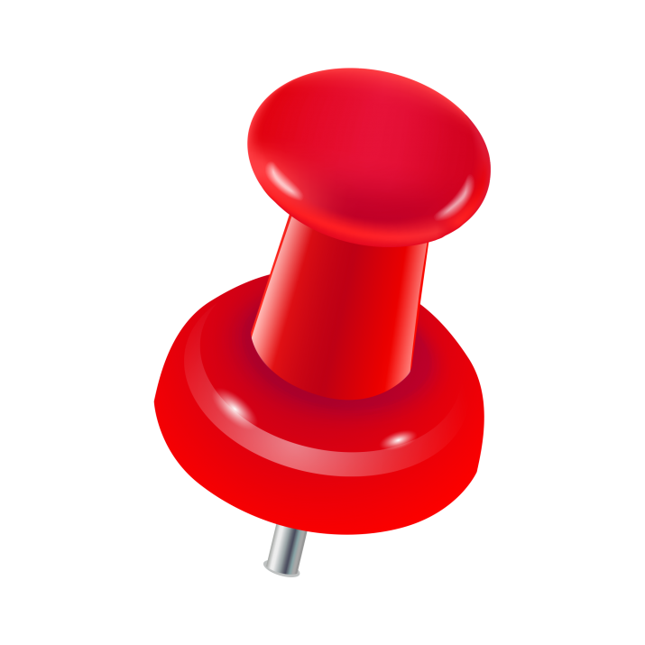
Outline of Today
Introduction to Robots and robot types
Meet our robots
Lab safety
Install/go over Python drivers
LUNCH
Brief Lab Tour
Teaching Pendant Lab
Python Lab
If extra time: switch robots
We are here.

Slide 3
Why use Python drivers?
TP programs are limited in what they can do
Still used a lot in industry, but still limited
Python provides flexibility
Machine Vision integration
Inter-robot communication
Etc...

Slide 4
How does it work?
The robot TP runs a program continuously reading and updating its registers.
The Python program sets movement/gripper registers and handles all logic.
Python writes to robot controller registers via Ethernet-IP.

Slide 5
FANUC Driver
Navigate to the Github repository:
https://github.com/laceyhunt/robots_bootcamp_2026/tree/master
Clone it (or download as a ZIP) and open it
Activate your Python environment and run:
pip3 install pycomm3 OR conda install pycomm3

Slide 6
StdBot Driver
Open the 'standard_bot' folder in the terminal
Ensure a python virtual environment (conda, venv, etc.) is active
Run 'pip install –r requirements.txt'
Open 'standard_bot.py' in Visual Studion Code
The folder contains several files:
Standard_bot.py
Get_pose.py
Requirements.txt
Positions.py

Slide 7
After Lunch Lab 1: TP
Whichever Robot you choose to work with, you will first make a TP program to...
Go to home location
Pick up a die
Move the die
Place die somewhere new
Return home

Slide 8
After Lunch Lab 2: Python
Home Robot
Pick up die
Place on conveyor
Turn on conveyor
Stop conveyor once die reaches proximity sensor
Pick up die
Place die back at start
Go back home

Slide 9
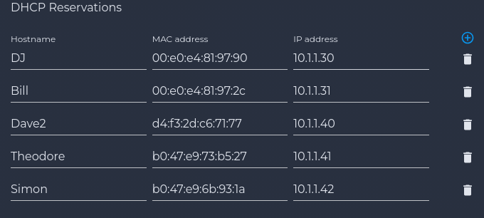
When we are down there, log into WiFi
Network: CDA Robot
Password: 12345678

Slide 10
Outline of Today
Introduction to Robots and robot types
Meet our robots
Lab safety
Install/go over Python drivers
LUNCH
Brief Lab Tour
Teaching Pendant Lab
Python Lab
If extra time: switch robots
We are here.

