Slide 1
CIIR Robots
Robotics Bootcamp 2026

Slide 2
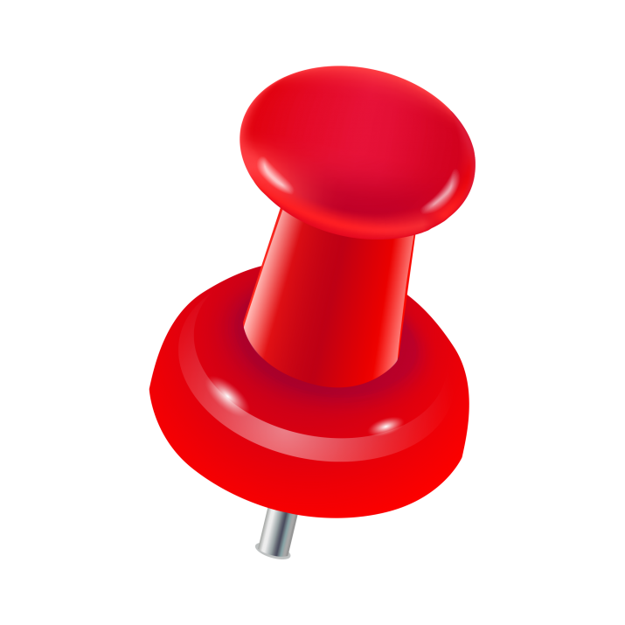
Outline of Today
Introduction to Robots and robot types
Meet our robots
Lab safety
Install/go over Python drivers
LUNCH
Brief Lab Tour
Teaching Pendant Lab
Python Lab
If extra time: switch robots
We are here.

Slide 3
Center for Intelligent Industrial Robotics (CIIR)
The lab downstairs (tour coming soon...) is full of many different robots, student projects, labs, etc.
Today, we will be working with two robot types
FANUC
Standard Bot

Slide 4
FANUC Robots
Robotics Bootcamp 2026

Slide 5

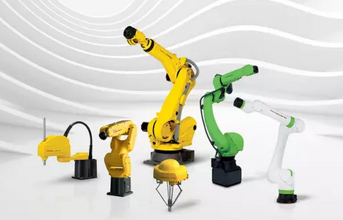
FANUC
Fuji Automatic Numerical Control (FANUC)
Japanese automation technology company
Their robots are everywhere
https://www.fanucamerica.com/images/default-source/cnc-images/cnc-retrofit.png?sfvrsn=115448d4_0
https://www.fanuc.eu/eu-en/fanuc-industrial-robots

Slide 6
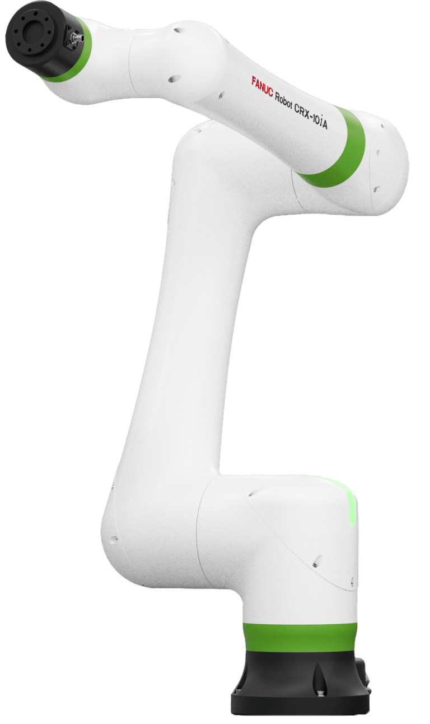
CRX-10
10kg payload capacity (~22lb)
Currently set to around 2kg (~4lb)
1249mm reach (~50in)
6 axes
Collaborative Robot
Ours are named Bill and DJ!
https://crx.fanucamerica.com/crx-10ia

Slide 7
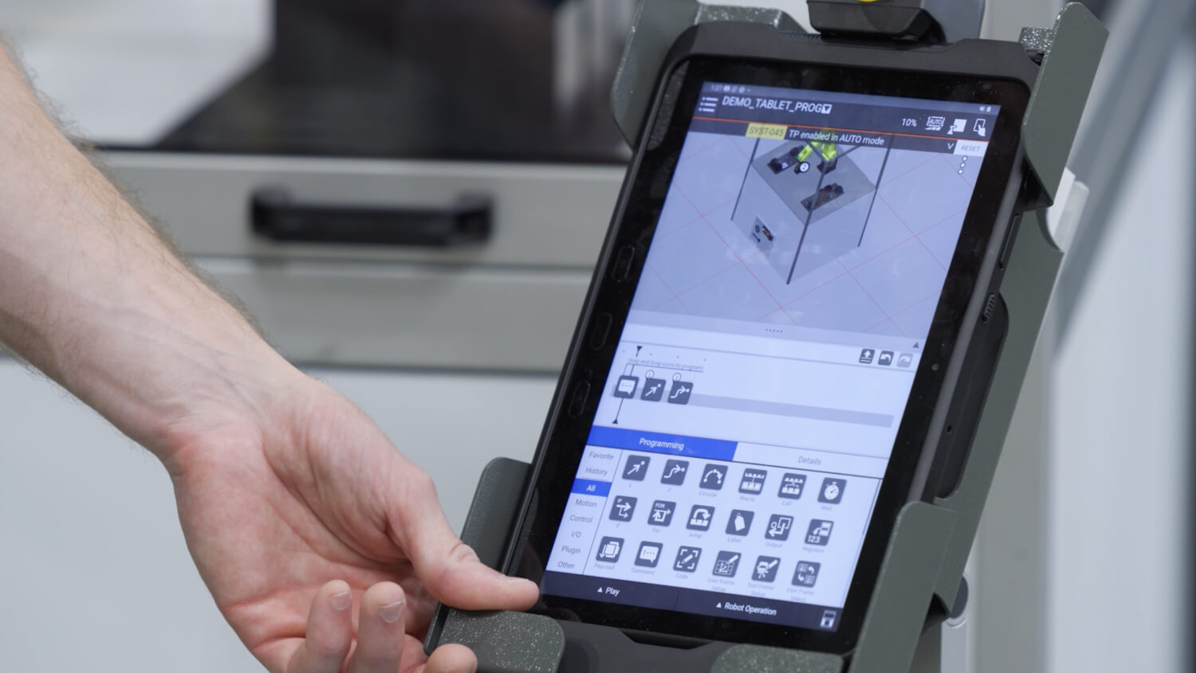
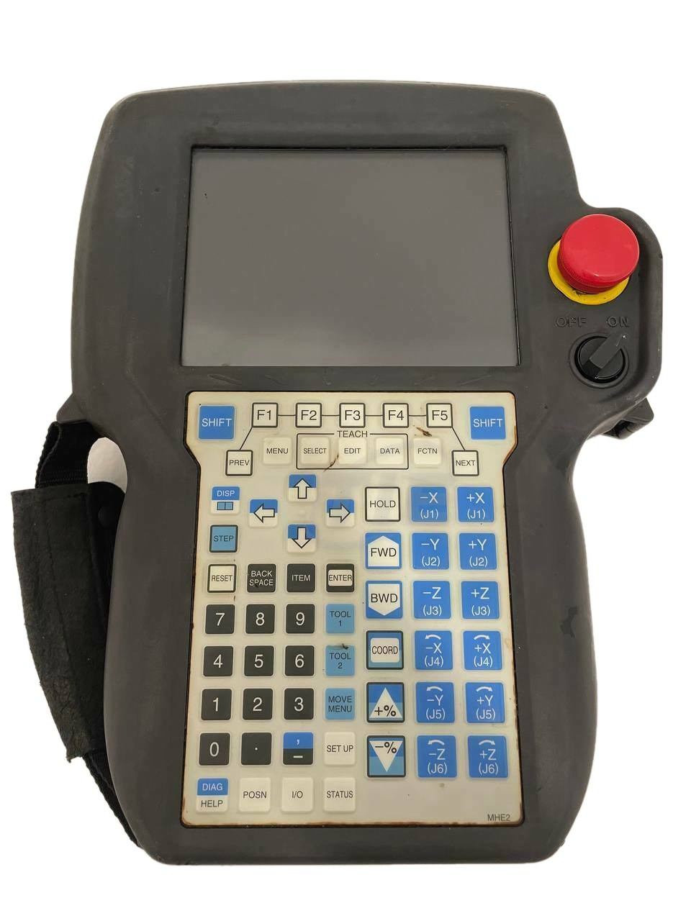
FANUC Teach Pendant (TP)
This is how we access the robot controller
https://www.fanucamerica.com/images/default-source/robot-options/4d-modeling.jpg?sfvrsn=5c475059_0
https://cdn11.bigcommerce.com/s-8zq34mp8cu/images/stencil/1280x1280/products/284809/391826/A05B-2490-C171__50152.1707926639.jpg?c=1

Slide 8
FANUC Teach Pendant (TP)
E-Stop
Big Red Button!
If something goes wrong, hit it. All robot motion will stop.
Not great for the motors, but don't be afraid to use it if you need to
https://cdn11.bigcommerce.com/s-8zq34mp8cu/images/stencil/1280x1280/products/284809/391826/A05B-2490-C171__50152.1707926639.jpg?c=1

Slide 9
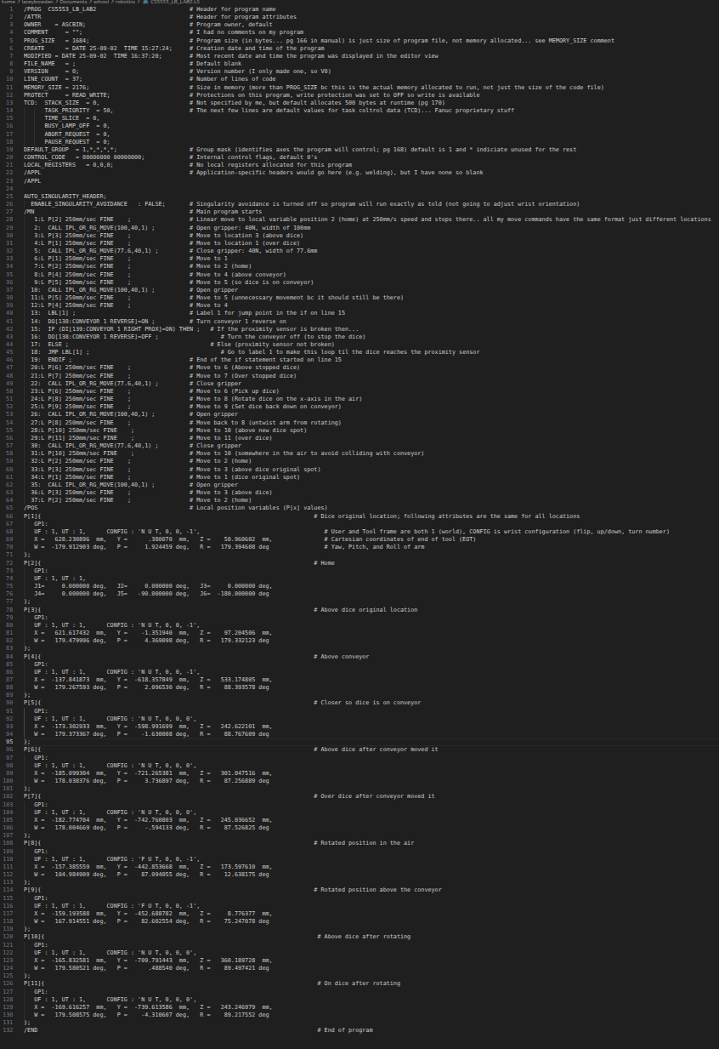
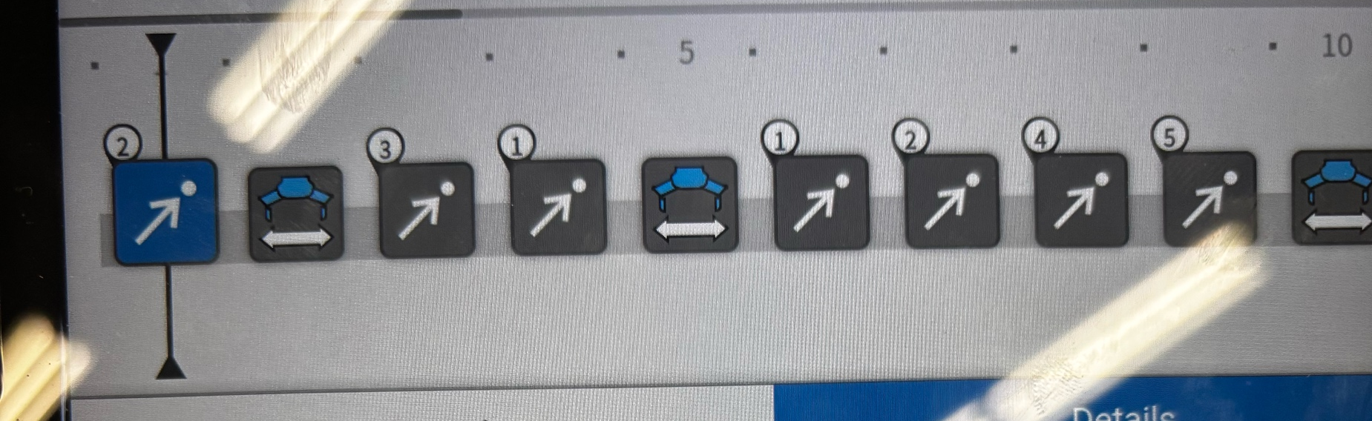
Teach Pendant (TP)
The robots can be programmed directly on the TP via block programming
These are saved as .TP files and sent to the robot when run
What we see...
What the robot runs...

Slide 10
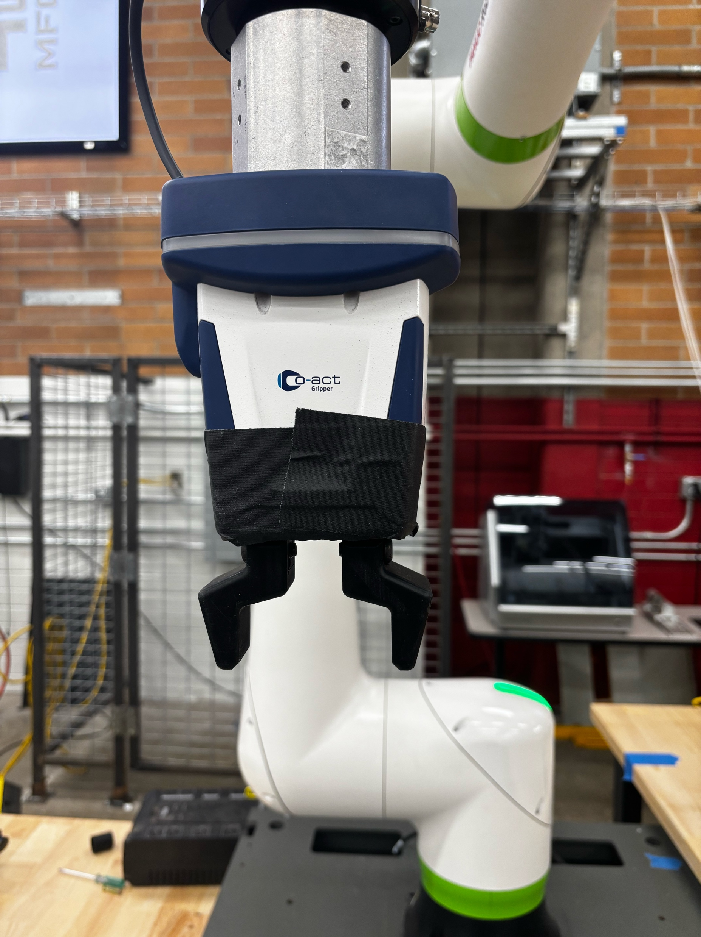
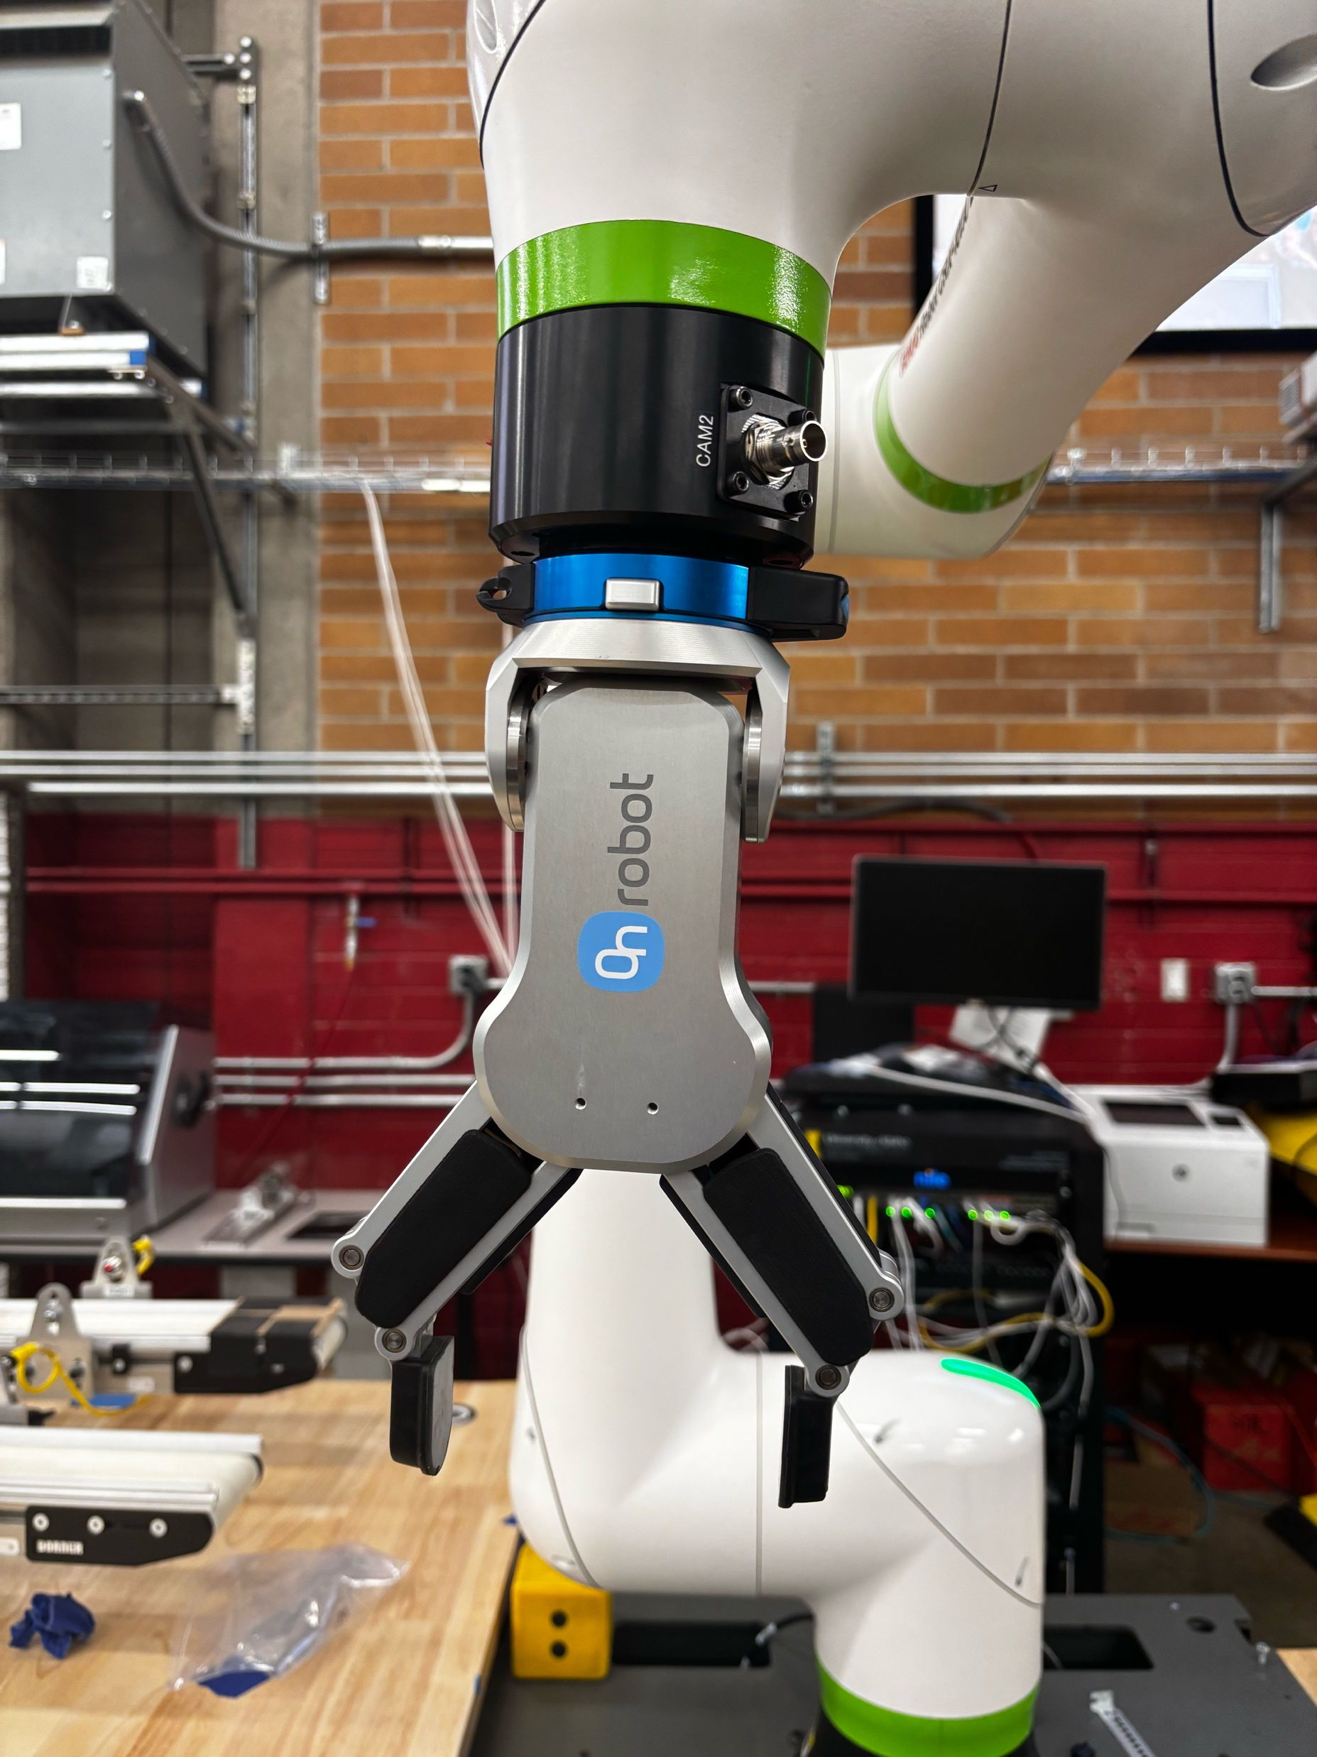
Grippers
Schunk
(Non-Force Controlled)
OnRobot
(Force-Controlled)

Slide 11
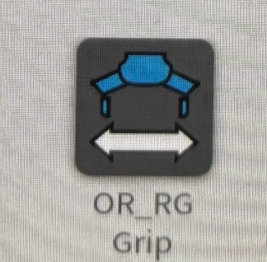
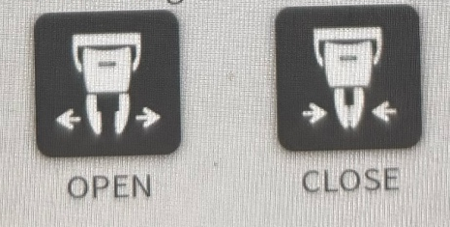
Grippers
Schunk
(Non-Force Controlled)
OnRobot
(Force-Controlled)

Slide 12
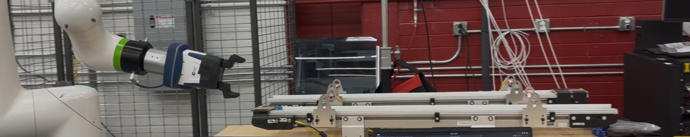
Conveyors
Each robot controls one conveyor
Two proximity sensors

Slide 13
Standard Bots
Robotics Bootcamp 2026

Slide 14
Standard Bots
A US-based robotics company
Their flagship product is(was?) the RO1, a six-axis collaborative robot arm (cobot)
Built to be easy to use(?)
Includes full Python SDK for programatic control.
Works with standard end effectors like the OnRobot grippers and a built-in wrist camera, so one arm can pick, place, and inspect.
Positioned as a lower-cost, capable alternative to traditional industrial arms.

Slide 15
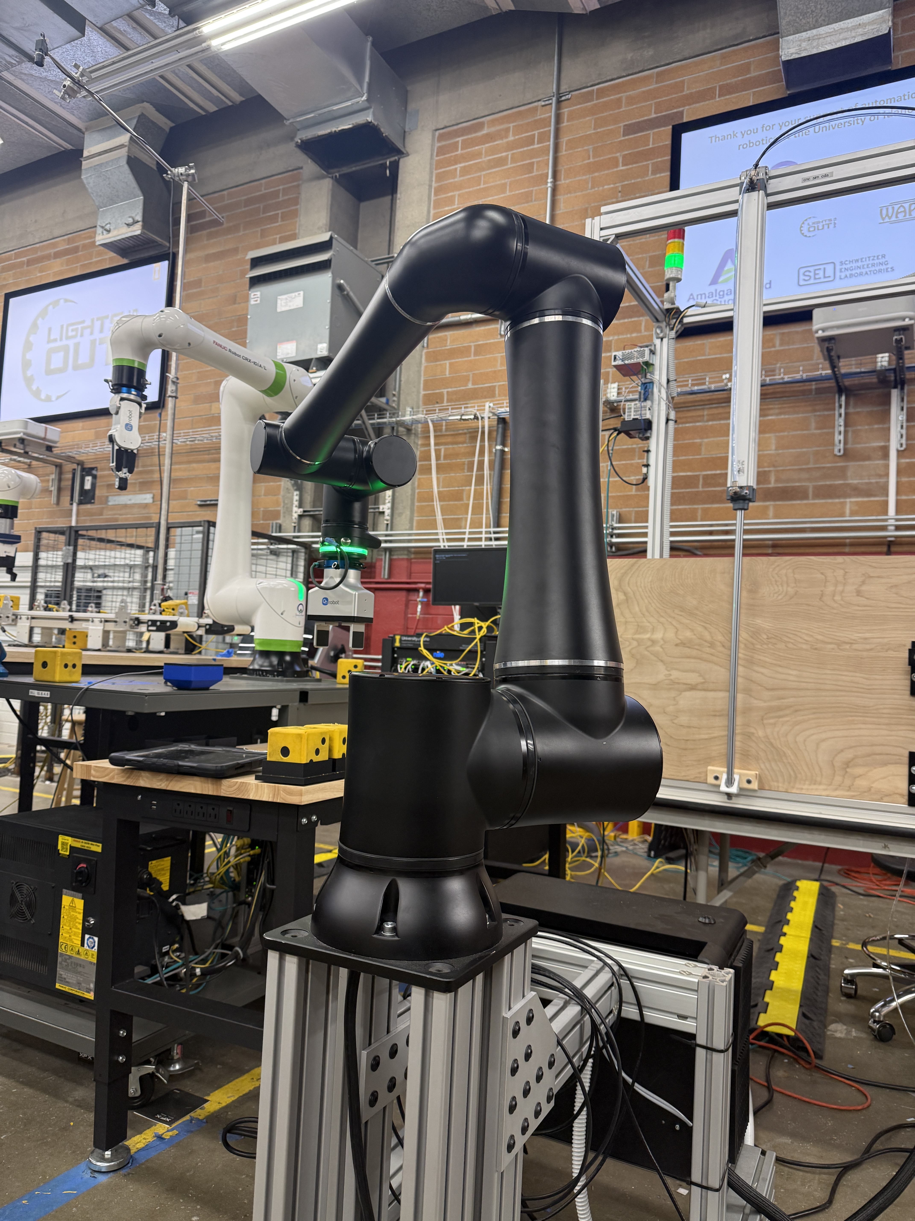
Standard Bots r01
A six-axis collaborative robot arm.
Built for real factory work: pick-and-place, machine tending, assembly, and inspection.
Three ways to program it: the teach pendant, AI-assisted setup, and the Python SDK.
A tool flange at the wrist accepts end effectors, like the OnRobot 2FG14 gripper, plus a built-in wrist camera for taking pictures and guiding tasks.
Collaborative by design: safety features let it work safely alongside people, no cage required (my head thinks otherwise).

Slide 16
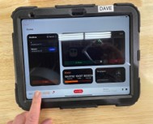
Teach Pendant
A touchscreen tablet that is the main hands-on way to operate the RO1, no programming required.
Build routines visually: add moves, gripper actions, and logic by tapping through a no-code interface.
Jog and hand-guide the arm: move the robot by hand (or with on-screen controls) and save positions where you want them.
Run and supervise: start, pause, and stop routines, and watch the robot's status and faults in real time.
Most common way of programming a robot in industry.
Photo courtesy of Sarah Davis

Slide 17
The Camera
A camera built into the robot's wrist, so it sees whatever the gripper is working on and moves with the arm to any position you send it.
Captures color (RGB) images on demand through the Python SDK or the teach pendant.
Great for inspection, verifying a part is placed, or guiding a task.
Adjustable camera settings (brightness, exposure, contrast) let you get a clear picture in different lighting.
Pairs naturally with computer vision: decode the image into OpenCV and you can detect objects, find colors, or draw bounding boxes.

Slide 18
Quaternions
A quaternion is a set of four numbers (x, y, z, w) that describes an orientation; which way a tool or joint is pointing in 3D space.
They answer "how is it rotated?", not "where is it?".
Robots use them instead of simple angles because quaternions avoid "gimbal lock"; a glitch where certain rotations get stuck or jump.
They're compact and smooth: great for the computer, but not human-friendly to read or type by hand.
The r01 uses them for linear movement. ​

Slide 19
Tips for Programming Robots
Robotics Bootcamp 2026

Slide 20
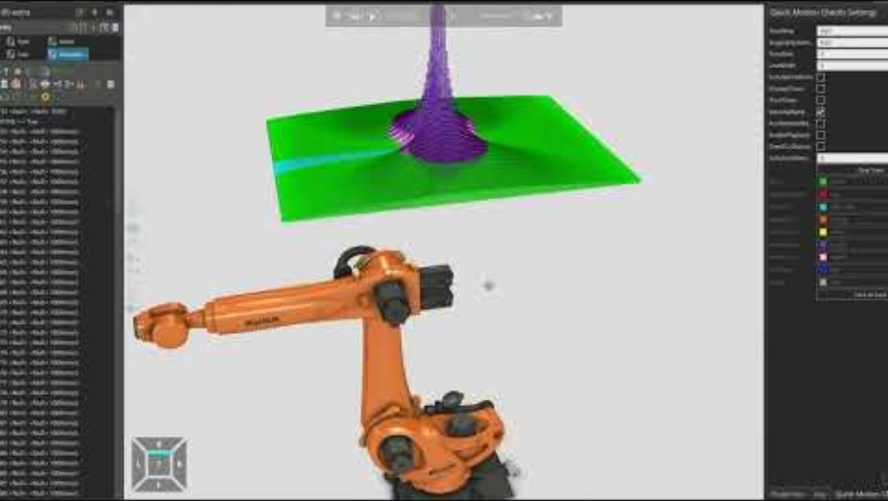
Common Errors
Payload Force Warning/Force Exceeds Limit
The cobot features have kicked in
The robot hit some sort of physical block
Cannot Reach Point
This is a singularity

Slide 21
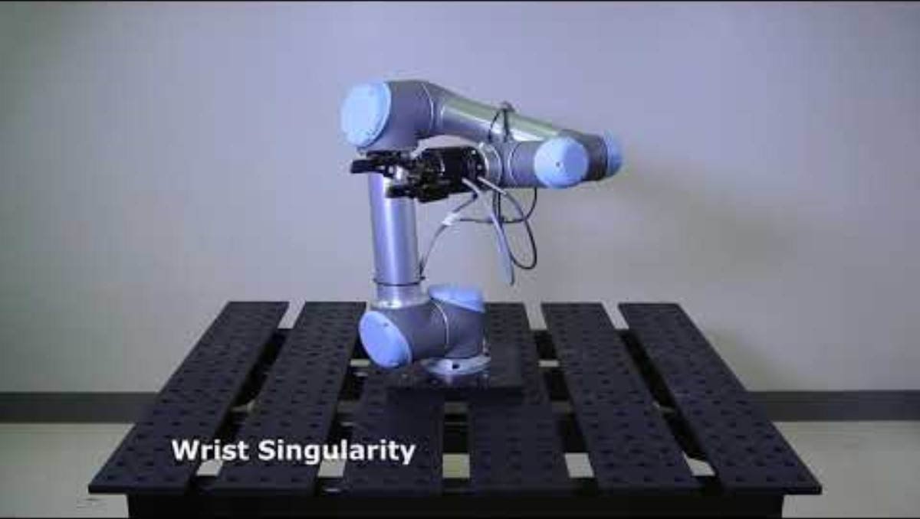
Singularities Examples...

Slide 22
Best Practices
Keep an eye on your surroundings
Tell people around you when you are about to move a robot to avoid injury
Avoid being too close to a moving robot
Go above item/location before picking up/placing down
Run programs first at a slow speed (40-50%) then speed it up once you know all positions and movements are safe
Work on one piece at a time, test it, then move on
Ex: Make sure your robot can move, then test the gripper, etc.

Slide 23
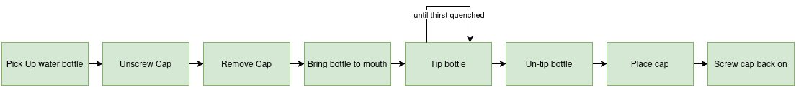
Flow Charts
Useful for planning robotic programs/movement before programming
Be explicit, but not unnecessarily verbose

Slide 24
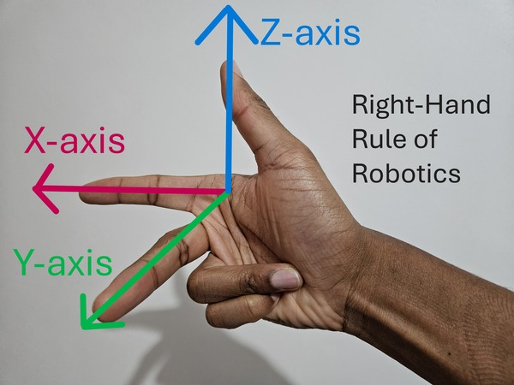
Right Hand Rule
The Right-Hand-Rule (RHR) can help us with programming robot movement.
https://automaticaddison.com/wp-content/uploads/2024/11/2-right-hand-rule-of-robotics.jpg

Slide 25
Outline of Today
Introduction to Robots and robot types
Meet our robots
Lab safety
Install/go over Python drivers
LUNCH
Brief Lab Tour
Teaching Pendant Lab
Python Lab
If extra time: switch robots
We are here.

