Slide 1
Robots Intro
Robotics Bootcamp 2026

Slide 2
Instructor Background
Lacey Bowden
CS Masters Student
Masters Topic: Industrial Robotics
NIC Fellow
Kevin Wing
CS PhD Student
Masters Topic: Agriculture IoT Device
PhD Topic: Genetic Algorithms/Optimization with AI

Slide 3

Outline of Today
We are here.
Introduction to Robots and robot types
Meet our robots
Lab safety
Install/go over Python drivers
LUNCH
Brief Lab Tour
Teaching Pendant Lab
Python Lab
If extra time: switch robots
Upstairs Downstairs

Slide 4
What is a robot?
At the highest level: a computer and an actuator.
A computer accepts raw data as input, processes it using stored instructions (software), stores the results, and produces output.
An actuator converts energy—typically electric, hydraulic, or pneumatic—into mechanical motion to move or control something.

Slide 5

In other words...
The computer performs operations, the actuator interacts with the world somehow.
Look at this washing machine...

Slide 6

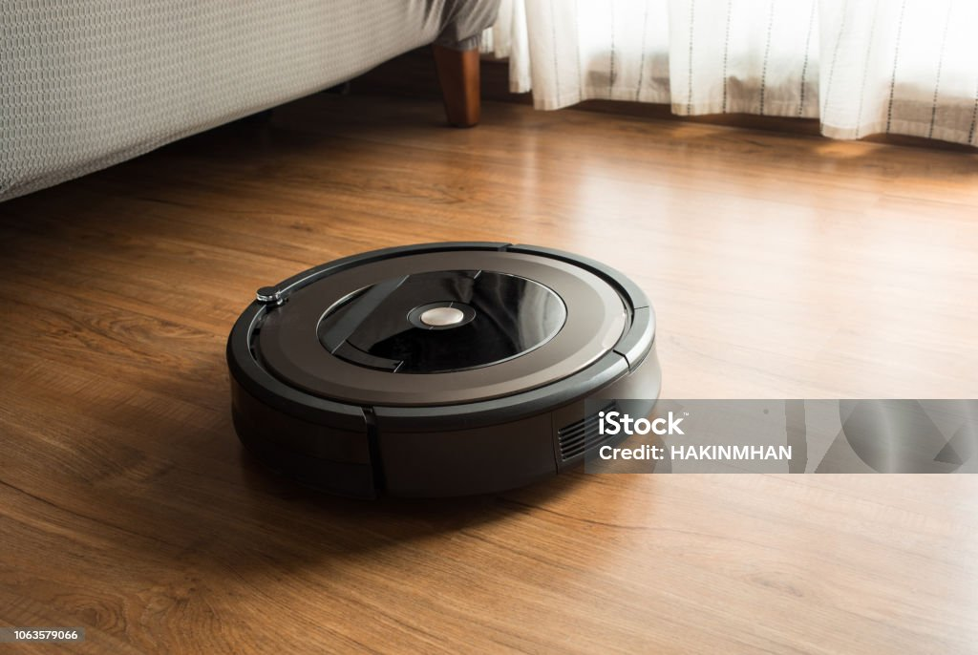



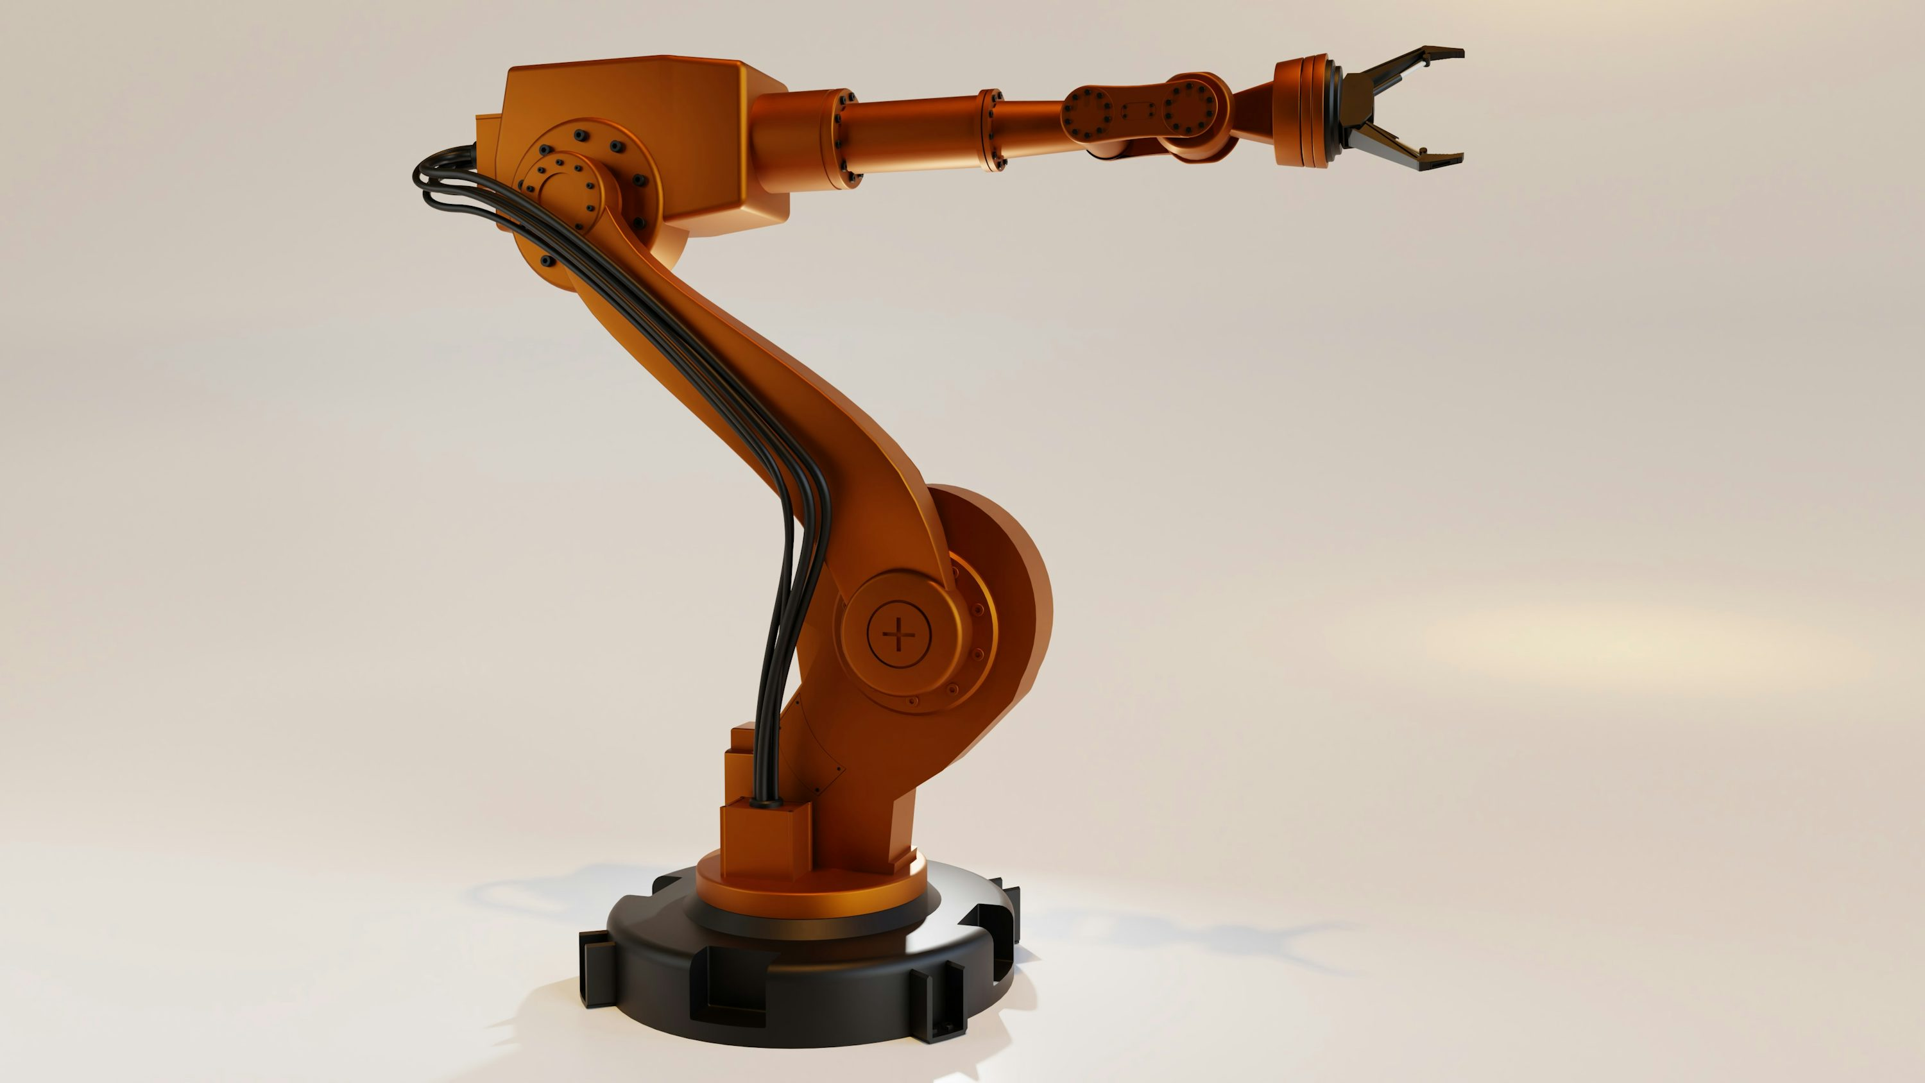
Some more examples

Slide 7
Some robot types
There are many types of robots. Today, we are going to look at and discuss these five types:
Humanoid Robots
Gantry Robots
SCARA Robots
Articulated Robots
Cobots

Slide 8
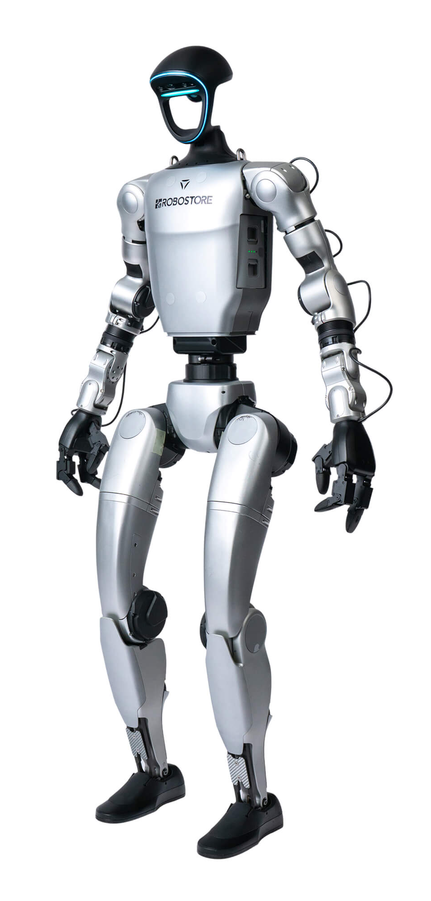
Humanoid Robots
This is often what people picture...
These robots are designed to reflect humans
Bipedal (two feet)
Sensing
Vision
In theory, these are great (because humans are great)
We are low-power, high-efficiency
https://robostore.com/cdn/shop/files/unitree-g1-edu-ultimate-a-robotic-humanoid-u3-8215619.jpg?v=1759440110&width=2000

Slide 9
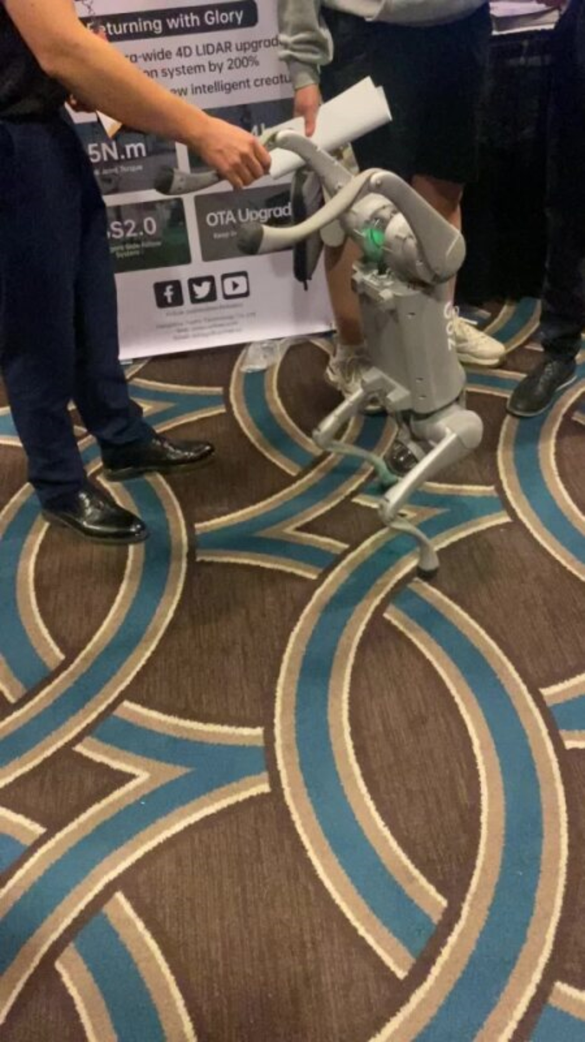
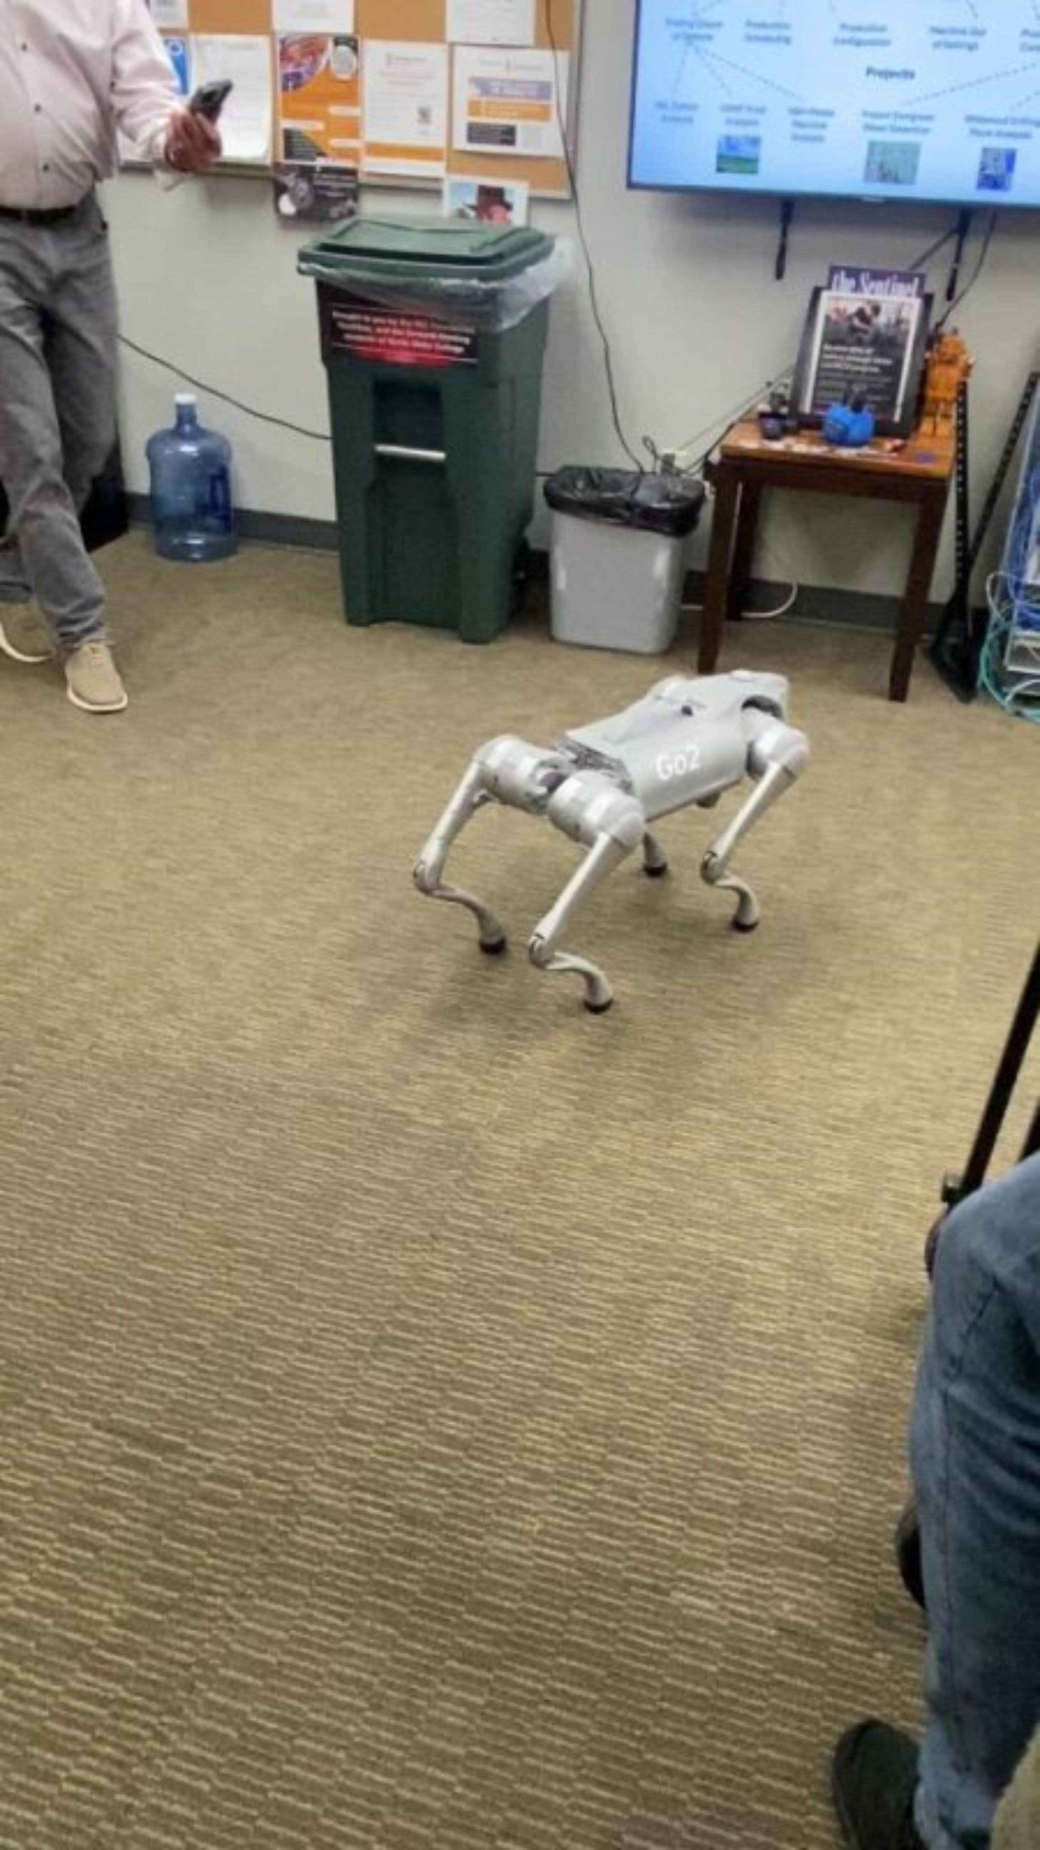
Humanoid Robots
Similar to this is the quadruped (four-legged) robot dog

Slide 10
Humanoid Robots
What are some limitations of this type of robot?
Sensory input requirements
Power
Balance
Battery Life
Etc...
https://robostore.com/cdn/shop/files/unitree-g1-edu-ultimate-a-robotic-humanoid-u3-8215619.jpg?v=1759440110&width=2000

Slide 11
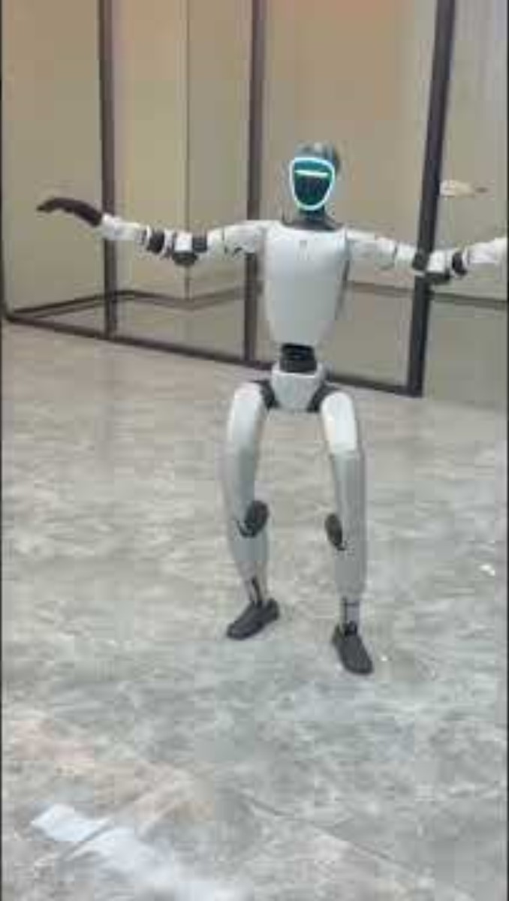
Humanoid Robots
What are some limitations of this type of robot?
Sensory input requirements
Power
Balance
Battery Life
Etc...
https://www.youtube.com/shorts/jvQdFe8FPCw

Slide 12
Other types
There are many other types of robots. Today, we are going to look at and discuss these five types:
Humanoid Robots
Gantry Robots
SCARA Robots
Articulated Robots
Cobots

Slide 13
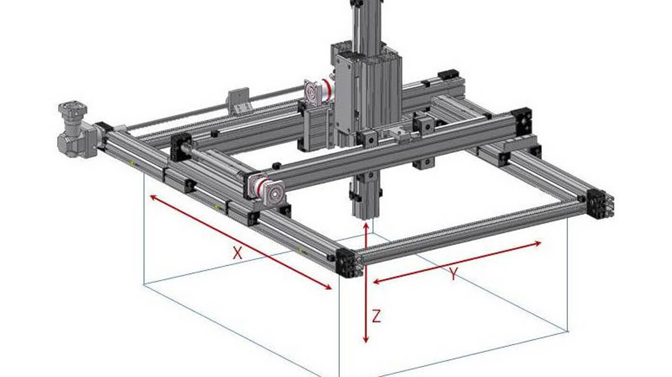
Gantry Robots
Gantry Robots (or Cartesian Robots)
Move along a 3-axis linear coordinate system
X, Y, and Z
Example: Computer Numeric-Controlled (CNC) machines
https://www.macrondynamics.com/wp-content/uploads/2023/03/Gantry-Systems-Working-Outside-and-Envelope.jpg

Slide 14
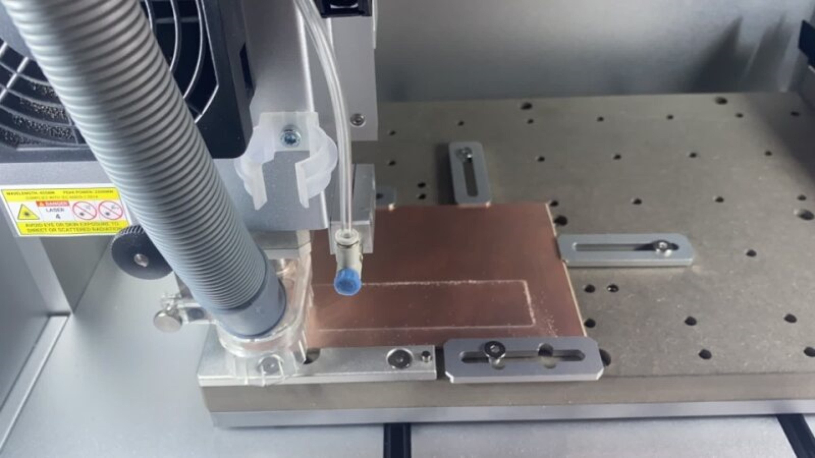
Gantry Robots
Great for subtractive (milling) or additive (3D printing) manufacturing

Slide 15
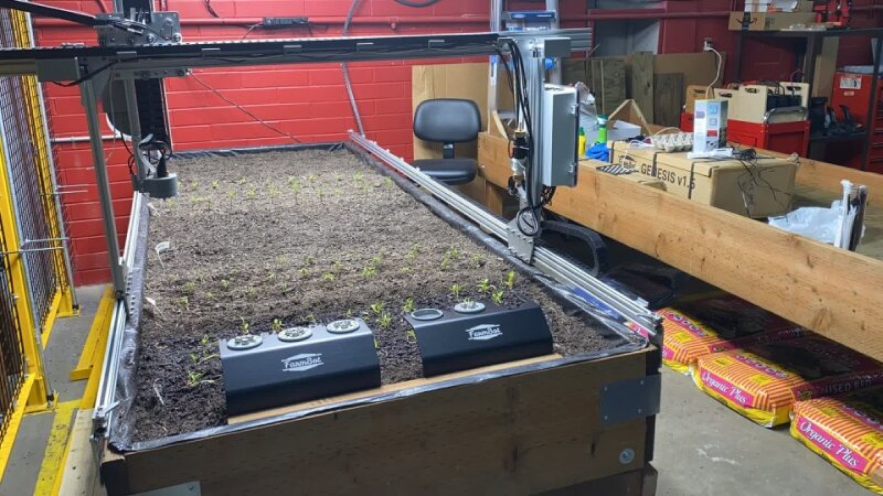
Gantry Robots
Also for traversing and monitoring some plane

Slide 16
Gantry Robots
What are some limitations of this type of robot?
Curved surfaces
Limited by end of arm tool
Large footprint
Etc...
https://www.macrondynamics.com/wp-content/uploads/2023/03/Gantry-Systems-Working-Outside-and-Envelope.jpg

Slide 17
Other types
There are many other types of robots. Today, we are going to look at and discuss these five types:
Humanoid Robots
Gantry Robots
SCARA Robots
Articulated Robots
Cobots

Slide 18
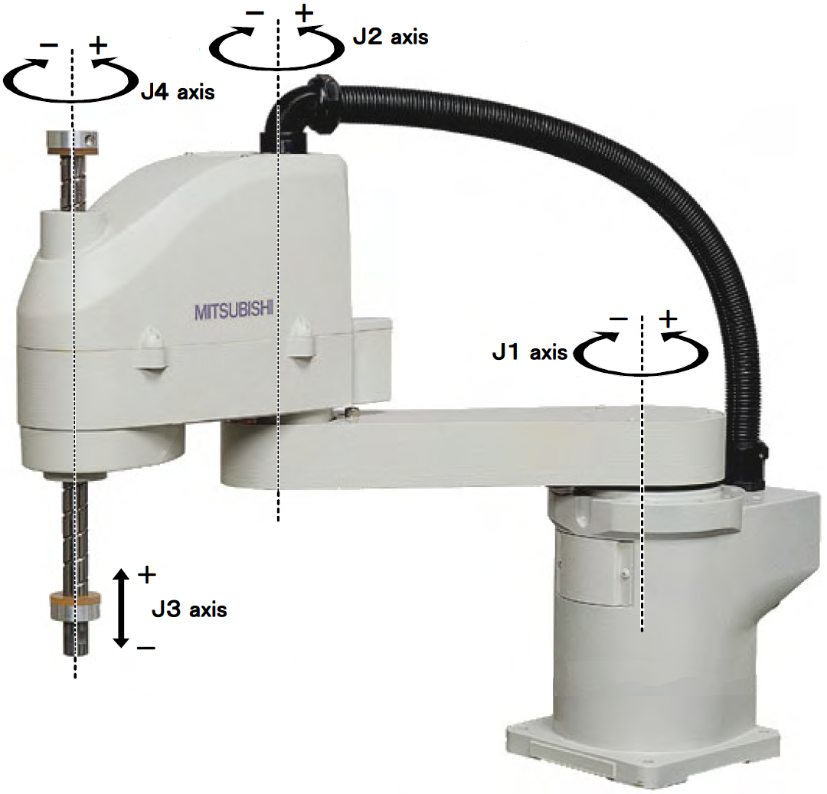
SCARA Robots
Selective Compliance Articulated Robot Arms (SCARA) robots
High-speed, high-precision, excellent repeatability
Four axes
https://upload.wikimedia.org/wikipedia/commons/0/09/SCARA_robot_2R.png

Slide 19
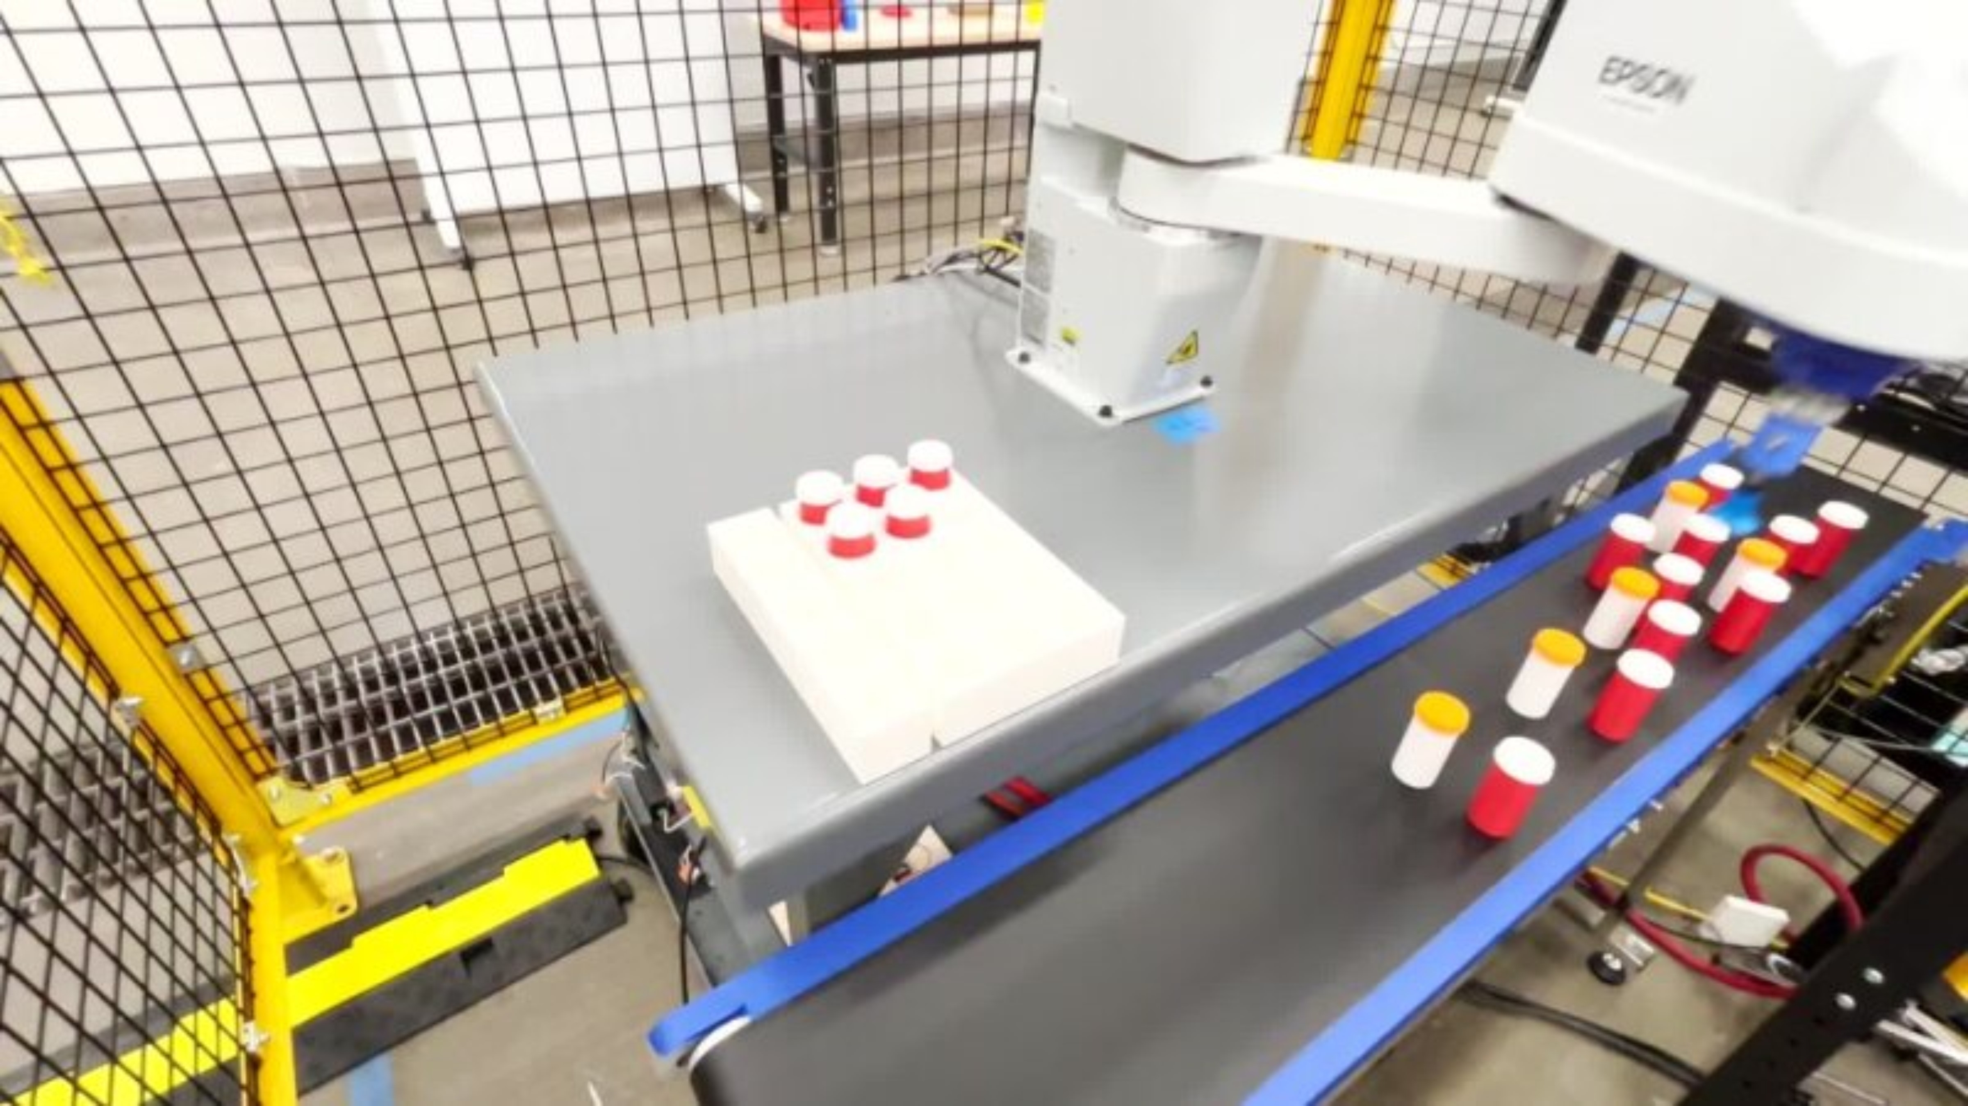
SCARA Robots
Used for assembly, palletizing, packaging, pick-and-place, etc.

Slide 20
SCARA Robots
What are some limitations of this type of robot?
Short reach
Light payload
Limited by three planes of movement, can't work with curved surfaces
Etc...
https://upload.wikimedia.org/wikipedia/commons/0/09/SCARA_robot_2R.png

Slide 21
Other types
There are many other types of robots. Today, we are going to look at and discuss these five types:
Humanoid Robots
Gantry Robots
SCARA Robots
Articulated Robots
Cobots

Slide 22
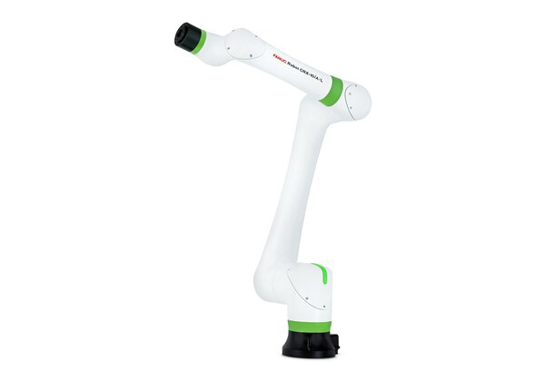
Articulated Robots
Articulated robots are arms with rotary joints
Rotary joints are connection points allowing rotational movement around a single axis, acting like a human joint (shoulder, elbow, wrist)
Typically four to seven joints (or axes)
Six is probably most common
https://d16ohktstcjvly.cloudfront.net/image/513891251684/image_2jpmakctih2bd5pq8eo0d5l60d/-T1%3A1.2-FJPG

Slide 23
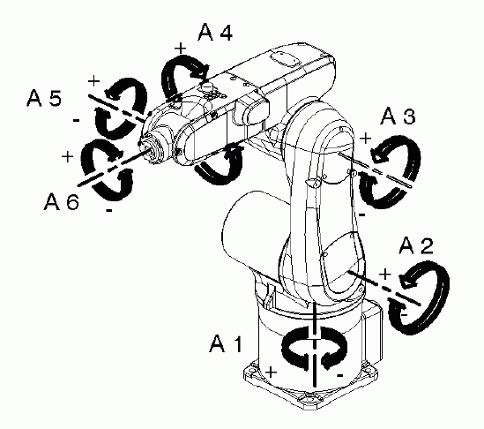
Articulated Robots
These robots are often controlled one of two ways:
First, by sending degree values to each axis in a list like this:
[0, 0, 0, 0, 0, 90]
Or
[0, 0, 90, 0, 0, 90]
This is called joint movement
But we often don't think of space like this...
https://docs.quanser.com/quarc/documentation/kuka_axes.gif

Slide 24
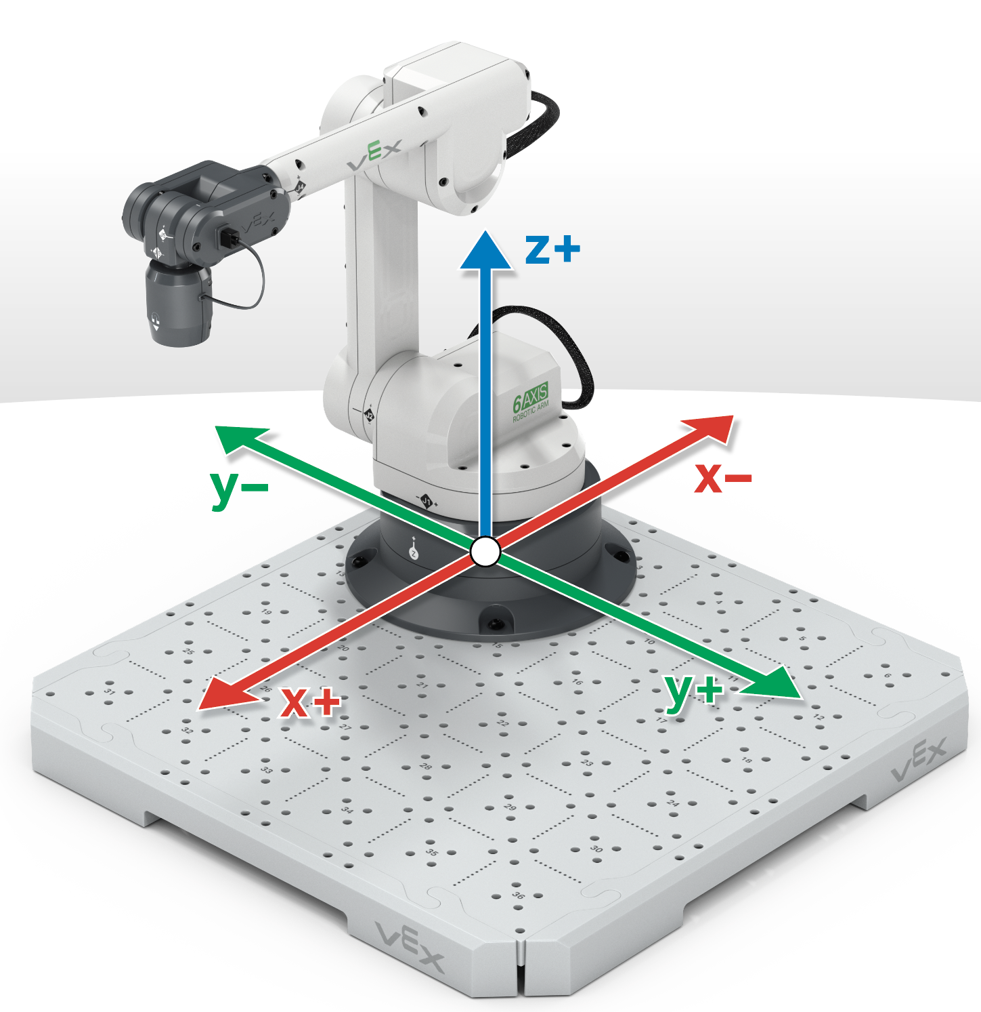
Articulated Robots
So, most articulated robots also offer cartesian movements, which allow us to pass x, y, z coordinates, and the robot calculates the joint values to get there.
Like this:
[600, 100, 50, -180, 0, 180]
Note: from end of arm, often in millimeters
X Y Z
https://education.vex.com/stemlabs/sites/default/files/inline-images/Screen%20Shot%202023-11-08%20at%201.09.12%20PM%20%282%29.png

Slide 25
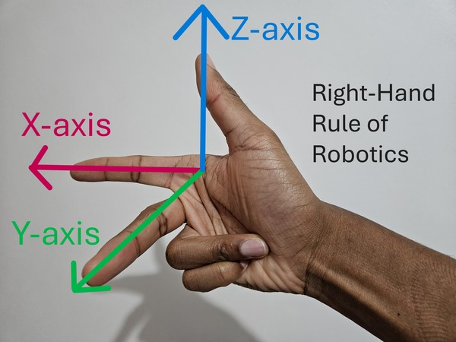
Side Note: Right Hand Rule
The Right-Hand-Rule (RHR) can help us with programming robot movement.
https://automaticaddison.com/wp-content/uploads/2024/11/2-right-hand-rule-of-robotics.jpg

Slide 26
Articulated Robots
So, most articulated robots also offer cartesian movements, which allow us to pass x, y, z coordinates, and the robot calculates the joint values to get there.
Like this:
[600, 100, 50, -180, 0, 180]
Note: from end of arm, often in millimeters
X Y Z
...but what are these?
https://education.vex.com/stemlabs/sites/default/files/inline-images/Screen%20Shot%202023-11-08%20at%201.09.12%20PM%20%282%29.png

Slide 27
Articulated Robots
With cartesian movements, we pass x, y, and z and something called Euler Angles
[600, 100, 50, -180, 0, 180]
The Euler Angles define the tool's orientation
The rotation around each axis
X Y Z
Yaw Pitch Roll
Euler Angles
https://education.vex.com/stemlabs/sites/default/files/inline-images/Screen%20Shot%202023-11-08%20at%201.09.12%20PM%20%282%29.png

Slide 28
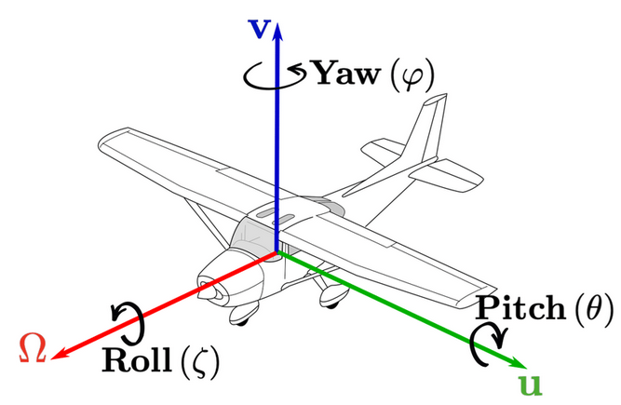
Articulated Robots
With cartesian movements, we pass x, y, and z and something called Euler Angles
[600, 100, 50, -180, 0, 180]
The Euler Angles define the tool's orientation
The rotation around each axis
X Y Z
Yaw Pitch Roll
Euler Angles
https://www.researchgate.net/figure/a-Pitch-yaw-and-roll-angles-of-an-aircraft-with-body-orientation-O-u-v-original_fig7_348803228

Slide 29
Articulated Robots
Singularities are points in space where these rules of movement break down, and we try to send a robot to a place it physically cannot go
These most often occur with articulated robots
Example: what if I try to send this coordinate value?
[0,0,0,0,0,0]
https://education.vex.com/stemlabs/sites/default/files/inline-images/Screen%20Shot%202023-11-08%20at%201.09.12%20PM%20%282%29.png

Slide 30
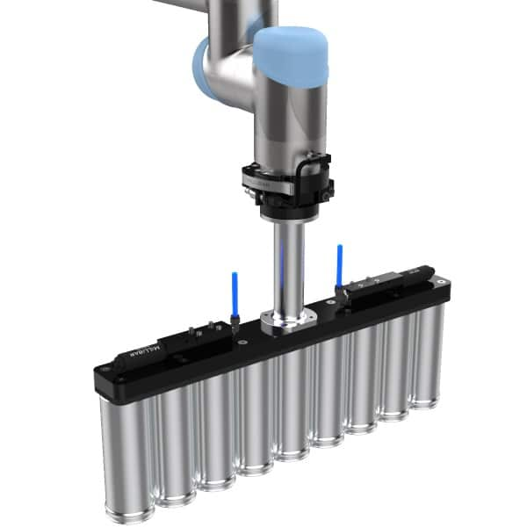
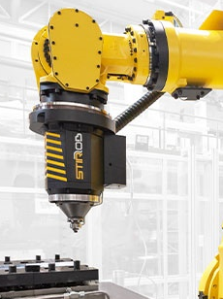
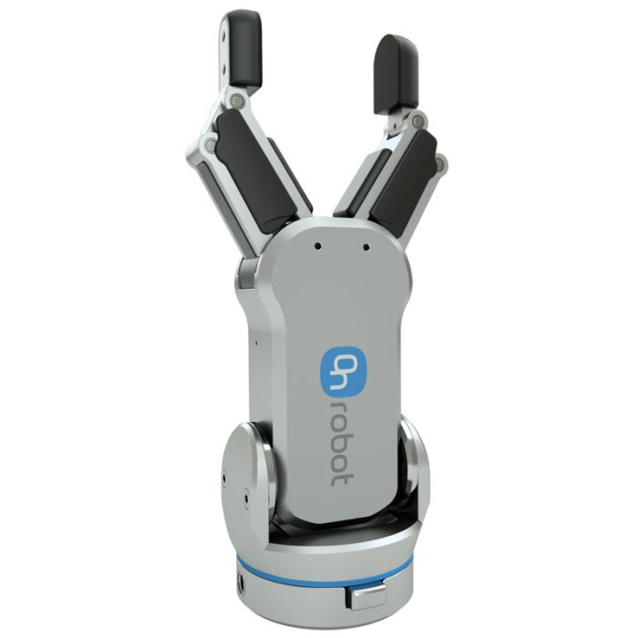
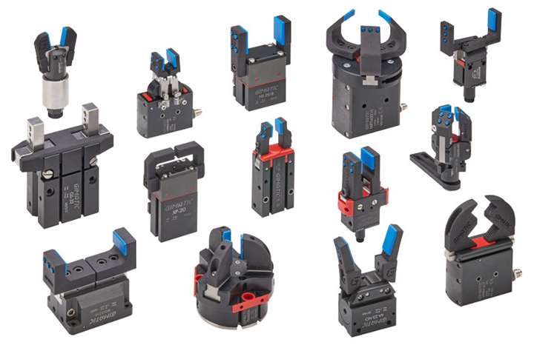
Articulated Robots
As with most robots, an end-of-arm tool (EOAT) is added to the end to increase functionality
Often, but not limited to, a gripper
https://millibar.com/wp-content/uploads/vacuum-pick-head-for-aluminum-tubes-18x2-inch-aluminum-extension-millibar-custom-end-of-arm-tooling-600px.jpg
https://www.tthk.ee/inlearcs/wp-content/uploads/2020/11/Picture-72.png
https://toolbox.igus.com/wp-content/uploads/2023/10/end-effectors-in-robotics.png
https://www.emicorp.com/media/catalog/product/cache/0daeb07bb1d294c1f281fab47369d56a/l/g/lg-8201.jpg

Slide 31
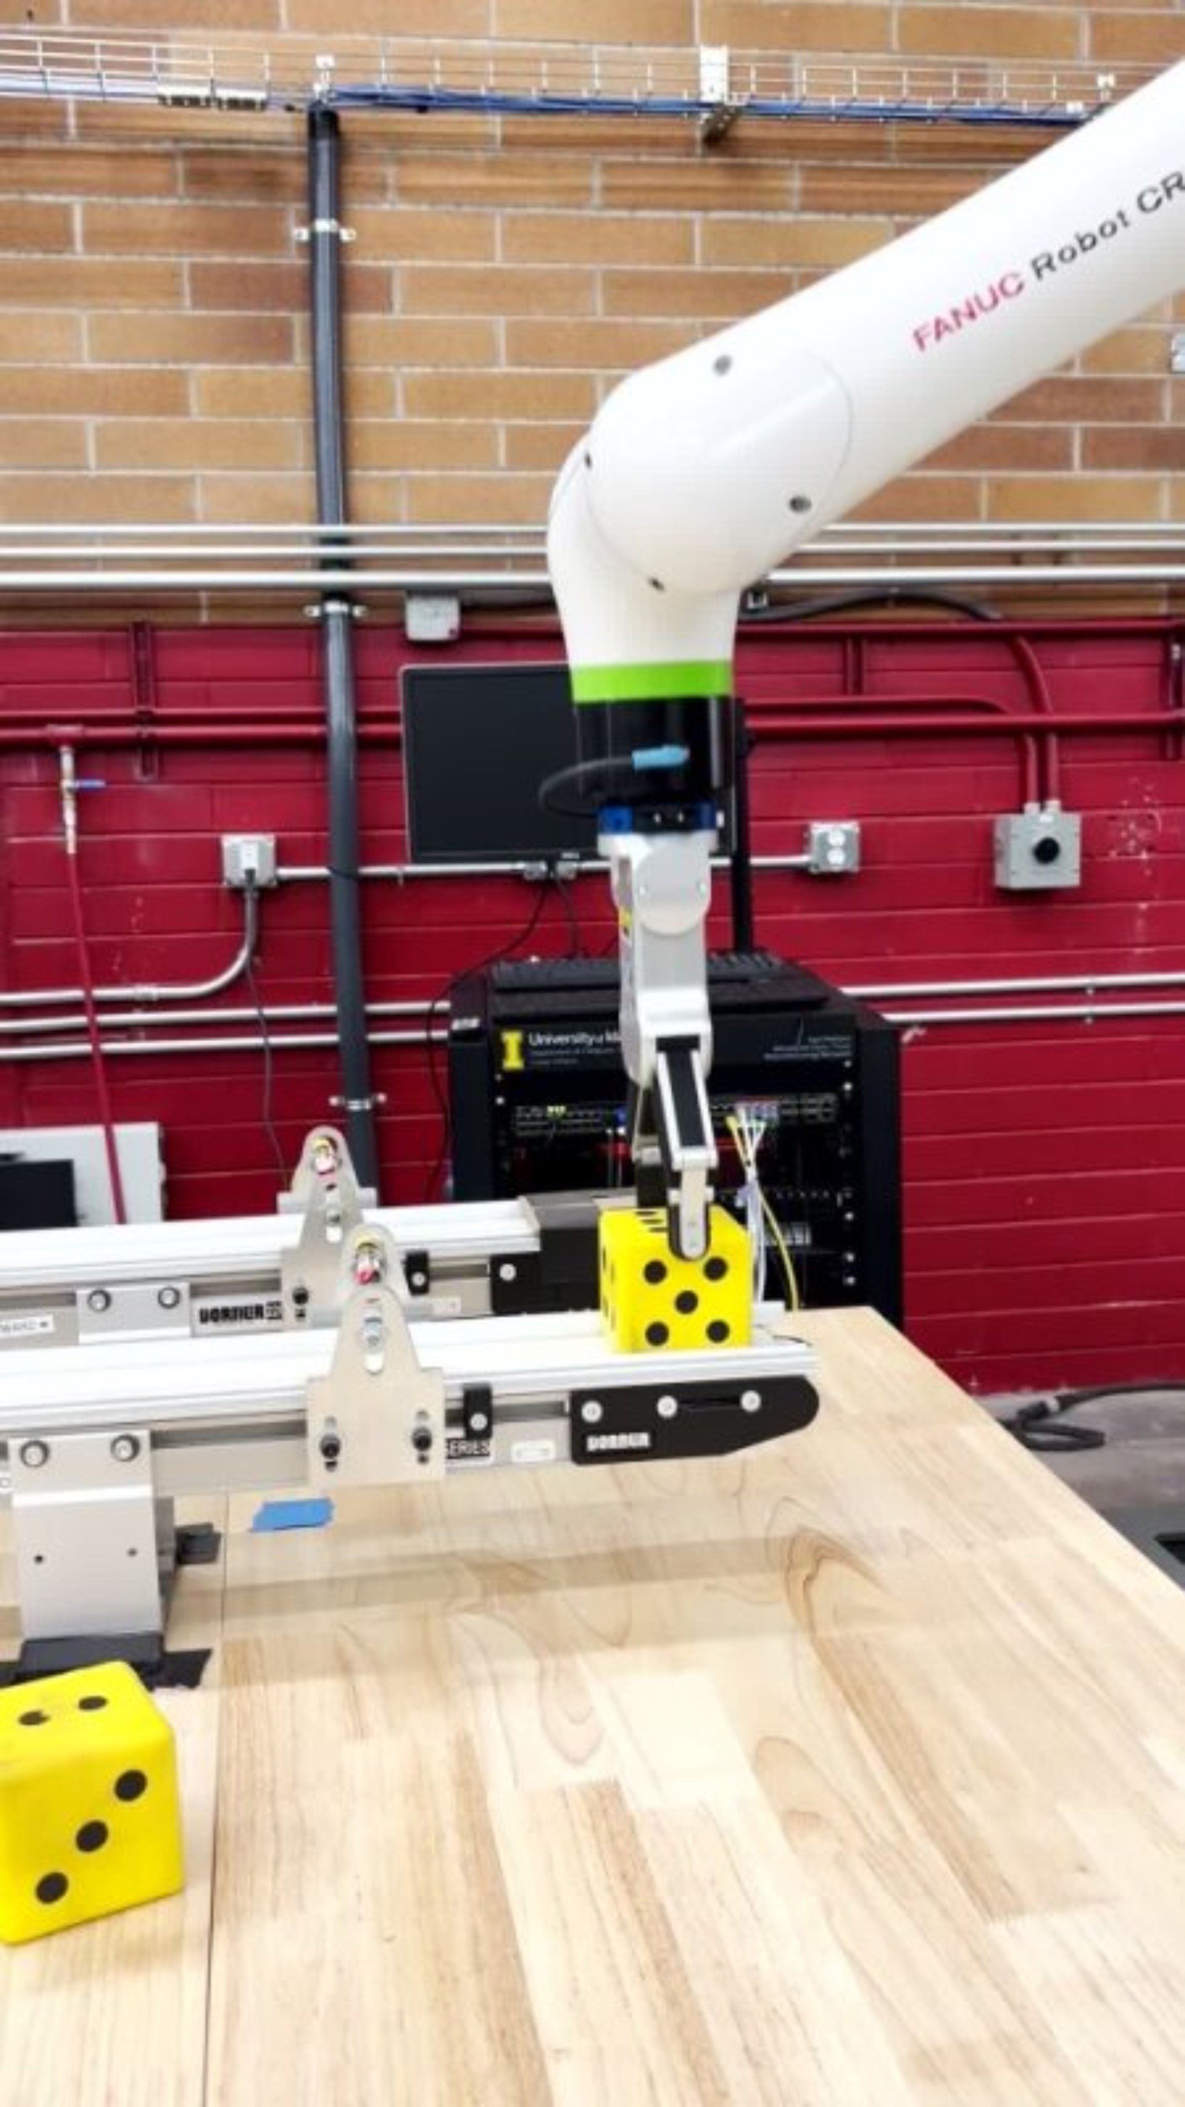
Articulated Robots
We will be using this type of robot in lab this week
Specifically, the FANUC CRX-10

Slide 32
Articulated Robots
What are some limitations of this type of robot?
Specialized programming
Singularities
Unpredictable path
Etc...
https://d16ohktstcjvly.cloudfront.net/image/513891251684/image_2jpmakctih2bd5pq8eo0d5l60d/-T1%3A1.2-FJPG

Slide 33
Other types
There are many other types of robots. Today, we are going to look at and discuss these five types:
Humanoid Robots
Gantry Robots
SCARA Robots
Articulated Robots
Cobots

Slide 34
Cobots
Finally, Collaborative Robots (cobots for short) are robots that are safe for humans to work around without protective cages
They have safety sensors in each joint that detect resistance and stop all movement if it crosses some threshold
They are not 100% safe, you can still hit your head and they can still drop things
But much safer than no sensing at all

Slide 35
Other types
There are many other types of robots. Today, we are going to look at and discuss these five types:
Humanoid Robots
Gantry Robots
SCARA Robots
Articulated Robots
Cobots

