Slide 1
Lab Safety

Slide 2

Overview
Lab Hazards
The Manual
Cobot
Non-cobot
Safety Equipment
First Aid kits
Eye wash stations
Fire extinguishers
Emergency procedures
E-STOPS
Emergency exits
Lab areas
Food and drink policy

Slide 3
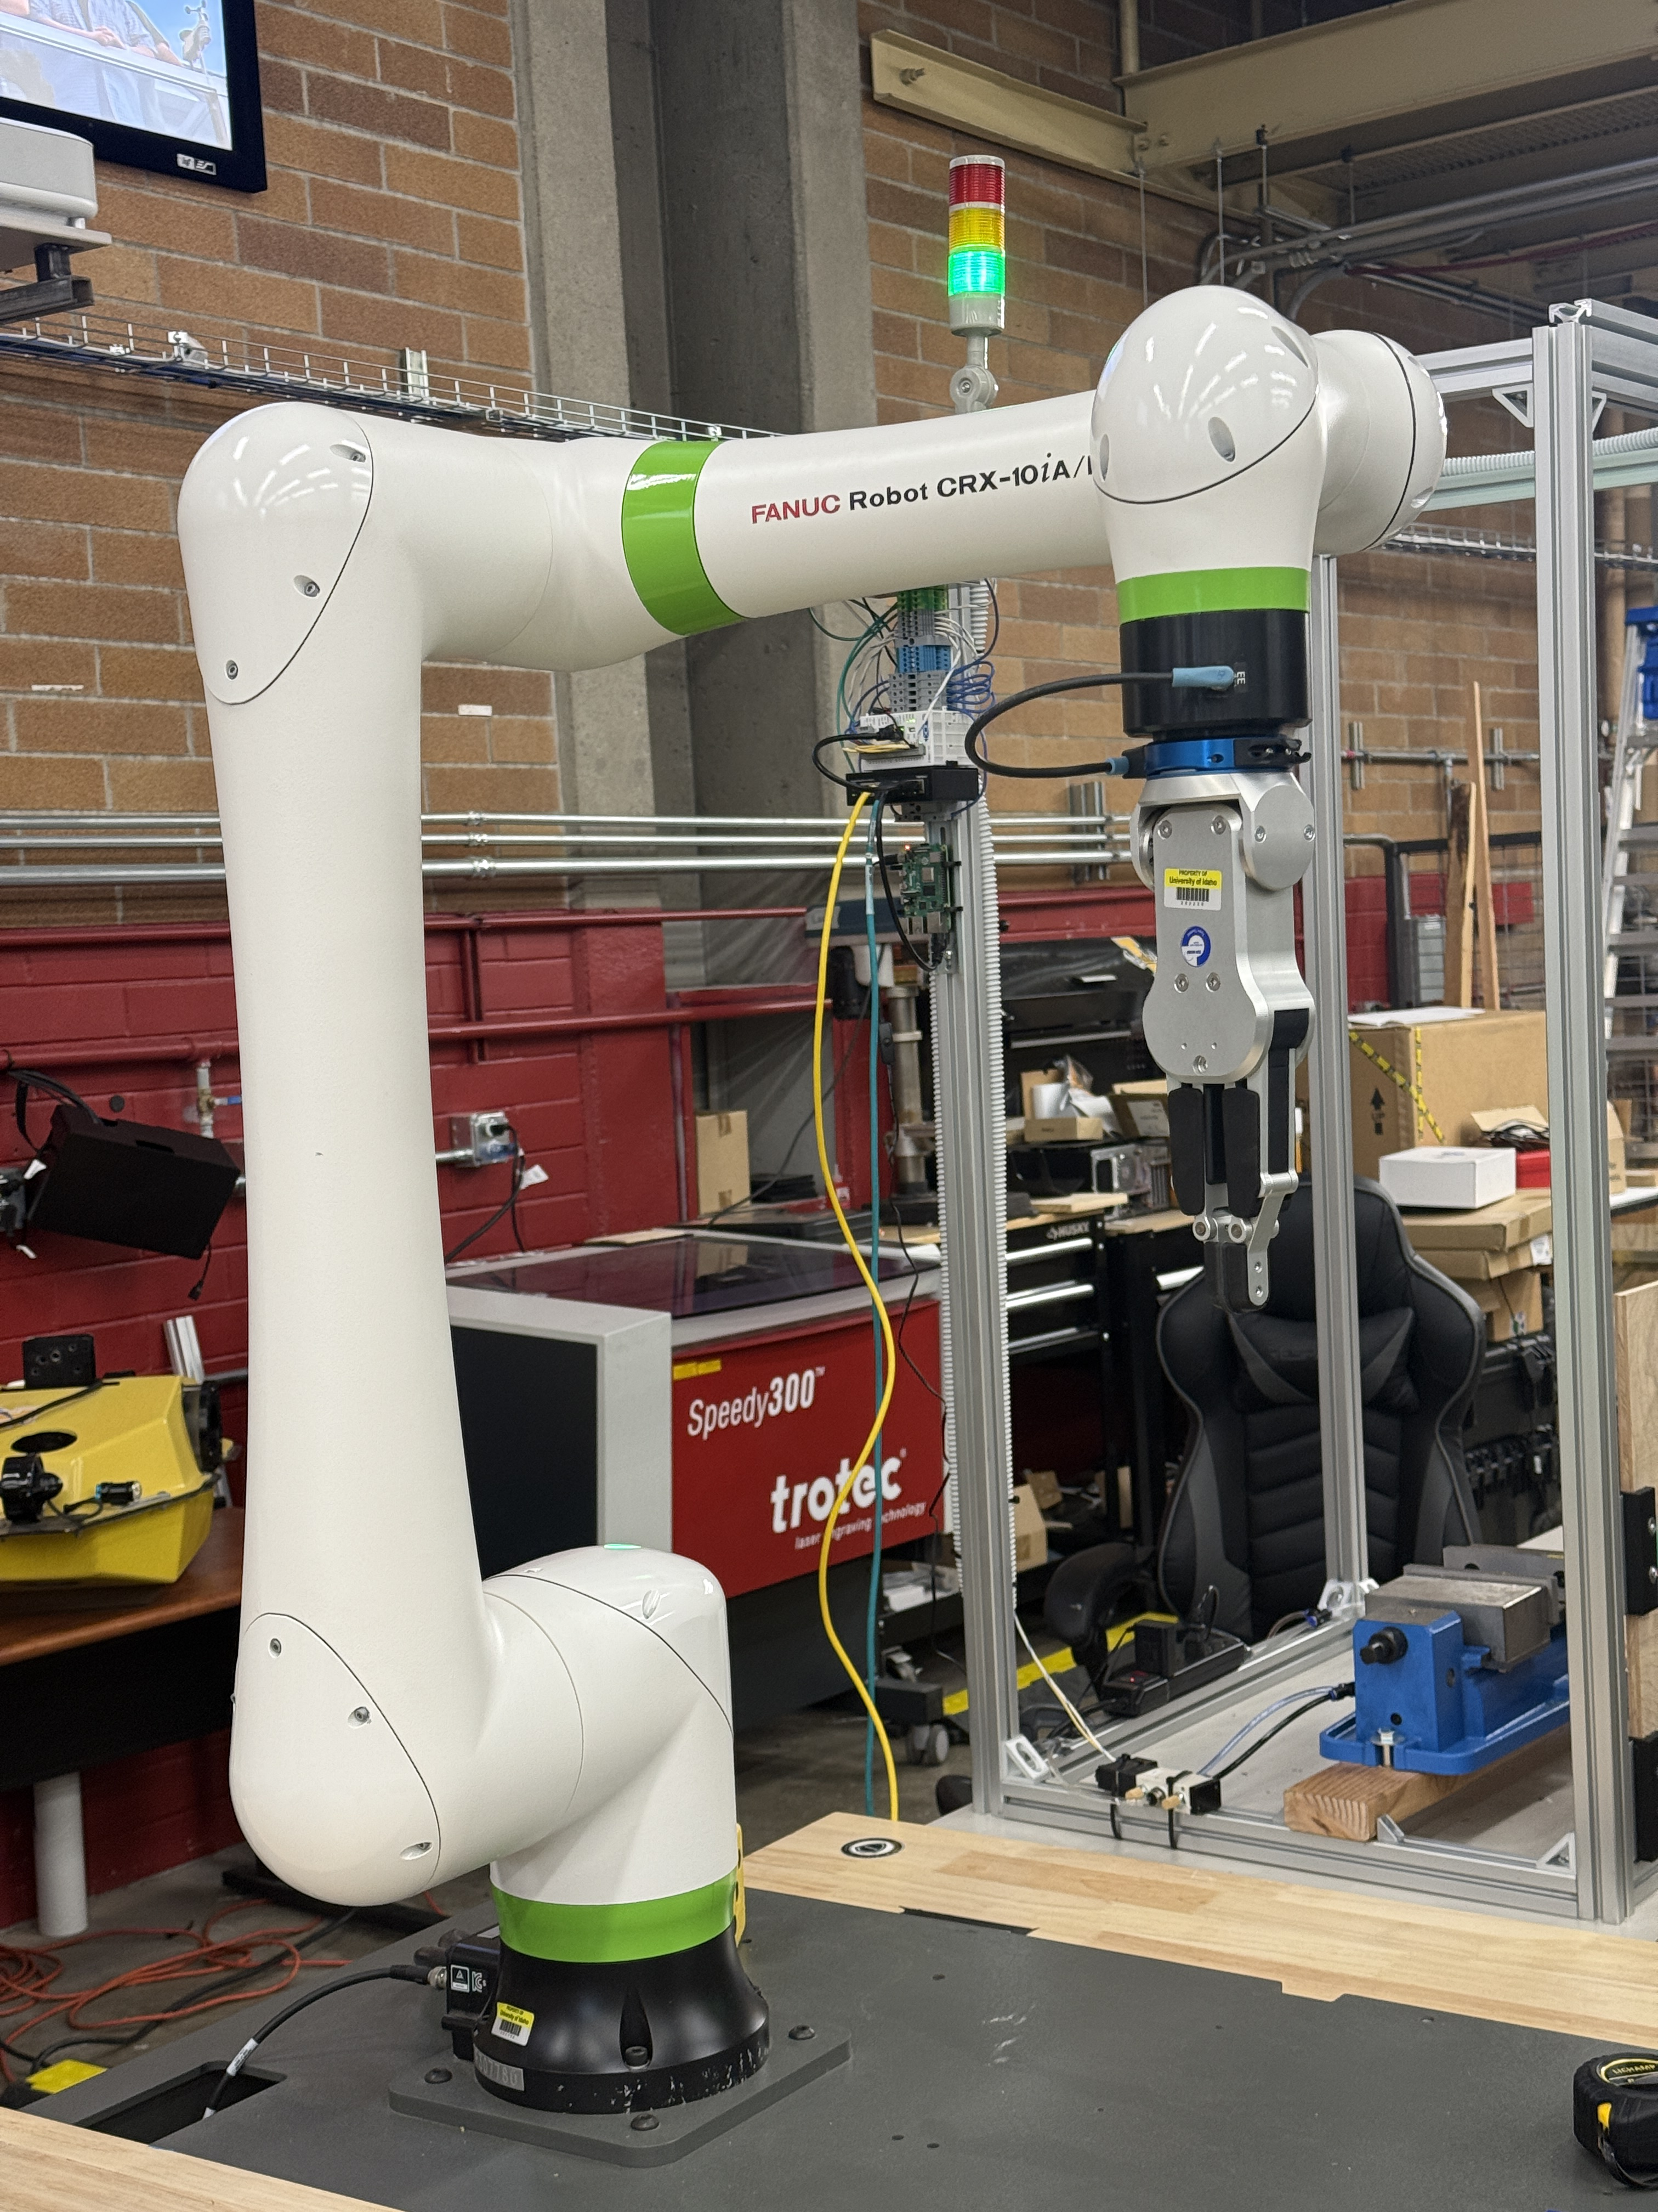
Lab hazards
Cobots
Most of the robots in the lab are cobots
Designed to work around humans
Wear eye protection when in robot’s area
Ask if unsure of robots reach
Can still pinch, even at low speeds

Slide 4
Lab hazards
Non-cobots
We also have several non-cobot robots
NOT designed to work around humans!
Must be enclosed behind protective barriers, light curtains, etc.
DO NOT enter their area when powered on
DO NOT leave cages unlocked

Slide 5
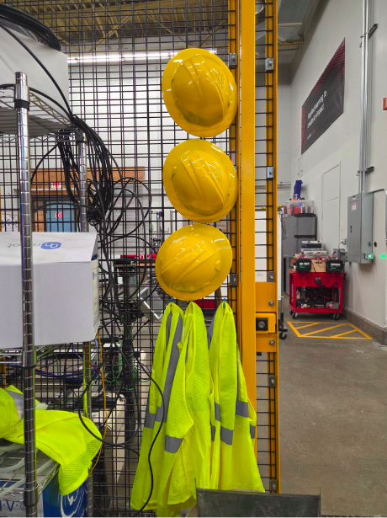
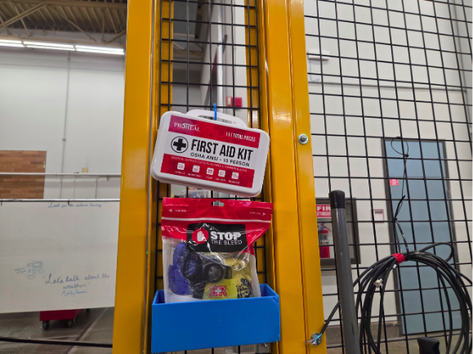
Safety equipment
First aid and trauma kits located next to west cage door
Head protection and high-visibility apparel located next to west cage door

Slide 6
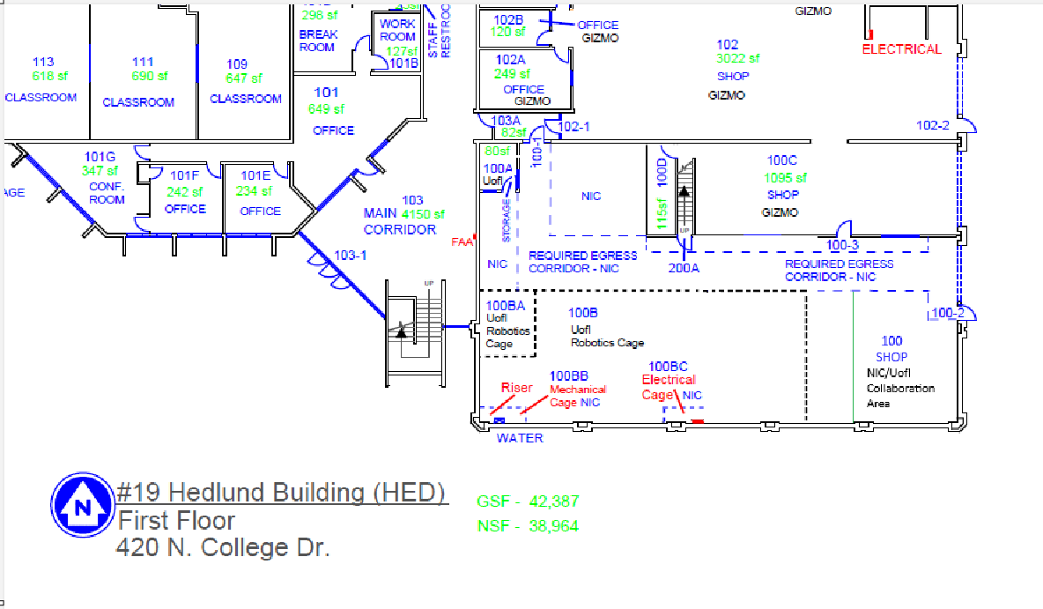
Emergency exits

Slide 7
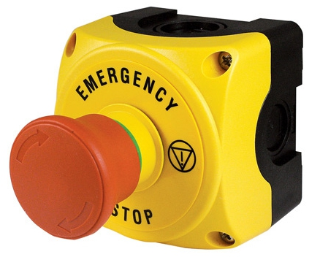
E-stop
WHEN IN DOUBT, PRESS!!!

Slide 8
Food and drink
No food or drink in the lab areas

Slide 9
Tables
Column 1 | Column 2 | Column 3
Basic Gold
Column 1 | Column 2 | Column 3
Basic Black
Column 1 | Column 2 | Column 3
Alternating Rows Gold
Column 1 | Column 2 | Column 3
Alternating Rows Black
Column 1 | Column 2 | Column 3 | Column 4
Alternating Columns Gold
Column 1 | Column 2 | Column 3 | Column 4
Alternating Columns Black

Slide 10
Tables
Row 1 | First Column Gold
Row 2
Row 3
Row 1 | First Column Black
Row 2
Row 3
 | Column 1 | Column 2 | Column 3
Row 1 | Header + First Column Gold
Row 2
Row 3
 | Column 1 | Column 2 | Column 3
Row 1 | Header + First Column Black
Row 2
Row 3
 | Column 1 | Column 2 | Column 3
Row 1 | Adv. Gold/Black
Row 2
Row 3
TOTAL
 | Column 1 | Column 2 | Column 3
Row 1 | Adv. Black/Gold
Row 2
Row 3
TOTAL

Slide 11
Charts

Slide 12
Pie Charts

