Slide 1
Context Cart
An agentic retrieval-augmented product recommendation prototype
Author: [Name] | Institution: [Institution]
Local, reproducible, and usable without paid API keys
All catalogue products and attributes are synthetic.
1

Slide 2
Problem Statement
Shopping queries express intent, constraints, and preferences together.
A keyword match alone does not explain retrieval or consistently enforce a budget.
Goal: build a transparent, testable recommendation workflow.
2

Slide 3
Objectives
Implement five specialized agents under one orchestrator.
Support TF-IDF retrieval, metadata filtering, and context-aware ranking.
Show explanations, comparisons, trace, and measured baseline evaluation.
3

Slide 4
Existing System and Limitations
Keyword-only matching misses broader text matches and context.
No retailer catalogue, purchase history, or collaborative signals are available.
This demonstration therefore uses a labelled synthetic catalogue.
4

Slide 5
Proposed System
Streamlit UI and Python orchestration.
TF-IDF lexical retrieval and exact category metadata filter.
Weighted rank, explicit budget feasibility, catalogue-grounded explanation.
No LLM, dense embedding model, or vector database is implemented.
5

Slide 6
Architecture
Shopper query and explicit settings → five-agent orchestrator.
Synthetic CSV → validation → in-memory TF-IDF index.
Retrieved evidence → ranking → explanation and trace.
Seven editable Mermaid diagrams are included in docs/diagrams/.
6

Slide 7
Five Specialized Agents
1. Query Understanding: terms, category, and budget.
2. Customer Context: explicitly provided preferences and channel.
3. Product Retrieval: TF-IDF scores and catalogue evidence.
4. Recommendation and Ranking: transparent weighted factors.
5. Explanation: reasons grounded in retrieved fields.
7

Slide 8
Dataset
120 deterministic synthetic product records; six categories.
Fields include price, brand, description, specifications, rating, stock, and channel.
No actual retailer records, customers, or consumer reviews.
8

Slide 9
Methodology
TF-IDF unigram/bigram product text and cosine similarity.
Rank = 0.50 relevance + 0.20 rating + 0.15 budget + 0.10 availability + 0.05 explicit preference.
Preference averages preferred-brand and selected-channel match.
Over-budget items excluded when at least one in-budget candidate exists; labels are synthetic categories.
9

Slide 10
Application Workflow
Search: natural-language query and context controls.
Inspect recommendation rationale, five-agent trace, and retrieved evidence.
Compare two or more products using available catalogue fields.
Actual screenshot not captured in this run; this slide describes the implemented workflow, not a screenshot.
10

Slide 11
Output 1: Recommendation
Query: Lightweight wireless headphones for travel under 3000
Northstar Headphones 13: ₹1771, rating 4.4/5
Northstar Headphones 01: ₹900, rating 3.2/5
Pioneer Headphones 03: ₹1762, rating 4.6/5
See outputs/examples/recommendation.json for all ranked products, explanations, context, and trace.
11

Slide 12
Output 2 and 3: Compare and Explain
Northstar Headphones 13 | Northstar | ₹1771 | 4.4/5 | In stock
Northstar Headphones 01 | Northstar | ₹900 | 3.2/5 | Limited stock
Context and retrieved evidence are saved in outputs/examples/context_explanation.json.
Advantages and limitations are restricted to synthetic catalogue data.
12

Slide 13
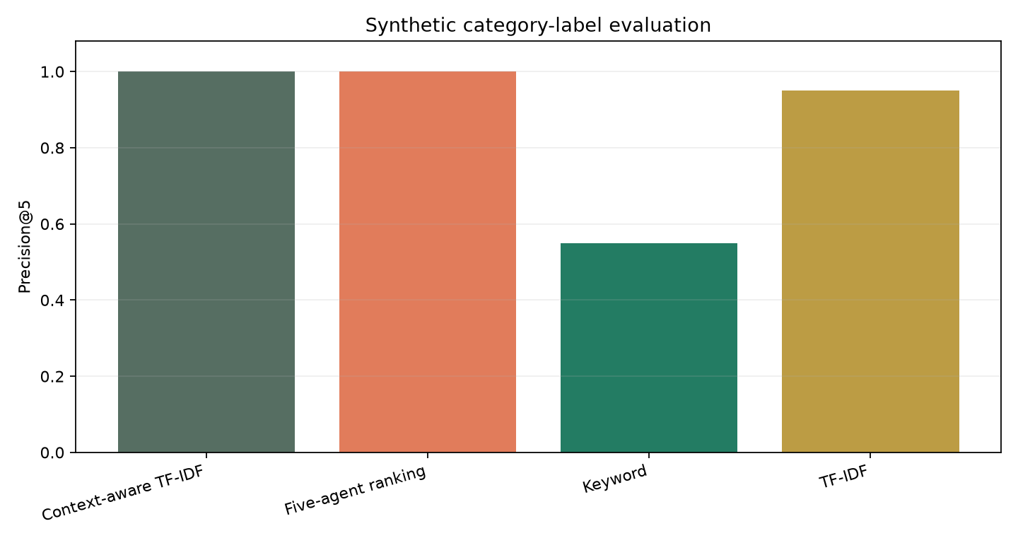
Evaluation Results
Context-aware TF-IDF: P@5 1.000, R@5 0.250, budget 0.650
Five-agent ranking: P@5 1.000, R@5 0.250, budget 1.000
Keyword: P@5 0.550, R@5 0.138, budget 0.500
TF-IDF: P@5 0.950, R@5 0.237, budget 0.600
Four synthetic intents; category relevance labels, no human judgments.
Single local timing run; not a controlled benchmark.
13

Slide 14
Limitations and Future Scope
No LLM, vector DB, licensed real catalogue, or retailer integration.
Category labels make retrieval metrics optimistic and limited.
Next: human relevance labels, realistic licensed data, fairness review, and controlled ablations.
14

Slide 15
Conclusion and References
Runnable, tested, inspectable local recommendation baseline.
Measured results are implementation checks, not real-world performance claims.
Salton & Buckley (1988); Ricci et al. (2015); Lewis et al. (NeurIPS 2020).
See paper/ieee_paper_draft.md for the editable reference list and submission caveats.
15

