Slide 2
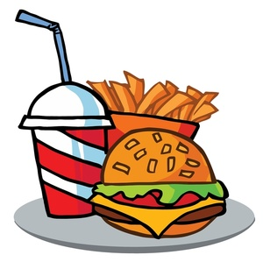

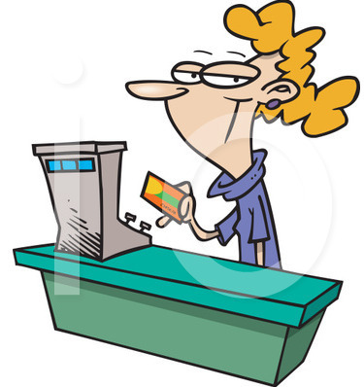
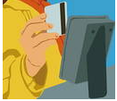


Slide 3

DATA

Slide 4

Me spend how much?
Consumer trends?

Slide 5

Why you no use this data?

Slide 6


Slide 7
The Foodie

Slide 8


