Slide 1



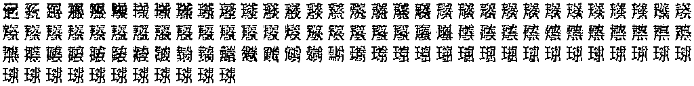

Input presentation and image-answer transfer
a
b
c
Exact-answer gain: 12.5 percentage points (95% interval 0 to 25).
Both-correct change: -6.25 points (-18.75 to 0). Both intervals include zero.
d
Same full passages and weights; zero new updates
Both erased controls: 0/32 exact in each layout
Inherited visual/contextual body: 7.522B parameters
Registered answer-retention requirement failed
e Complete original outputs
Fixed cells
Proportional
Area: lost readable answer
Location: exact retained
Quantity: newly exact
Examples selected retrospectively after complete scoring. All original pixels retained.
One model reviewer with prior cohort familiarity; no independent human adjudication.
Notes:
Sources: references/evidence/glyph_tail_compact_learning_20261111.json and glyph_tail_input_presentation_learning_20261111.json. Same 32 questions, sixteen paired passage groups, fixed weights and actual emitted-pixel feedback, 128-glyph cap. Both complete cohorts and erased controls retained. Strict complete canonical matching requires a natural stop; noncanonical wording is not automatically semantically false. Pointwise 95% intervals use 10,000 paired whole-passage-group bootstrap draws, seed 202611154. Reused development cohort, no independent seed or untouched confirmation. The single successful fixed-cell pair is lost under proportional presentation; the area output loses whole readability. The displayed location remains exact, and the displayed quantity is a new exact answer. These three examples were chosen after scoring to expose that tradeoff; original complete PNGs are embedded without reconstruction, cropping or raster resampling, with a common physical scale per matched row. No new training or language-learning curve. The retained larger inherited body does not establish compact-model parity or a matched-quality efficiency advantage.

