Slide 1
Conditional generation of visible language
a Training
60 visible glyph images
Frozen causal reader
Continuous visual history
384 state + 1024 image field
History conditions every residual scale
Four noisy future cells
Independent or shared noise levels
Conditional strip denoiser
FiLM and cell attention
Velocity and visual losses
5.90M trainable parameters
b Inference
Noise and visible history
32-level reverse process
Four output images
Append pixels to next context
Source: V53 frozen protocol, implementation and locked audit. Schematic objects are editable.

Slide 2
Direct block generation under paired visual histories
Identity (%)
256 prefixes, one primary sample each, four output cells
Ordered block identity 0.586%, shuffled 0.488%, zero condition 0.195%
Source: locked V53 development report. Native chart includes its editable evidence workbook.

Slide 3
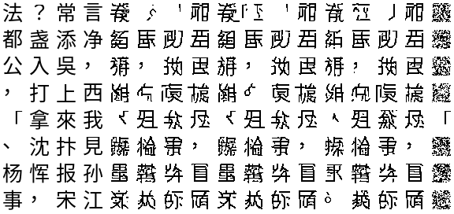
Unselected output images expose the language error
Target (4)
Ordered (4)
Shuffled (4)
Zero condition (4)
Plan
Fixed first eight audit rows. Pixels are model output, with nearest-neighbour enlargement. No glyph replacement.

Slide 4
Exact raster likelihood preserves a visible copy path
64 writing images
Frozen 16.28M reader
Continuous visual state
Hidden384 + image field1024
Fixed inverse field
Aligned signed pixel plan
Training: exact Bernoulli image NLL
Earlier target rows
Four-layer row transformer
Earlier pixels within row
Strictly masked MADE
Aligned logit + residual
Normalized next-image law
25% supplied-image motor exercises; 75% natural predicted conditions. No glyph inventory.
Inference: sample 1,024 causal pixels; append the visible raster to history
2.43M new density parameters; 18.71M total. Supplied-image copying is architectural, not language evidence.

Slide 5
Copying succeeds; autonomous language remains unresolved
Exact-image copying: 256/256 greedy. Autonomous target identity: 4/256 ordered, 3/256 shuffled.
Target NLL: 15.219 ordered; 15.254 shuffled nats/image
Paired advantage 0.0355 nat; source-record bootstrap 95% CI [-0.1014, 0.1693]
V54 locked development audit. Native chart and embedded workbook. Supplied-image controls reveal the answer.

Slide 6




Actual rasters: exact motor copying and failed continuation
Target
Supplied / greedy
Ordered / sample
Shuffled / sample
Ordered / greedy
First eight fixed audit rows; nearest-neighbour enlargement. No OCR, image replacement or selected examples.

Slide 7
Matched joint learning: better likelihood, incomplete generation
Exact target NLL: joint 7.026; matched frozen 7.579 nats/image
Paired gain 0.553; 95% source-record interval [0.450, 0.665]
Both arms retain exact supplied-image copying. Joint model passes 6/8 gates; generation remains unqualified.
V55 locked matched audit; 512 NLL targets, 256 single-sample prefixes. Native chart includes its editable workbook.

Slide 8




Raw matched output: exact copying and remaining language errors
Target
Frozen sample
Joint sample
Joint shuffled
Joint greedy
Supplied copy
First eight fixed audit rows, no selection. Pixels are actual output; no OCR, evaluator-bank replacement or external inference.

Slide 9
Clear glyphs and correct language are separate tests
Exact known-form gain, joint minus frozen: 10.156 percentage points
95% source-record interval [4.219, 16.240]; 256 saved first samples
The fixed 9,932-image bank is used only for evaluation. No image is repaired or replaced.
Post-result diagnostic; all original qualification decisions remain unchanged. Native chart includes its editable workbook.

Slide 10




Raw-pixel beam search: better immediate choice, repetitive output
2,048 prefixes: beam gain over greedy 3.369 points [2.351, 4.412]; over shuffled 1.758 [0.966, 2.552]
Observed-stream repetition: 0.112%; beam: 25.446%. Rollout gate fails; decoder rejected.
Observed future
Ordered beam
Shuffled beam
Original greedy
Unselected first two eight-step audit streams. Unchanged V55 weights; no vocabulary or repair. Both controls use highest FP32 precision.

Slide 11




Natural Chinese questions: some binding, inaccurate complete answers
Question-dependent F1 gain: 10.165 points [7.043, 13.371]
Exact answers: 10/256; both questions correct: 1/393 pairs. Four of seven gates pass; model rejected.
Q1
Q2
Reference 1
Copy
Blank question
No-copy
First two fixed audit rows; actual output images. White means zero emitted cells. All primary copy-arm answer cells use observed prompt images.

