Slide 1
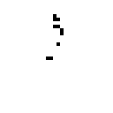

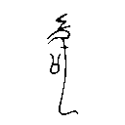


Historical forms through the glyph codec
a Reconstruction fidelity
b Source rasterization
32 × 32
64 × 64
128 × 128
B12643 retains 10 ink pixels at 32 × 32 and 407 at 128 × 128.
c Four-tile decoding
Source
Decoded
B12642
F1 0.883
Numbers in parentheses give the number of forms.
Supplied-image reconstruction through the fixed codec. Historical answer generation remains unmeasured.
Notes:
Source: references/evidence/historical_visual_evaluation_20261111.json. The panels show observed source and decoded pixels. B12643 and B12642 illustrate the sparsest input and lowest tall-crop F1.

