Slide 1
Compact V1: complete-answer evaluation
a
b
Visual model: 0/32 at every checkpoint
Text reference: 8/32; 95% interval 9.375% to 43.75%
Visual model: 0/16 at every checkpoint
Text reference: 2/16; 95% interval 0% to 31.25%
Pointwise passage-group intervals are [0, 0] for every visual-model point.
Constant observations do not imply a zero population success probability.
c
Empty responses, included above: 9, 9, 8, 2, 2 of 44 at successive checkpoints.
All 372 outputs retained. One model-based visual review; no independent human adjudication.
Training completion and stopping do not establish readable language generation.
Notes:
Sources: /home/lachlan/ProjectsLFS/ImagizedLanguageModel/references/evidence/compact_visual_span_learning_20261111.json; /home/lachlan/ProjectsLFS/ImagizedLanguageModel/references/evidence/compact_visual_span_qwen_uncertainty_20261111.json. All values authenticate against the analysis CSV. Bootstrap resamples sixteen passage groups, 10000 replicates, seed 202611154. Book coherence is limited by unreadable whole-output transcriptions. The reference ran on CPU; no matched-quality efficiency claim.

Slide 2

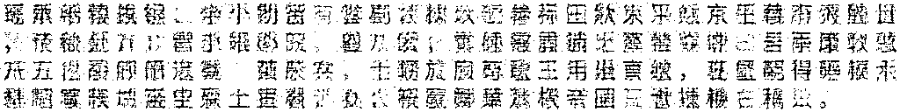
Fixed QA question A: raw outputs
Visible input: last three rows; the complete source PNG is retained in the evidence
Update 0 0 glyphs predicted stop (blank output)
Update 1,956 60 glyphs predicted stop
Update 4,049 11 glyphs predicted stop
Update 6,152 70 glyphs predicted stop
Update 8,172 126 glyphs predicted stop
The first QA pair and first book prefix were fixed before fitting. All five outputs are shown.
Original answer PNGs are embedded without cropping, reconstruction, OCR replacement or repair.
Notes:
Source: /home/lachlan/ProjectsLFS/ImagizedLanguageModel/references/evidence/compact_visual_span_learning_20261111.json. Case qa_01_a_normal. This figure contains the exact original answer PNGs bound by the source receipt. Only the identified input preview is cropped; its full PNG remains in the evidence directory. Model outputs failed complete-response review; recognizable individual glyphs do not supply a complete answer.

Slide 3
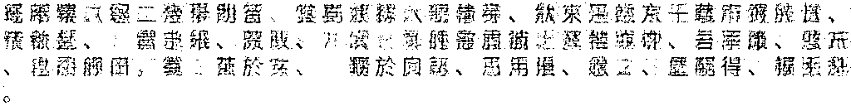
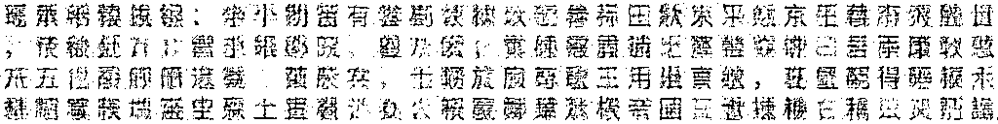
Fixed QA question B: raw outputs
Visible input: last three rows; the complete source PNG is retained in the evidence
Update 0 21 glyphs predicted stop
Update 1,956 60 glyphs predicted stop
Update 4,049 11 glyphs predicted stop
Update 6,152 97 glyphs predicted stop
Update 8,172 128 glyphs generation budget reached
The first QA pair and first book prefix were fixed before fitting. All five outputs are shown.
Original answer PNGs are embedded without cropping, reconstruction, OCR replacement or repair.
Notes:
Source: /home/lachlan/ProjectsLFS/ImagizedLanguageModel/references/evidence/compact_visual_span_learning_20261111.json. Case qa_01_b_normal. This figure contains the exact original answer PNGs bound by the source receipt. Only the identified input preview is cropped; its full PNG remains in the evidence directory. Model outputs failed complete-response review; recognizable individual glyphs do not supply a complete answer.

Slide 4
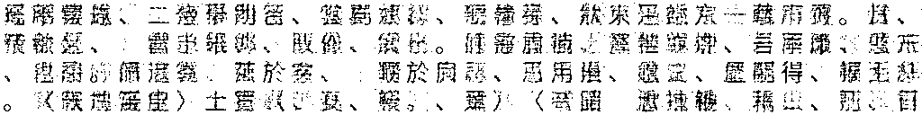
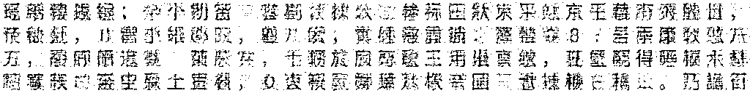
Fixed book continuation: raw outputs
Visible input: last three rows; the complete source PNG is retained in the evidence
Update 0 0 glyphs predicted stop (blank output)
Update 1,956 0 glyphs predicted stop (blank output)
Update 4,049 0 glyphs predicted stop (blank output)
Update 6,152 128 glyphs generation budget reached
Update 8,172 128 glyphs generation budget reached
The first QA pair and first book prefix were fixed before fitting. All five outputs are shown.
Original answer PNGs are embedded without cropping, reconstruction, OCR replacement or repair.
Notes:
Source: /home/lachlan/ProjectsLFS/ImagizedLanguageModel/references/evidence/compact_visual_span_learning_20261111.json. Case book_01_normal. This figure contains the exact original answer PNGs bound by the source receipt. Only the identified input preview is cropped; its full PNG remains in the evidence directory. Model outputs failed complete-response review; recognizable individual glyphs do not supply a complete answer.

