Slide 1
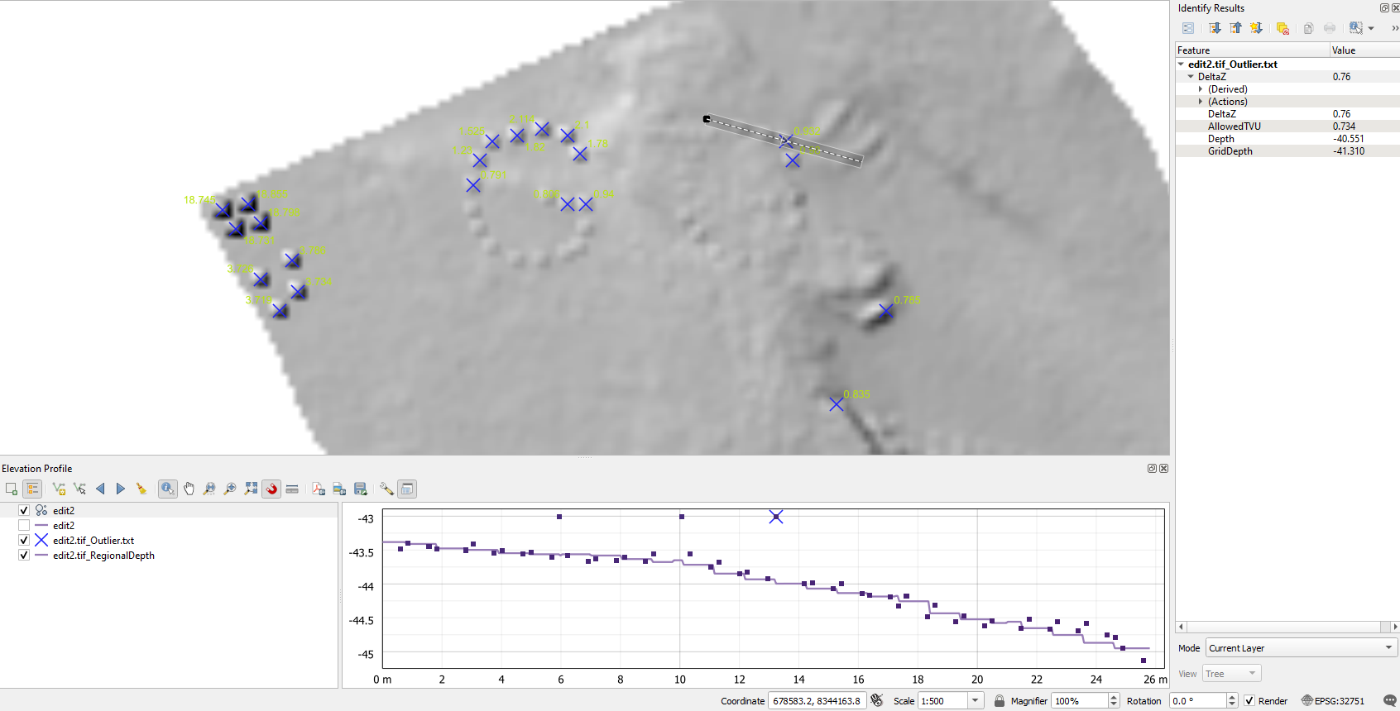
KMALLCLEAN

Slide 2
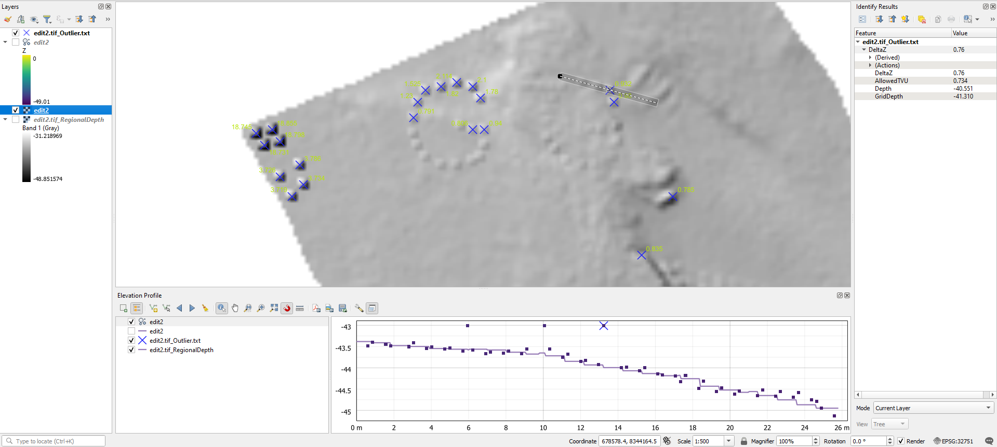

Slide 3
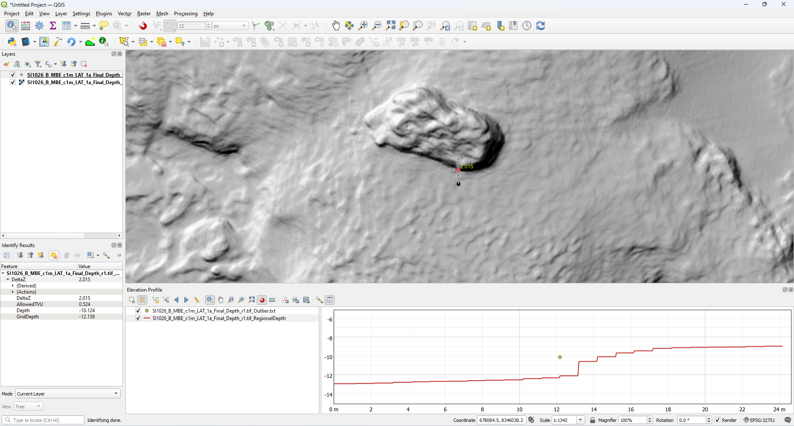
GGFindOutlier

Slide 4
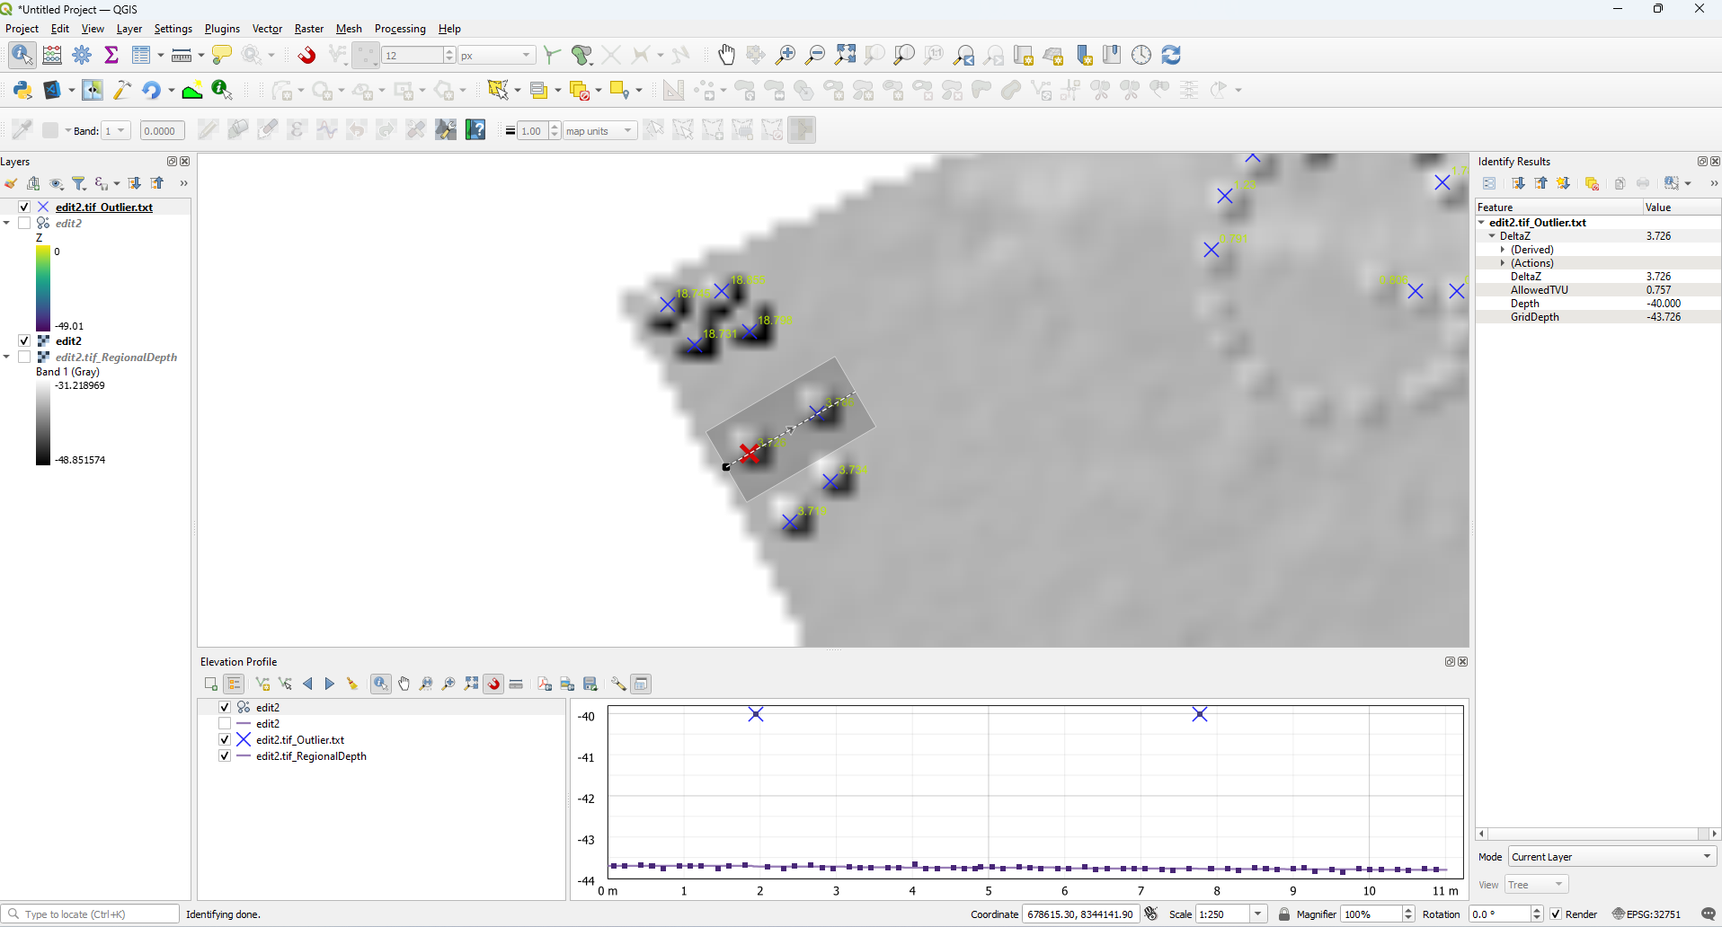
GGFindOutlier

Slide 5
GGFindOutlier
python c:\ggtools\kmallclean\ggfindoutlier.py -epsg 32751
configuration: Namespace(epsg='32751', inputfile='', odir='NearestNeighbours_20_OutliersPercent_0.10_zscale_1.00', numpoints='20', outlierpercentage='0.1', zscale='1.0', standard='order1a', debug='-1')
Output Folder: Y:/Subsea-Cloud/ggtools/kmallclean/TIFF2\NearestNeighbours_20_OutliersPercent_0.10_zscale_1.00
Processing file: Y:/Subsea-Cloud/ggtools/kmallclean/TIFF2/SI1026_B_MBE_c1m_LAT_1a_Final_Depth_r1.tif
Cleaning to IHO Standard: order1a
EPSGCode for geodetic conversions: 32751
Band1 has shape (11989, 7180)
lons shape (86081020,)
Loading Point Cloud...
Depths loaded for cleaning: 30,555,522
Understanding your data noise levels...
Current filter Nearest Neighbours 20
Current filter StdDEv 50.00
Percentage rejection 0.00
Filter level increasing to reject a few more points...
Current filter Nearest Neighbours 20
Current filter StdDEv 25.00
Percentage rejection 0.02
Filter level increasing to reject a few more points...
Current filter Nearest Neighbours 20
Current filter StdDEv 12.50
Percentage rejection 0.15
Filter level decreasing to reject a few less points...
Current filter Nearest Neighbours 20
Current filter StdDEv 18.75
Percentage rejection 0.08
Points accepted by machine learning: 30531793.00
Points tagged for further evaluation: 23729.00
Clean Duration: 111.421 seconds
Creating raw laz file of input raw points: Y:/Subsea-Cloud/ggtools/kmallclean/TIFF2\NearestNeighbours_20_OutliersPercent_0.10_zscale_1.00\SI1026_B_MBE_c1m_LAT_1a_Final_Depth_r1_R.txt
Created REGIONAL TIF file for IHO validation: Y:/Subsea-Cloud/ggtools/kmallclean/TIFF2/NearestNeighbours_20_OutliersPercent_0.10_zscale_1.00/SI1026_B_MBE_c1m_LAT_1a_Final_Depth_r1_R.laz
Created REGIONAL LAZ file of input raw points: Y:/Subsea-Cloud/ggtools/kmallclean/TIFF2/SI1026_B_MBE_c1m_LAT_1a_Final_Depth_r1.tif
Points accepted: 30546737
Points outside specification: 8785
Percentage outside specification: 0.0288
Creating tif file... Y:/Subsea-Cloud/ggtools/kmallclean/TIFF2\NearestNeighbours_20_OutliersPercent_0.10_zscale_1.00\SI1026_B_MBE_c1m_LAT_1a_Final_Depth_r1.tif_Inlier.txt_Depth.tif
Creating tif file Complete.
Created LAZ file of inliers: Y:/Subsea-Cloud/ggtools/kmallclean/TIFF2/NearestNeighbours_20_OutliersPercent_0.10_zscale_1.00/SI1026_B_MBE_c1m_LAT_1a_Final_Depth_r1.tif_Inlier.laz
Created LAZ file of outliers: Y:/Subsea-Cloud/ggtools/kmallclean/TIFF2/NearestNeighbours_20_OutliersPercent_0.10_zscale_1.00/SI1026_B_MBE_c1m_LAT_1a_Final_Depth_r1.tif_Outlier.laz
Cleaning complete at: 2023-09-21 17:31:57.884053

Slide 6
Overview
What is KMALLClean?
Is a tool to automate the cleaning of raw MBES data in KMALL file format.
Computes a raw point cloud from the kmall file.
Uses machine learning to analyse the raw point cloud and determine the level of noise present
Cleans the largest outliers to a user-specified percentage of the file.

Slide 7
How do we control the cleaning process?
MBES data quality can be very inconsistent across projects, vessels, terrains, weather conditions and survey line direction.
A filter configuration which works well on one file, is often not suitable for another file.
KMALLclean analyses each file and makes an assessment of the noise level.
Using the user configuration of “percentage outliers to reject”, the engine rejects the most noisy outliers in the file.
By using a percentage rather than a ‘outlier threshold’ the filter only rejects the most noisy points, not everything beyond a threshold. This is a very different approach and permits the machine learning to adapt to the data in hand
If more points are required to be rejected, a higher percentage threshold should be specified.
If less points are required to be rejected, a lower percentage threshold should be specified.
On completion of outlier selection, an NEW kmall file is created.
The original kmall file is not modified in any way
The new file contains the same volume of data, same datagrams
The only modification is the beam quality flag which is set to rejected.
The original depths remain unchanged. This means they can easily be reviewed and re-accepted in CARIS if required.

Slide 8
How to we assess the engine performance?
We have compared the results of the engine with manual cleaning. The results are quite similar to manual cleaning, but not identical.
Testing has demonstrated manual cleaning is very inconsistent. Different processing personnel never provide identical cleaned data. Even the same person cannot repeat the same cleaned result.
A better way to assess performance is to use the QAX tool find fliers. This is used to identify outliers in the processed TIF/BAG files following data processing.
QAX will find fliers but is not 100% accurate. On steep slopes, reefs, rocky seafloor it often reports false positives. The tool needs to be used as a guide, not as an absolute validation

Slide 9
Notes
Percent 0.1 is sensible
NN 3 is sensible
NN20 and NN10 have negligible differences
tatistical_outlier_removal removes points that are further away from their neighbors compared to the average for the point cloud. It takes two input parameters:
nb_neighbors, which specifies how many neighbors are taken into account in order to calculate the average distance for a given point.
std_ratio, which allows setting the threshold level based on the standard deviation of the average distances across the point cloud. The lower this number the more aggressive the filter will be.

