Slide 1
EspY3

Slide 2
Making a phylogenetic tree
BLASTp
General Search
n = 944
Mostly E. coli
12 Shigella (High % identity)
Filter: Escherichia albertii
n = 147
95% query coverage
30% identity
Merge outputs
Remove Shigella
Protect from clustering
CD-HIT
0.985% identity
80 clusters
MAFFT
trimAl
RAxML-NG

Slide 3
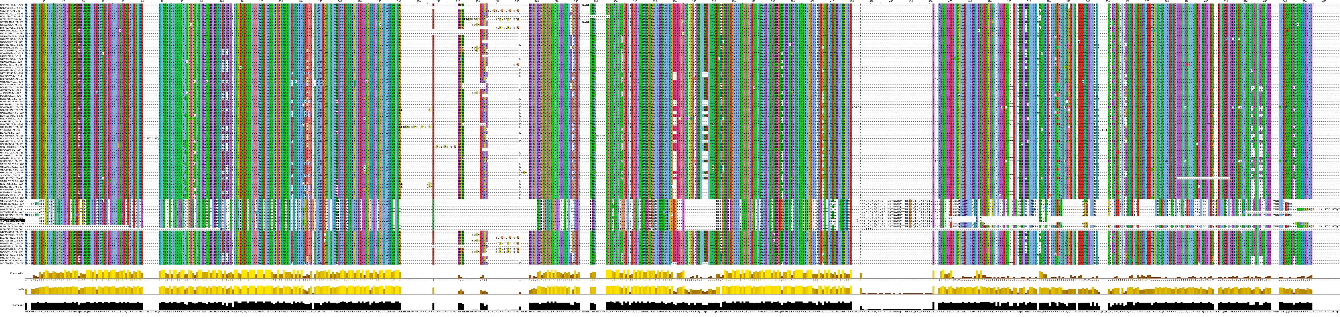
MSA
Gaps from insertions
In a few E. coli
homologues
Insertion in all E. albertii
sequences
E. Albertii sequences

Slide 4
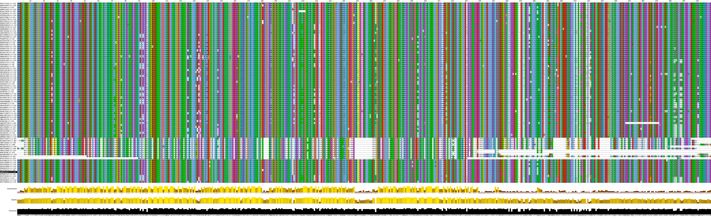
TrimAl

Slide 5
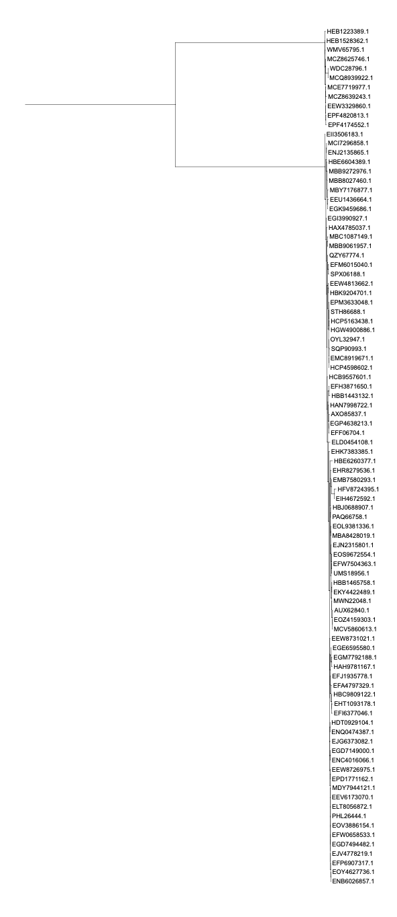
Maximum-likelihood tree
Maybe including E. albertii in the tree was not the best idea

Slide 6
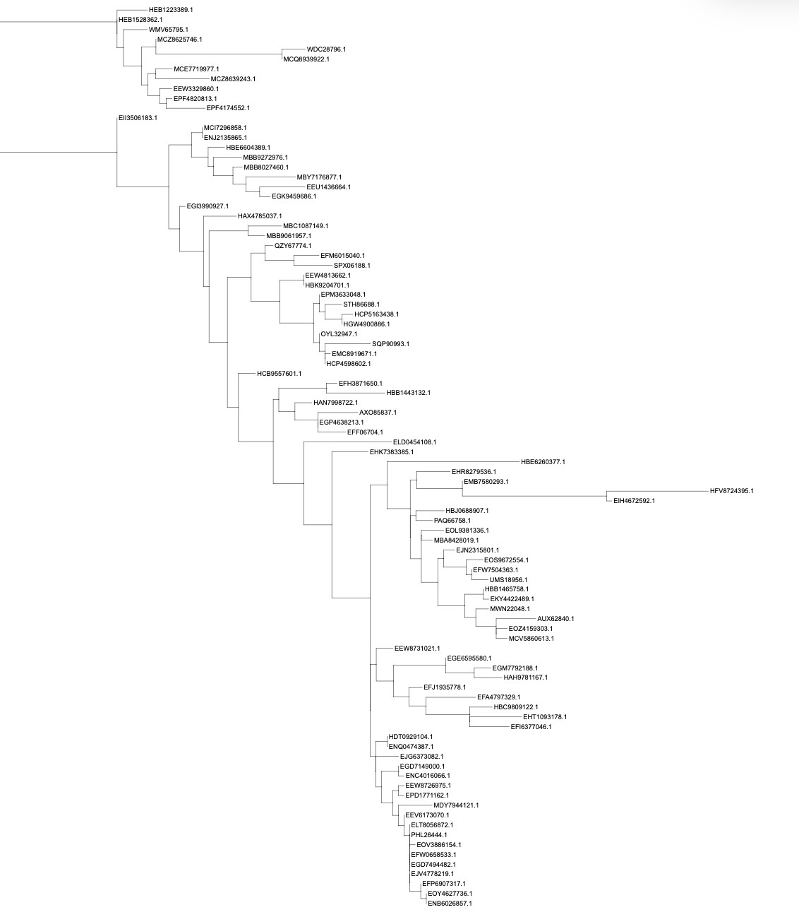
Scaling factor 50x gives a better view

Slide 7
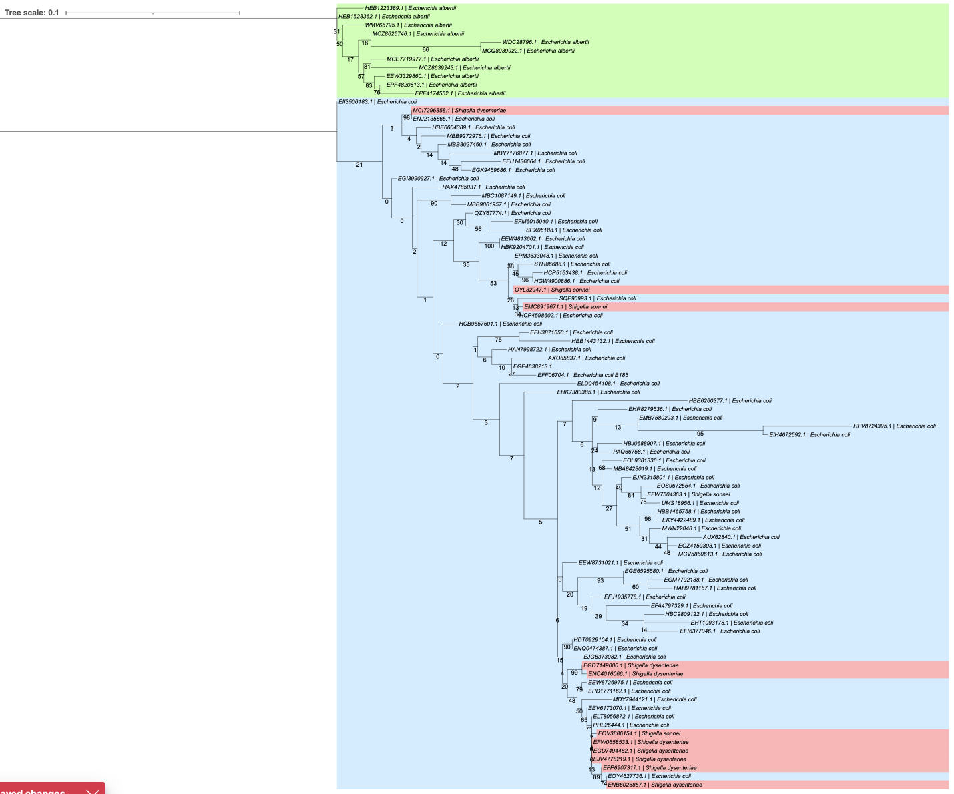
Annotated species
-

Slide 8
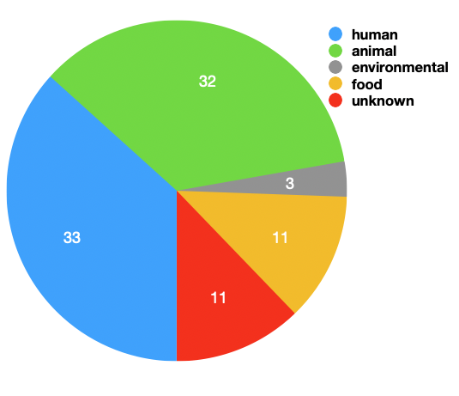
Homologue sources
TODO:
Annotate sources on tree
See if human isolates group together?

Slide 9
Structure and conservation mapping

Slide 10
Make a tree of the conserved PipB2 domain

