Slide 1
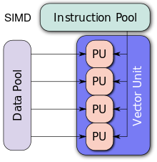

Single Instruction, Multiple Data
(SIMD)
From Concept to Code
Lachlan Kuhr - n9767151 &
Dhamar Haryadi - n10091769
CAB401 - SIMD
Notes:
Today we will be presenting on Single Instruction, Multiple Data - From Concept to Code.

Slide 2
Context
Where does SIMD fit in the overall scheme of things?
vs.
Task parallelism: multiple processors.
Data parallelism: multiple data operations.
SIMD: Single Instruction, Multiple Data.
Execute multiple instructions in the same CPU cycle [1].
Uses vector operations.
Instructions operate on 4 or 8 inputs, yielding 4 or 8 results depending on the SIMD implementation used¹.
Use cases:
Graphics: e.g. shading pixels with a coherent shader.
Physics: e.g. motion of atoms in potentials or particle dynamics.
Mathematics: e.g. matrix operations in general and linear algebra.
CAB401 - SIMD
¹ AVX512, available in Intel’s Knights Landing architecture, supports 16 inputs. This technology is not yet available in consumer level CPUs.
Notes:
Modern CPUs increasingly rely on parallelism to achieve peak performance. The most well-known form is task parallelism, which is supported at the hardware level by multiple cores, hyperthreading and dedicated instructions supporting multitasking operating systems. We heard about this from the previous presenters. Less known is the parallelism known as data level parallelism: the capability of a CPU to execute the same operation on multiple data points simultaneously, i.e., in the same cycle(s), in a single thread. This is achieved by instructions that operate on 4 or 8 inputs, yielding 4 or 8 results, often in a single cycle. This is known as SIMD: Single Instruction, Multiple Data.
Several examples of good candidates for vectorization by SIMD from different fields of science are:
Graphic
Physics
Mathematics
Generally, of course, anything that can be done in parallel mostly coherently with the same set of instructions is a candidate for vectorisation.

Slide 3
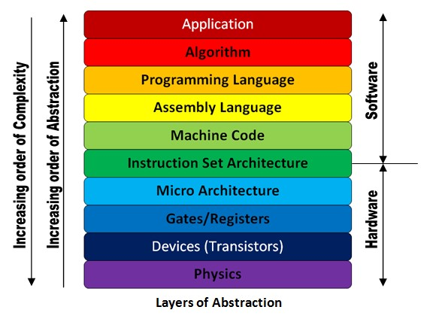
Overview: A bit more detail...
x86 is an instruction set architecture (ISA) that is introduced by Intel in 1978 [4].
Another example of ISA is ARM which is used for Arduino.
ISA is a middle man between hardware and software.
Instruction sets are not programming language.
SIMD are extensions to ISAs that use
vector operations.
ISA Role [2]
CAB401 - SIMD
Notes:
x86 is an instruction set architecture (ISA) that was introduced by Intel in 1978. The ISA is a middle man between hardware and software. It has memory addressing, interrupt handling, data type registers and I/O. Most importantly, it has instructions to be performed by the processor. SIMD implementations are extensions to ISAs that use vector instructions that operate on 1D arrays of data called vectors, compared to the scalar processors whose instructions operate on single data items.

Slide 4
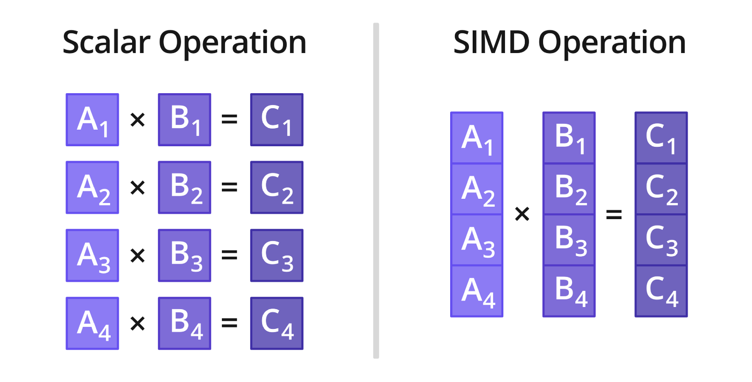
Overview: How does it work?
Typical scalar register stores 32 or 64 bits² [2].
SIMD register sizes depends on implementation and data type [2].
Perhaps four 32-bit single-precision floating point numbers (SSE).
Supported data types [5]:
sixteen 8 bit integer values
eight 16 bit integer values
four 32 bit integer values
four single precision floating point values
two double precision floating point values
(can be unsigned or signed)
Supported operations [5]:
Load and Store
Arithmetic operations
Logical operations
Shift operations
Pack and Unpack
Comparisons
Data type conversion
CAB401 - SIMD
² For the sake of simplicity, we ignore the fact that some registers can be split in 16-bit halves, or even in single bytes. Floating point numbers may be stored in 80-bit registers.
Notes:
A CPU uses registers to store data and to operate on them. We will see this when we look into the assembly code in a later section of this presentation. A typical register stores 32 or 64 bits, and holds a single scalar value which is operated on. This can be clearly seen in the scalar operation depicted above as it is sequentially operated on each register. SIMD engines usually work with wide registers (a typical number is 128 bits) that can contain several independent values (in the diagram, 4 numbers). A list of typically supported data types is provided in the slides. As a result, SIMD instructions can be seen as vector instructions. Data level parallelism is achieved by operations that can be conducted in parallel. A list of supported operations by SIMD implementations in given in the slides.

Slide 5
Overview: SIMD Implementations.
SIMD instructions can be found, to one degree or another, on most CPUs
IBM: AltiVec, Signal Processing Engine (SPE)
HP: MAX (Multimedia Acceleration eXtensions)
Intel: MMX (MultiMedia eXtension), SSE1-4 (Streaming SIMD Extensions), AVX (Advanced Vector Extensions)
The code examples presented in this lecture will be targeted at SSE.
Streaming SIMD Extension
SSE: 8 registers with each 128 bits wide
SSE-2: more data type support
SSE-3: DSP and thread management
SSE-4: dot product, string and text new instructions
CAB401 - SIMD
Notes:
SIMD is a concept - implementations are provided by processor producers.SIMD instructions can be found, to one degree or another, on most CPUs.
IBM’s AltiVec, Signal Processing Engine (SPE)
HP’s MAX (Multimedia Acceleration eXtensions)
Intel: MMX (MultiMedia eXtension), SSE1-4 (Streaming SIMD Extensions), AVX (Advanced Vector Extensions)
The code examples presented in this lecture will be targeted at SSE. SSE has had 4 revisions and the changes are noted in the slidess

Slide 6
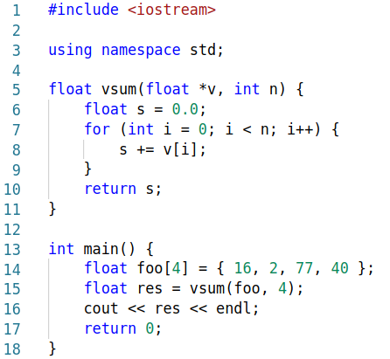
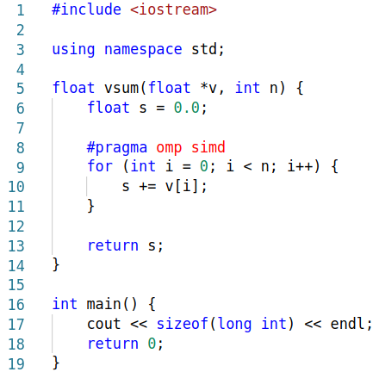
Overview: A simple example.
Using optimisation flag -O3.
Using APIs like OpenMP.
CAB401 - SIMD
Notes:
To demonstrate these concepts, let’s simply takes two arrays of four floating point numbers and add them together. This is done by “sequentially” adding them together and assigning within the loop on lines 7-9.
However, since level 3 optimisations have been selected, the compiler will notice that we are operating on 4-component vectors, and it will use SSE instructions to speed up the code. To get maximum throughput, we want four independent streams, running in parallel. You can also use APIs like OpenMP by placing directives #pragma omp simd.
However, life isn’t as simple as adding a flag to compilation or directive to code and getting performance gains of upwards of 4x. To leverage this compute potential, we can no longer rely on the compiler. Algorithms that exhibit extensive data parallelism benefit most from explicit SIMD programming.

Slide 7
Programming for SIMD
Assembly Language
SIMD Intrinsic Functions
Compiler-Dependent Vector Data Types
Domain Specific Language for SIMD Programming
SIMD Libraries
Auto-Vectorization
Lowest Level
Highest Level
CAB401 - SIMD
Notes:
Here the programming for SIM D methods. The lower levels have higher control, but they are harder to code while the higher levels are easier to code and more portable, but it does not have greater control over the desired parallelisation result. We’ll discuss some of them today.

Slide 8
Assembly SSE Instructions
SIMD SSE Assembly Instruction Examples
x1 | x2 | x3 | x4
+ + + +
movaps | move four aligned packed single-precision floating-point values between XMM registers or memory
addps | add packed single-precision floating-point values
divps | divide packed single-precision floating-point values
mulps | multiply packed single-precision floating-point values
y1 | y2 | y3 | y4
z1 | z2 | z3 | z4
Scalar Assembly
movss xmm1,x1
adds xmm1,y1
movss z1,xmm1
For each element of the 2 vectors
Assembly SSE :
movaps xmm0,x
addps xmm0,y
movaps z,xmm0
For all elements of the 2 vectors.
xmm : registers of x86 microprocessors with Streaming SIMD Extensions (SSE)
Notes:
Here’s Assembly SSE instructions. In SSE, we would use xmm register to store data. It is 128 bit wide.
For example, here we have 2 vectors x and y. In scalar assembly, we need to perform a move, add, move instruction for each of the element resulting in a total of 12 instructions.
The same operations can be applied to the 4 elements of each vector at the same time using assembly sse, consequently it will only generate 3 instructions, instead of 12 instructions.

Slide 9

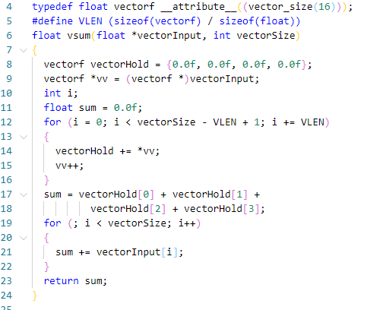
Compiler Dependent Data Types
Defining Data Types
Vector Data Types are compiler dependent but platform independent.
Ordinary arithmetic operations can be applied to these vector data types.
Sum of elements in a matrix
CAB401 - SIMD
Notes:
Vector Data Type. As an example, we will convert the previous code to add elements in a matrix using vector data types.
To do this, we define vector4f as vector of type float variables that occupies 16 bytes (128 bits) of contiguous memory.
On line 7, we assign array of 4 elements directly to the variable vector4f, and on line 8 we cast the vector that we’re going to sum as vector4f.
Inside the for loop, we add every 4 elements of the input vector with 4 elements inside vector4f variable vectorHold, that has the initial value of zeros
Then the for loop will increment by 4 and repeat the process again until the condition has passed.
After that in the line 15, we add each element of vectorHold which stores the sum of elements up to this point, then add the rest of the elements.

Slide 10
SIMD Intrinsics
SIMD SSE Assembly Instruction Examples
SIMD Intrinsics are compiler independent but platform dependent.
Each function has its corresponding assembly SIMD instruction.
Assembly | Intrinsic
movaps | _mm_load_ps
addps | _mm_add_ps
divps | _mm_div_ps
mulps | _mm_mul_ps
See all intrinsics available here :
https://software.intel.com/sites/landingpage/IntrinsicsGuide/
CAB401 - SIMD
Notes:
The other method is using Intrinsic Functions. Here, the compiler exposes all low-level SIMD operations through functions. Each function has its corresponding assembly SIMD instructions.

Slide 11
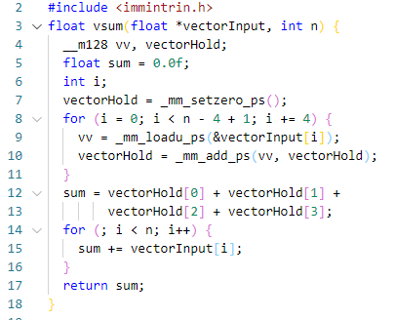
Sum of Elements in a Matrix using Intrinsic
data type that is stored in xmm register. 128 bit wide
vectorHold = {0.0f, 0.0f, 0.0f, 0.0f}
_mm_loadu_ps = Load Unaligned Packed Single-precision
add packed single-precision (32-bit) floating-point elements in vv and vectorHold, and store the results in vectorHold.
CAB401 - SIMD
Notes:
Here using intrinsic function, we convert the previous code. In line 4, we declare 2 vectors using intrinsic data type that can hold four 32 bits float values. We set the holding variable to zero on line 7.
The same as the vector data types method, inside the for loop, we would load each 4 elements of the input matrix to the m128 variable and then add them to the holding variable vs.
Then perform this operation until the condition of the loop has passed.
Then do the rest similar as the vector data type method

Slide 12
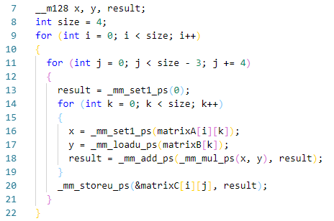
Matrix Multiplication using Intrinsic
iterate at steps of 4 due to SIMD processing
x is set as the ith element of the kth column.
y is set as the kth row
First iteration of k loop:
Set x to the first element of the first row of A (A[i][i])
Set y to the all elements of first row of B
Multiply each element of x with each element of y, then get the total of the results
Store the result to first element of the first row of C
CAB401 - SIMD
Notes:
Here we perform matrix multiplication using intrinsic functions.
Using a nest for loop, we calculate the resulting matrix multiplication for the ith, jth element.
We iterate the j loop by four because we’re now performing SSE operations on the rows which is perform 4 at a time.
Within the k loop, x is set to be a vector repeating the ith element of the kth column of matrix A 4 times using intrinsic set function. y is set as the kth row of matrix B using intrinsic load function. Through a combination of intrinsic for adding and multiply we perform matrix multiplication on four elements at a time. As K iterates we go through the columns of matrix A and rows of matrix B and store it in a resulting vector. At the end of the k loop, the result is stored in the ith, jth position of the resulting matrix C.

Slide 13
Critique: Limitations
Time required to vectorize most algorithms and that time is often better spent elsewhere.
Data alignment familiarity.
Collecting data into registers and putting it to correct destination location is tricky.
Single precision floating point in SSE is often not enough.
Using doubles halves the performance gains.
CAB401 - SIMD
Notes:
It takes time to vectorize using SSE and sometimes that time is often better spent elsewhere. However, for intensive and longer operations such as rendering that might take months, decreasing 1 month of rendering down to a week is obviously worth it.
Floating point arithmetic often isn’t accurate enough. If double precision is required, this halves the performance gains.

Slide 14
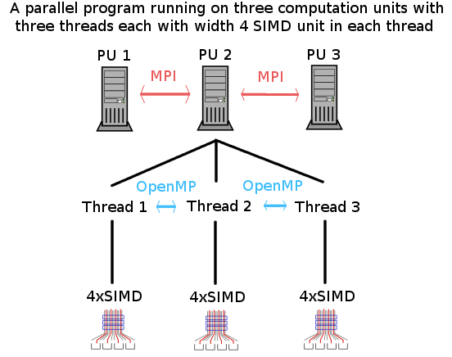
Critique: Comparison to Other Parallelisation Levels
All parallel concepts can and should be utilised at the same time.
e.g. vectorization can be utilized inside each thread.
SIMD intrinsics, compiled code is not portable since it’s platform dependent.
Large registers → More Power Consumption → Large Chip Area
Figure: Using SIMD in conjunction with other parallelisation levels.
CAB401 - SIMD
Notes:
This vectorization concept is should be used in conjunction with other parallel concepts. From this diagram, vectorization is used inside each thread, in this case are threads created using OpenMP which is then commanded by 3 computation units.
Compared to other parallel method such as POSIX thread or Java thread, it is not portable since it’s either platform dependent or compiler dependents.
It also has larger registers, which means it requires more power and larger chip area compared to other parallelisation methods.

Slide 15
References
[1] Tonteri, T. (2019). A practical guide to SSE SIMD with C++. [online] Sci.tuomastonteri.fi. Available at: http://sci.tuomastonteri.fi/programming/sse.
[2] Bikker, J. (2019). Practical SIMD Programming. [online] Cs.uu.nl. Available at: http://www.cs.uu.nl/docs/vakken/magr/2017-2018/files/SIMD%20Tutorial.pdf?fbclid=IwAR1M0Oe6Kk7BdEZzZCUHv3_BqnbvovsvAmH4s5tMgbHNK_RakyCPObFEuQI.
[3] Intrinsics Guide. [online] software.intel. Available at: https://software.intel.com/sites/landingpage/IntrinsicsGuide/#
[4] From C# to SIMD : Smith, R. (2018). Numerics.Vector and Hybridizer
http://www.altimesh.com/c-sharp-simd-numerics-vector-hybridizer/
[5] SIMD/Operations. [online] wiki.mozilla. Available at: https://wiki.mozilla.org/SIMD/Operations
CAB401 - SIMD

Slide 16

Want to learn more?
Source code, other examples, and recommended readings.
https://github.com/lachlankuhr/simd-resources
CAB401 - SIMD

