Slide 1

objective
n this checkpoint, you are going to create a presentation (max 5 slides) where you will develop the following subjects:
How does the web work?
What do you need to be a web developer?
What is the role of a web developer.
Hint: The purpose of this presentation is not to copy-paste information from the internet but to learn how to research, ask precise questions and find the best answers. In other words, the goal here is to learn how to learn.

Slide 2
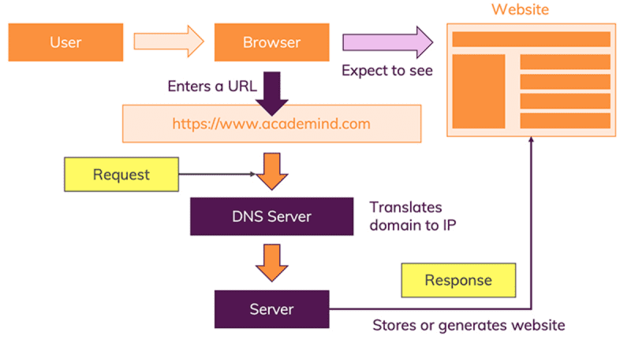
How does the web work?
The moment you enter this address in your browser and you hit ENTER, a lot of different things happen:
The URL gets resolved
A Request is sent to the server of the website
The response of the server is parsed
The page is rendered and displayed

Slide 3
What do you need to be a web developer?
The web developer is in charge of designing and deploying web sites and applications, maintaining their creations.
To thrive in this job, you must have a number of personal skills, such as a natural curiosity, an appetite for the web and a strong ability to adapt.
In terms of technical skills, you will need to master one of the latest existing programming languages to be able to join a web development agency: React, Symfony, Angular, Node or even Laravel.

Slide 4
What is the role of a web developer
The web developer plays several roles. Contrary to what most people think, its role is not limited to the creation and delivery of websites. The web developer has a role both upstream and downstream. The main mission that we know is the creation of websites according to the needs of its customers. Each website will have to be adapted to the desires of its owner.
The role of the web developer is not to propose the presentation of a website. Its role is rather to manage the technical side to offer a platform that resembles what the client requested. The customer must therefore come to the developer with all the important information. He must already have an idea of ​​the functionalities to be integrated, the presentation, the display, etc.
Obviously, before delivering a website, the web developer must have tested it. If, for example, he is asked for an e-commerce site, he must launch a fictitious order to see how the process unfolds. In the event of a bug, he will have to correct everything and deliver a fully functional site. After the delivery of the site, the web developer can also take care of the training of the owner. This role is not mandatory if the owner does not express the need to have the operation of his website explained to him.

Slide 5
Conclusion
To start developing you need to focus on each detail that you learn, practice it and try it with some extra skills that will search on it.

