Slide 1


Iterative typing
Master thesis
Author: Laurent Christophe
Promotor: Wolfgang De Meuter
Advisor: Dries Harnie
Notes:
Greetings everyone, I'm Laurent Christophe. I studied informatics engineering at ULB.
Today I will present you my master thesis in which we defend a new kind of static code analysis called iterative typing.
This thesis was made at VUB, was promoted by Wolfgang Demeuter and advised by Dries Harnie.
Lets jump to the context of my thesis

Slide 2
Static safety vs Expressiveness
Inputs
Program
Output
(+ 1 2)
Error
(+ 1 “foo”)
Unsafe
No algorithm can separates the safe programs from the unsafe ones
Safe
A compromise must be made between static safety and expressiveness
Programs
Notes:
First of all let me introduce two concepts I will use through the whole presentation.
Those concepts, static safety and expressiveness, are most important for iterative typing in particular and static code analysis in general.
In this presentation we represent programs as black boxes that expects inputs and either succeed and returns an output or fail and raise an error.
Based on that behavior we define the safe programs as the programs that always succeed independently of the inputs. The green programs is an example of Scheme safe program.
If a static code analysis could separate exactly the safe programs from the others, the unsafe ones, like the red scheme programs, we could detect all the bugs in advance and produce bug free applications.
Unfortunately, this is generally not possible. And static code analysis must make a compromise between static safety and expressiveness.
Let me explain this. As this exact separation is not possible. We must either accept some unsafe programs and damage the static safety or reject some safe programs and damage the expressiveness.
Now lets situate iterative typing relatively to other typings.

Slide 3


The iterative compromise
Static
safety
Runtime type checks on uncertainties
Nirvana
Static typing
Partial unfication of runtime type checks
Iterative
typing
Dynamic typing
Expressiveness
Iterative typing → Static typing that delays some type checks to runtime
Notes:
Their exist two broad kind of typings, static typing and dynamic typing.
Static typings heavily rely on static code analysis that detect many errors but inhibit the expressiveness as well.
On the other hand, dynamic typings perform poor static code analysis which lead to low static safety but high expressiveness.
Their are many investigations currently performed to combine the best of those two words. But, we must keep in mind that the perfect solution, here called nirvana, does not exist.
Iterative typing is one of those combinations.
Typically, on uncertainties, static typings make restrictive assumptions. Those assumptions are needed to carry on the static analysis but inhibit the expressiveness. Iterative typing try to avoid such restrictions and delay some checks to runtime instead. As a result iterative typing is more expressive than static typing but also less statically safe.
We can also see iterative typing as a partial unification of the runtime type checks made by standard dynamic typings. As a result the static safety is enforced but the expressiveness is damaged.
To conclude this contextualisation of iterative typing, we say that iterative typing is a static typing that delays some type checks to runtime.
Lets now introduce iterative typing 's behavior through a case study about deserialization

Slide 4
Case study: Deserialization (1/2)
Late error detection on use
(define x (read))
(+ x 1)
>> “foo”
Error: + expects type
<number> as 1st
argument, given: "foo"
Early error detection on input processing
main = do x <- getLine
let y = read x
return (y + 1)
>> “foo”
Prelude.read: no parse
Notes:
Deserialization is the process to convert sequences of bytes into others data structures.
Here we present two programs that both deserialize an input from the user and try to add one to it.
The first programs is written in Scheme which is dynamically typed, the second programs is written in Haskell which is statically typed.
If the user entered a string on the Scheme program, the type error is detected lately on the use of that input.
If the user entered a string on the Haskell program, the type error is detected right inside the input deserialization.
The Haskell program detect errors earlier but it uses advanced concepts like output overloading which are difficult to understandable by unskilled programmers.
Now lets see what iterative typing propose.

Slide 5
Case study: Deserialization (2/2)
(define x (read))
(+ x 1)
Late error
detection
Runtime type check,
early error detection
Iterative
compilation
(define x ([r => Number] read))
(+ x 1)
>> “foo”
Error on: [r => Number, r => String]
Iterative typing aims to provide early error detection - without involving the programmer into typing
- without damaging to much the expressiveness
Notes:
In the iterative framework, there is a compilation step that insert the runtime check I previously evoked.
After that compilation, the Scheme programs of the previous slide would contain this runtime type check which mean that the return type of read should be a number.
If the user entered “foo” we would get this error that mean the return type of read should be a number but the user entered a string.
So errors are detected as soon as the Haskell case but without using complicate features like output overloading
To conclude this first sneak preview of iterative typing we say that iterative typing aims to provide early error detection without complicate the programming task and without damaging to much the expressiveness.
Lets now move to the interpretation of the compiled programs. And see how some dynamic patterns are supported by iterative typing

Slide 6
Preserving side effects
(define x ([r => Number] read))
(display “Log info: ”)
(display (typeOf x))
(+ 1 x)
>> “foo”
Error on [r => String, r => Number]
(unsafe
(define x ([r => Number] read))
(print “Log info: ”)
(print (typeOf x))
(+ 1 x))
(unsafe <body>)
On error prediction, the iterative part of the interpretation is shut down instead of raising an error
>> “foo”
Log info: String
Error: + expects type
<number> as 1st
argument, given: "foo"
Notes:
The early error detection is not always advantageous and sometimes we want to perform the program until the last possible moment.
For example, a log file is files that contain information for debugging purpose. And we want as many information as possible inside those files.
So if such file is written during the computation as it is the case here, we want to execute the computation until the error actually arise.
To tackle this issue, we developed a new special form called unsafe. If an error is predicted inside the body, the iterative prediction is shutdown instead of raising an error
So when the previous program is wrapped inside the unsafe special form, we can have full computation until an untrapped error like this is case here.

Slide 7
Input dispatch
(define input (read))
(if (equal? input “!”)
(concat “Yo” input)
(+ input 1))
(define input ([r => a] read))
(if (equal? input “!”)
[a => String](concat “Yo” input)
[a => Number](+ input 1))
>> “!”
“Yo!”
>> “foo”
Error on: [a => String, a => Number]
>> “!”
<then>
[a => String,
a => String]
[]
[a => String]
>> “foo”
<else>
[a => String,
a => Number]
[]
[a => String]
Notes:
The first example we will see is called input dispatch. In this program...
Adter compilation three runtime checks are insert
During the interpretation, a set of constraints are carried around. Those constraints are affected by the annotations in red.
Lets see new how those constraints evolve during a particular execution.
Lets see now how iterative typing detect type errors.
And we detect a type error inside the else branch without actually executing it.

Slide 8
Multiple return types
(define (evil x)
(if x 1 “foo”))
(+ 1 (evil #t))
(concat “yo” (evil #f))
;; evil : ∀ a . Bool → a
(define (evil x)
(if x
[a => Number] 1
[a => String] “foo”))
(+ 1 ([a => Number] evil #t))
(concat “yo” ([a => String] evil #f))
2
“yofoo”
Constraints
Enforcing
Standard
procedure
Relaxing
Constraints
Arguments
Result
Enforcing
Then branch
[a => Number
a => Number]
[]
[a => Number]
Relaxing
[]
[a => String]
[a => String
a => String]
[]
Enforcing
Else branch
Relaxing
Notes:
Lets now move to a more advance example called multiple return types.
In this program we define a procedure called evil that expects an argument and depending on the value of that argument either return a number or a string.
Then we call two times this procedure, the first time, inside a sum and second time inside a concatenation.
This program is safe and the output is 2 for the first application and “yofoo” for the second application
After compilation four runtime checks are inserted.
So evil expects a boolean and returns something we have no information about. This something labeled a is number if the then branch is executed and a string if the second branch is executed.
As we can see, although this program is safe, those two constraints are incompatible and yet they have to be added sequentially to the carried set of constraints.
So the wrapper allow to use procedure call with different input and output types.

Slide 9
Compilation overview
(begin <expr1>
(if <pred>
<then>
<else>)
<expr2>)
begin
if
<expr1>
<expr2>
(begin <expr1>
(if <pred>
A1 <then>
A2 <else>)
<expr2>)
<pred>
<then>
<else>
A1
A2
Notes:
Lets now focus on the generation of those runtime checks.
Here we have a sequence of statement expr1, a conditional structure and exrp2.
After compilation the constraints A1 are inserted in front of the then branch and the constraints A2 are inserted in front of the A2 branch.
A1 are the assumption made during the type inference of the then branch and A2 are the assumptions made during the type inference of the else branch.
Actually A1 is nothing else that the assumption made during the type inference of the then branch. And of course A2 are the assumptions made during the type inference of the else branch.
A1 and A2 are the assumptions made during the type inference of respectively the then branch and the else branch.
Lets me explain this.
During the compilation a standard hindley milner inference is performed expr1 the predicate and expr2.
All the assumption made during that inference are used inside the type inference of the then branch but the assumptions made inside the then branch does not pollute the rest of the inference. Instead, they are stored inside A1.
We have similar scenario for the else branch.
The point I want to stress is that the then branch and the else branch are analyzed separatly. That allows to express conditional structure with incompatible types.

Slide 10
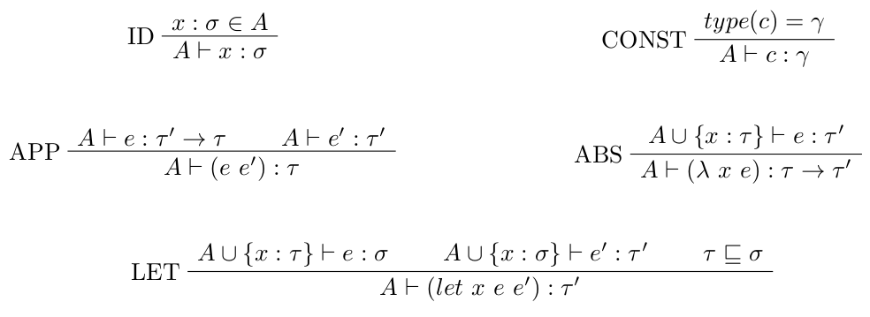


Iterative type system
Only procedures can be polymorphic
;; read : ∀ a . () → a
(+ 1 ([a => Number] read))
Notes:
A type system is a set of mathematical rules that defines the type safe programs.
For example this rule means that.... [APP]
As said before, the iterative inference is based on the Hindley-Milner type inference. And those are the rules we directly took from the Hindley-Milner type system.
The two next rules of this slide are slightly modified to fit the iterative typing need.
The first rule is the generalization rule that defines how we can infer polymorphic types. In this rules we only allow procedures to be polymorphic when the original rule allow any kind of type to be polymorphic.
The second rule is the specialization rule that defines how we can instantiate monomorphic types from polymorphic types.
This rule is equivalent to the Hindley-Milner rule but we have to insert the instantiation inside the code. This insertion represent the enforcement of the wrapper previously introduced.
For example the read procedure is of type nothing to a. If we want to use it, we first have to instatiate a. And, in this case, a must be a number.
Lets now move to the most important rule of the iterative type system.

Slide 11

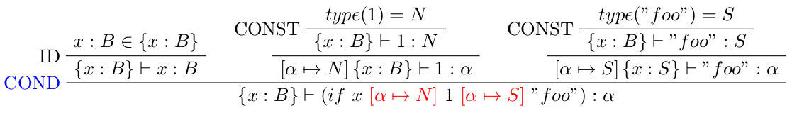
Conditional rule
Encapsulation of assumptions
made inside the “then” branche
The assumptions made inside the
“then” branch are inserted into the code
(if x
1
“foo”)
Notes:
This rule defines how runtime checks are generated for conditional structure.
This piece of code is rejected by standards static type systems. But a derivation can be made in the iterative type system:

Slide 12


Conclusion
New compromise between static safety and expressiveness
Aims early error detection without involving the programmer into typing and without damaging to much the expressiveness
Hindley-Milner type inference that upon uncertainties delays type checks to runtime:
  Constraints on conditional structures:
  Constraints on calls to polymorphic procedure:
(if x [a => Number] 1 [a => String] “foo”)
(+ 1 ([r => Number] read))

Slide 13

A biology story
(define (read-protein)
(define x (read-line))
(cond ([a => DNA] (string-dna? x) (make-dna x))
([a => RNA] (string-rna? x) (make-rna x))
([a => Void] else (void))))
(define input ([a => DNA] read-protein))
;; possibly many computations
(process-dna input)
Iterative typing: Early error detection
Dynamic typing
Late error detection
;; process-dna : DNA → DNA
(define (process-dna x)
(cond (trisomy21? x) (remove21 x)
(XXY? x) (removeX x)
(else x)))
Type-compatible branch, no runtime checks and precise type inference of the procedure process-dna
Notes:
Lets now move to some concrete applications of iterative typing.
In this slide, we suppose a biologist want to deserialize an DNA and then process-it.
The point I want to highlight is that the biologist does not have code any guards and does not have to know about type system to produce code that detects errors very early.
Furthermore, iterative typing automatically detect when two conditional branches are type-compatibles.
In that case the assumptions are used outside the branches in the rest of t he type inference.
This feature allow the programmer to write safer code without even knowing its existence. And that is what iterative typing is good at: it hide the complexity of typing from our poor unskilled biologist.

