Slide 1

SMART VISION
Condition-Aware Object Detection for Adverse Weather
Team: Janani R S, Lakshanadevi M
Department: AIDS
College: SJIT
Guide / Mentor: Dr. S. Sumathi
Academic Year: Third Year
Notes:
Title slide: Smart Vision - Condition-Aware Object Detection for Adverse Weather.

Slide 2



Problem Statement
Existing object detection systems often suffer from reduced accuracy under adverse conditions such as fog, rain, snow, low-light, and sand-dust, limiting reliable real-world detection.
Objectives
›
Develop a 6-class condition-aware classification module.
›
Compare ResNet-18 and EfficientNet-B0 for condition classification.
›
Evaluate YOLOv8, YOLO11, and YOLO26 for object detection.
›
Conduct five YOLO11–YOLO26 experiments using standard evaluation metrics.
›
Build a conditional preprocessing and detection pipeline for improved performance.
Page 02
Notes:
Problem statement and project objectives.

Slide 3









Dataset Overview & Annotation
Datasets
Annotation
DAWN & S7-ISP
Object class + bounding-box coordinates
Annotation
Detection Output
YOLO-format bounding boxes
Confidence score for each predicted object
Object Classes
Preprocessing
Person, Bicycle, Car, Motorcycle, Bus, Train & Truck
Data cleaning
→
Annotation validation
→
Class mapping
→
Train / val / test split
Condition Classes
Normal, Low-Light, Fog, Rain, Snow & Sand-Dust
Page 03
Notes:
Dataset overview, annotation format, classes, detection output and preprocessing pipeline.

Slide 4



›
Data Cleaning
Removed invalid, unsuitable, and inconsistent samples.
›
Annotation Validation
Verified YOLO bounding-box annotations and class mappings.
›
Data Augmentation
Applied geometric and visual transformations to improve model generalization.
Data Augmentation & Preprocessing
›
Condition-Specific Preprocessing
Low-Light
Gamma Correction + CLAHE
Fog
Dehazing + CLAHE
Rain
Deraining
Snow
Restoration
Sand-Dust
Visibility Enhancement + Bilateral Filtering
Normal
Original image
›
Super-Resolution
ESRGAN applied after condition-specific preprocessing to recover fine image details.
Page 04
Notes:
Data cleaning, annotation validation, augmentation, condition-specific preprocessing and ESRGAN super-resolution.

Slide 5



Model Architecture & Backbone
Condition Classification
Object Detection
Proposed YOLO11 Optimization
EfficientNet-B0 used as the condition classification model.
Classifies images into 6 environmental conditions.
Input resolution: 224 × 224.
YOLOv8s, YOLO11s and YOLO26s evaluated as detection models.
Input resolution: 640 × 640.
Detects 7 object classes: Person, Bicycle, Car, Motorcycle, Bus, Train and Truck.
Training Optimization
Residual SPPF modification
SE-inspired Channel Attention
Loss-weight Optimization
Overall Architecture
Input Image
→
EfficientNet-B0
→
Condition Classification
→
Adaptive Preprocessing
→
ESRGAN
→
YOLO Detector
→
Object Detection
Page 05
Notes:
Model architecture: EfficientNet-B0 condition classifier, YOLO detectors, proposed YOLO11 optimizations and the overall pipeline.

Slide 6



Training Setup
Framework
Ultralytics YOLO
Optimizer
AdamW
Initial Learning Rate
0.001
Training Setup & Loss Functions
Epochs
100
Batch Size
16
Input Size
640 × 640
LR Scheduler
Cosine Decay + Warm-up
Weight Decay
0.0005
Augmentation
HSV, Translation, Scaling & Horizontal Flip
Training Objective
Loss Functions
Optimize localization and classification losses to improve detection precision, recall, and overall mAP.
Box Loss
Bounding-box localization
Classification Loss
Object class prediction
DFL (Distribution Focal Loss)
Precise bounding-box localization
Optimized Weights
Box = 7.5, Class = 0.5, DFL = 1.5
Page 06
Notes:
Training setup hyperparameters, loss functions with optimized weights, and the training objective.

Slide 7





Performance Evaluation & Metrics
Evaluation Metrics
Precision
Measures the accuracy of detected objects.
Recall
Measures the ability to detect actual objects.
mAP@0.5
Detection accuracy at IoU threshold 0.5.
mAP@0.5:0.95
Detection performance across multiple IoU thresholds.
Model Comparison
Model | Precision | Recall | mAP@0.5 | mAP@0.5:0.95
YOLOv8s | 76.40% | 92.90% | 92.60% | 72.70%
YOLO11s | 83.89% | 45.89% | 61.11% | 37.27%
YOLO11s – Training Optimization | 84.61% | 56.59% | 64.52% | 41.79%
YOLO26s | 86.49% | 57.86% | 70.21% | 43.44%
Key Observation YOLO26s achieved the highest overall precision and mAP among the compared YOLO models, while training optimization improved YOLO11s recall and mAP over its baseline.
Page 07
Notes:
Evaluation metrics definitions, model comparison table and key observation.

Slide 8
Per-Class Performance Metrics
YOLOv8s
YOLO11s
YOLO26s
Class | Precision | Recall | mAP@0.5 | mAP@0.5: 0.95
Person | 66.90 | 91.70 | 91.90 | 65.90
Bicycle | 77.90 | 80.00 | 75.50 | 53.90
Car | 75.40 | 97.30 | 97.00 | 73.60
Motorcycle | 68.40 | 94.10 | 92.10 | 65.70
Bus | 81.40 | 96.00 | 98.20 | 85.90
Train | 87.10 | 100.00 | 99.50 | 89.50
Truck | 77.60 | 90.80 | 94.10 | 74.10
Overall | 76.40 | 92.90 | 92.60 | 72.70
Class | Precision | Recall | mAP@0.5 | mAP@0.5: 0.95
Person | 84.90 | 81.50 | 88.70 | 60.40
Bicycle | 100.00 | 34.70 | 78.60 | 46.10
Car | 94.30 | 87.40 | 96.10 | 70.50
Motorcycle | 89.30 | 100.00 | 98.90 | 66.90
Bus | 88.60 | 92.00 | 97.20 | 78.30
Train | 100.00 | 0.00 | 99.50 | 89.50
Truck | 89.50 | 81.00 | 91.30 | 68.70
Overall | 92.40 | 68.10 | 92.90 | 68.60
Class | Precision | Recall | mAP@0.5 | mAP@0.5: 0.95
Person | 98.80 | 78.70 | 95.40 | 66.70
Bicycle | 92.10 | 60.00 | 81.80 | 45.70
Car | 96.80 | 85.70 | 96.70 | 71.70
Motorcycle | 100.00 | 85.40 | 93.30 | 66.00
Bus | 99.30 | 100.00 | 99.50 | 81.00
Train | 88.80 | 100.00 | 99.50 | 99.50
Truck | 96.80 | 85.80 | 94.60 | 71.10
Overall | 96.10 | 85.10 | 94.40 | 71.70
Values are percentages. Source: validation logs of each model.
Page 08
Notes:
Per-class precision, recall, mAP@0.5 and mAP@0.5:0.95 for YOLOv8s, YOLO11s and YOLO26s across the seven object classes.

Slide 9


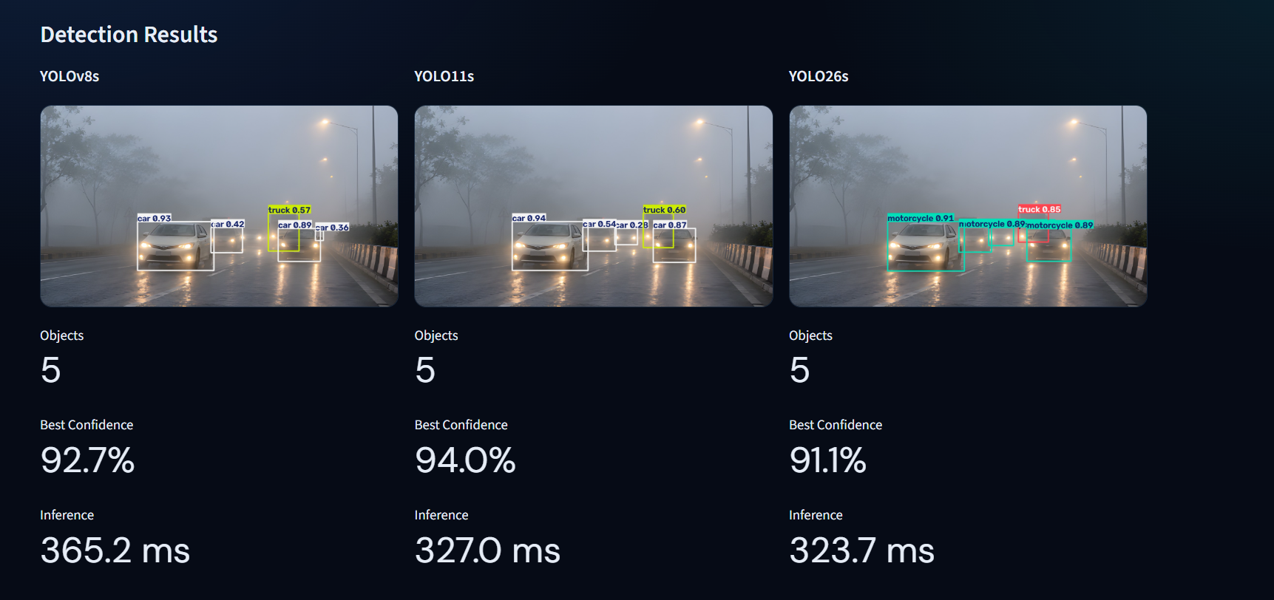
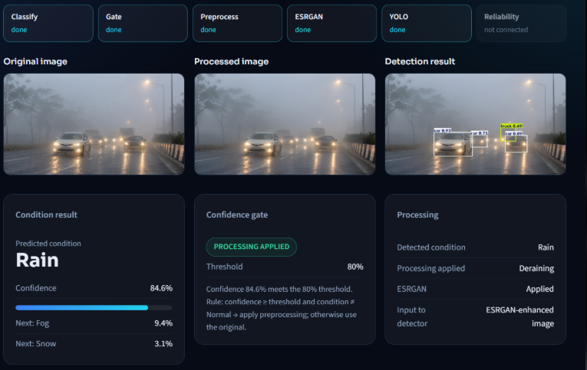


Visual Results & Inference
Visual Results
Inference
Tested under Fog, Rain, Snow, and other adverse conditions
Compared YOLOv8s, YOLO11s, and YOLO26s
Visualized bounding boxes, object classes, and confidence scores
Condition-aware preprocessing improves image visibility before detection
Real-time image inference through the Smart Vision dashboard
Reports detected objects, confidence scores, and inference time
Supports side-by-side model comparison
Pipeline Output
Input Image
→
Condition
→
Enhanced Image
→
Detected Objects
→
Confidence Score + Inference Time
Visual evaluation demonstrates the practical behavior of the proposed condition-aware detection pipeline across challenging environmental conditions.
Page 09
Notes:
Detection results across YOLOv8s, YOLO11s and YOLO26s on a foggy road image, plus the Smart Vision dashboard showing condition result, confidence gate and processing. Pipeline: input image, condition, enhanced image, detected objects, confidence score and inference time.

Slide 10

Deployment &
Future Scope
Future Scope
01
Improve detection recall under severe weather conditions
Deployment
02
Optimize inference speed and computational efficiency
Platform
Streamlit + VS Code
Input
Image upload
03
Extend the system to video and real-time camera input
Pipeline
Classification → Gate → Preprocessing → ESRGAN → YOLO
04
Evaluate on larger and diverse adverse-weather datasets
Output
Condition, confidence, enhanced image & detections
05
Further optimize the YOLO11 architecture and preprocessing pipeline
Dashboard
Real-time visual results and model comparison
Deployment Flow
User Image
→
Smart Vision Dashboard
→
Adaptive Pipeline
→
Detection Results
Future work focuses on improving robustness, efficiency, and real-time deployment in challenging visual environments.
Page 10
Notes:
Deployment platform, input, pipeline and outputs; future scope items; deployment flow.

Slide 11
Thank You
SMART VISION
Condition-Aware Object Detection for Adverse Weather
Janani R S, Lakshanadevi M
Department of AIDS | SJIT
Guide / Mentor: Dr. S. Sumathi
Questions & Discussion
Page 11
Notes:
Closing slide: thank you and questions.

