Slide 1
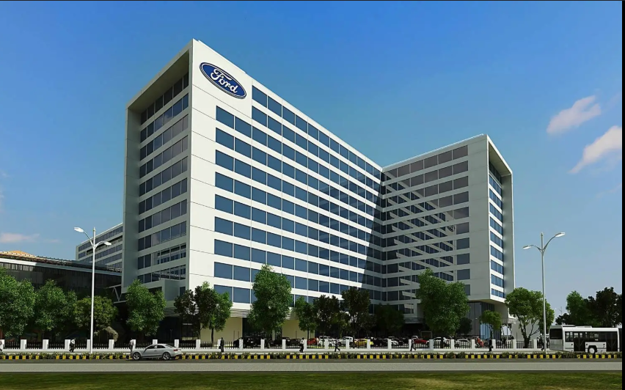



FORD INTERNSHIP EXPERIENCE
Product Part Pricing
Automation & Learning Journey
Cloud automation, enterprise data engineering, and web scraping systems
built during my Ford internship.
Lakshanadevi M
St. Joseph's Institute of Technology, Chennai
Internship Duration — 17/06/26 - 20/07/26
Notes:
Title slide. Introduce yourself, the internship, and the project scope: cloud automation, enterprise data engineering, and web scraping systems built for Ford's product part pricing workflow. Mention your college and the internship duration. Keep this to 20-30 seconds — this is the hook, not the detail. Speak with confidence: this is an engineering review, so set the tone as a peer presenting real technical work, not a student presenting a class project. Preview that you will walk through the journey chronologically, starting with a small automation utility and building up to enterprise cloud services, data engineering, and a production-style scraping pipeline, before closing with the challenges encountered and lessons learned. If you have exact internship dates, replace the placeholder before presenting.

Slide 2
JOURNEY
Internship Journey Roadmap
PHASE 1 — FOUNDATIONS & CLOUD SETUP
PHASE 2 — AUTOMATION, DELIVERY & REFLECTION
1
Internship Begins
8
Product Part Pricing Automation
2
Ford Dealer URL Finder
9
AutoZone / NAPA Web Scraping
3
Google Cloud Environment
10
Airflow
4
Service Account Impersonation
11
CI/CD Pipeline
5
BigQuery
12
Jira
6
Cloud Storage
13
Manual Validation
7
Enterprise Cloud Services
14
Key Learnings
Ford Internship Experience
02
Notes:
Walk through the internship as a chronological roadmap rather than a generic overview — this is the map for the rest of the talk. Phase one covers the foundations: the internship began with a small standalone automation utility, the Ford Dealer URL Finder, which was the first real deliverable. From there I moved into the Google Cloud environment, learned to authenticate securely through service account impersonation, and worked hands-on with BigQuery and Cloud Storage as part of broader enterprise cloud services exposure. Phase two covers the core project and supporting practices: the product part pricing automation project, which involved web scraping AutoZone and NAPA's sites, and the enterprise tooling around it — Apache Airflow for orchestration, a CI/CD pipeline for deployment, and Jira for tracking work. The journey closes with manual validation of results and the key learnings I'm taking forward. Tell the audience each of these numbered stops will get its own slide, so they know what's coming.

Slide 3






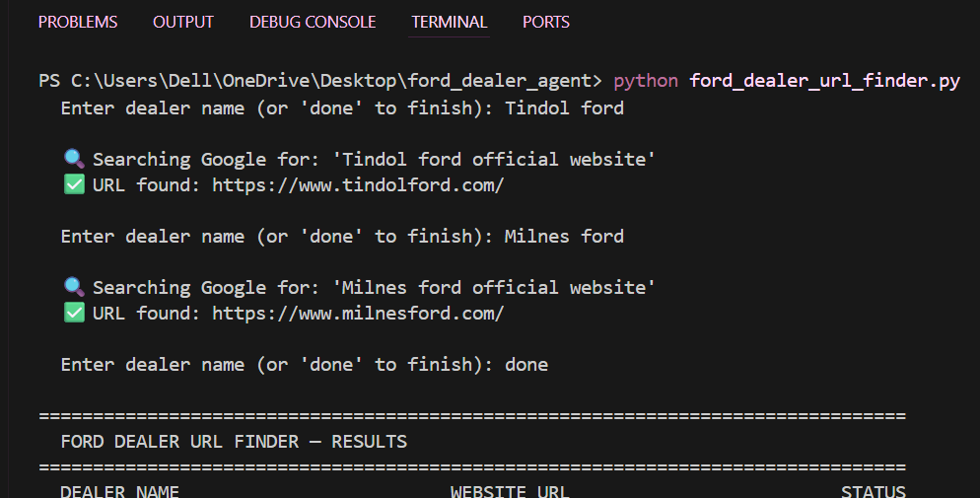
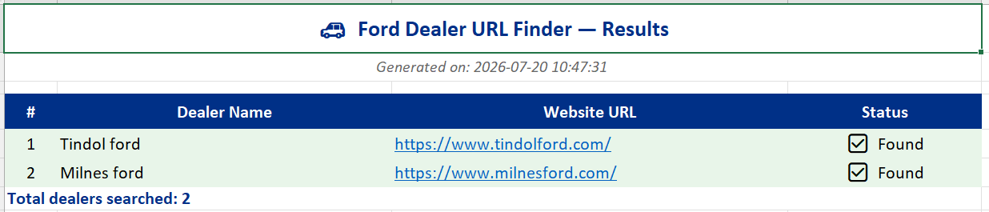
FIRST AUTOMATION UTILITY
Ford Dealer URL Finder
Objective — automatically find the official website of a Ford dealership from its name, removing a manual search step from the workflow.
WORKFLOW
Dealer
Name
▸
Python
▸
SerpAPI
▸
Google
Search
▸
Extract
Website
▸
Excel
Report
TECHNOLOGIES USED
Python
Requests
SerpAPI
OpenPyXL
Excel Automation
Exception Handling
SCREENSHOTS
<< VS Code Screenshot >>
Ford Internship Experience
03
Notes:
This was the first automation utility I built, before moving into the cloud-heavy part of the internship. The objective was simple but time-saving: given a Ford dealer's name, automatically find and confirm its official website instead of searching manually. The workflow reads a dealer name, uses Python to call the SerpAPI service, which runs a Google search on my behalf, then parses the results to extract the official website link, filtering out directory listings and unrelated pages. Results are written to an Excel report using OpenPyXL, so the output is ready for business use without extra formatting. On the technology side, I used the Requests library for API calls, wrote custom exception handling so a failed lookup or missing result does not stop the whole batch, and used OpenPyXL to build the report programmatically. Key functions included one that constructs the SerpAPI query, one that parses and validates the returned URLs against a dealer-name similarity check, and one that writes each row incrementally to Excel so partial progress is never lost. This small project taught me how to structure a clean, resilient Python script early on, which shaped how I approached later, larger automations.

Slide 4














CLOUD FOUNDATIONS
Google Cloud Platform Learning
Google Cloud Platform (GCP) is Google's suite of cloud computing services — on-demand access to compute, storage, and data infrastructure over the internet instead of on local hardware. Enterprises like Ford use cloud platforms for scalability, reliability, and centralized security, without managing physical servers.
Identity & Security
Data & Storage
IAM
BigQuery
Service Accounts
Cloud Storage
Secret Manager
Cloud SQL
Pub/Sub
Compute & Deployment
Operations
Cloud Build
Cloud Logging
Artifact Registry
Cloud Monitoring
Cloud Run
Cloud Scheduler
Cloud Functions
Ford Internship Experience
04
Notes:
Before touching the core project, I spent time learning Google Cloud Platform from the ground up, since this was my first hands-on exposure to enterprise cloud infrastructure. I explain cloud computing simply: instead of running everything on a local machine, compute, storage, and data services run on Google's infrastructure and are accessed on demand, which is why large enterprises adopt it — it scales elastically, is centrally secured, and removes the burden of managing physical servers. I grouped what I learned into four areas. Identity and security covers IAM for permissions, service accounts for machine identities, and Secret Manager for credentials. Data and storage covers BigQuery for analytics-scale data, Cloud Storage for files and objects, Cloud SQL for relational databases, and Pub/Sub for messaging between services. Compute and deployment covers Cloud Build, Artifact Registry, Cloud Run, and Cloud Functions — the pieces that turn code into a running, deployed service. Operations covers Cloud Logging, Monitoring, and Scheduler, which keep automated systems observable and on schedule. I did not use every one of these in depth, but understanding how they fit together gave me a real picture of enterprise-grade cloud architecture.

Slide 5



ENTERPRISE SECURITY
Service Account Impersonation
I did not have direct, standing access to Google Cloud resources. Instead, access was granted through service account impersonation — a short-lived, auditable way to borrow permissions without holding them permanently.
AUTHENTICATION FLOW
Developer
▸
Authenti-
cation
▸
Service
Account
▸
Temporary
Credentials
▸
Google
Cloud
KEY CONCEPTS
Least Privilege
IAM
Secure Authentication
Access Control
SCREENSHOT
<< VS Code Screenshot >>
Ford Internship Experience
05
Notes:
Working inside a real enterprise environment meant I could not simply be handed broad, permanent access to Google Cloud resources — that would violate least-privilege security practice. Instead, the team used service account impersonation. In practice this means my developer identity authenticates first, is verified against IAM policy, and if authorized, is allowed to impersonate a service account for the duration of the task. That impersonation generates short-lived, temporary credentials, which are what actually authenticate against Google Cloud — not my personal identity directly. Once the task is done, those credentials expire, so there is no standing access left over to misuse or forget about. I explain why this matters: it enforces least privilege, since permissions are scoped to the service account and only active when needed; it keeps an audit trail, since every impersonation event is logged; and it separates human identity from machine identity, which is a core enterprise security pattern. Learning to authenticate this way, instead of using a static key file, was one of the most valuable practical security lessons from the internship, and it directly shaped how I approached every GCP script afterward.

Slide 6
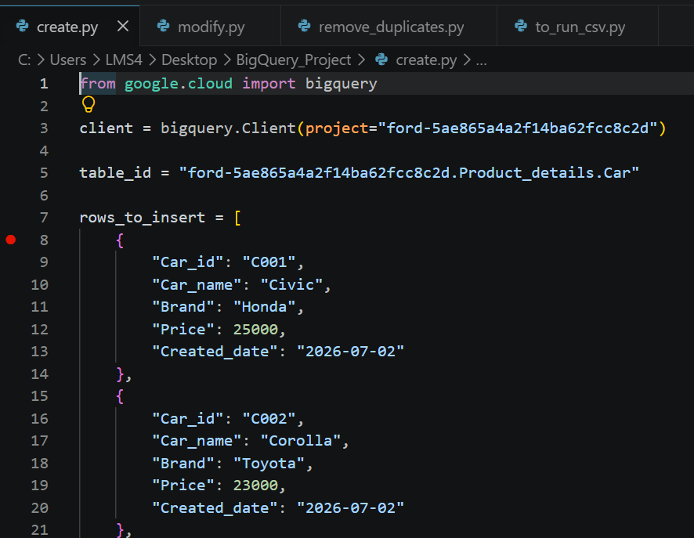
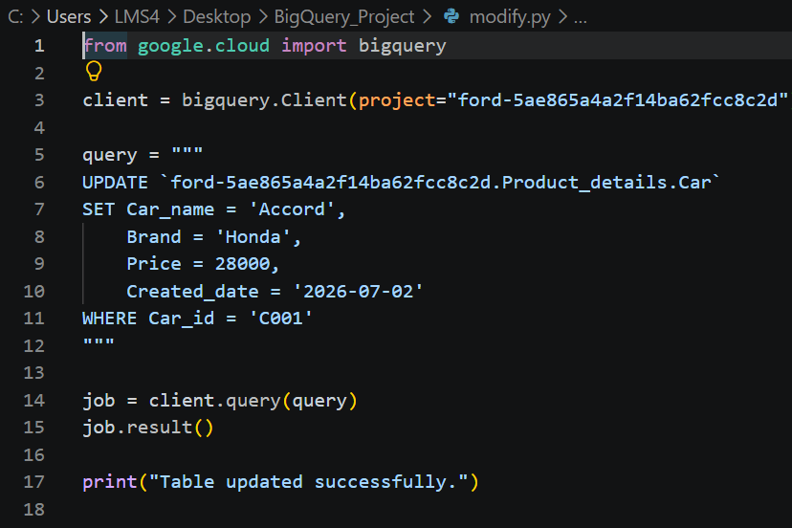
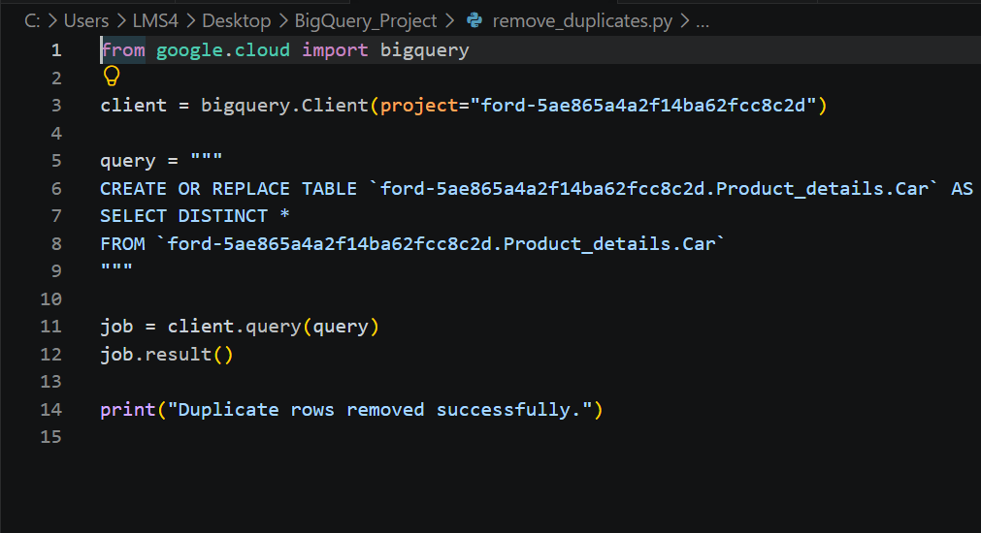
DATA & STORAGE
BigQuery & Cloud Storage
BigQuery
Cloud Storage
CORE CONCEPTS
CORE CONCEPTS
Dataset
Table
SQL
Buckets
Objects
Regions
Storage Classes
OPERATIONS
OPERATIONS
Create
Insert
Update
Delete
Query
Create Bucket
Upload Objects
Delete Bucket
Manage Files
<< SQL >>
<< BigQuery >>
Ford Internship Experience
06
Notes:
This slide covers the two core data services I used most: BigQuery and Cloud Storage. For BigQuery, I explain the basic hierarchy — a dataset holds tables, and tables hold structured rows queried with SQL. Day to day, I performed the standard operations: creating datasets and tables, inserting new records, updating existing rows, deleting stale data, and running queries to pull results back into Python. This gave me practical, hands-on SQL experience at cloud scale rather than on a local database. For Cloud Storage, I explain the object storage model — buckets are containers, objects are the files inside them, and each bucket has a region and a storage class that affects cost and access speed. Operationally, I created buckets, uploaded objects programmatically from Python, deleted buckets when no longer needed, and generally managed files as part of the pipeline's input and output handling. Together, BigQuery and Cloud Storage formed the backbone of how data moved through the automations I built — structured, queryable data in BigQuery, and files, exports, or images in Cloud Storage. Point out the screenshots as the actual evidence of these operations running in the console and in code.

Slide 7
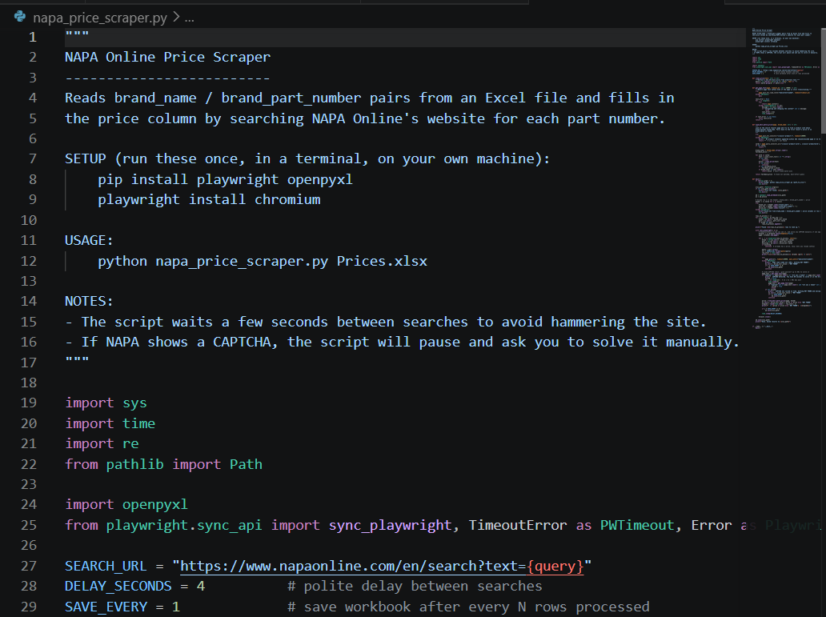
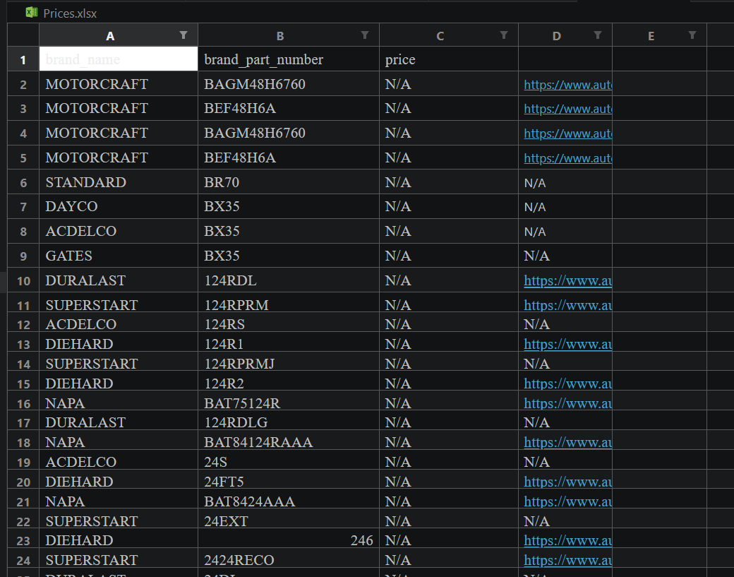
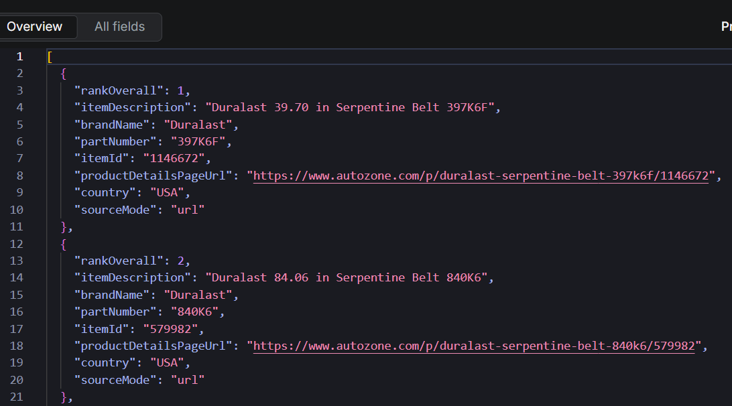
CORE PROJECT
Product Part Pricing Automation
The Problem — checking part prices on AutoZone and NAPA Auto Parts manually, part by part, is repetitive and does not scale across a large product catalog.
WORKFLOW
Excel
Input
▸
Read Part
Number
▸
Generate
Search URL
▸
Search
AutoZone/NAPA
▸
Retrieve
Product Price
▸
Generate
Excel Report
▸
Generate
JSON Output
OUTPUTS
<< Automation Code >>
<< Exce
<< JSON Output >>
Ford Internship Experience
07
Notes:
This is the core project of the internship. The business problem: manually checking AutoZone and NAPA Auto Parts prices for every part number in a catalog is slow, repetitive, and error-prone at scale. The automation reads part numbers from an Excel input file, then for each one generates the corresponding AutoZone or NAPA search URL, searches the site, and retrieves the listed price — or records that the part was not found. Results are written back out in two formats: an Excel report for business users, and a JSON file for any downstream system that needs structured data. Walk through each stage briefly: the Excel input stage reads part number and brand columns; the URL generation stage builds a clean, correctly formatted search link per part; the search and retrieval stage is where the actual page is requested and the price parsed from the response; and the output stage writes both formats so the results are usable by both people and other tools. This project is where everything else in the internship connects — the cloud learning, the Python scripting discipline from the dealer finder project, and the data-handling practices from BigQuery and Cloud Storage all fed into building this pipeline.

Slide 8


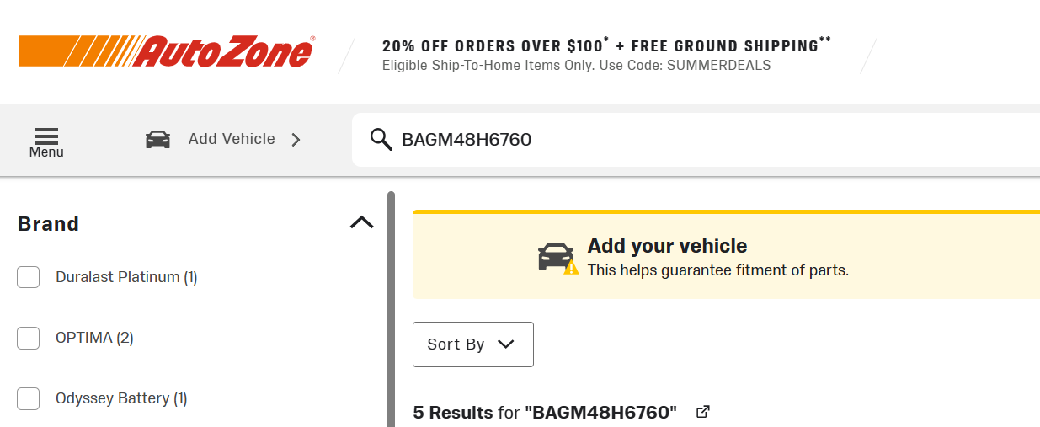
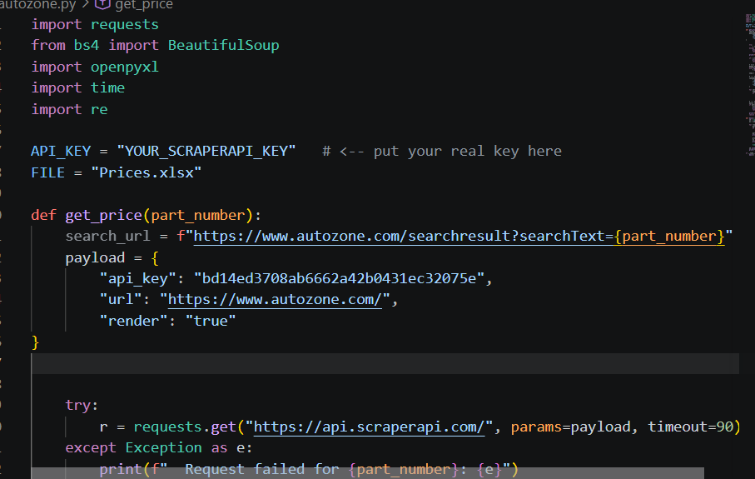
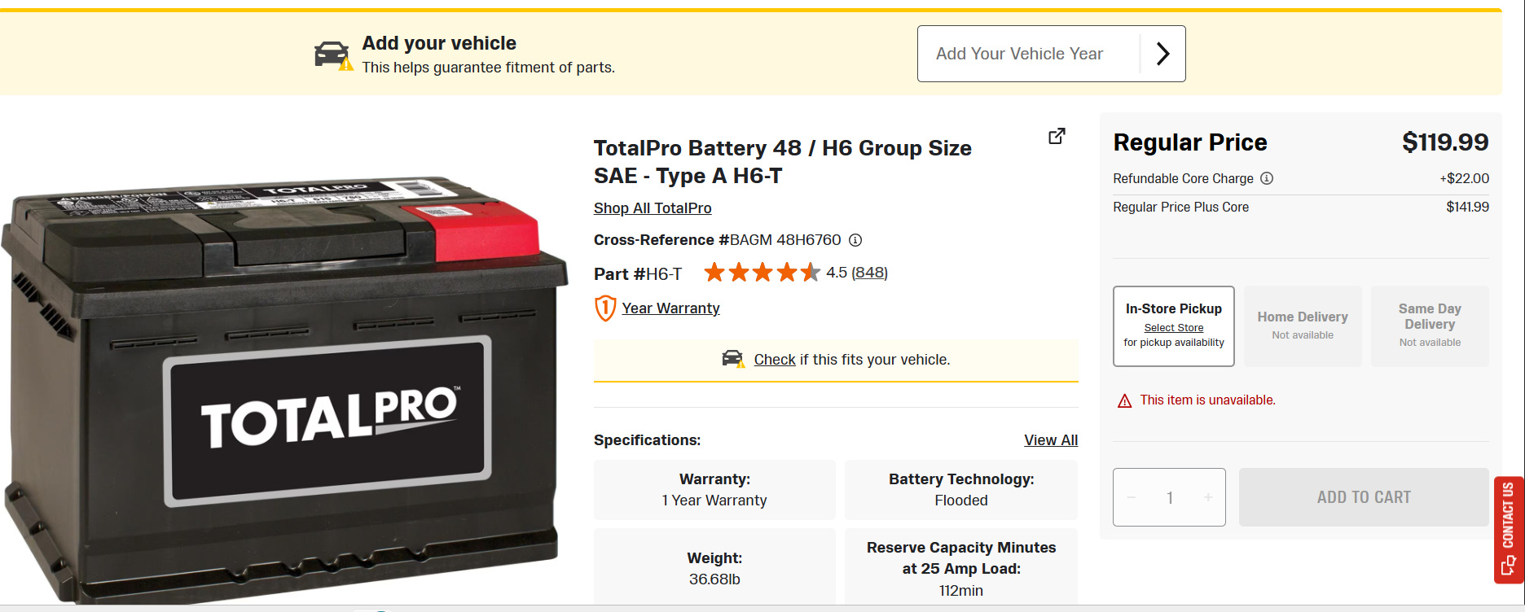
Part Numbers Processed
Product URLs Generated
Prices Extracted
Product Mismatches
SCRAPING AUTOMATION
AutoZone Scraping Analysis
Apify-Based Price Automation
OBJECTIVE
CHALLENGES FACED
Automate retrieval of automotive part information by searching AutoZone using part numbers, exporting matched results to Excel and JSON.
Some part numbers returned different or unrelated products.
The search results were not always an exact match for the input part number.
WORKFLOW
›
›
›
›
›
Excel Input
Apify Actor
AutoZone Search
Retrieve URL
Price Extraction
Excel / JSON Output
Key Learning — The pipeline worked end-to-end, but the selected AutoZone Apify actor only supports search and URL matching; it does not expose product pricing, making it unsuitable for full price automation.
AutoZone Logo
Homepage Screenshot
Product Search Screenshot
Product Page Screenshot
Ford Internship Experience
08

Slide 9

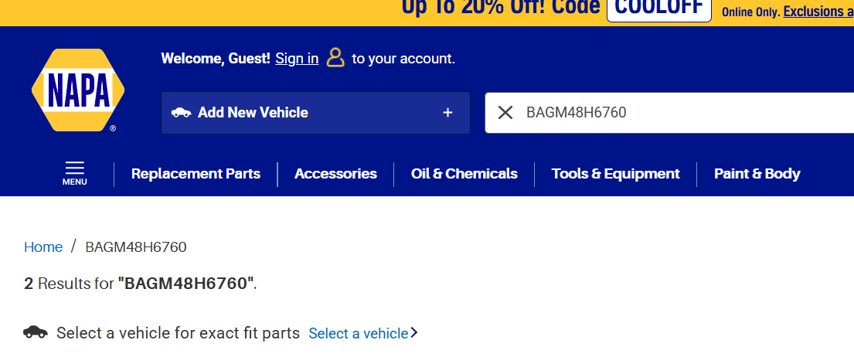
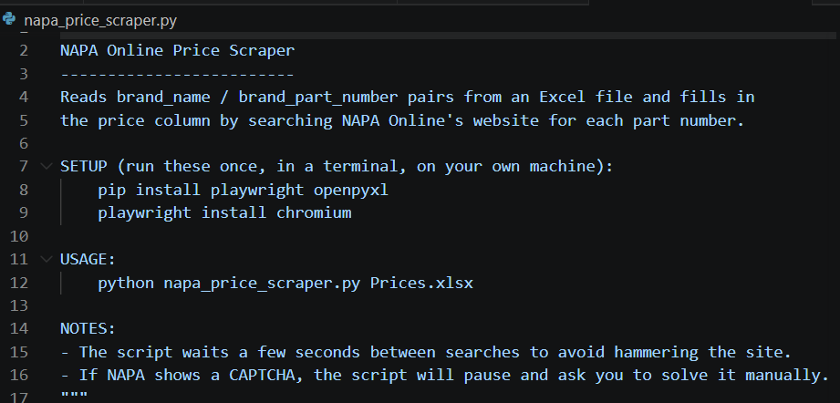
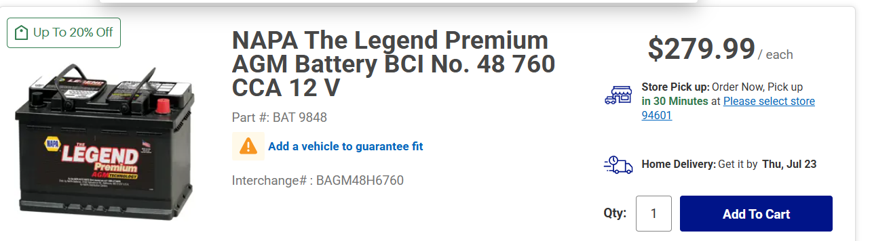
Excel Generation
3)
SCRAPING AUTOMATION
NAPA Scraping Analysis
Apify-Based Price Automation
OBJECTIVE
CHALLENGES FACED
Automate retrieval of automotive part prices from NAPA Auto Parts using Apify, exporting results into Excel.
L
Every API request returned 403 Forbidden.
Even after generating a new API token, the issue remained.
WORKFLOW
›
›
›
›
Excel Input
Apify NAPA Actor
NAPA Search
Price Retrieval
Excel Output
Key Learning — The Python automation, Excel processing, and workflow were fully functional; the limitation was the Apify actor's licensing model, which required a paid rental after the free trial expired.
NAPA Logo
Homepage Screenshot
Product Search Screenshot
Product Page Screenshot
Ford Internship Experience
09

Slide 10

TECHNIQUES & TOOLING
Web Scraping & Automation
CORE CONCEPTS
Web Scraping
Automation
Browser Automation
API
Extracting data directly from a page's HTML.
Running a scripted workflow end-to-end.
Driving a real browser to load pages.
Requesting data through a structured interface.
TOOLING & REQUEST PATH USED
Automation
Script
▸
Apify Actor
▸
Residential
Proxy
▸
Stealth Browser
(Fingerprinting)
▸
Target
Website
Apify hosted and ran the scraping actor; residential proxies routed requests through real consumer IPs instead of flagged datacenter IPs; and the stealth browser masked automation signals such as headless-browser fingerprints to appear as a normal user session.
Ford Internship Experience
10
Notes:
This slide sets up vocabulary before the challenges slide. I distinguish four related but different concepts: web scraping is extracting data directly from a page's HTML; automation is any scripted, end-to-end workflow, scraping included; browser automation specifically drives a real browser to load and interact with pages, which is heavier but harder for sites to distinguish from a human; and an API is a structured, sanctioned way to request data, which is the easiest and most reliable option when a site provides one — the target site did not expose a usable public API for this. Below that, I walk through the actual request path used to try to reach the target site's pricing pages: an automation script triggered an Apify actor, which routed requests through residential proxies to avoid datacenter IP blocks, and used a stealth browser configuration to mask automation fingerprints like headless-browser signatures. Emphasize that all of this tooling is industry-standard for this kind of problem — it is not that the approach was wrong, which sets up the challenges and root-cause slides that follow.

Slide 11
SCRAPING EXPERIMENTS
Challenges Faced
Project 1 — Apify Actor
Project 2 — Direct Scraping
TARGETS
Standard Browser
403 Forbidden
NAPA
AutoZone
OUTCOME
NAPA required a paid actor rental to run at scale.
Residential Proxy
403 Forbidden
AutoZone returned incorrect products and no usable price information.
Stealth Browser
403 Forbidden
Ford Internship Experience
11
Notes:
Two parallel efforts ran into real-world blockers. Project one used Apify actors against two other retailers, NAPA and AutoZone, as an alternative or comparison path. NAPA's actor required a paid rental to run at any meaningful scale, which was not a sustainable option for this use case. AutoZone's actor ran, but returned incorrect products and no usable price information, so its output could not be trusted. Project two was the main direct website scraping effort against the primary target site, where three separate methods were tried in sequence: a standard browser automation request, which was blocked; a residential proxy to disguise the request as coming from a normal consumer IP, which was still blocked; and a stealth browser configured to mask automation fingerprints, which was also blocked. Every method returned the same result — a 403 Forbidden response. Present this as a systematic, professional debugging process rather than a failure: each method was a reasonable next step given the previous result, and ruling all three out is exactly what led to the root-cause investigation on the next slide. This is the kind of persistence and structured problem-solving managers want to see in an engineering review.

Slide 12



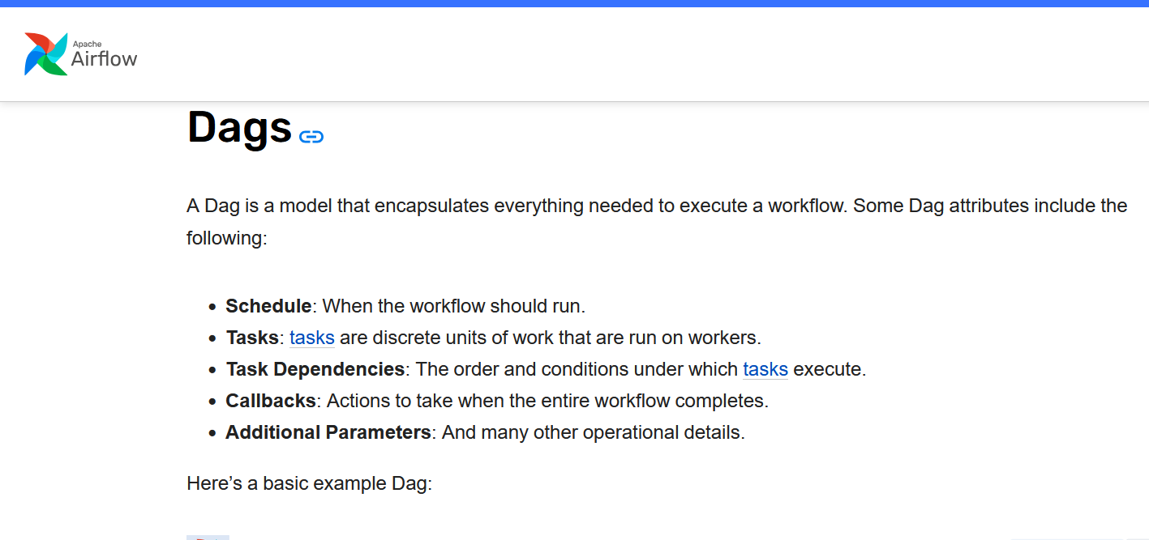
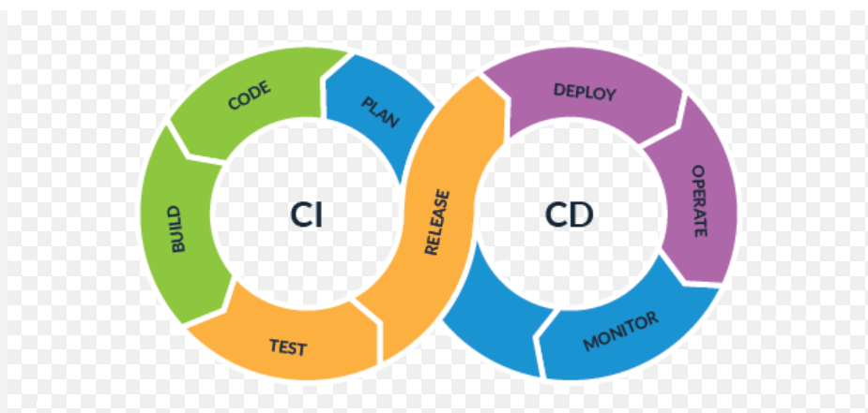

BEYOND THE CORE PROJECT
Enterprise Software Development
Terraform
Apache Airflow
Jira
• Infrastructure as Code
• DAGs
• Scheduling
• Task Dependencies
• Monitoring & Retries
• Ticket Creation
• Issue Tracking
• Agile Workflow
CI/CD PIPELINE
Developer
▸
Cloud Build
▸
Artifact
Registry
▸
Cloud Run
▸
Deployment
<< Airflow Screenshot >>
<< Pipeline Screenshot >>
<< Jira Screenshot >>
Ford Internship Experience
13
Notes:
Beyond the core pricing project, the internship exposed me to the broader enterprise software development toolchain. Terraform introduced me to Infrastructure as Code — defining cloud resources in version-controlled configuration files instead of clicking through a console, so environments are reproducible and auditable. Apache Airflow was used for workflow orchestration: I learned what a DAG is, a Directed Acyclic Graph that represents a workflow as a set of tasks with dependencies between them, how tasks are scheduled to run automatically, how Airflow monitors task status, and how it retries failed tasks automatically rather than requiring manual intervention. The CI/CD pipeline ties deployment together: a developer pushes code, Cloud Build compiles and packages it, the resulting artifact is stored in Artifact Registry, and Cloud Run deploys and serves it — a fully automated path from code change to running service. Jira rounded this out on the process side: creating tickets for new work, tracking issues through their lifecycle, and following an agile workflow with the team. None of these were the core deliverable, but understanding how they fit around a project gave me a realistic picture of how software actually ships inside a large enterprise like Ford.

Slide 13

QUALITY ASSURANCE
Manual Validation
Automation results were not taken at face value. Pricing output was manually validated across multiple regions before being treated as reliable for business use.
REGIONS VALIDATED
United Kingdom
Germany
Spain
France
VALIDATION FLOW
Cloud Storage
Images
▸
Website
Prices
▸
Part
Pricing
▸
Validation
Manual validation matters because automated output can look complete while still being wrong — a bad selector, a stale page, or a currency mismatch can silently produce believable but incorrect prices. Checking output against the live site and source images is what makes the data trustworthy.
Ford Internship Experience
14
Notes:
Automated output is only as trustworthy as the checks behind it, so before treating the pricing data as reliable for business use, I ran a manual validation pass across four regions: United Kingdom, Germany, Spain, and France. The validation flow compared source images stored in Cloud Storage against live website prices, cross-checked those against the part pricing the automation produced, and flagged any mismatches for review. I explain why this step matters, plainly: automated output can look complete and well-formatted while still being wrong — a broken page selector, a stale cached page, or a currency or unit mismatch can all produce a price that looks plausible but is not correct, and nothing in the automation itself would catch that. Manual validation is the safety net that catches those silent failures before the data reaches a business decision. This is also a professional habit worth highlighting to the reviewers: treating automation output as a draft that needs verification, not a finished product, is standard practice in production data engineering, and building that habit early was one of the more important, less visible lessons of the internship.

Slide 14
GROWTH
Skills & Reflection
TECHNICAL SKILLS
PROFESSIONAL SKILLS
Python
Automation
Web Scraping
Problem Solving
Debugging
BigQuery
Cloud Storage
Terraform
Documentation
Team Collaboration
Airflow
CI/CD
Jira
Validation
Cloud Computing
Security Awareness
REFLECTION
This internship gave me practical, hands-on exposure to enterprise cloud infrastructure, secure authentication patterns, structured data engineering, and real-world web automation — not as isolated exercises, but as pieces of one connected pipeline. Working through Google Cloud, BigQuery, and Cloud Storage taught me how enterprise systems are actually structured and secured, while the pricing automation project taught me that real-world engineering includes constraints outside my own code, like enterprise-grade bot protection, that have to be investigated and explained rather than assumed away. Building the CI/CD, Airflow, and Jira habits around the core project showed me that shipping software professionally is as much about process, monitoring, and validation as it is about writing the initial script. Above all, I learned to treat automated output as something to verify, not something to trust blindly.
Ford Internship Experience
15
Notes:
Close the technical narrative with a skills summary and a genuine reflection. On the technical side: Python, automation, and web scraping formed the scripting core; BigQuery and Cloud Storage gave hands-on cloud data experience; and Terraform, Airflow, CI/CD, and Jira rounded out exposure to how enterprise teams build, deploy, and track work. On the professional side: problem solving and debugging came directly from working through the 403 blocking issue methodically instead of guessing; documentation and team collaboration came from working within an existing engineering team's practices; validation is its own professional skill, not just a technical step; and cloud computing and security awareness came from the service account impersonation and IAM work. Read the reflection paragraph slowly and genuinely rather than rushing it — this is the moment to sound like an engineer who understands that real-world development means working within constraints, verifying results, and collaborating with a team, not just writing code that runs once. This slide is meant to leave managers and mentors with a clear sense of growth, not just a list of tools touched.

Slide 15

THANK YOU
With sincere thanks to my mentors, teammates, and Ford for this learning opportunity.
Notes:
Close with genuine thanks to mentors, teammates, and Ford for the opportunity, then open the floor for questions. Keep this brief and sincere — 15-20 seconds — and be ready to speak in more depth about any of the earlier slides, especially the root-cause investigation and the cloud architecture, since those are the most likely places managers and engineers will probe further.

