Slide 1
Inscribed
Circumscribed

Slide 2
254
253
252 * exp(-1.0 * csf * (distance - radius))
Inflation Radius

Slide 3
Cost
254
253
cost_decay
Inflation radius
Robot centre
cell
Robot radius
Distance from obstacle (cells)

Slide 4
RVIZ
Transform frames
move_base/simple_goal
move_base package
base_link
Global planner
Global
costmap
\map
Cartographer
Height publisher
\range
Recovery
behaviour
\scan_filtered_nans
Ultrasound sensor
Local
planner
Local
costmap
Scan filter
\filtered_nans
\scan
Imu filter
Hokuyo Laser Scanner
\imu
Controller
Erle brain
MAVROS
Hardware
To px4 offboard mode
Modifications by URSA
Written by URSA

Slide 5
Goal
Carrot goal
Drone
Wall

Slide 6
Goal
Drone
Wall

Slide 7
Global goal
Local goal
Wall
Drone

Slide 8
Wall
Max cost
Superimposes
footprint
Start from origin
Drone

Slide 9
Wall
Max cost
Only considers origin
Start from footprint
Drone

Slide 10
d
Local goal
Local trajectory
Global goal
Inflation radius
c
θ
Obstacle
α
Current position

Slide 11
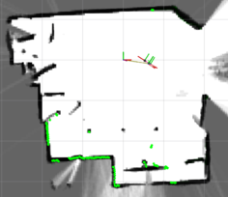
M
H
I
J
K

Slide 12
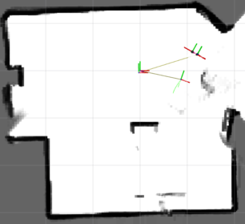
A
B
C
L
D
E
F
G

