Slide 1
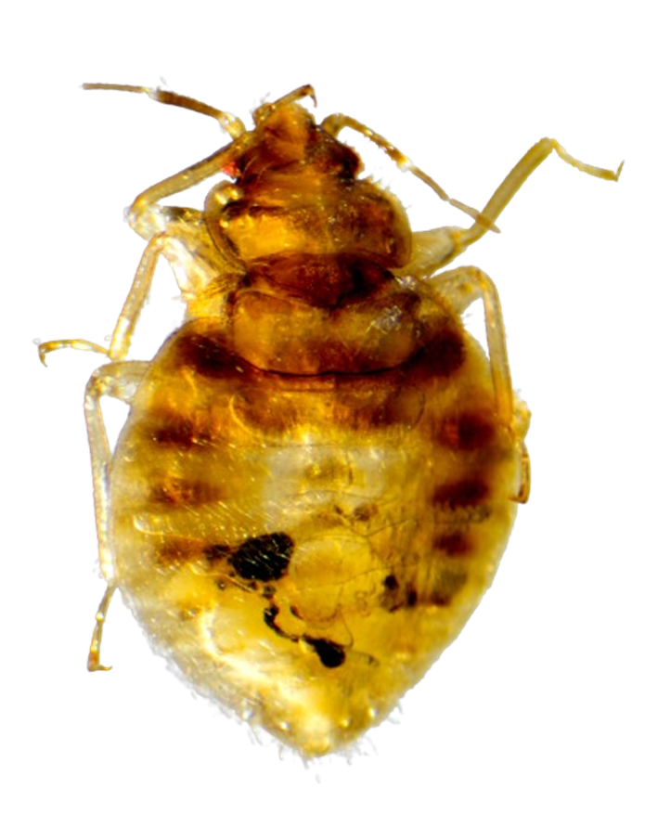
Presence/absence of Isolation by distance in the swallow bug
fastQC
STACKS
R: GENEPOP;
HIERFSTATS;
vcfR;
Laci Cartmell
BIOL-7263
Notes:
Should I list lab in addition to university?
Today, I am going to tell you about the population genetics of the swallow bug. They are a temporary parasite of the cliff swallow.

Slide 2
Background: Cimex vicarius
Parasitizes the cliff swallow (Petrochelidon pyrrhonota) which is a migratory and highly colonial passerine
colonies are typically separated by 1-10km in a study area of 200x50km
colonies are non-randomly clustered (Moran’s I)
Actively disperse within a colony
Passively disperse between colonies by cliff swallow movement

Slide 3
Aim
Previous work found that the genetic diversity of swallow bugs from cliff swallow colony sites were negatively associated with distance from ancestral cliffs (Moore, 2016)
Using restriction-associated sequencing to generate SNPs, evaluate the genetic distance with respect to geographic distance between colonies

Slide 4
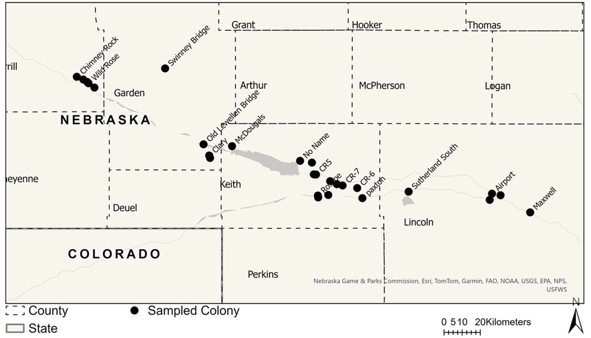
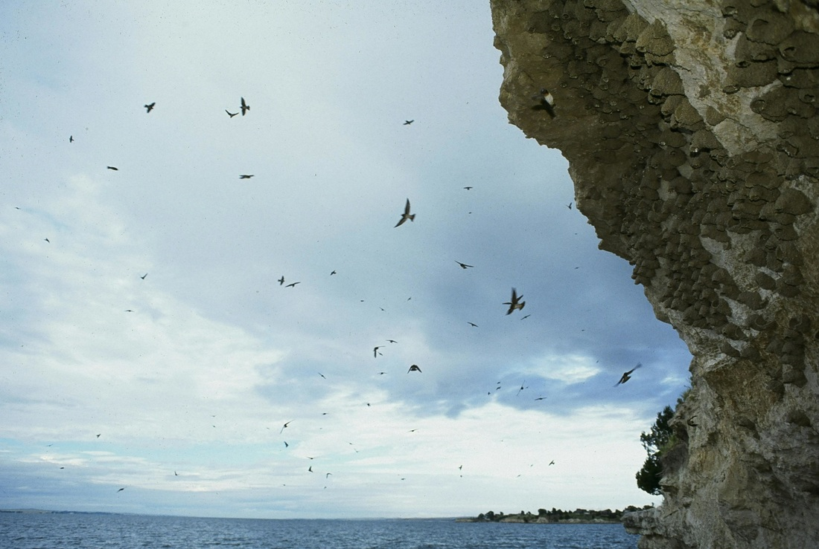
Methods: pre-sequencing
https://www.cliffswallow.org/photos
Swallow bugs were collected from 23 cliff swallow colonies in 2014 and 14 colonies in 2021
DNA extraction & library prep
double-digest Restriction Site-Associated DNA sequencing (ddRAD-seq)
Sequenced using Illumina HiSeq 4000 at the University of Oregon Genomics and Cell Characterization Core Facility (GC3F)

Slide 5
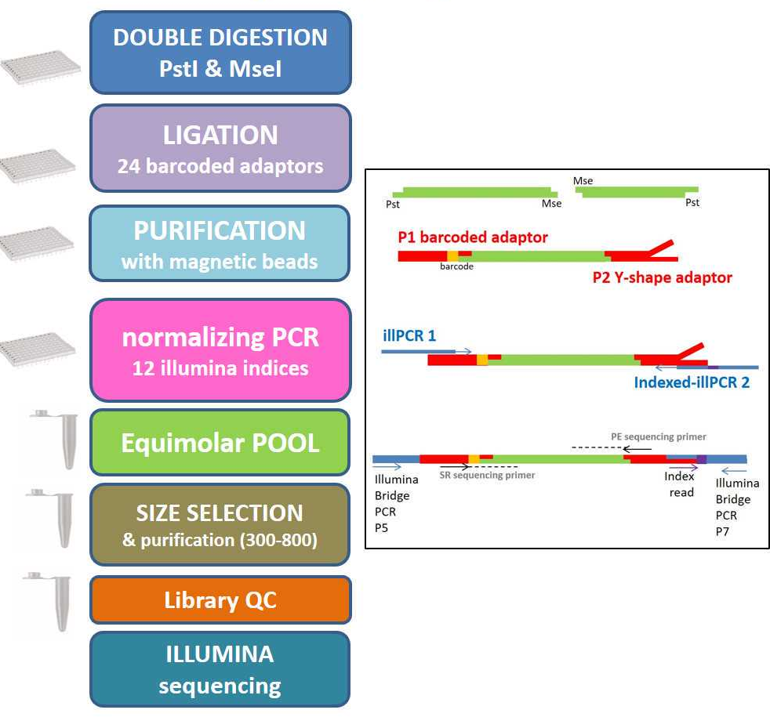
Methods: pre-sequencing
Swallow bugs were collected from 23 cliff swallow colonies in 2014 and 14 colonies in 2021
DNA extraction & library prep
double-digest Restriction Site-Associated DNA sequencing (ddRAD-seq)
sequences the same subset of a genome across many samples at one time
Sequenced using Illumina HiSeq 4000 at the University of Oregon Genomics and Cell Characterization Core Facility (GC3F)

Slide 6
Common Restriction Enzyme
Rare Restriction Enzyme
Digestion by Restriction Enzymes
Genomic Fragment
Ligation of P1 and P2 adapters
Genomic Fragment
Adaptor 1
Multiplexing
Barcode
Common Restriction Site
Rare
Restriction Site
Adaptor 2
Single-end Sequencing
Single Nucleotide Polymorphisms (SNPs)
Sample 1
AATCGCAG
AATCGCAG
Sample 2
AATCGCTG
AATCGCTG
AATCGCTG

Slide 7
Methods: post-sequencing
fastQC & MulitQC
STACKS
R
adegenet
hierfstats
vcfR
Notes:
The samples were separated by year so that the core pipeline and populations were run twice - once for 2014 and once for 2021 collected samples. The core pipeline builds loci (ustacks), creates a catalog of loci (cstacks), matches samples to the catalog (sstacks), reorganizes the data by RAD locus (tsv2bam), and calls genotypes and phases SNPs into haplotypes (gstacks). The catalogs were constructed from 63 (2014) and 40 samples (2021) that were representative of the sampling sites and included individuals with greater than 1 million reads. After the core de novo pipeline completed, it was followed by the alignment of the consensus sequences in the catalog to the reference genome of C. lectularius using the BWA-MEM algorithm. The stacks-integrate-alignments program integrates the locus alignment coordinates into the de novo catalogs, while filtering to eliminate spurious alignments. (Catchen et al., 2011).

Slide 8
fastQC → MulitQC
Sequence File | Dups | GC | Length | Seqs
L2203_01_S1_L002_R1_001 | 91.8% | 46.0% | 132bp | 181.3M
L2203_02B_S2_L002_R1_001 | 93.3% | 41.0% | 132bp | 157.7M
L2203_08_S3_L002_R1_001 | 91.0% | 39.0% | 132bp | 95.1M
L2209-01_S1_L002_R1_001 | 90.7% | 43.0% | 132bp | 140.0M
L2209-02_S2_L002_R1_001 | 91.1% | 43.0% | 132bp | 149.4M
L2210-01_S3_L001_R1_001 | 92.6% | 38.0% | 132bp | 124.5M
L2211-01_S1_L001_R1_001 | 94.2% | 39.0% | 132bp | 144.4M
L2211-02_S2_L001_R1_001 | 97.1% | 39.0% | 132bp | 165.3M

Slide 9
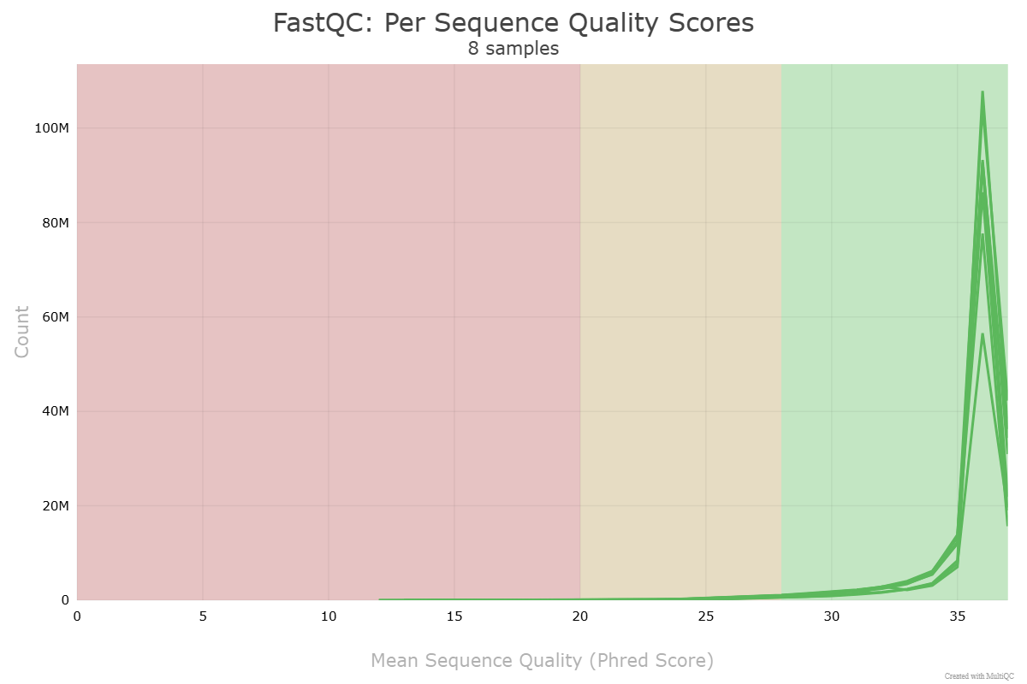
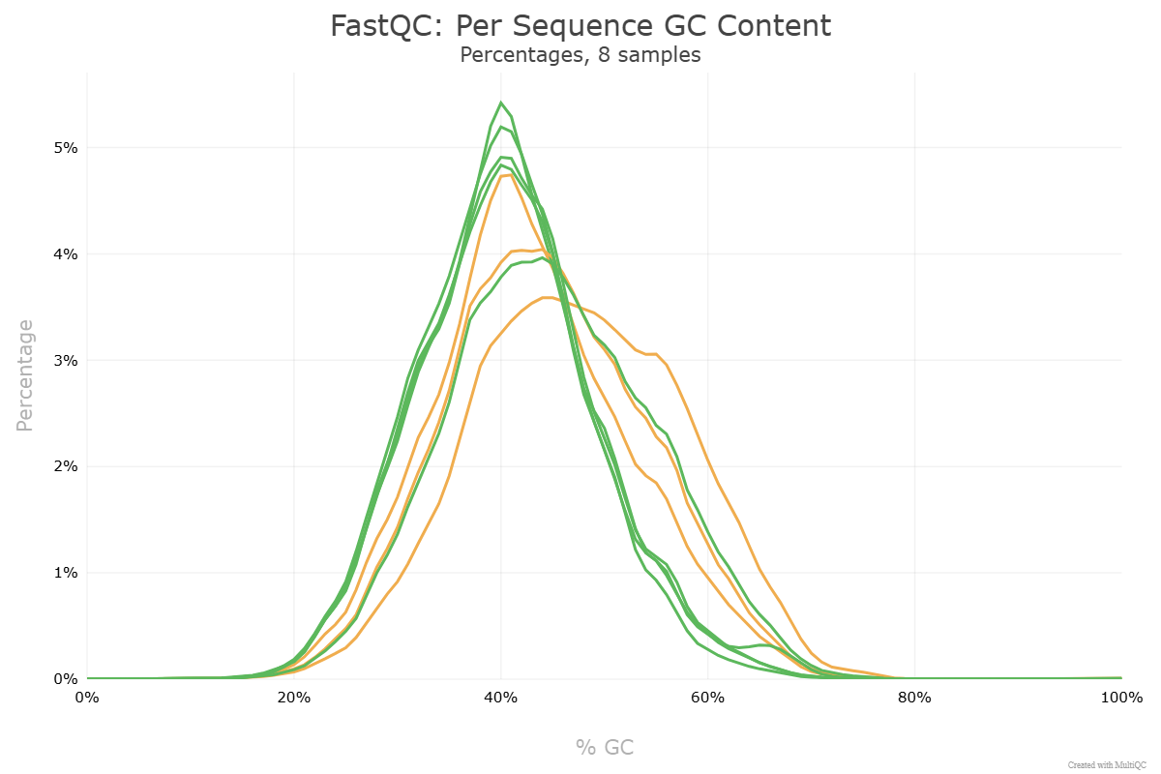
fastQC → MulitQC

Slide 10
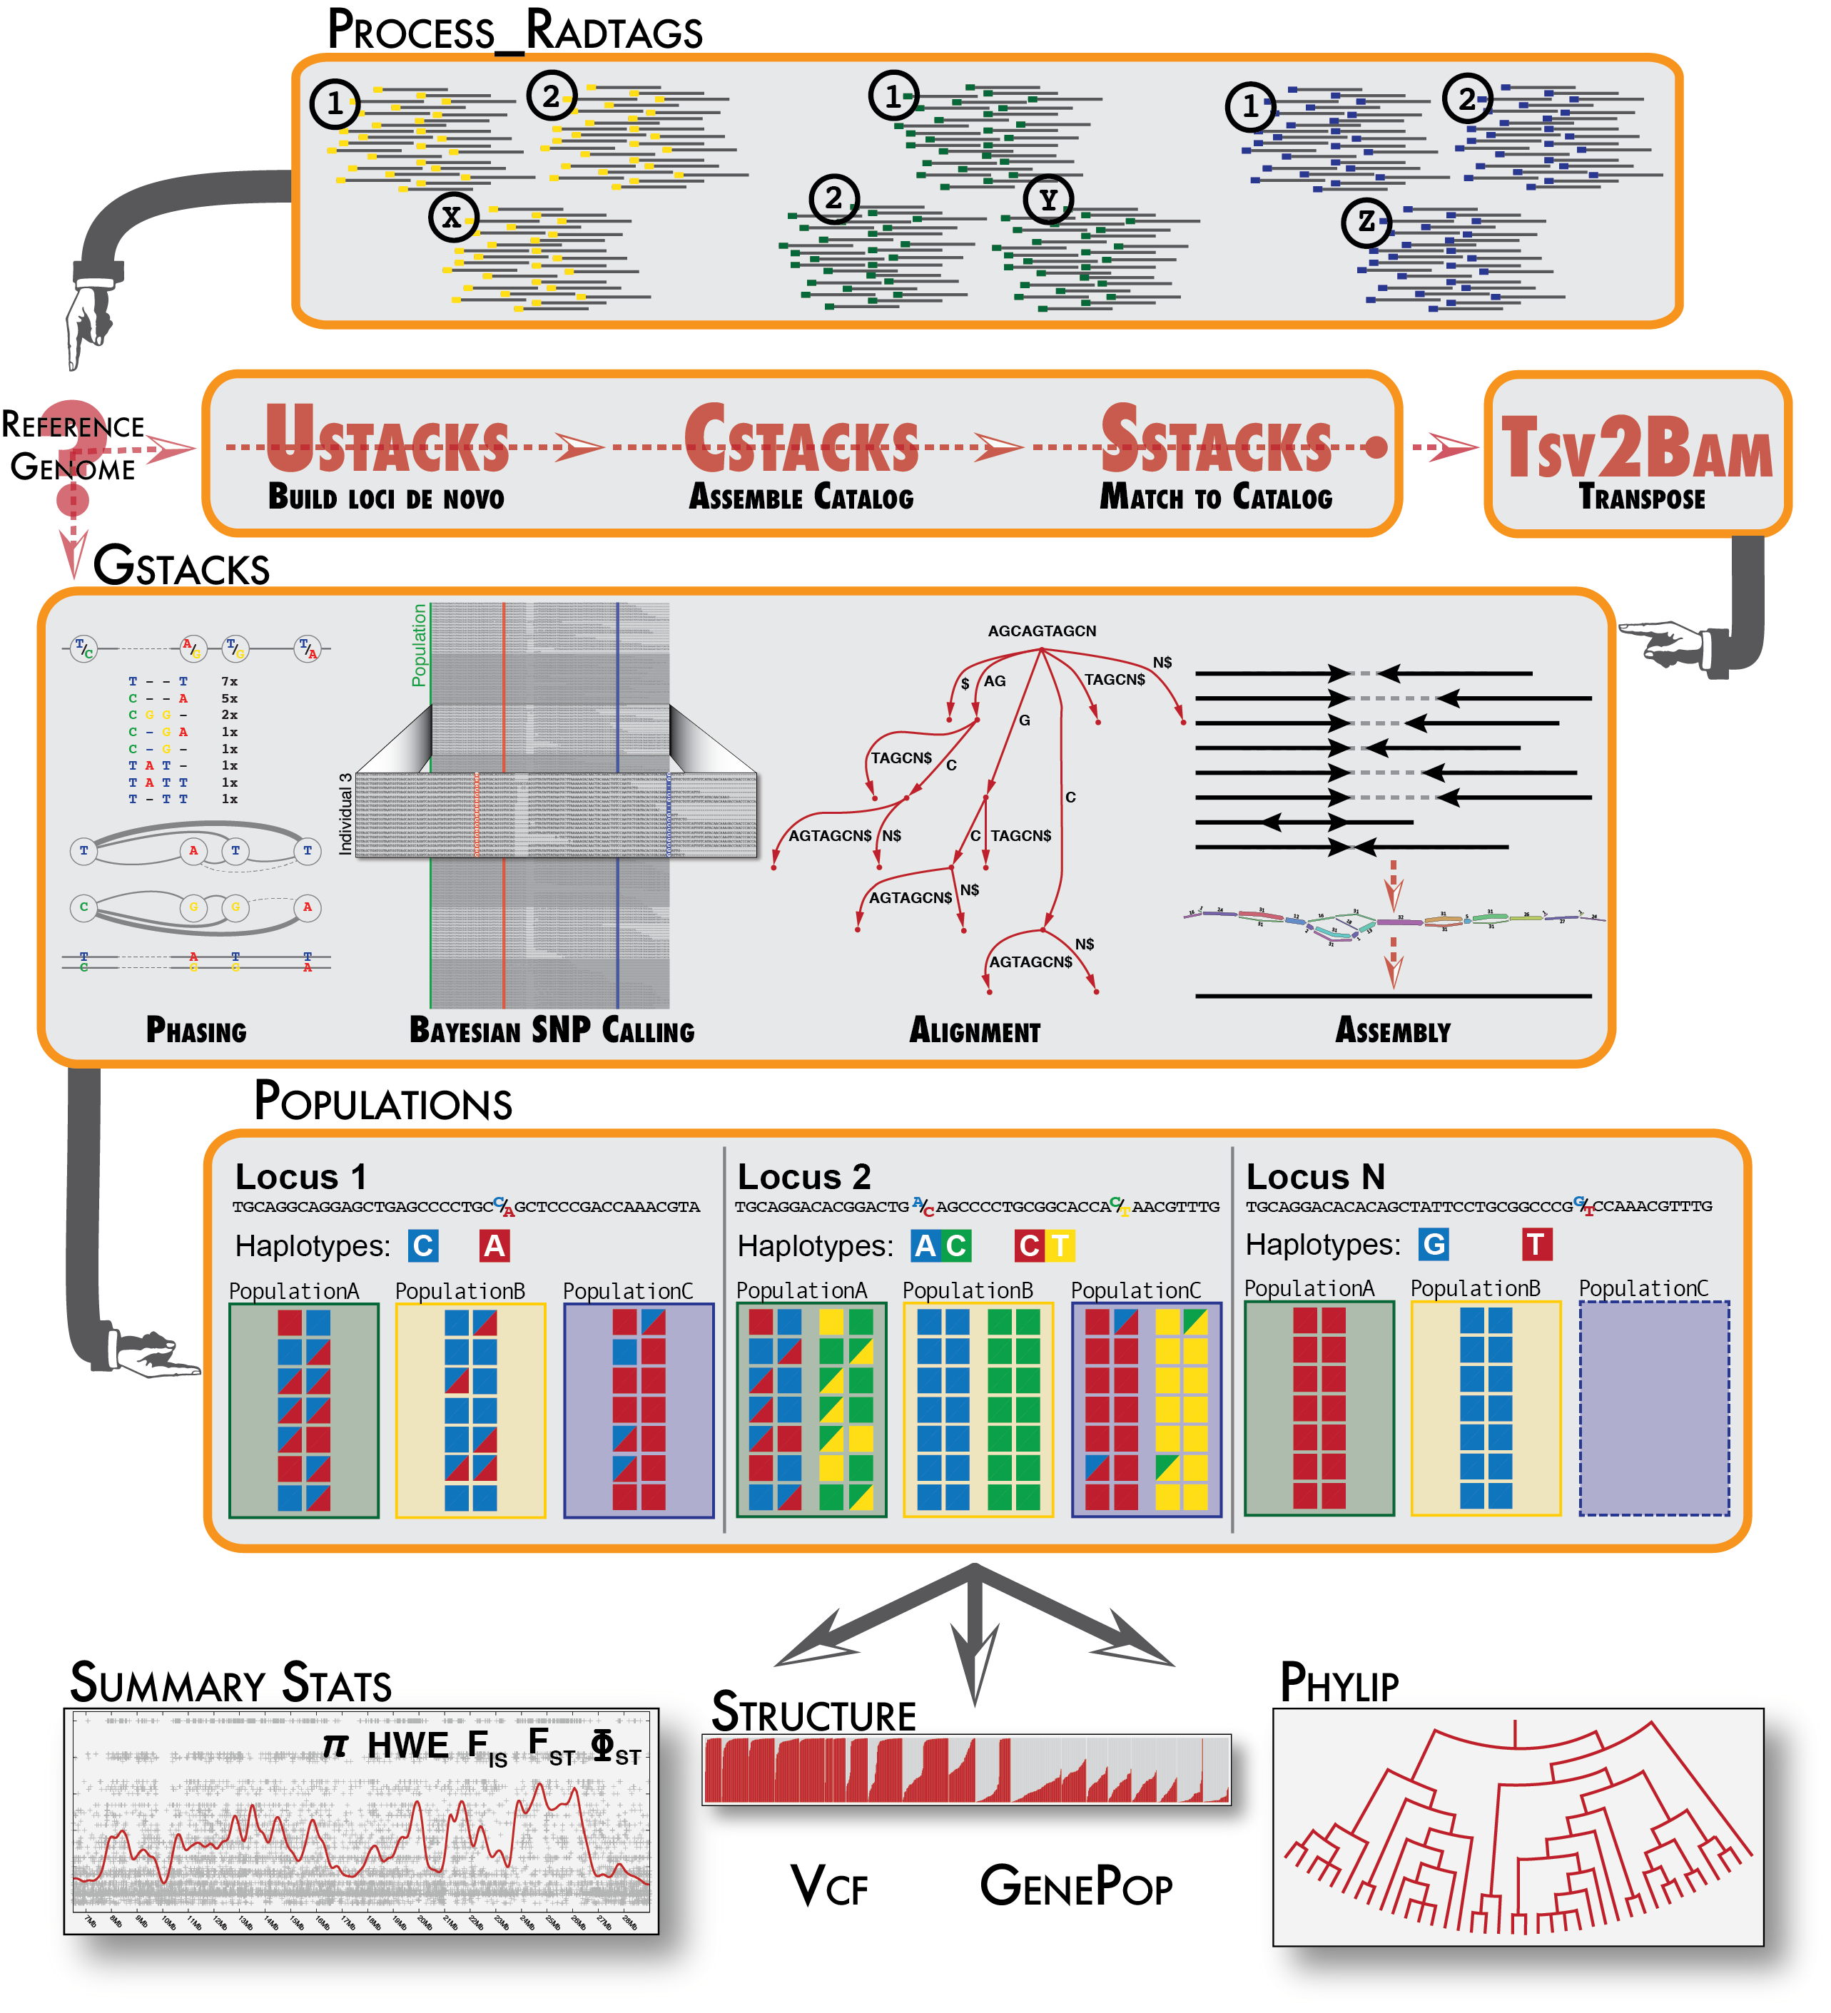
STACKS v2.65
Assembles loci from short-read sequences derived from RAD-seq protocols
process radtags – cleans and demultiplexes samples
ustacks – builds loci from all individuals
cstacks – attempts to match loci across select samples to build a catalog
sstacks – matches samples to a catalog
tsv2bam – sorts by RAD locus
gstacks – calls genotypes and phases SNPs into haplotypes
bwa mem – aligns consensus sequences in catalog to reference genome
integrate alignment – integrates the locus alignment coords into the de novo catalog
populations – filters and exports files

Slide 11
STACKS – process radtags
Raw Illumina sequence files are demultiplexed and filtered
Sequence files for each sample is created from the raw file based on the index and barcode
Reads with uncalled bases and raw phred quality scores < 30 were discarded
the probability of an incorrect call for that base is 1 in 1000 and the base call accuracy is 99.9%
Recover barcodes and RAD-TAG cut sites with 2 bp mismatches
Overall, 1,157,738,121 reads, of which 1,108,233,323 (95.72%) were retained after filtering .

Slide 12
STACKS v2.65
Assembles loci from short-read sequences derived from RAD-seq protocols
process radtags – cleans and demultiplexes samples
ustacks – builds loci from all individuals
cstacks – select samples to build a catalog
sstacks – matches samples to a catalog
tsv2bam – sorts by RAD locus
gstacks – calls genotypes and phases SNPs into haplotypes
bwa mem – aligns consensus sequences in catalog to reference genome
integrate alignment – integrates the locus alignment coords into the de novo catalog
populations – filters and exports files

Slide 13
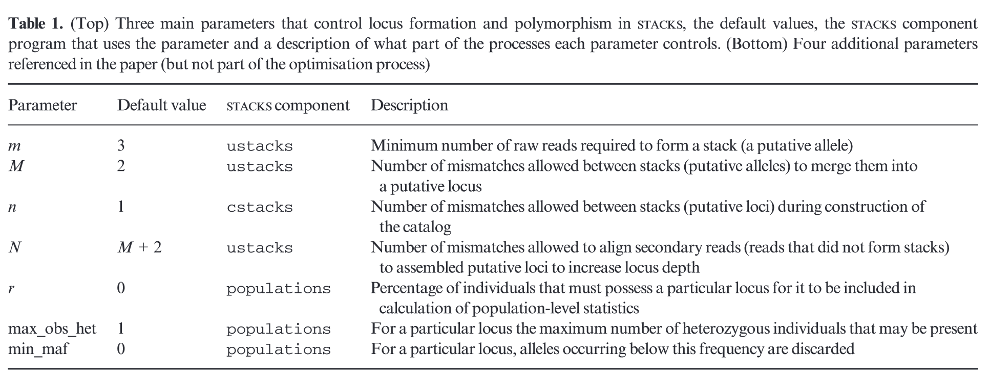
Notes:
The samples were separated by year so that the core pipeline and populations were run twice - once for 2014 and once for 2021 collected samples. The core pipeline builds loci (ustacks), creates a catalog of loci (cstacks), matches samples to the catalog (sstacks), reorganizes the data by RAD locus (tsv2bam), and calls genotypes and phases SNPs into haplotypes (gstacks). The catalogs were constructed from 63 (2014) and 40 samples (2021) that were representative of the sampling sites and included individuals with greater than 1 million reads. After the core de novo pipeline completed, it was followed by the alignment of the consensus sequences in the catalog to the reference genome of C. lectularius using the BWA-MEM algorithm. The stacks-integrate-alignments program integrates the locus alignment coordinates into the de novo catalogs, while filtering to eliminate spurious alignments. (Catchen et al., 2011).

Slide 14
STACKS 2.65 – bwa mem/integrated alignment
bwa mem – aligns consensus sequences in catalog to reference genome & integrates the locus alignment coordinates into the de novo catalog
create index for reference genome
bwa index /home/lcartmell/genome/GCF_000648675.2/GCF_000648675.2_Clec_2.1_genomic.fna
align de novo loci to the reference genome
bwa mem /home/lcartmell/genome/GCF_000648675.2/GCF_000648675.2_Clec_2.1_genomic.fna ./catalog.fa.gz | samtools view -b | samtools sort > ./integrated/catalog_loci.bam
index the mapped alignment
samtools index /scratch/lcartmell/stacks_2014/integrated/catalog_loci.bam
extract loci not aligned
touch ./integrated/unmapped.bam
samtools view -b -f 4 ./integrated/catalog_loci.bam > ./integrated/unmapped.bam
convert to fasta
touch ./integrated/unmapped.fasta
samtools fasta -f 4 ./integrated/unmapped.bam > ./integrated/unmapped.fasta
integrate alignment – integrates the locus alignment coords into the de novo catalog

Slide 15
STACKS 2.65 – bwa mem/integrated alignment
2014
Read 690,485 total alignments: 133,780 mapped; 546509 unmapped
60680 loci filtered; 41401 due to mapping quality (mapq); 19279 due to alignment coverage; 73,100 loci remain
2021
Read 489,459 total alignments: 74,889 mapped; 409,779 unmapped; 4791 supplementary alignments.
31569 loci filtered; 22750 due to mapping quality (mapq); 8819 due to alignment coverage; 43,320 loci remain.

Slide 16
STACKS 2.65 - populations
used to filter the data and export loci for downstream analyses.
minimum of 2 populations and in 70% of individuals within a subpopulation
minimum allele count of 3
maximum heterozygosity of 0.5
A single, random snp was kept
exports a genepop file

Slide 17
Now to R!
gpop.x <- read.genepop("populations.snps.gen", ncode = 2)
rename populations
current_pops <- pop(gpop.x)
popmap_10x_2021 <- read_delim("popmap_2021_10x.txt", delim = "\t", header=FALSE)
pop_id <- (popmap_10x_2021[,2])
pop_id_vector <- pop_id$X2
pop(gpop.x) <- pop_id_vector
specify ploidy
ploidy(gpop.x) <- 2
check the class, adegenet
class(gpop.x)

Slide 18
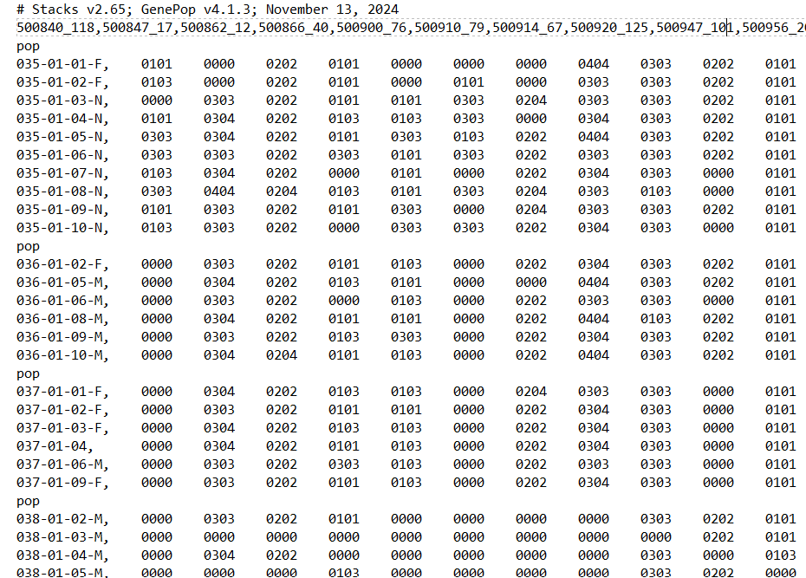
Genepop files – adegenet/hierfstat
add stratification to genind for hierfstat
strata(gpop.x) <- hier_WE_YRprint(gpop.x)
view strata
strata(gpop.x)
check that its genind, adegenet
class(gpop.x) // is.genind(gpop.x)
convert genind to hierfstat
fstat <- genind2hierfstat(gpop.x)str(hfstat)

Slide 19
Hierfstat - fst
Estimates pairwise FSTs according to Weir and Cockerham (1984)
pwcfst <- pairwise.WCfst(hfstat, diploid=TRUE)
pwcfst.zero <- pmax(pwcfst, 0)
Save results to table
write.table(pwcfst.zero, file='pairwise.WCfstZ.txt’)
boot.wcfst <- boot.ppfst(hfstat, nboot =10000, quant=c(0.025,0.975), diploid = TRUE)
boot.wcfstwrite.table(boot.wcfst$ul, file='boot.fst.ul.txt’)
write.table(boot.wcfst$ll, file='boot.fst.ll.txt’)
write.table(boot.wcfst, file='boot.fst.txt')

Slide 20
Geographic distance
Read in coordinates
col.coords <-read_excel("F:\nlcd_land_cover_l48_20210604\ColonyData\NLCD_Coordinates.xlsx", sheet = "sheet1")
Keep only unique rows
datatable <- unique(colcoords[,1])
Compute pairwise geographic distances
geo_distances <- distm(as.matrix(coords), fun = distVincentySphere)
genetic distance measure
genetic_distances <- vegdist(genotype_matrix, method = "bray)

Slide 21
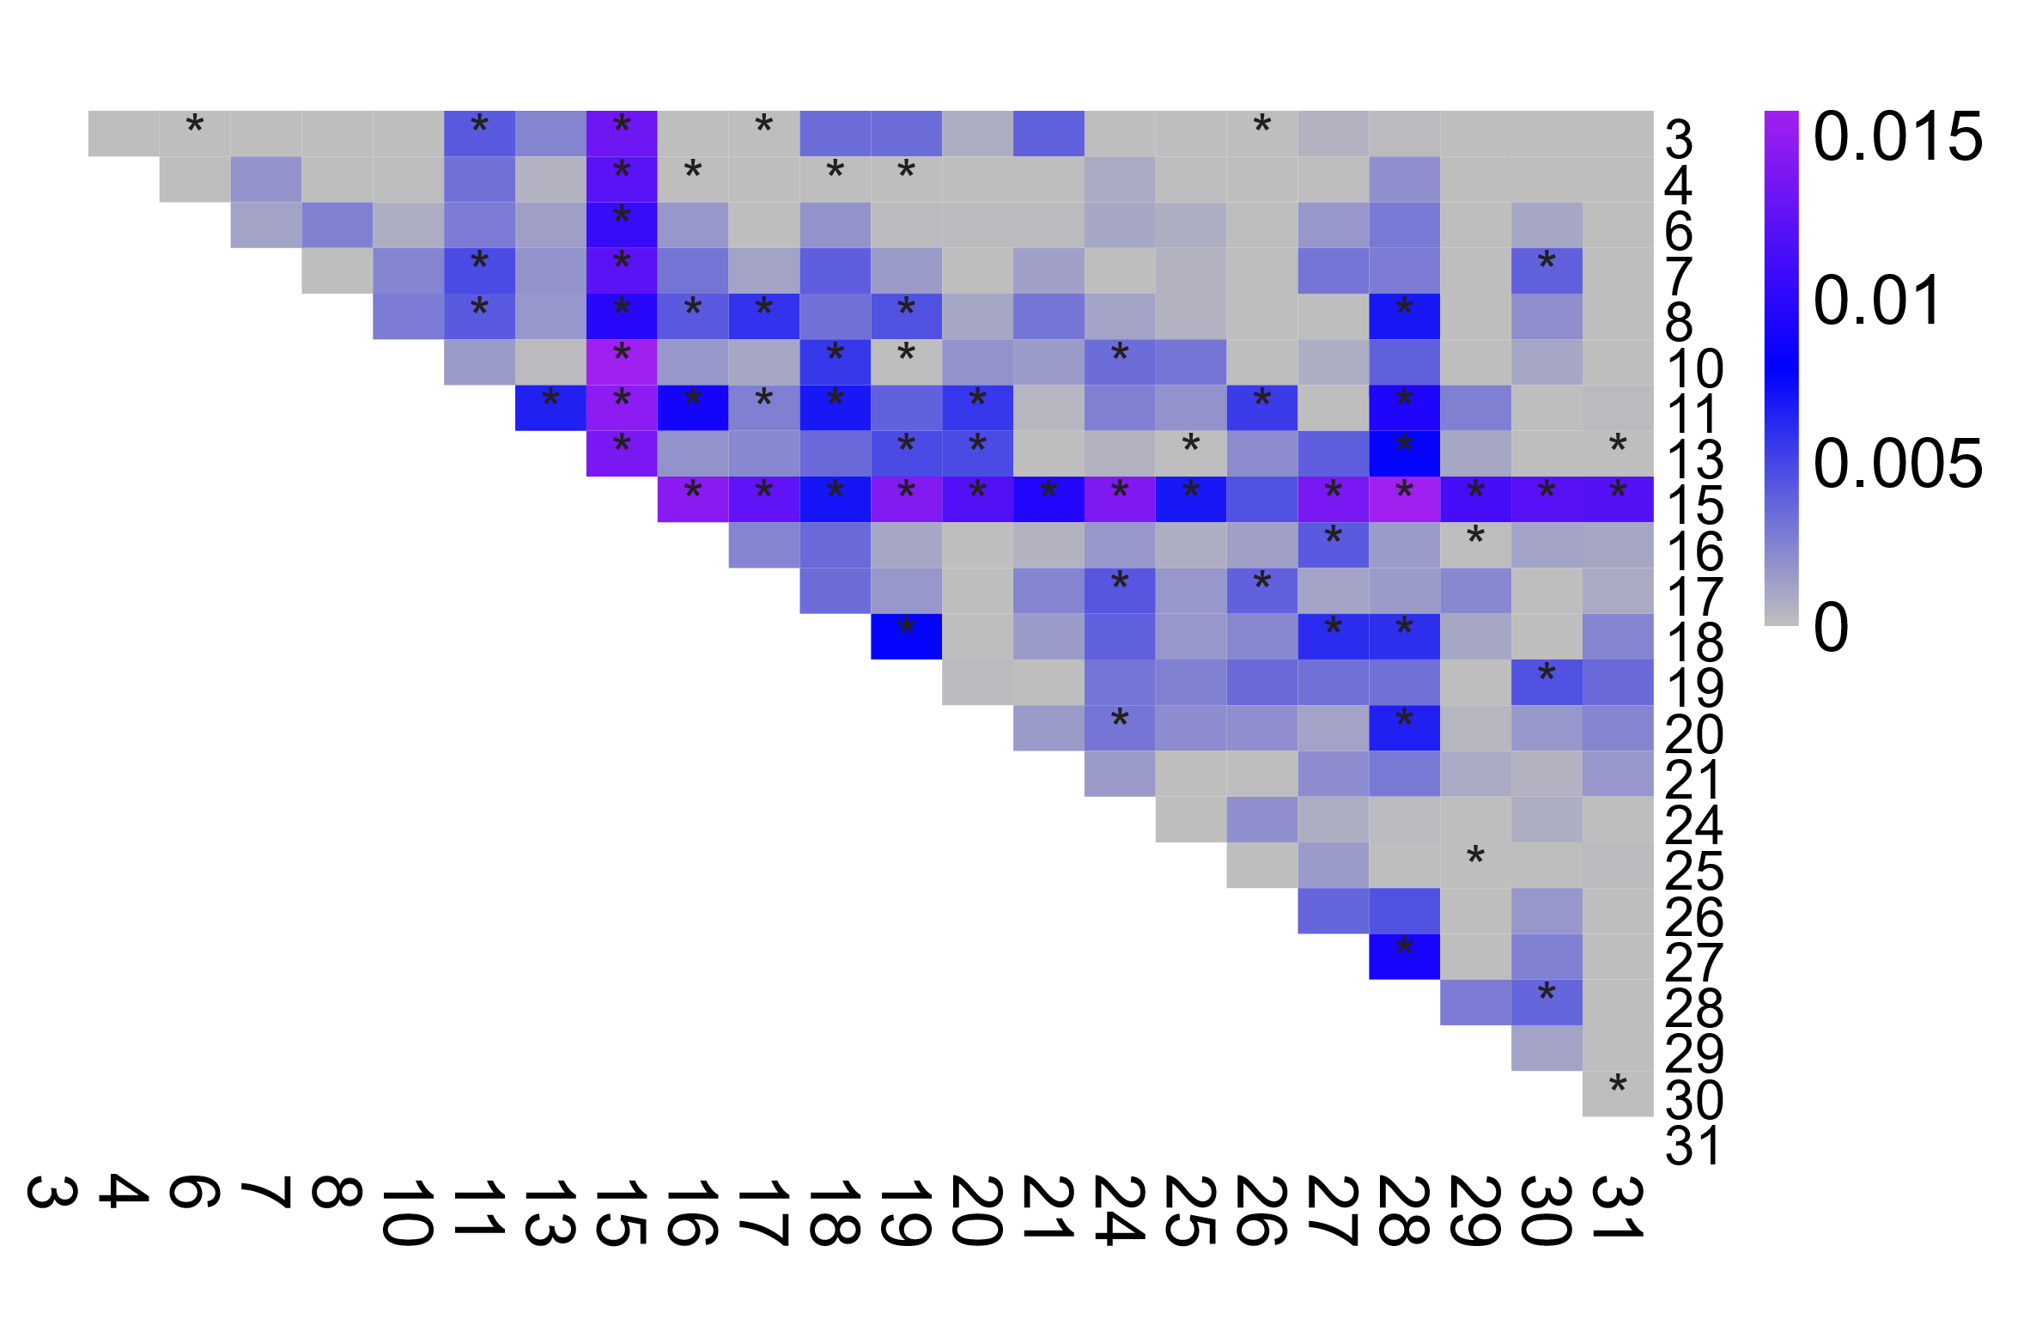
F_{ST}, Fixation Index
2014
Measure of genetic differentiation between subpopulations
Higher F_{ST} correspond to more genetic differentiation between colonies
Hierfstat in R

Slide 22
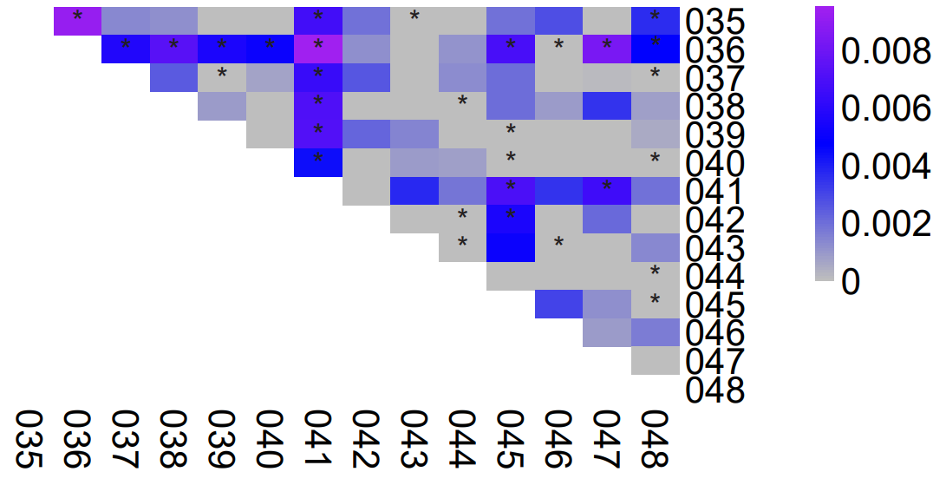
F_{ST}, Fixation Index
2021
Measure of genetic differentiation between subpopulations
Higher F_{ST} correspond to more genetic differentiation between colonies
Hierfstat in R

Slide 23
The results
Genetic analyses revealed low population differentiation of swallow bugs across southwestern Nebraska
These results indicate that passive dispersal may occur more frequently than previously estimated
Don’t have IBD results yet

