Slide 1

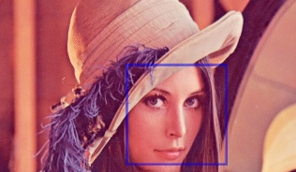
Introduction to OpenCV
Marvin Smith

Slide 2

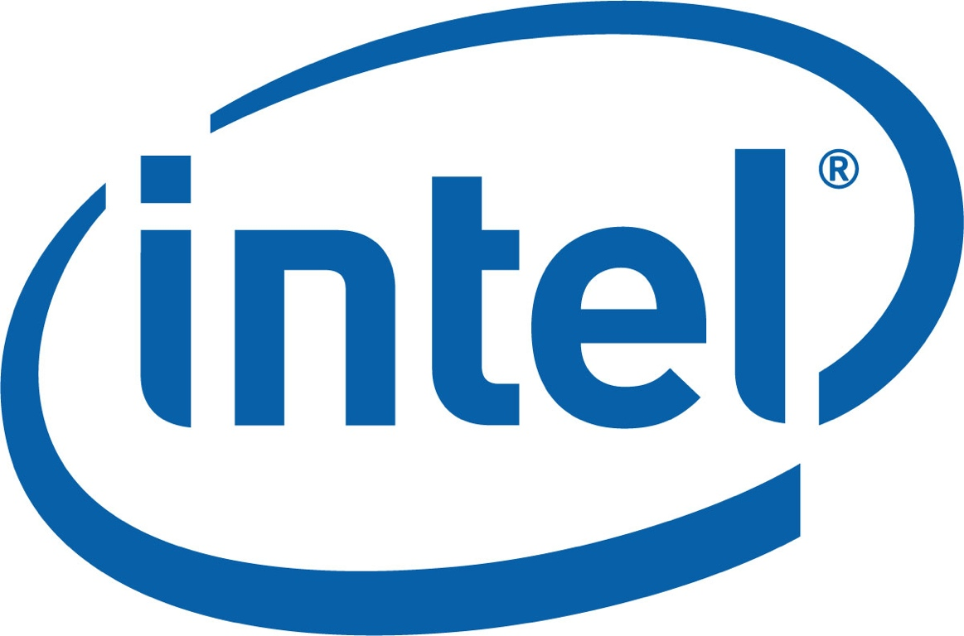

Introduction
OpenCV is an Image Processing library created by Intel and maintained by Willow Garage.
Available for C, C++, and Python
Newest update is version 2.2
Open Source and free
Easy to use and install

Slide 3
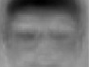
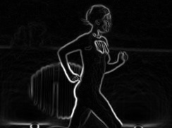
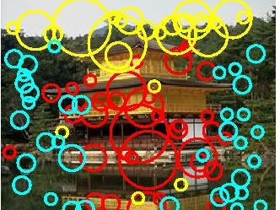
Installation Instructions
For Mac OS X. Simply install Mac Ports then type
sudo port install opencv
Do not use synaptic on Linux to install OpenCV.
It is version 1.2.
For Linux and Windows, follow the installation guide at http://opencv.willowgarage.com/wiki/InstallGuide
Linux users can come to me for help. I have built it on Ubuntu dozens of times. I have built it successfully on Windows once.
Make sure to read the beginning as it gives you precise commands to install ffmpeg, libavformat-dev, libswscale-dev, and other required libraries.
Follow instructions exactly!!!!!

Slide 4
BASIC OPENCV STRUCTURES
  Point, Point2f - 2D Point
  Size - 2D size structure
  Rect - 2D rectangle object
  RotatedRect - Rect object with angle
  Mat - image object

Slide 5
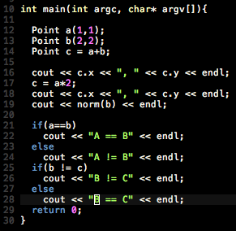

Point
Math operators, you may use
Point operator +
Point operator +=
Point operator -
Point operator -=
Point operator *
Point operator *=
bool operator ==
bool operator != double norm
2D Point Object
  int x, y;
Functions
  Point.dot(<Point>) - computes dot product
  Point.inside(<Rect>) - returns true if point is inside

Slide 6
Size
2D Size Structure
  int width, height;
Functions
  Point.area() - returns (width * height)
RECT
2D Rectangle Structure
int x, y, width, height;
Functions
Point.tl() - return top left point
Point.br() - return bottom right point

Slide 7
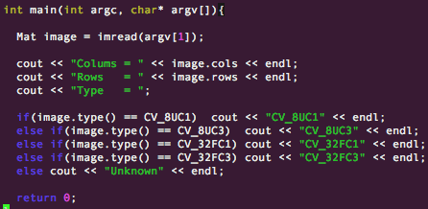

cv::Mat
The primary data structure in OpenCV is the Mat object. It stores images and their components.
Main items
  rows, cols - length and width(int)
  channels - 1: grayscale, 3: BGR
  depth: CV_<depth>C<num chan>
See the manuals for more information

Slide 8
cv::Mat
Functions
  Mat.at<datatype>(row, col)[channel] - returns pointer to image location
  Mat.channels() - returns the number of channels
  Mat.clone() - returns a deep copy of the image
  Mat.create( rows, cols, TYPE) - re-allocates new memory to matrix
  Mat.cross(<Mat>) - computes cross product of two matricies
  Mat.depth() - returns data type of matrix
  Mat.dot(<Mat>) - computes the dot product of two matrices

Slide 9
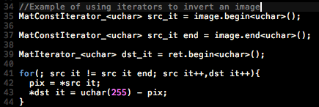
cv::Mat
Functions
  Mat(Range(xmin,xmax),Range(ymin,ymax)) - returns sub image
  Mat.type() - returns the TYPE of a matrix
Iterator Usage
  Mat.begin() - moves Mat iterator to beginning of image
  Mat.end() - moves Mat iterator to end of image

Slide 10
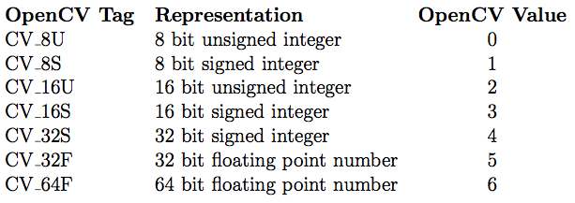
Image TYPES
The TYPE is a very important aspect of OpenCV
Represented as CV_<Datatype>C<# Channels>
Example Datatypes/ Depths

Slide 11
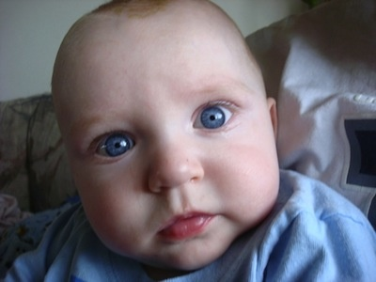
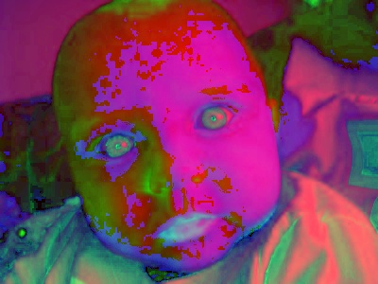
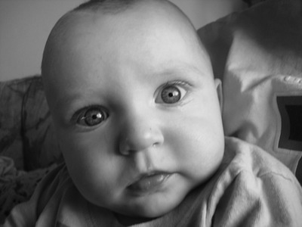
Pixeltypes
PixelTypes shows how the image is represented in data
  BGR - The default color of imread(). Normal 3 channel color
  HSV - Hue is color, Saturation is amount, Value is lightness. 3 channels
  GRAYSCALE - Gray values, Single channel
OpenCV requires that images be in BGR or Grayscale in order to be shown or saved. Otherwise, undesirable effects may appear.

Slide 12
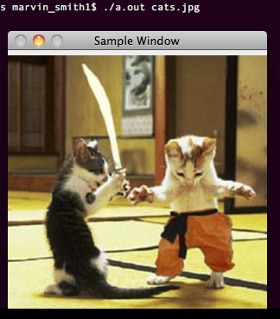
HELLO WORLD
Example Code
This program will load and show an image
//Loads image and displays
//call by ./a.out image.jpg
//
#include <cv.h>
#include <cvaux.h>
#include <highgui.h>
using namespace cv;
int main(int argc, char* argv[ ]){
Mat image = imread(argv[1]);
namedWindow(“Sample Window”);
imshow(“Sample Window”,image);
waitKey(0);
return 0;
}

Slide 13
Starting Out in OpenCV
OpenCV uses the cv namespace.
cv::Mat object replaces the original C standard IplImage and CvMat classes.
All original functions and classes of the C standard OpenCV components in the Bradski book are still available and current. However you will need to read that book for it.
namedWindow is used for viewing images. See my manual for instructions on calling it.
  In general, default string as input with original image size set. Else, use string as input name and 0 for adjustable size.

Slide 14
Image I/O
Examples
//Read an image
Mat image = imread( <string>, <0 -gray, 1 -BGR>)
//Note 1 is default
//Write an image
imwrite( <string filename> , image );
//Create window for output
namedWindow( <window name> );
//Output image to window
imshow( <window name> , <image Mat to show> );
//pause program for input
key = waitKey( 0 );
OpenCV provides simple and useful ways to read and write images.
Note that there are many extra options to these commands which are available on the wiki.
waitKey( int x ) has two main features.
  if x > 0, then waitKey will wait x milliseconds
  if x = 0, then waitKey will not move until key is pressed

Slide 15
DRAWING STUFF
Sometimes it is necessary to draw stuff onto the image. Instead of using complicated functions, why not just call a simple function?
Here are some simple examples...
void circle(image, Point(x,y),int rad, CV_BGR(b,g,r), int thickness=1)
void ellipse(image, RotatedRect box, CV_BGR(b,g,r), int thickness=1)
void line(image, Point(x,y), Point(x,y), CV_BGR(b,g,r), int thickness= 1)
void rectangle(img, Point(x,y), Point(x,y), CV_BGR(b,g,r), int thickness)
  NOTE: negative thickness will fill in the rectangle
MORE... http://opencv.willowgarage.com/documentation/cpp/core_drawing_functions.html

Slide 16
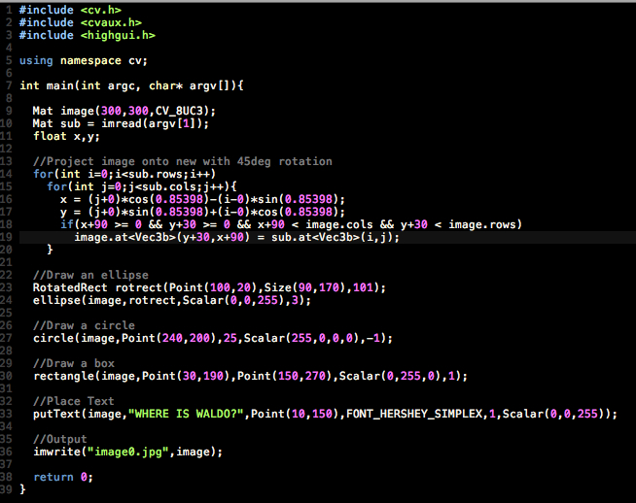
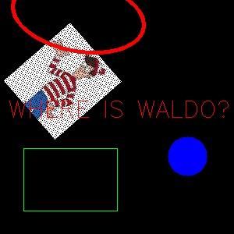
Drawing stuff

Slide 17
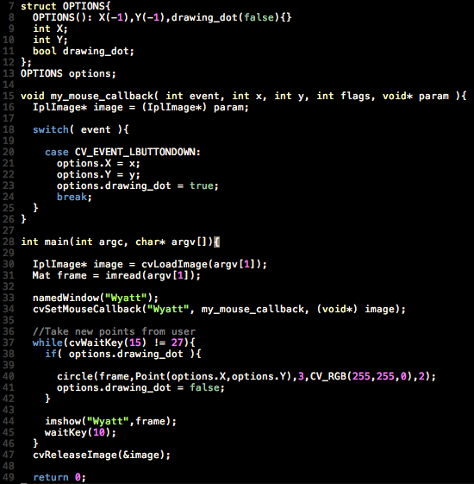
Using the Mouse
OpenCV allows you to use the mouse to interact with the screen. Note that this feature is from OpenCV 1.0 and is compatible with Mat objects.
This program allows you to draw dots on the image.

Slide 18
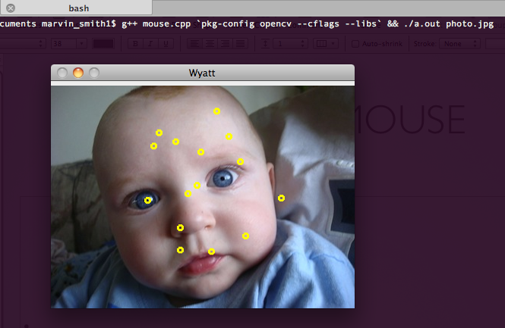
USING THE MOUSE

Slide 19
Converting colorspaces
cvtColor( image, image, code)
  Codes
    CV_<colorspace>2<colorspace>
    Examples
    CV_BGR2GRAY
    CV_BGR2HSV
    CV_BGR2LUV

Slide 20
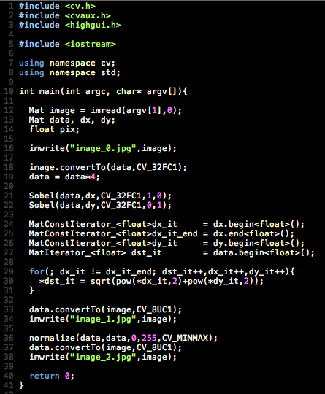
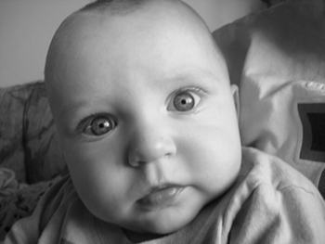
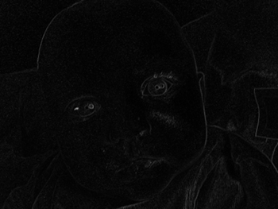
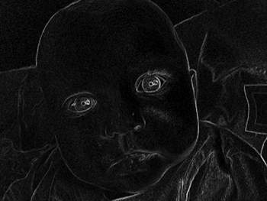
Image Normalization
normalize(imagein, imageout, low, high, method);
Image normalization is the process of stretching the range of an image from [a, b] to [c, d].
This is incredibly important for visualization because if the image is beyond [0,255] it will cause truncation or unsightly effects.

Slide 21
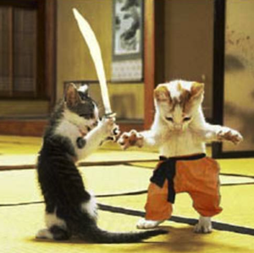
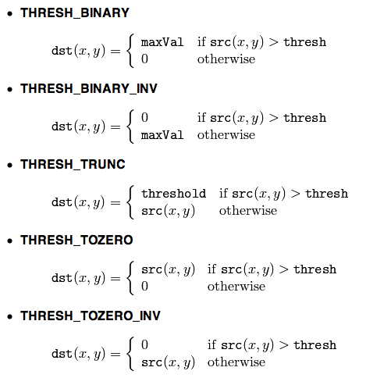
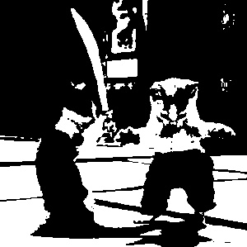
Thresholding
threshold( image, image, thresh, maxVal, CODE);
CODE - this is the method of thresholding. Different actions will be taken depending on this code.

Slide 22
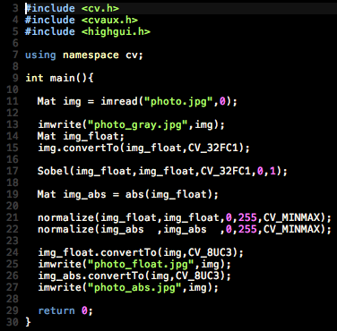

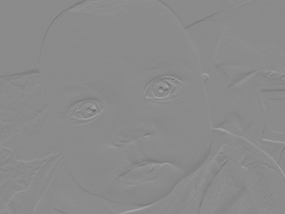
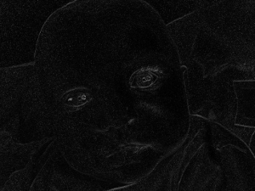
Edge Detection
Sobel Edge Detection
void cv::Sobel(image in, image out, CV_DEPTH, dx, dy);
Scharr Edge Detection
void cv::Scharr(image in, image out, CV_DEPTH, dx, dy);
Laplacian Edge Detection
void cv::Laplacian( image in, image out, CV_DEPTH);

Slide 23
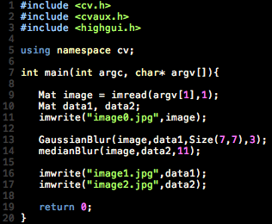
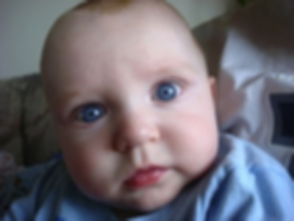

Image Smoothing
Image smoothing is used to reduce the the sharpness of edges and detail in an image.
OpenCV includes most of the commonly used methods.
void GaussianBlur(imagein, imageout, Size ksize, sig);
  Note that there are more options, however this should keep things simple
void medianBlur (imagein, imageout, Size ksize);
Other functions include generic convolution, separable convolution, dilate, and erode.
Original
Gaussian Blur
Median Blur

Slide 24
STOP!
  This is not relevent until the last part of the class.
Beware!

Slide 25
Linear Algebra
OpenCV contains many useful and simple functions for applying linear algebra on images.
Most major operators are allowed.
operator * performs matrix multiplication, NOT elementwise multiplication.
Operators
given: Mat image;
image.inv(); //inverse
image.t(); //transpose
image.clone(); //creates deep copy
image.diag(int d=0) //returns diagonal
  image.mul(mat, double); //performs elementwise multiplication.
  image.cross(mat); //performs cross product
  image.dot(mat); //performs dot product
  image.eye(); //converts mat to identity matrix

Slide 26
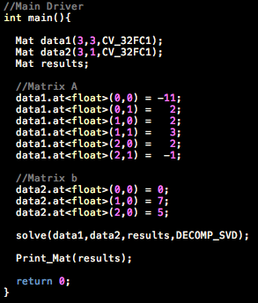
Singular Value Decomposition
Example
given:
-11x + 2y = 0
2x + 3y = 7
2x - y = 5
Singular Value Decomposition is a vital part of any computer vision based system. Luckily, OpenCV makes this a trivial task.
To solve a least-squares problem, simply call the solve command.
bool solve(src1, src2, dst, int flags);
Usually, src1 is A, src2 is b, and dst is x. Remember flags is method...
DECOMP_LU - Fast but cannot solve over-determined systems.
DECOMP_SVD - SVD, can solve just about anything
Others available, but stick to the basics...

Slide 27

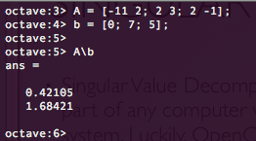
SVD Results
Using OpenCV
Using GNU Octave

Slide 28
Principle Component Analysis
Since you will need to learn this, I will include it. Although you will undoubtably will have to create your own PCA program, OpenCV covers it very nicely.
PCA( Mat data, Mat mean, int FLAG, int numcomp=0)
  FLAG: PCA_DATA_AS_ROW / PCA_DATA_AS_COL
  numcomp is the k value, 0 means all values retained
  in general, just pass the vectors into data and the mean will be returned.
PCA.project( Mat vector)
  projects the vector into the built eigenspace and returns the result
PCA.backproject( Mat vector)
  reconstructs the vector from the principle component subspace

Slide 29
Important Tips
Remember that images are read from file as 8-bit unsigned integers. In order to do complicated math operations, convert to 32-bit floating point type. Then convert back to write to file.
Always remember that rows is your y coordinate and that cols is your x coordinate. Size objects are called X,Y while images are referenced row, col. There are many subtle things that will ruin good code.

