Slide 1
Module 5 Architectures, Features, and Details of Data Integration Tools
Lesson 3: Talend Open Studio
Notes:
Welcome to Lesson 3 of Module 5 on Architectures, Features, and Details of Data Integration Tools.
Opening question
What business model does Talend use for its data integration products? Core model
What is the difference between the community edition and commercial edition?
What distinction does Talend have in the open source world? First commercial open source vendor.

Slide 2
Lesson Objectives
List major features of Talend Open Studio for data integration
Gain familiarity with Talend features for jobs and transformations
Explore more details about Talend Open Studio
Notes:
Lesson 3 covers the features of Talend Open Studio, a prominent open source product.
Objectives:
Compare and contrast the approaches and features of Talend and Pentaho
List major features of Talend Open Studio for data integration
List major features of Pentaho data integration
Compare and contrast the approaches and features of Talend and Pentaho
Practice using Pentaho on data integration workflows using the Pentaho demonstration and assignment

Slide 3
Talend Product Editions
Community edition with a standard open source license
Enterprise editions with a subscription service for technical support and extended features
Several enterprise and platform editions for Talend Data Integration product
Notes:
Family of products and services
Base products are open source.
Enterprise and platform editions: subscription service providing technical support and additional features for multiple users and large scale computing
Talend Open Studio enterprise versions: team, professional, cluster, and big data

Slide 4

Data Integration Features
Graphical job design using components
Palette of data transformation components
Job execution with database connectivity
Meta data repository
Notes:
Image taken from http://www.talend.com/products/data-integration
Open source, free product
Business modeling uses a flow chart notation.
Repository: mostly for database schemas
Database connectivity to many DBMSs
Uses both ETL and ELT (Extract, Load, Transform) execution strategies. ELT performs transformations inside DBMS.

Slide 5
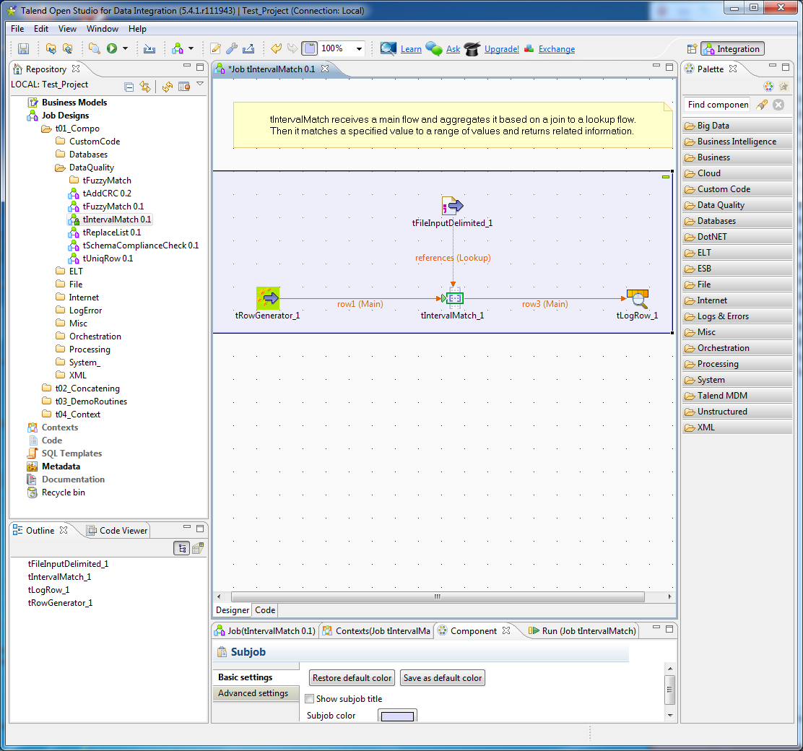
Talend IDE
Repository pane
Component palette
Canvas with job design
Design pane
Job pane
Notes:
Repository pane
Business models
Job designs
Code
Metadata
SQL templates
Documentation
Design pane:
Outline of components in the job
Code viewer if custom code written
Canvas with job design
Job design demonstrating connected components for interval match
Row generator connected to interval match component
tIntervalMatch receives a main flow and aggregates it based on a join to a lookup flow.
Then it matches a specified value to a range of values and returns related information.
Component palette: list of folders containing components
Big data
Business intelligence
Business
Cloud
Custom code
Data Quality
Databases
…
Job pane: controlling and monitoring execution
Job properties
Contexts
Component details
Run details

Slide 6
Palette with Components
Category | Prominent Components
Data quality
Databases
ELT
Processing
Internet
XML
Big data
Notes:
Graphical notation: drag, drop, and connect components
Data quality components: fuzzy match for distance comparisons, lookup match, uniqueness comparison
Database components for reading and writing to databases
File components for reading and writing to databases
ELT components:
- Perform transformations after loading in target database
aggregate, filter column (name changes) and rows (condition), mapping (SQL modification statements for complex transformations)
Processing:
Sorting
Type conversion
Normalize/Denormalize
Other component groups:
XML
Internet: email, web pages, file transfers, sockets, news streams
Logs and errors
Task control (sequencing)

Slide 7
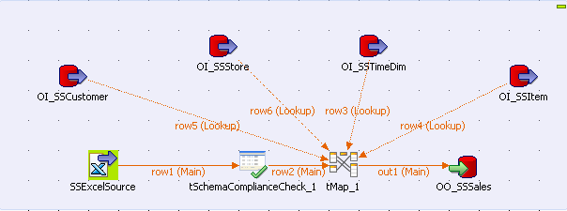
Simple Job Design Example
Notes:
For more concrete details about Talend job designs, this slide depicts the Excel job design from the unit exercise. The slide shows a screen snapshot of the job design pane of Talend Open Studio. The unit exercise document provides guided practice about creating this job design. This slide provides an overview of the job design. This job design involves transforming input records from an Excel file to load into an Oracle table. This job design involves the tables of the Store Sales data warehouse presented in the textbook.
A job design involves a number of components connected to process work. In this job design, the Excel source contains rows to be loaded into the SSSales table, the fact table of the Store Sales data warehouse. The first component in the flow is the Excel file, a tFileInputExcel component. The file input is processed by the tSchemaComplianceCheck component, a data quality component. Null value and data type checks are performed in the tSchemaComplianceCheck component. The output of the tSchemaComplianceCheck component is further processed by the tMap component. The tMap component performs joins on four Oracle tables (SSCustomer, SSStore, SSTimeDim, and SSItem) to ensure valid foreign keys. The tMap component uses four tOracleInput components to perform the joins. The output of the tMap processing is loaded into the SSSales table, a tOracleOutput component.
A commercial job flow would also have outputs for rejected records. The Excel job in this slide only has outputs for accepted records. The tSchemaComplianceCheck and tMap components would both be connected to an additional output for rejected records.

Slide 8
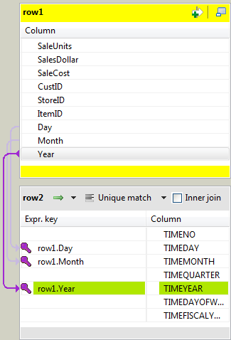
Component Details
Notes:
Component details are specified in a non procedural manner using property windows and graphical displays. For example, the tMap component uses a graphical display to support join specification. In this slide, the fields in the Excel data source are mapped to columns in the SSTimeDim Oracle table. The columns in the top part (row1) are from the input file. The columns in the bottom part (row2) of the window are the SSTimeDim table. A “drag and drop” method is used to match the columns in the data source and table.

Slide 9
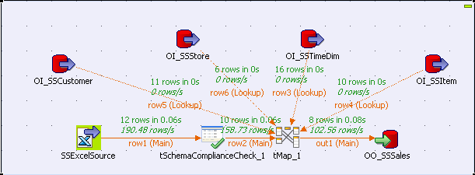
Job Execution Example
Notes:
This slide shows the executed excel job. The screen snapshot was taken from the job design pane after executing the job. You can see that the Excel input file contains 12 row. The tSchemaComplianceCheck component rejects two rows for null value or data type violations, passing 10 rows to the tMap component. The tMap component rejects two rows for FK violations, passing 8 rows to the tOracleOutput component. The job execution documentation shows the number of rows processed along with processing times.

Slide 10
Summary
Prominent open source data integration tool
Supports graphical specification of transformations, components, and job management
Install and use Talend for more details
Notes:
Prominent open source tools: not sure about the market share but continue to evolve with new versions so some market acceptance
Editions:
Open: standard open source license for usage and distribution
Subscription editions: more features and support
Basic features supported
Integrated development environment
Graphical specification
Job management
Transformation libraries
Use Pentaho software demonstration and complete assignment

Slide 11
Open Core Model
Feature-limited core product under a standard open source
Commercial versions with proprietary extensions
Paid support services
First commercial open source vendor
Becoming widespread
Notes:
Answer to opening questions about Talend business model and distinction as first

