Slide 1
Module 2 Multidimensional data representation and manipulation
Lesson 5: Overview of Pivot4J
Notes:
Welcome to Lesson 5 of Module 2 on Multidimensional data representation and manipulation
Opening question
What is the relationship between Pivot4J and MDX statements?
Is it easy to learn MDX using Pivot4J?

Slide 2
Lesson Objectives
Gain basic understanding of Pivot4J interface
Understand relationship of Pivot4J and Microsoft MDX
Gain motivation and context for guided practice and assignment
Notes:
Previous video lecture introduced Microsoft MDX statements
This lectures covers Pivot4J, a convenient and open source tool to manipulate data cubes.

Slide 3
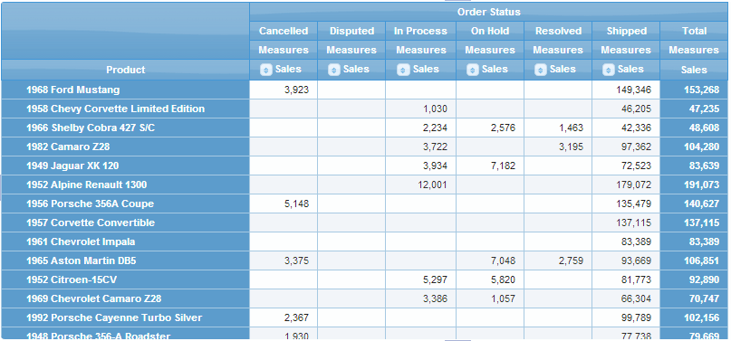
Pivot Table
Powerful interface for data cubes
Convenient rearrangement of row and column headings
Expand or collapse dimensions
Notes:
Pivot table from Pivot4J
Product dimension on rows
Order status on columns
Cells show sales
Last column shows total sales across order status values
Features
Supports more than 2 dimensions
Add/remove rows, columns, and measures
Rearrange rows and columns
Built in feature in Microsoft Access 2000 to 2010 and Microsoft Excel (many versions).
Open source and web implementations as well as Microsoft

Slide 4
Pivot4J
Allows cube representation similar to pivot table in Microsoft Excel
Works with Pentaho Business Analytics
Separate add-on
Graphical implementation of the MDX language
Notes:
Pivot4J history:
Extension of JPivot project
Based on MDX language
Open source plug-in in continuous development
Pentaho Business Analytics and all its plug-ins can be obtained from SourceForge
Guided tutorial and assignment

Slide 5
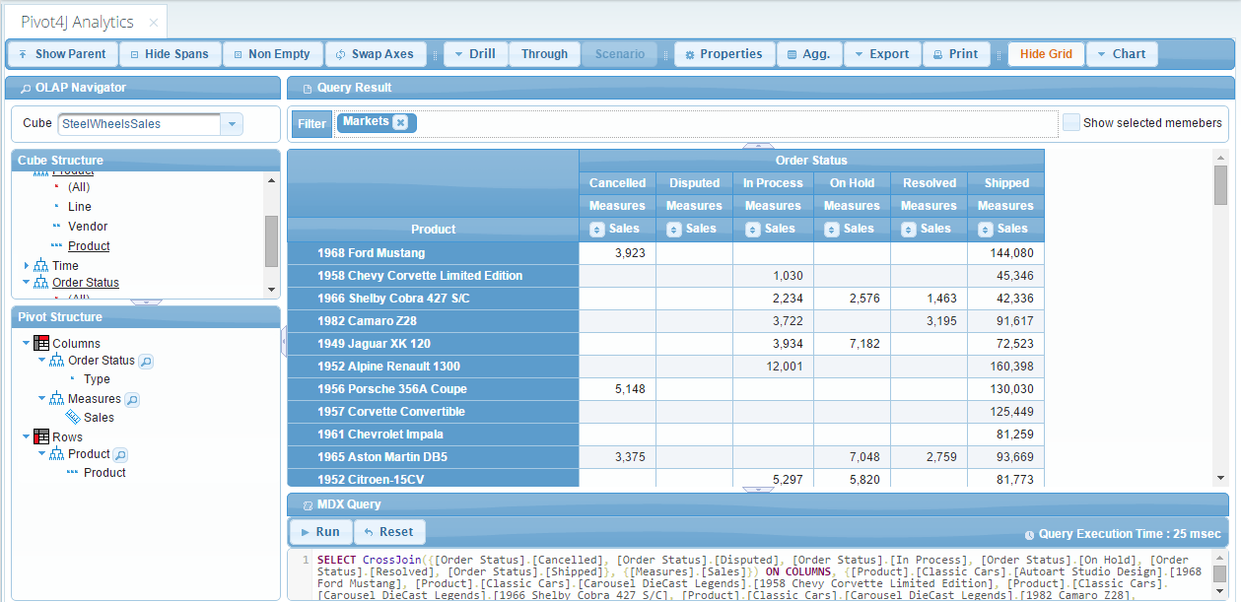
Pivot4J Interface
Notes:
Chart view is supported in Pivot4J.
Aggregation fields, to calculate the total of rows or columns, is supported.
There are three major steps to create a pivot table:
- Use “Pivot4J View” to access the data cube
- Customize the table
- Save the table as a report
The top left side shows all cube structures.
The bottom left side shows the Pivot structure
Pivot4J allows drag and drop between these two areas.
You can expand/collapse the view by using the +/- sign
Filtering the values can be achieved by using the Filter field at the top.
MDX command field is placed under the table. The MDX statement can be modified to perform DICE operations (subset of member values) in a dimension axis.

Slide 6
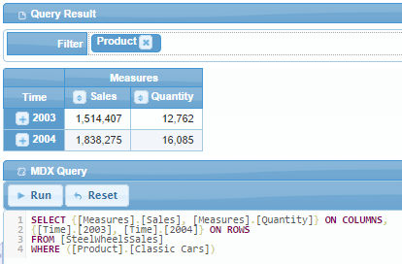
Pivot Table with MDX Statement
Notes:
Snapshot from Pivot4J
The result of the previous MDX query.
Time, Sales and Quantity are the columns.
Time is on the row.
2003 and 2004 are the attributes.
Sales and Quantity are on the columns
The numbers (in black) inside the cells are the measures
Cells show sales and quantity for classic cars

Slide 7
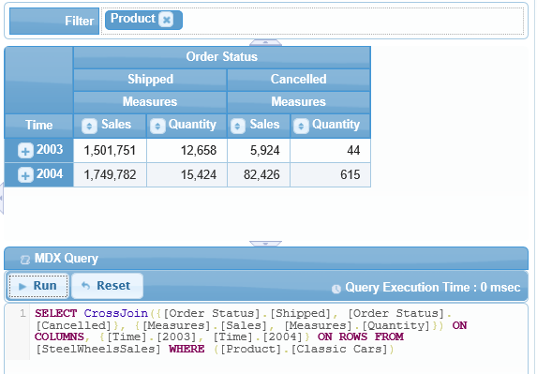
Pivot Table with CrossJoin
Notes:
The result of the previous MDX query.
Order Status is among the dimensions.
Sales and Quantity values are shown for “Shipped” and “Cancelled” only
Shipped and Cancelled are not exhaustive so some part of sales and quantity are not allocated from slide 21.

Slide 8
Summary
Open source implementation of pivot table interface
Visual interface for MDX
Complete guided practice and assignment
Notes:
Pivot4J
Extension of Jpivot project
Visual interface for MDX
Part of Pentaho Business Analytics open source software
Guided practice and assignment
Grounding in MDX makes the tool very powerful

