Slide 1


Impact of Non Medicaid Expansion on Rural Communities

Slide 2

Table of Contents
Problem Definition
Data Analysis
Methodology
Visualizations
Demo
Conclusion

Slide 3

Problem: Hospital Closures in Rural Areas
Most Closures in the South
Mostly for-profit hospitals
Among Medicare qualifying hospitals
Medicare is intended to cover the under privileged.
Non Medicare Expansion States have majority hospital closures.

Slide 4
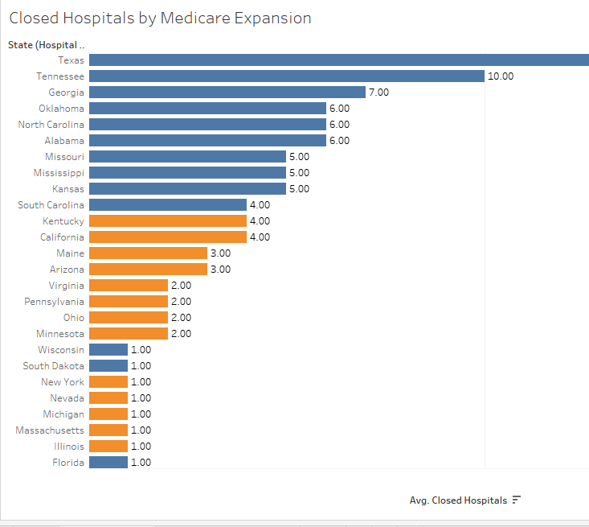
More Closed Hospitals in Non-Medicare Expansion States

Slide 5
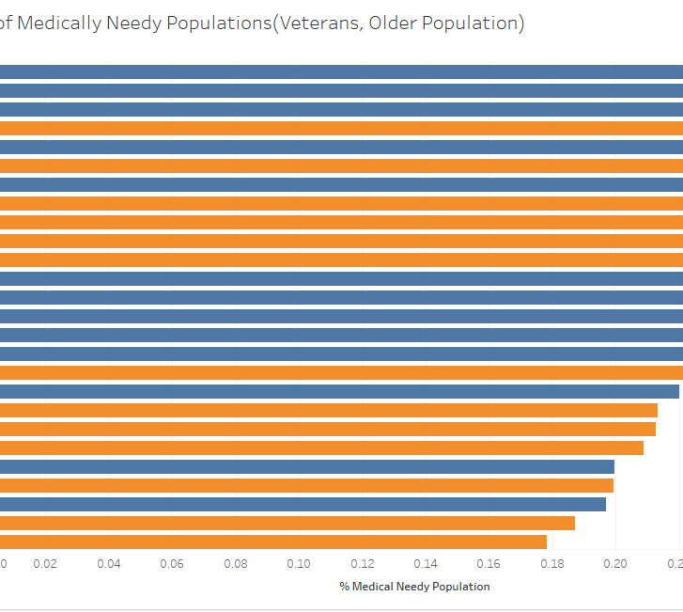
High Medical Needs Demographics in Non-Medicare Expansion States

Slide 6
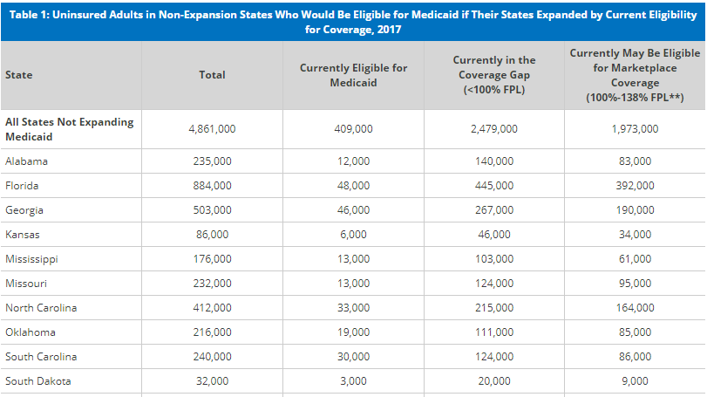
Non Expanding States Eligible for Expansion
Source: Henry Kaiser Family Foundation Research
Notes:
States with closed hospitals show need for financial help
You would expect their states to accept additional Medicare coverage offered under Affordable Care Act

Slide 7




Methodology
Problem Definition
Data acquisition
Data Preparation
Visualization
Analysis of research on issue
Policy Implications?
Social Implications?
Problem scope identification
Problem statement
American Communities Survey(ACS)
Demographic
Geographic Relationships
Center for Medicare & Medicaid Services(CMS)
In patient Hospital
Joined datasets
Derived needed variables
Data Scope boundaries
Standalone graphs and maps
Dashboard single view
Relevant Data filtering

Slide 8
Data Analysis
In Patient Hospital Data
Medicare Payments
Providers
Zip Codes
Closed Hospitals
States
Hospitals
Non Medicare Expansion
States
Expansion Flag
Rural Definition
State
Geography
Urban Indicator
Zip Code Tabulation Area (ZCTA) Relationships
Zip code level populations
Census tracts
Population
Medical Needs
Veterans
Elderly
Overall population

Slide 9
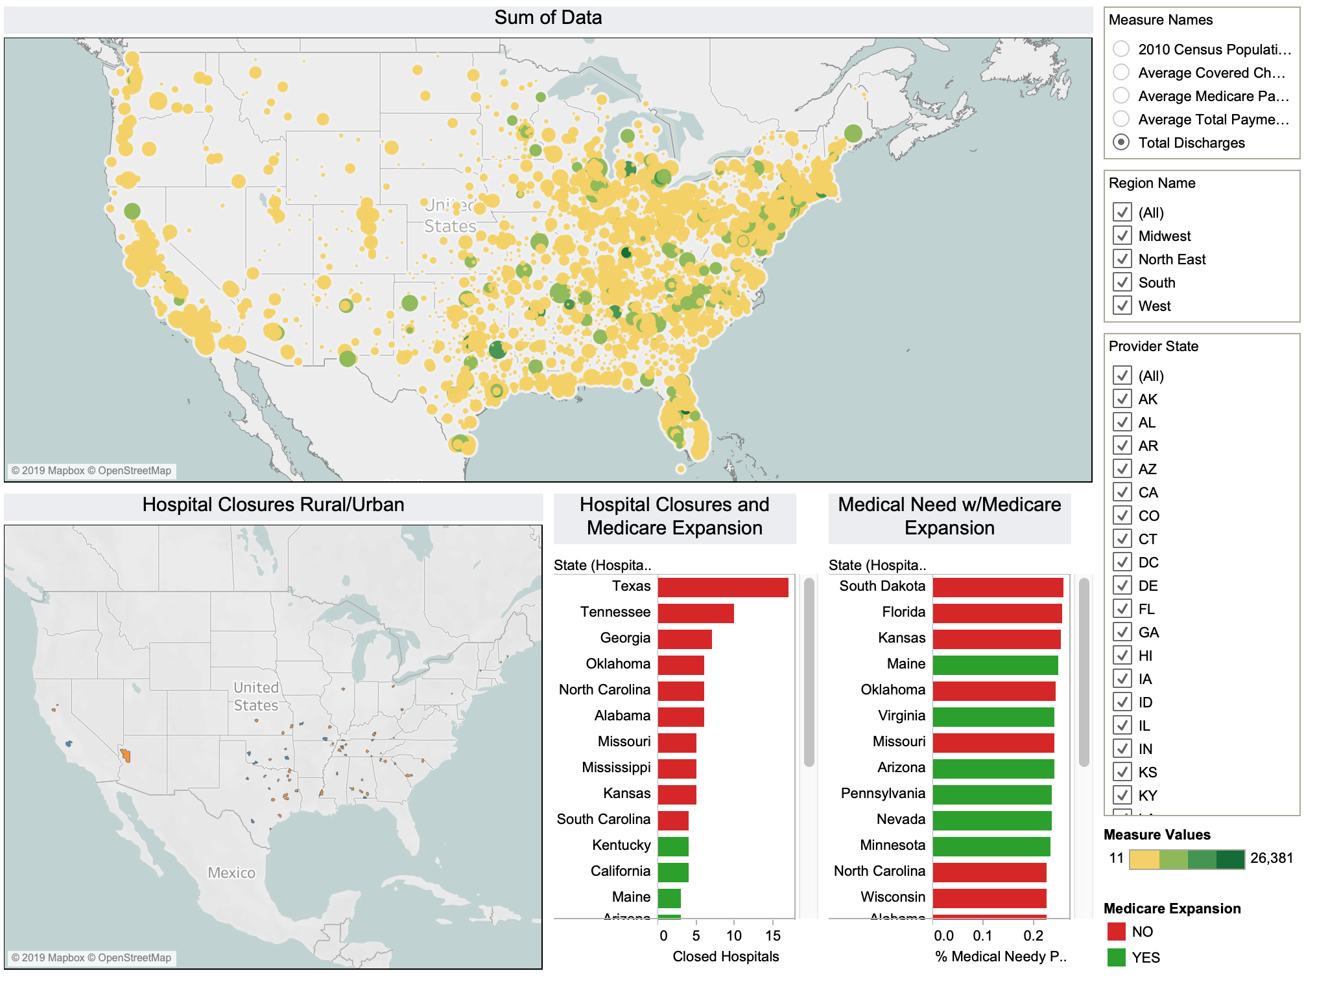
Results
Results

Slide 10

Future Work
For Hospitals At Risk of Closure
Medicare Expansion Medicare Expansion Refusal
Income generation prospects
Intervention programs
State and Federal Government
Analysis of Reasons and Political Strategies
Legal Challenges
Activist Pressure

Slide 11

Demo

Slide 12
Citations/References
Retrieved from: https://www.beckershospitalreview.com/finance/state-by-state-breakdown-of-93-rural-hospital-closures.html. Accessed on 6/25/2019.
Rural Closures. Umber and Characteristics of Affected Hospitals and Contributing Factors.US Government Accountability Office(GAO).August 2018. Retrieved from: https://www.gao.gov/assets/700/694125.pdf. Accessed on 6/28/2019.
Garfield, R. Orgera, K. and Damico, A. Mar 21, 2019. The Coverage Gap: Uninsured Poor Adults in States that Do Not Expand Medicaid. Retrieved from; https://www.kff.org/medicaid/issue-brief/the-coverage-gap-uninsured-poor-adults-in-states-that-do-not-expand-medicaid/. Accessed on 6/29/2019.
Center for Medicaid Services (2014). Inpatient Prospective Payment System (IPPS) Provider Summary for the Top 100 Diagnosis-Related Groups (DRG) - FY2011. Retrieved from https://data.cms.gov/Medicare-Inpatient/Inpatient-Prospective-Payment-System-IPPS-Provider/97k6-zzx3 (Accessed 05/31/2019).
Dellasega, Dave (2018). The Rural Health Care Challenge, Cerner, August 15, 2018. Retrieved from https://www.cerner.com/blog/the-rural-health-care-challenge (Accessed 06/05/2019).
Ellison, Ayla (2019). State-By-State Breakdown of 102 Rural Hospital Closures, Hospital CFO Report March 20th, 2019. Retrieved from https://www.beckershospitalreview.com/finance/state-by-state-breakdown-of-102-rural-hospital-closures.html (Accessed 6/11/2019).
Rural Health Information Hub (ND). Healthcare Access in Rural Communities. Retrieved from https://www.ruralhealthinfo.org/topics/healthcare-access (Accessed 06/03/2019).
Searing, Adam (2018). More Rural Hospitals Closing in States Refusing Medicaid Coverage Expansion, Rural Hospital Policy Project October 29, 2018. Retrieved from https://ccf.georgetown.edu/2018/10/29/more-rural-hospitals-closing-in-states-refusing-medicaid-coverage-expansion/ (Accessed 6/13/2019).
Warshaw, Robin (2017). Health Disparities Affect Millions in Rural U.S. Communities, Association of American Medical Challenges, October 31, 2017. Retrieved from https://news.aamc.org/patient-care/article/health-disparities-affect-millions-rural-us-commun/ (Accessed 06/05/2019).

