Slide 1
Quick summary
CONFIDENTIAL | © 2025 EPAM Systems, Inc.

Slide 2
First lesson (3) summary

Slide 3
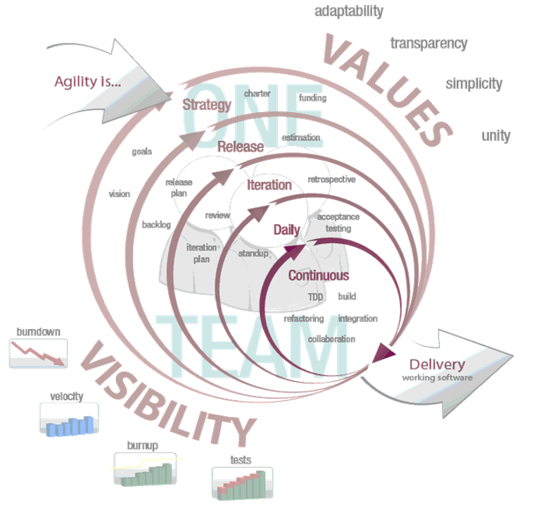
Development models
Agile
“Agile”, the word has been applied around 2001 for building software in a non-traditional way
Features:
  low ceremony (fewer procedures, documents)
  more effective resource usage
  focused on customer and changes
  rapid development and feedback
Customer Satisfaction
An approach to building software, in which the overall lifecycle is composed of several iterations in sequence
Each iteration is a self-contained mini-project composed of activities such as requirements analysis, design, programming, and test
The system grows incrementally
CONFIDENTIAL | © 2022 EPAM Systems, Inc.

Slide 4
DoR and DoD
Definition of Ready:
  These are the criteria that the Product Backlog Items must meet to be planned for the upcoming Sprints.
  For example, “Performance criteria must be written for the task.”
Definition of Done:
  DoD is a checklist that helps you to acknowledge that the feature is finalized.
  For example, “The related unit/service and UI tests should be implemented.”
CONFIDENTIAL | © 2022 EPAM Systems, Inc.

Slide 5
Requirement management
Requirements management is the process of documenting, analyzing, tracing, prioritizing and agreeing on requirements and then controlling change and communicating to relevant stakeholders. It is a continuous process throughout a project. A requirement is a capability to which a project outcome (product or service) should conform.
In today’s world of development, it becomes utterly necessary to track changes in the requirement at every step, automatically. Audit trail of requirements is done more efficiently with the involvement of tools.
CONFIDENTIAL | © 2022 EPAM Systems, Inc.

Slide 6

Atlassian Jira
“Jira Software is built for every member of your software team to plan, track, and release great software.”
HIGHLY CUSTOMISABLE – every aspect of the tool that will be shown on the next slides can be customised
Plan: Create user stories and issues, plan sprints, and distribute tasks across your software team.
Track: Prioritize and discuss your team’s work in full context with complete visibility.
Release: Ship with confidence and sanity knowing the information you have is always up-to-date.
Report: Improve team performance based on real-time, visual data that your team can put to use.
CONFIDENTIAL | © 2022 EPAM Systems, Inc.

Slide 7
Kanban board and SCRUM board in Jira
Both are used to track our work through the tickets
Kanban board has 2 side columns (Backlog, Done) which can have unlimited tickets, every other column has a limit
Kanban board tracks the whole project from start to finish
SCRUM board usually tracks an ongoing sprint, and its content always reflects the actual sprint
SCRUM board has no limit for the columns, since the team committed to the sprint and they should be able to deliver
CONFIDENTIAL | © 2022 EPAM Systems, Inc.

Slide 8
Velocity
Velocity is the average amount of work a scrum team completes during a sprint, measured in either story points or hours, and is very useful for forecasting.
The product owner can use velocity to predict how quickly a team can work through the backlog, because the report tracks the forecasted and completed work over several iterations–the more iterations, the more accurate the forecast.
It's important to monitor how velocity evolves over time. New teams can expect to see an increase in velocity as the team optimizes relationships and the work process.
It is important to include the variables to the forecast (e.g. Team changes, PTOs, trainings, etc.)
CONFIDENTIAL | © 2022 EPAM Systems, Inc.

Slide 9
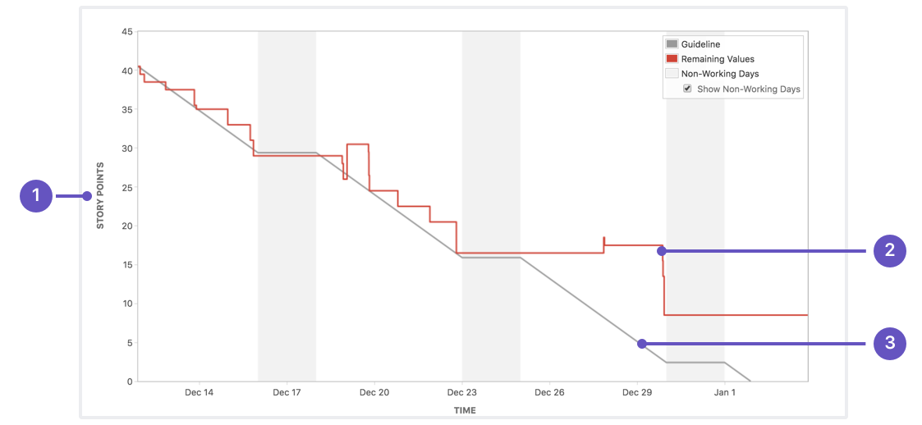
Sprint burndown
A sprint burndown report then tracks the completion of work throughout the sprint.
CONFIDENTIAL | © 2022 EPAM Systems, Inc.
Notes:
The x-axis represents time, and the y-axis refers to the amount of work left to complete, measured in either story points or hours. The goal is to have all the forecasted work completed by the end of the sprint.
1) Estimation statistic: The vertical axis represents the estimation statistic that you've selected.
2) Remaining values: The red line represents the total amount of work left in the sprint, according to your team's estimates.
3) Guideline: The grey line shows an approximation of where your team should be, assuming linear progress. If the red line is below this line, congratulations - your team's on track to completing all their work by the end of the sprint. This isn't foolproof though; it's just another piece of information to use while monitoring team progress.

Slide 10
Next lesson (4) summary

Slide 11
Requirements
Requirement types
Functional Requirements
  A functional requirement is a requirement concerning a result of behavior that shall be provided by a function of the system
Quality Requirements
  A quality requirement is a requirement that pertains to a quality concern that is not covered by functional requirements
  Performance, availability, dependability, scalability, portability (non-functional requirements)
Constraints
  A constraint is a requirement that limits the solution space beyond what is necessary for meeting the given functional and quality requirements
  Deadline, Web based solutions only, etc.
CONFIDENTIAL | © 2025 EPAM Systems, Inc.

Slide 12
Requirements Engineering
Requirement types
Requirements engineering is a systematic and disciplined approach to the specification and management of requirements with the following goals:
- Knowing the relevant requirements, achieving a consensus among the stakeholders about these requirements, documenting them according to given standards, and manage them systematically.
Understanding and documenting the stakeholders’ desires and needs, they specifying and managing requirements to minimize the risk of delivering a system that does not meet the stakeholders’ desire and needs
CONFIDENTIAL | © 2025 EPAM Systems, Inc.

Slide 13
Documenting Requirements
Natural Language, Transformational Processes - examples
Nominalization
  Data processing takes place
  The system automatically processes incoming data and saves it into the database within 2 seconds
Vague nouns:
  The system handles files
  The system can upload, store, and open PDF and DOCX files
Universal quantifiers:
  All users have access to the data
  Administrators and project managers can access all data, while regular users can only access their own
CONFIDENTIAL | © 2025 EPAM Systems, Inc.

Slide 14
Documenting Requirements
Natural Language, Transformational Processes - examples
Incompletely specified conditions
  The system displays an error message
  If the user enters the wrong password three times, the system displays a red warning message and blocks login for 5 minutes
Incompletely specified process verbs
  The system checks the data
  The system checks that the entered e-mail address contains an @ symbol and a valid domain name
CONFIDENTIAL | © 2025 EPAM Systems, Inc.

Slide 15
Next lesson (5) summary

Slide 16
Architect
Traditional (waterfall organization)
Modern (agile)
Conceives the perfect design
Spends months or years producing big up-front design
Drawbacks
  Big and complex designs
    Code is written after design
    Doesn’t capture the users’s true needs
    Doesn’t allow for learning
  Lack of flexibility
    Painful bureaucratic processes
    Not following the design
    Random improvisation
  Slow development process
    Centralized architect-making decisions
Doesn’t want to settle on a particular design too soon
  You’ll learn about the problems as you solve them
Instead of it
  Build very small things
  Release them constantly
  Evolve based on feedback
Prefers incremental design
Notion of experimentation
  If you are not sure, run an experiment
  If experiment succeeds, adopt
  If it doesn’t throw the code and the architectute
Looks at rebuilding as less costly than building the wrong thing
Part of the team: teaching, coaching, coordinating
Notes:
Traditional architect drawback IBM case study:
Project: U.S. Air Traffic control system
After one year desinging the system became out-dated
The hardware and the air traffic control practices had moved on
They started over and came up another design
It became out-dates again
They were doing in 10 years and nothing was built

Slide 17

Conway’s Law
Change the structure of the organization to match agile methods.
Instead of horizontal silos
Cross-functional teams
  Have all the skills
  Own complete vertical slice of the system
Move to agile-friendly architectures
  Lets the team work faster

Slide 18
Monoliths
The entire program is one large executable unit
Specified with hundreds and tousands of lines of source code
Mostly N-Tiered applications
Vetical and horizontal divisions
Strengths
  Homogeneous structure
Challenges
  Homogeneous structure
  Nobody understands the whole program
  Long test-and-deploy process
  Agility is nearly impossible

Slide 19
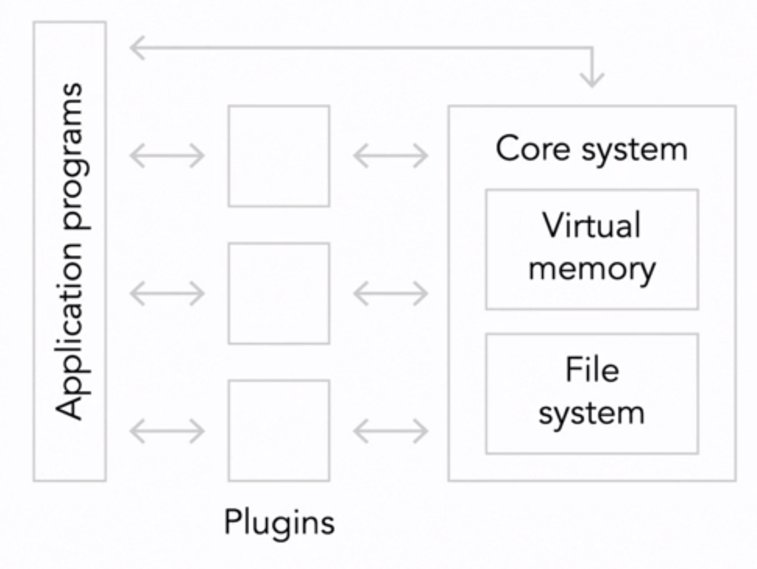
Microkernel (plugin) architectures
A Step up from a pure monolith
The first microkernel realization was an operating system
The idea is to put essential capabilities of your system into
a single stand-alone executable called the kernel
Strengths
  Isolation prevents big ball-of-mud dependencies
  Plugin are small and easy to write, debug and maintain
Challenges
  APIs to the kernel are delicate
  New APIs may require re-writing plugins
  Problems within a kernel can bring the system down
  Plugins are indirectly coupled through the kernel

Slide 20
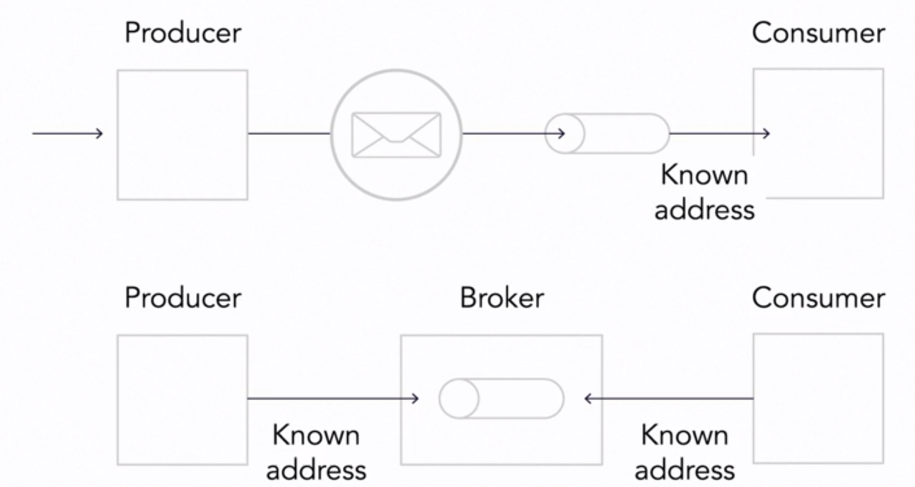
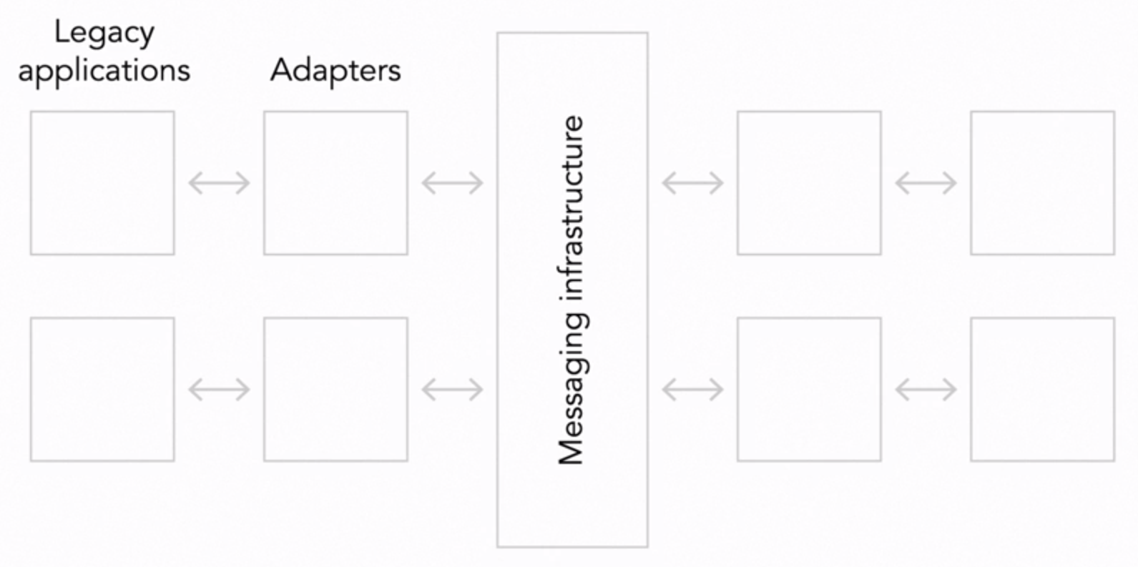
Message-based architectures
Formalizing the communication paths between elements and isolating them
Ease problems associated with network communication
Forge into a single system things that aren’t designed to work together
A common message bus control the flow of communication
Publish / Subscriber model
Strengths
  More maintainable than monolith
  Solve dependency problems in microkernel systems
Challenges
  Managing a highly complex system
  Can be very slow and time consuming
  Messages have to be stored on disk, replicated, backed up and so on

Slide 21
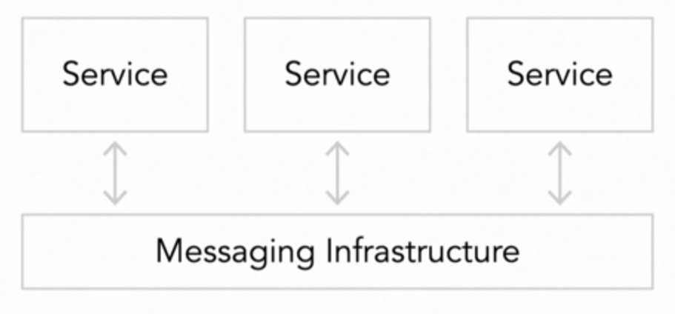
Microservice and miniservices
The large system is made up of a cloud of very small independent services that
cooperate as peers to get the larger work done
Supports distributed deployment and complex real-time interactions
Main requirements
  Small (few hundred lines of source code)
  Independently deployable
  Fully autonomous
  Hides implementation details
  Distributed
  Highly observable
  Modeled around business concepts
Strengths
  Independent services
  Changes do no affect the rest of the system
  Changes can occur quickly
Challenges
  Design and runtime complexity
  Network are slow compared to alternatives

Slide 22
Next lesson (6) summary

Slide 23

Mi a modell?
A modell egy “eredeti” leképezése, mely alapján könnyebben, olcsóbban, gyorsabban vagy egyáltalán korábban tehetők előrejelzések az eredetiről.
  szervezeti és/vagy műszaki folyamatok → elmezés és tervezés
  egy meglévő alkalmazásrendszer → dokumentáció
A rendszert minden esetben egy adott nézőpontból írja le
A modellezés értelmezhető a szoftverfejlesztési életciklus minden fázisában
  Jelentős hangsúlya azonban a korai szakaszokban van

Slide 24
UML diagramok
A diagramoknak két fő típusa van:
Szerkezeti diagramok: statikus viselkedést, állapotot ír le
Viselkedési diagramok: egy rendszeren belüli dinamikus viselkedését írják, együttműködést, tevékenységeket, állapotváltozásokat.
A rendszer dinamikus viselkedése a rendszerben történő időbeli változások sorozataként írható le.
A fenti felosztás nem zárja ki a különböző fajta diagramtípusok keverését.

Slide 25
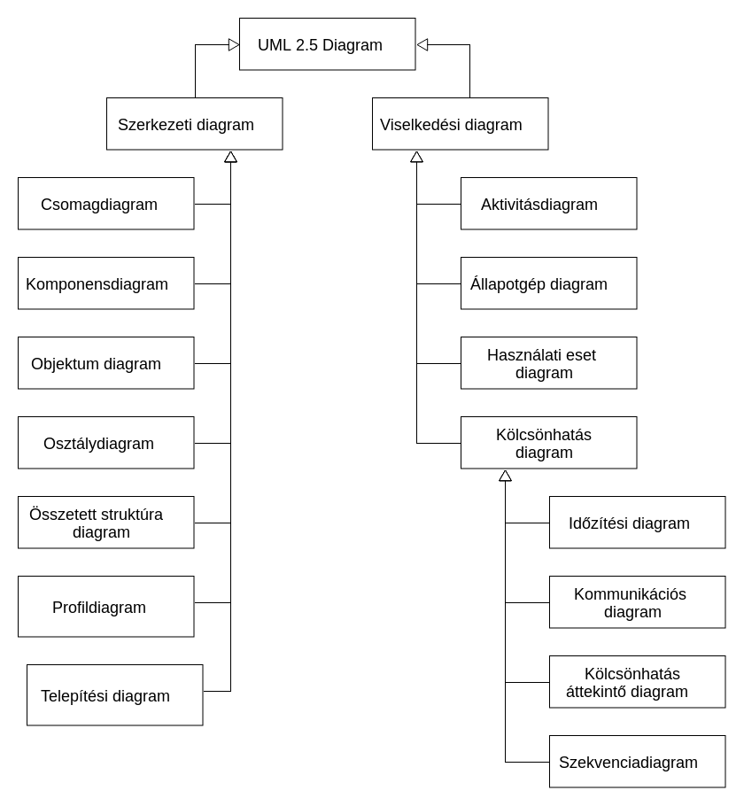
UML diagramok

Slide 26
Osztálydiagramok
A modellben szereplő osztályok és az osztályok között kölcsönhatások leírását szolgáló eszköz
Statikus
Három típusát különítünk el:
  elemzési osztálydiagram:
    a szakterület felépítését reprezentálja
  tervezési osztálydiagram:
    a megvalósítás jövőbeli részletei is megjelennek a modellben
  megvalósítási osztálydiagram:
    már egy valós implementációs nyelv osztály fogalmával ekvivalens modell

Slide 27
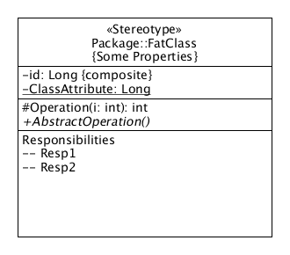
Osztályok jelölései
Láthatóság
  + (nyilvános)
  - (privát)
  # (védett)
  ~ (csomagszintű)

Slide 28
Állapotgép diagram
Az állapotgép diagram egy osztály objektumainak az életciklusuk alatt felvehető lehetséges állapotait és az állapotok közötti lehetséges átmeneteket ábrázolja.
Az állapotgép diagram esetén absztrakt állapotokkal foglalkozunk.
Az objektum orientált szemlélet szerint egy objektum állapotát az attribútumainak a pillanatnyi értékhalmaza határozza meg. → Konkrét állapot
A modellezés során egy bizonyos szempontból a konkrét állapotok meghatározott halmazai egyenértékűnek tekinthetők, egy állapot jelleget határoznak meg.

Slide 29
Állapotgép diagram
Ezt absztrakt állapotnak nevezzük. Például egy hallgatónak abból a szempontból, hogy teljesítette-e a tárgyat, két absztrakt állapota lehet:
  teljesítette: aláírása és legalább elégséges vizsgajegye van (ez négy lehetséges konkrét állapotot fog össze),
  nem teljesítette: nincs aláírása, vagy van aláírása, de nincs vizsgajegye, vagy elégtelen vizsgajegye van (ami három lehetséges konkrét állapot).
Ez a két absztrakt állapot elegendő ahhoz, hogy eldönthessük, egy ráépülő tárgyat felvehet-e. (Bár természetesen más szempontból nem lényegtelen, hogy a vizsgajegye elégséges vagy jeles.)
Másik példa: „Hétvége vagy hétköznap van ma?”
  Hétköznap van, ez egy absztrakt, és 5 konkrét állapot
  Hétvége van, ez szintén egy absztrakt, de már csak 2 konkrét állapot

Slide 30
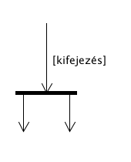
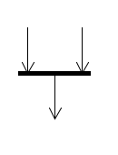
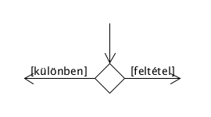
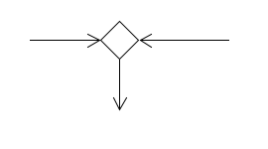
Állapotgép diagram
Kezdő állapot (Initial pseudostate)
Ennek mindig léteznie kell
Végállapot (Final state)
Ennek mindig léteznie kell
Elágaztató csúcs (fork pseudostate)
Szinkronizációs csúcs (join pseudostate)
Szétválasztó csúcs (choice pseudostate)
Összefuttató csúcs (merge pseudostate)

