Slide 1

Linux
Intro Session 1
Updated: 7 Aug 2026

Slide 2
Agenda
What is Linux
Why is Linux difficult easy
Distro Family Tree
Stretch goals
Brave Browser
Watch full video link
What other reasons to change to Linux

Slide 3
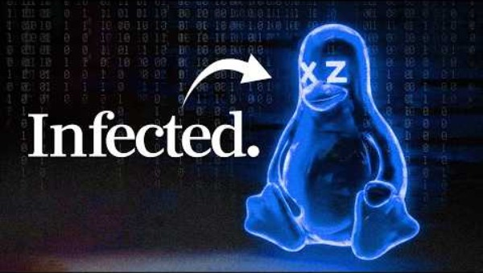
What is Linux?
Notes:
Open sources and Linux
https://youtu.be/aoag03mSuXQ?si=miyDdApRynMMJ_fN&t=348
https://www.youtube.com/watch?v=g4iKwWtVkw4

Slide 4
Why People think Linux is Easy & Difficult
What makes it easy also makes it difficult.
Too many choices
What Distribution to use? (Distributions or Distros)
Installation type – Network installer, LiveCD, LiveUSD, DualBoot, Embedded, Virtual Machine, Container
Flavours – e.g. Ubuntu; Desktop, Server, Cloud, etc.
Size :
11MB - Tiny Core Linux – Runs entirely in RAM
16 GB RAM, 50GB min storage – Garuda distro for gaming and multimedia.
CachyOS distro for high performance use such as AI, ML processing

Slide 5
Let’s make Linux easy
Expect to type some mysterious spells. It’s OK to not fully understand.
Expect to Google for solutions.
It is OK to fail.
This course is structured to streamline this learning process
To get you started
Made all the complicated decisions for you
Limit the way too many choices to one or two

Slide 6
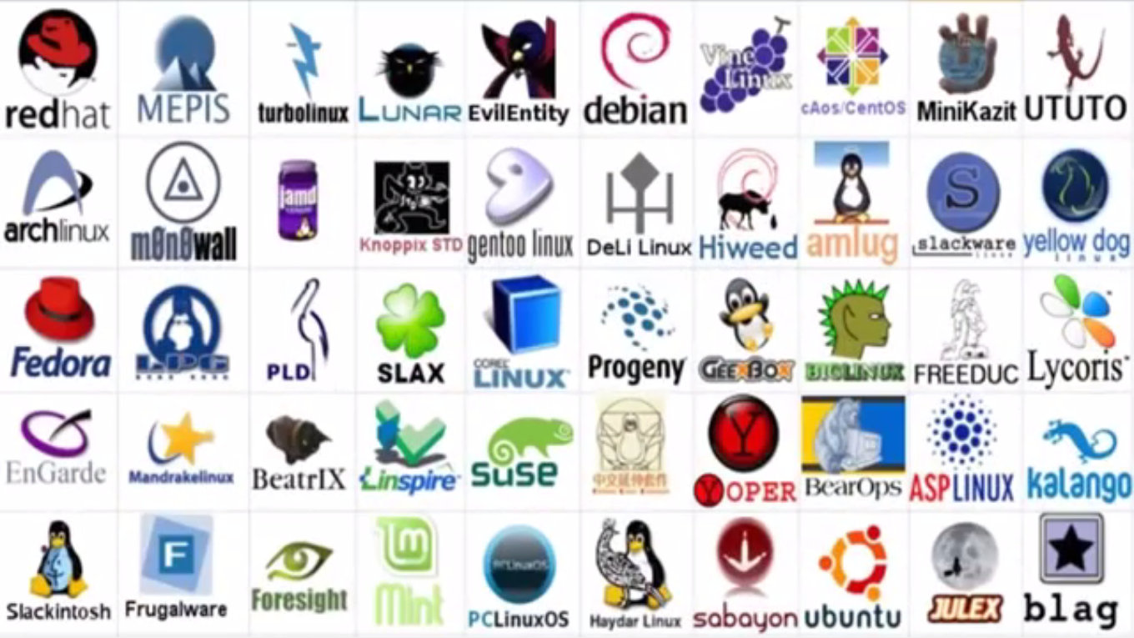
Introduction to Linux Distros
Welcome to the messy world of Linux
Notes:
Fasten your seatbelt, Sit back and Relax

Slide 7







Introduction to Linux Distros
Linux Family Tree
Slackware
Zenwalk
Mint
Ubuntu
Debian
ZorinOS
Raspbian
Fedora
RedHat
CentOS
Oracle
Notes:
https://distrowatch.com/dwres.php?resource=family-tree

Slide 8
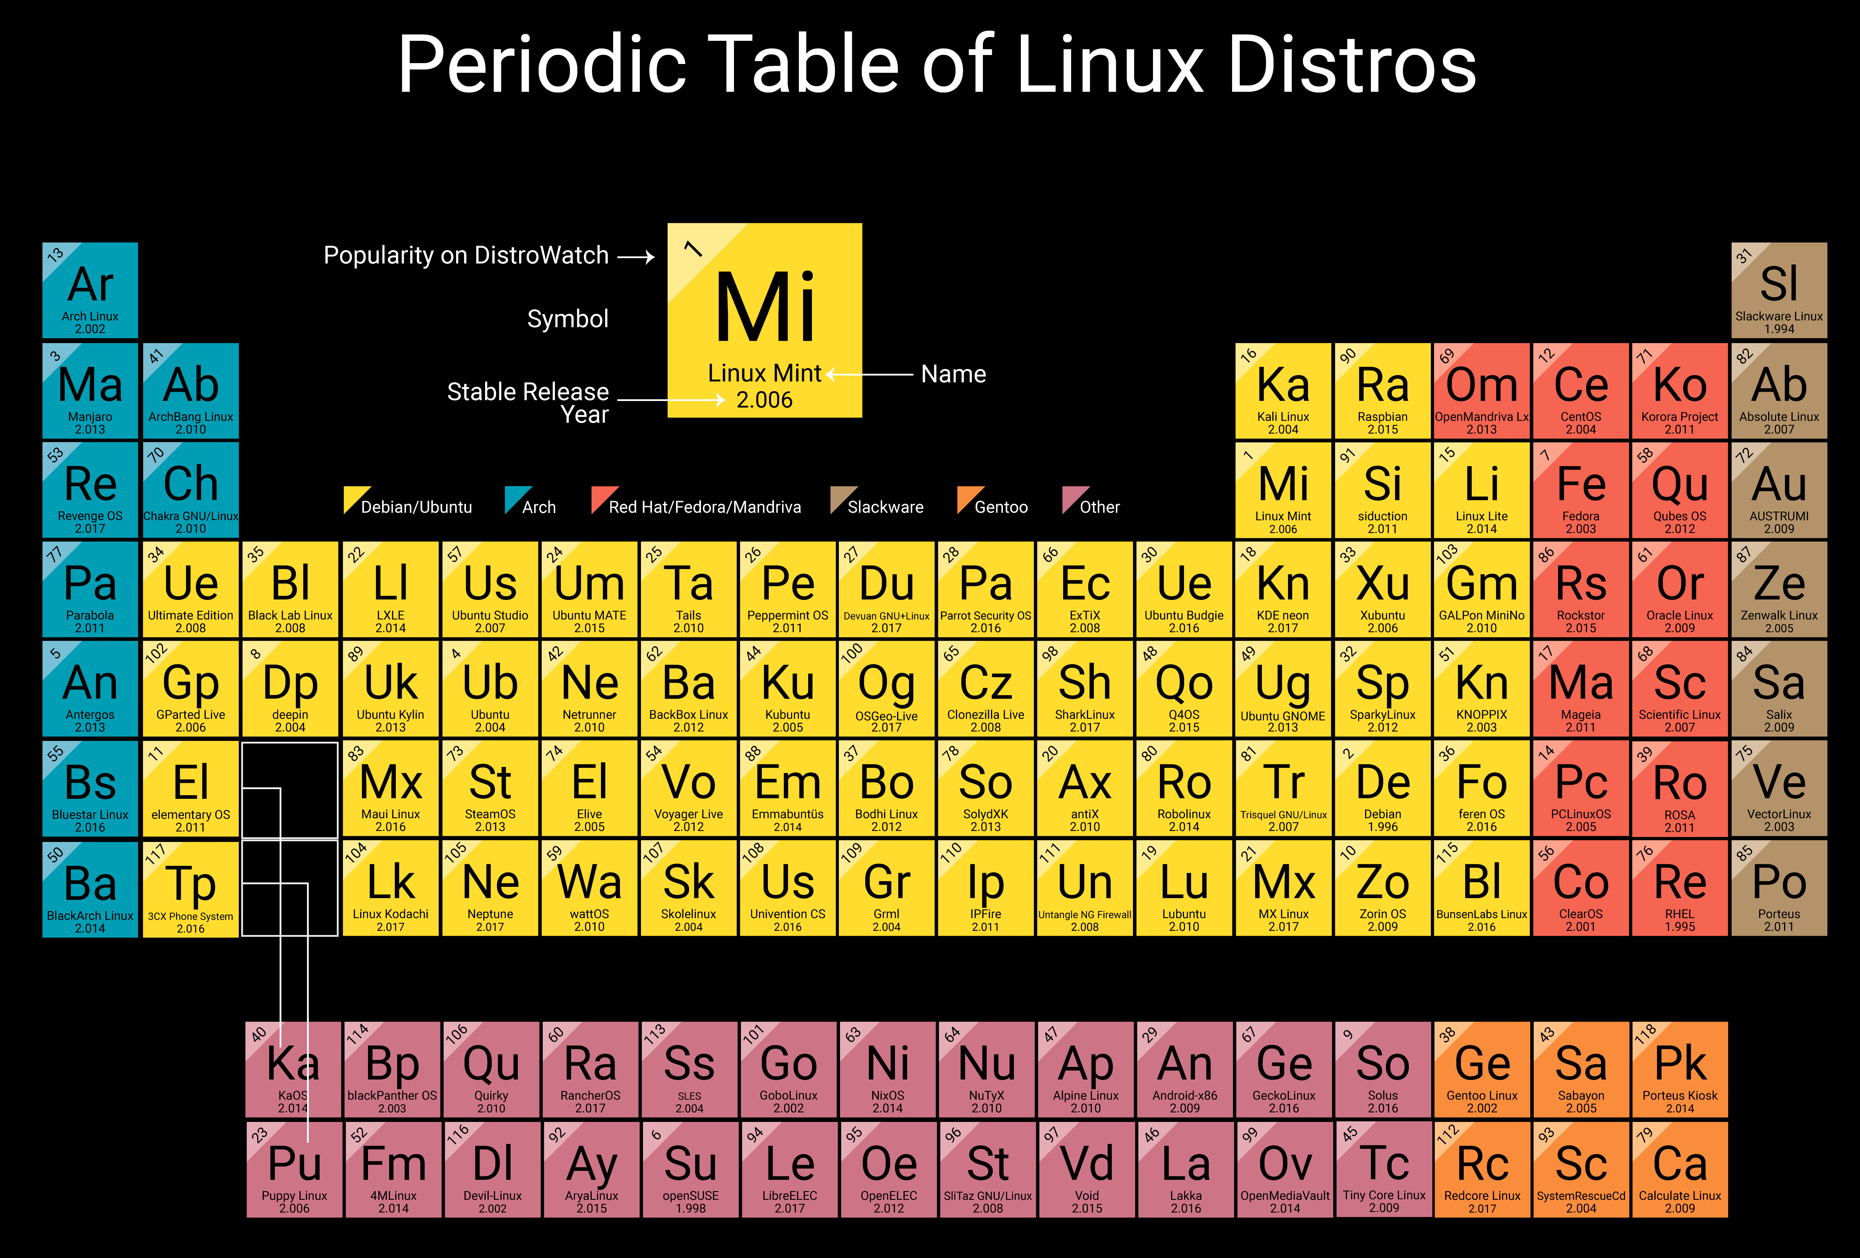
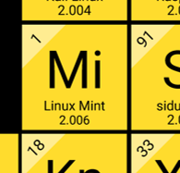
Introduction to Linux Distros
Popularity contest
Notes:
https://distrowatch.com/dwres.php?resource=family-tree

Slide 9
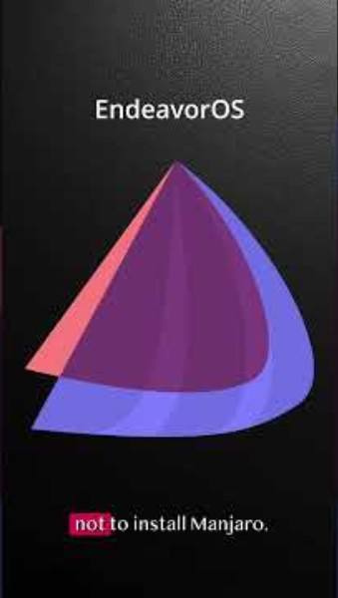
What does your Linux distro say about you?
Notes:
https://www.youtube.com/shorts/ImtoYNt8lFw
https://distrowatch.com/dwres.php?resource=family-tree

Slide 10
What is in GNU\Linux
GNU\Linux is an operating system (OS).
OS is the software on a computer that enables applications (programs) to access the devices on the computer to do things.
OS sends instructions from an application to, for example, the computer's processor. The processor performs the job, then sends the results back to the application via the operating system.
Linux is very similar to other operating systems, such as Windows and OS X.

Slide 11
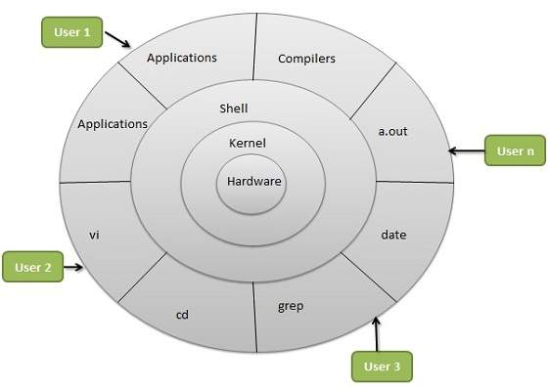
What is in GNU\Linux

Slide 12
Is Linux difficult?
Yes and no. Depends on the person being asked.
Easy
Linux is stable and reliable
Linux is an ideal operating system for power-users and programmers
Been and is being developed by power-users and programmers
Everything a good programmer can wish for is available: compilers, libraries, development and debugging tools
Highly customisable
System of choice for old and exotic hardware
Linux the only operating system in the world that covers a wide range of hardware.

Slide 13
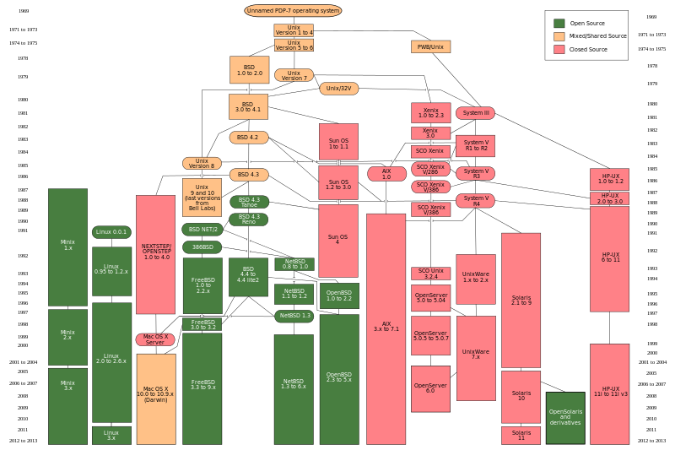
Linux follows the POSIX standard. Full UNIX clone. Easy to switching between UNIX and Linux
Unix
BSD
System III to V
HP UX
Mac OS X
Linux
AIX (IBM)

Slide 14
Why is Linux difficult
What makes it easy also makes it difficult.
Most non-IT professional users have no exposure to Unix.
Manuals are on every system, complete and comprehensive; but difficult to find and too technical to read.
Too many choices
Distributions
Installation type – Network installer, LiveCD, LiveUSD, DualBoot, Embedded, Virtual
Flavors – e.g. Ubuntu; Desktop, Server, Cloud, Kylin, Core, UbuntuFlavors - Ubuntu Wiki.html
Size :
50 MB – Damn Small Linux (DSL) is a little-lightweight Linux distro based on Debian Linux . It is very small, suitable for old computers and single-board computers. Run fully in RAM with as little as 128MB.
30 GB – Sabayon 3D Desktop is a full “out of the box” bleeding edge distro for gaming and multimedia. It needs i686, at least 2-8 GB RAM, 3D graphics card,etc.
Shell – sh, csh, bash, ksh
Text editors - vi, vim, nano, emacs
Reading file - cat, more, less, head, tail
Desktop environment - GUI windows-like environment - (Unity, GNOME, Cinnamon, Enlightenment, KDE, XFCE, etc)
Applications – More than 10 browsers, including Lynx (text based browser)

Slide 15
Ubuntu Desktop – First look
Boot up
Login
Navigate around Unity
Side bar
Disk and mounts
Top bar
Window handling
Setup Wifi
CLI terminal

