Slide 1
How To Study Design Patterns

Slide 2
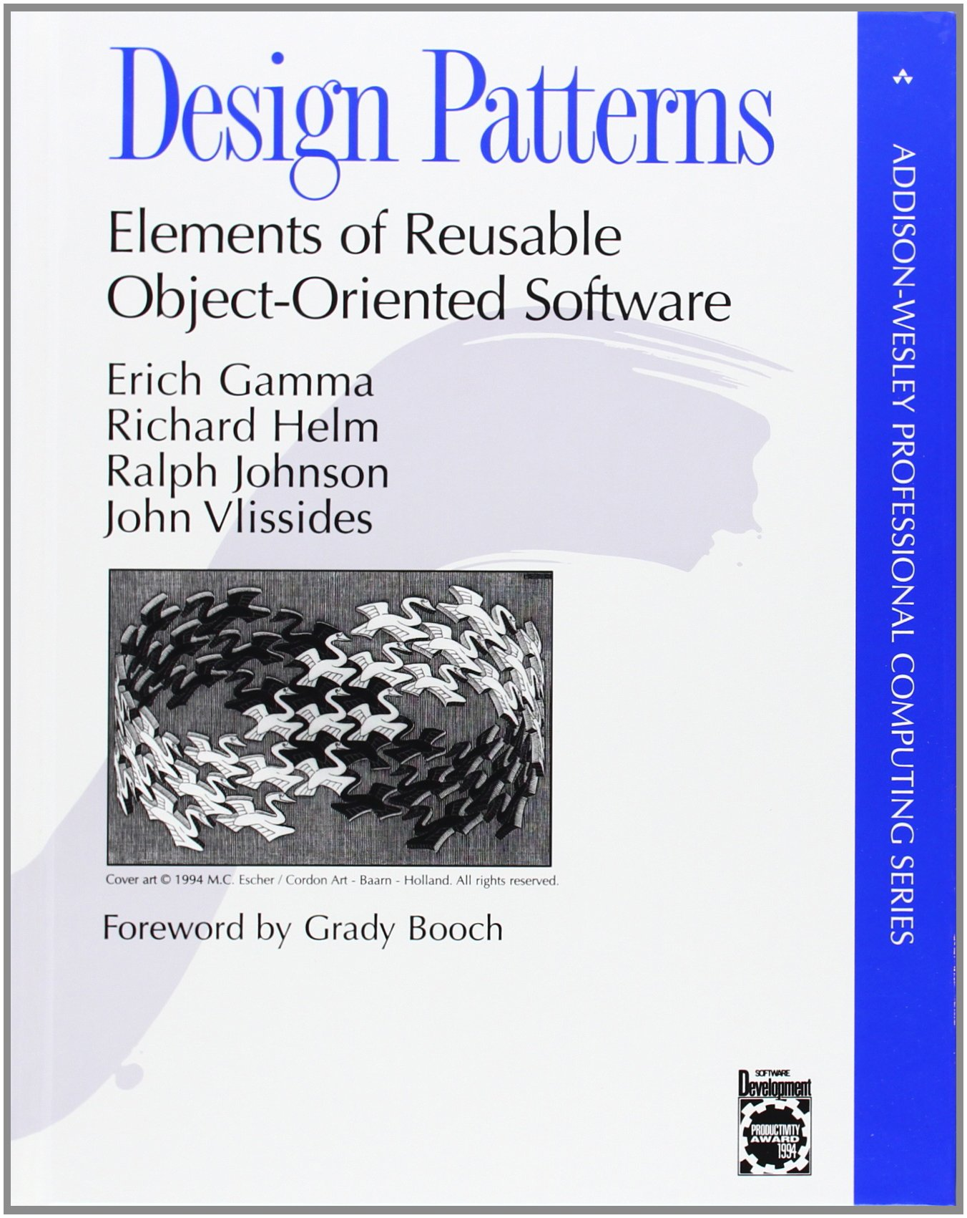

Slide 3
Praise
Allows developers to think at a higher level of abstraction
Provides a language to foster communication
Better understanding of the trade-offs inherent in a given design
Notes:
Think about design at a higher level

Slide 4
Criticism
Blind application can be harmful
Hard to read
Challenging to understand
Notes:
Blindly applying damages code
Difficult to study

Slide 5
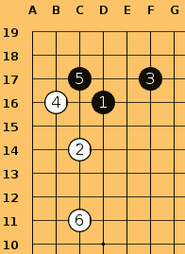

Slide 6
Criticism
Blind application can be harmful
Hard to read
Challenging to understand
Notes:
Blindly applying damages code
Difficult to study

Slide 7


Slide 8
How to Study Joseki
Don’t think that all you have to do is learn the moves. That is not studying the joseki.
Every stone played by both sides in a joseki is the best move, so it is important to know the reason.
Joseki moves are always the best on a local scale, but they sometimes become the worst in relation to the surrounding position.

Slide 9
How to Study Design Patterns
Don’t think that all you have to do is learn the pattern. That is not studying design patterns.
Every decision made in a design pattern is the best choice, so it is important to know the reason.
Design patterns are always best on a local scale, but are sometimes the worst in relation to the surrounding code.

Slide 10
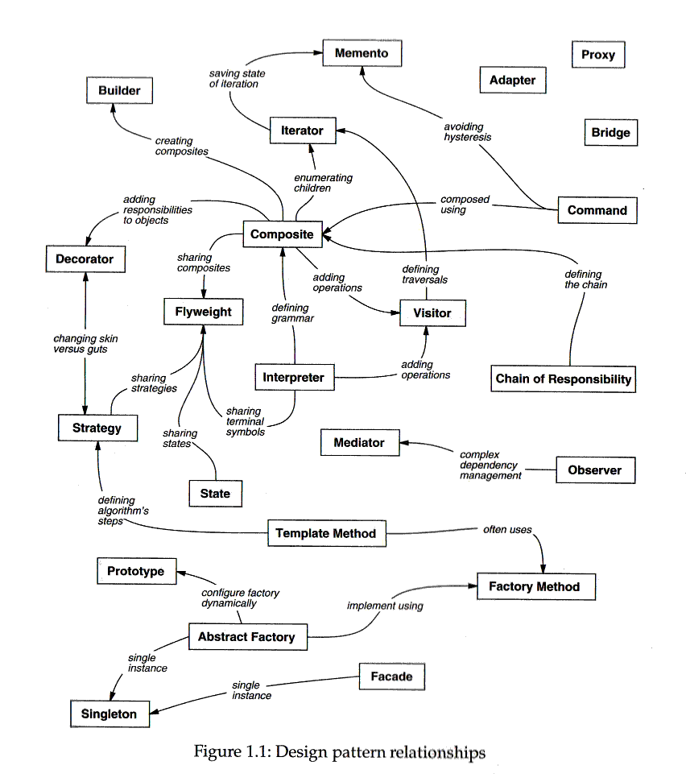
Notes:
page 12

Slide 11
Factory Method
docs
Document
Application
Open
Close
Save
Revert
NewDocument
OpenDocument
MyDocument
MyApplication
Notes:
* Abstract classes

Slide 12
Factory Method
docs
Document
Application
Open
Close
Save
Revert
CreateDocument
NewDocument
OpenDocument
MyDocument
MyApplication
CreateDocument

Slide 13
Factory Method
docs
Document
Application
Open
Close
Save
Revert
CreateDocument
NewDocument
OpenDocument
MyDocument
MyApplication
CreateDocument
Document* doc = CreateDocument();
docs.Add(doc);
doc->Open();

Slide 14
Factory Method
docs
Document
Application
Open
Close
Save
Revert
CreateDocument
NewDocument
OpenDocument
MyDocument
MyApplication
CreateDocument
return new MyDocument

Slide 15
import java.util.ArrayList;
public abstract class Application {
private ArrayList<Document> docs;
public Application() {
docs = new ArrayList<Document>();
}
public abstract Document createDocument();
public void newDocument() {
Document doc = createDocument();
docs.add(doc);
doc.open();
}
}

Slide 16
import java.util.ArrayList;
public abstract class Application {
private ArrayList<Document> docs;
public Application() {
docs = new ArrayList<Document>();
}
public Document createDocument();
public void newDocument() {
Document doc = createDocument();
docs.add(doc);
doc.open();
}
}

Slide 17
Notes:
page 12

Slide 18
Template Method
docs
Document
Application
Open
Close
Save
Revert
Read
CreateDocument
NewDocument
OpenDocument
MyDocument
MyApplication
Read
CreateDocument
Notes:
Check if document can be opened
Create document
Perform an preparation before openeing
Open
Read

Slide 19
Template Method
docs
Document
Application
Open
Close
Save
Revert
Read
CreateDocument
NewDocument
OpenDocument
AddDocument
CanOpenDocument
AboutToOpenDocument
MyDocument
MyApplication
Read
CreateDocument
CanOpenDocument
AboutToOpenDocument

Slide 20
Template Method
public void openDocument(String name) {
if(!CanOpenDocument(name)) {
// cannot handle this document
return;
}
Document doc = CreateDocument();
if(doc) {
docs.add(doc);
AboutToOpenDocument(doc);
doc.Open();
doc.Read();
}
}

Slide 21
Template Method
docs
Document
Application
Open
Close
Save
Revert
Read
CreateDocument
NewDocument
OpenDocument
AddDocument
CanOpenDocument
AboutToOpenDocument
MyDocument
MyApplication
Read
CreateDocument
CanOpenDocument
AboutToOpenDocument
https://github.com/lackita/DesignPatterns
Notes:
First 20 minutes: Examine each line and understand why it’s not different
Peek ahead at the Consequences if stuck.
When should this pattern be used?
When shouldn’t this pattern be used?
Next 5 minutes: What broader context would cause the structure to change?
How does the factory pattern relate?

Slide 22
Notes:
page 12

Slide 23
Mediator
Colleague
Colleague
Colleague
Colleague
Colleague
Colleague
Colleague
Colleague
Colleague
Colleague
Colleague

Slide 24
Mediator
Colleague
Colleague
Colleague
Colleague
Colleague
Mediator
Colleague
Colleague
Colleague
Colleague
Colleague

Slide 25
Mediator
Colleague
Colleague
Colleague
Colleague
Colleague
Mediator
Colleague
Colleague
Colleague
Colleague
Colleague
https://github.com/lackita/DesignPatterns

Slide 26
Notes:
page 12

Slide 27
Observer

Slide 28
Notes:
page 12

