Slide 1
How To Study Design Patterns

Slide 2
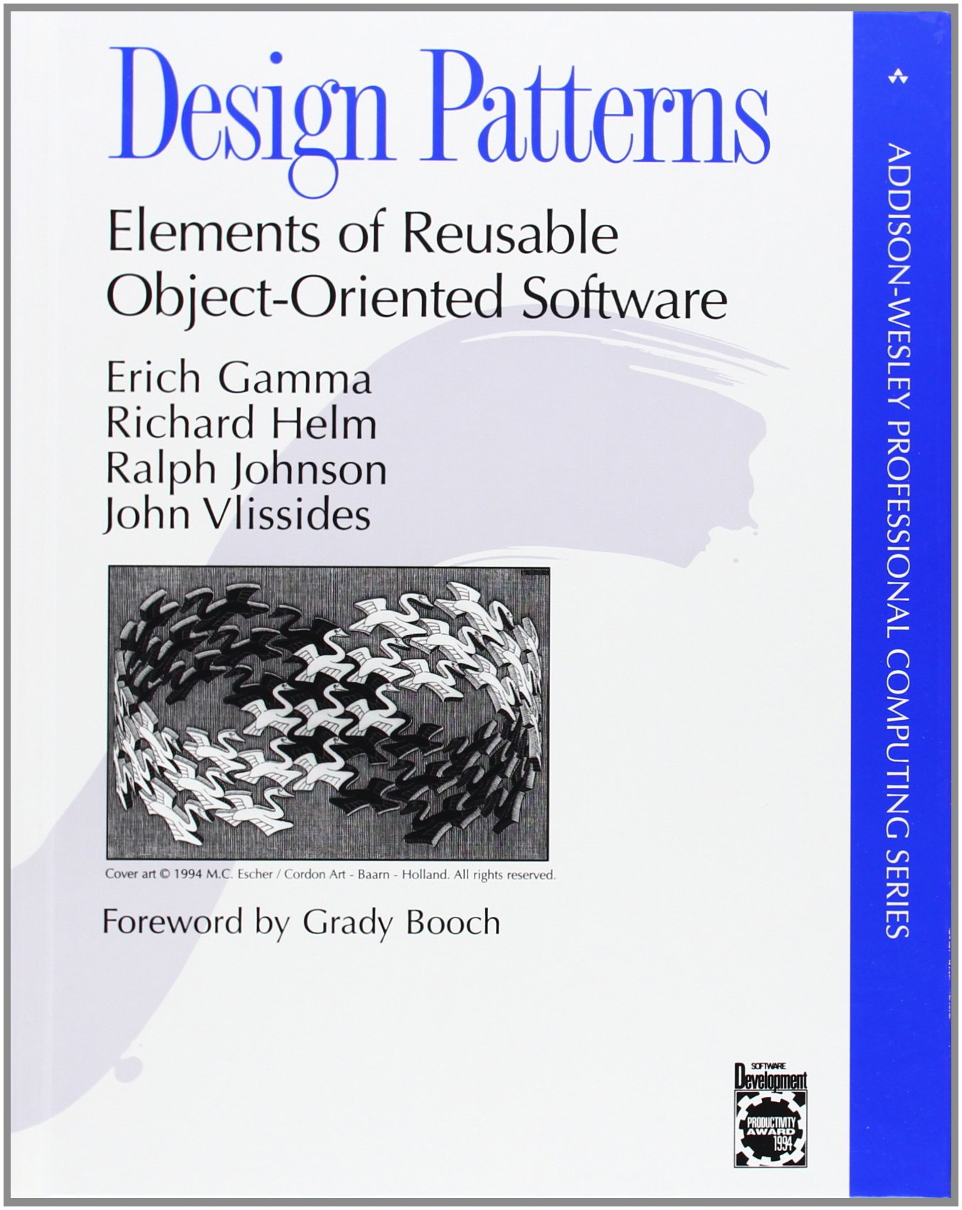

Slide 3
Praise
When designing a new class hierarchy, though implementation details may differ, you often find yourself using the same kinds of solutions over and over again.
At best, it will provide…a toolkit that can be drawn on to solve your own architectural issues without reinventing the wheel.
Patterns are a crucial tool for communication among developers.
This book will open your eyes and teach you how to utilize widely accepted and standardized design patterns to implement efficient solutions for frequently encountered design challenges.
Notes:
Think about design at a higher level

Slide 4
Criticism
The book advocates making code that is more indirect and complicated for no benefit.
After reading the patterns, I could not apply them to my code. The book is very hard to read.
This book is not a good choice for a person that is beginning in design patterns.
The concepts are hard to understand.
Notes:
Blindly applying damages code
Difficult to study

Slide 5
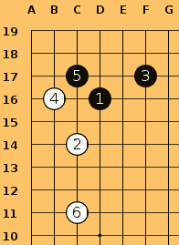

Slide 6
Praise
Go is all about patterns…Knowing how to use joseki is useful to me because it allows me to approach difficult situations without fear
Basically, learning joseki is a short-cut to playing the best moves.
If you know the right move in a position…it means you can spend your time thinking about which variation is best in the situation, rather than how to avoid screwing up and totally collapsing.
So, in other words, while diligently studying josekis - you cannot help but also study many of the other aspects of the game at their best - as represented by examples of perfect or near-perfect play!
Notes:
Think about the game at a higher level

Slide 7
Criticism
Learning joseki loses two stones in strength.
The main source for bad habits and misunderstandings by more experienced players may well be joseki.
When Michael Redmond came to Japan, one of the first things he was told was to forget everything he had read in Ishida's joseki dictionary.
Rote memorization of joseki is just delaying the problem of learning, "what should I do next?”
Notes:
Blindly applying damages game
Difficult to study

Slide 8
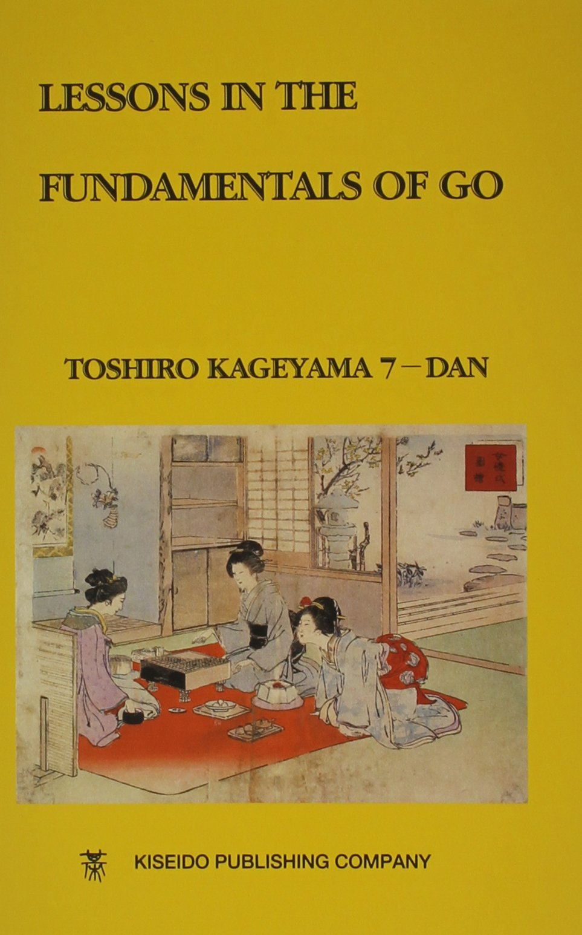

Slide 9
How to Study Joseki
Don’t think that all you have to do is learn the moves. That is not studying the joseki.
Every stone played by both sides in a joseki is the best move, so it is important to know the reason.
Joseki moves are always the best on a local scale, but they sometimes become the worst in relation to the surrounding position.

Slide 10
How to Study Design Patterns
Don’t think that all you have to do is learn the pattern. That is not studying design patterns.
Every decision made in a design pattern is the best choice, so it is important to know the reason.
Design patterns are always best on a local scale, but are sometimes the worst in relation to the surrounding code.

Slide 11
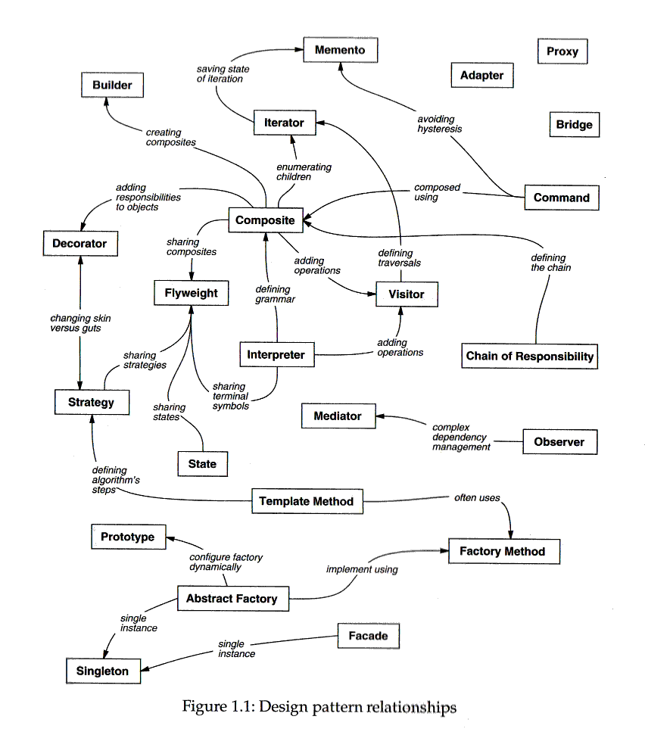
Notes:
page 12

Slide 12
Factory Method
docs
Document
Application
Open
Close
Save
Revert
NewDocument
OpenDocument
MyDocument
MyApplication
Notes:
* Abstract classes

Slide 13
Factory Method
docs
Document
Application
Open
Close
Save
Revert
CreateDocument
NewDocument
OpenDocument
MyDocument
MyApplication
CreateDocument

Slide 14
Factory Method
docs
Document
Application
Open
Close
Save
Revert
CreateDocument
NewDocument
OpenDocument
MyDocument
MyApplication
CreateDocument
Document* doc = CreateDocument();
docs.Add(doc);
doc->Open();

Slide 15
Factory Method
docs
Document
Application
Open
Close
Save
Revert
CreateDocument
NewDocument
OpenDocument
MyDocument
MyApplication
CreateDocument
return new MyDocument

Slide 16
Factory Method
docs
Document
Application
Open
Close
Save
Revert
CreateDocument
NewDocument
OpenDocument
MyDocument
MyApplication
CreateDocument
https://github.com/lackita/DesignPatterns
Notes:
First 20 minutes: Examine each line and understand why it’s not different
Why is createDocument abstract in base class?
Peek ahead at the Consequences if stuck.
When should this pattern be used?
When shouldn’t this pattern be used?
Next 5 minutes: What broader context would cause the structure to change?

Slide 17
Notes:
page 12

Slide 18
Template Method
docs
Document
Application
Open
Close
Save
Revert
Read
CreateDocument
NewDocument
OpenDocument
MyDocument
MyApplication
Read
CreateDocument
Notes:
Check if document can be opened
Create document
Perform an preparation before openeing
Open
Read

Slide 19
Template Method
docs
Document
Application
Open
Close
Save
Revert
Read
CreateDocument
NewDocument
OpenDocument
AddDocument
CanOpenDocument
AboutToOpenDocument
MyDocument
MyApplication
Read
CreateDocument
CanOpenDocument
AboutToOpenDocument

Slide 20
Template Method
public void openDocument(String name) {
if(!CanOpenDocument(name)) {
// cannot handle this document
return;
}
Document doc = CreateDocument();
if(doc) {
docs.add(doc);
AboutToOpenDocument(doc);
doc.Open();
doc.Read();
}
}

Slide 21
Template Method
docs
Document
Application
Open
Close
Save
Revert
Read
CreateDocument
NewDocument
OpenDocument
AddDocument
CanOpenDocument
AboutToOpenDocument
MyDocument
MyApplication
Read
CreateDocument
CanOpenDocument
AboutToOpenDocument
https://github.com/lackita/DesignPatterns
Notes:
First 20 minutes: Examine each line and understand why it’s not different
Peek ahead at the Consequences if stuck.
When should this pattern be used?
When shouldn’t this pattern be used?
Next 5 minutes: What broader context would cause the structure to change?
How does the factory pattern relate?

Slide 22
Notes:
page 12

Slide 23
Mediator
Colleague
Colleague
Colleague
Colleague
Colleague
Colleague
Colleague
Colleague
Colleague
Colleague
Colleague

Slide 24
Mediator
Colleague
Colleague
Colleague
Colleague
Colleague
Mediator
Colleague
Colleague
Colleague
Colleague
Colleague

Slide 25
Mediator
Colleague
Colleague
Colleague
Colleague
Colleague
Mediator
Colleague
Colleague
Colleague
Colleague
Colleague
https://github.com/lackita/DesignPatterns

