Slide 1
Training: Visualization Techniques with R
Lackson David
Software Developer & Data Scientist
https://ladam.me
lacksinho@gmail.com

Slide 2
Objectives
Learn data visualization using base R (no ggplot2).
Perform linear regression in R.
Interpret regression results using visual outputs.

Slide 3
Introduction to Base R Visualization
Base R plotting functions:
plot()
hist()
boxplot()
barplot()
Example:
hist(df$Score, main="Distribution of Scores", xlab="Score", col="skyblue")

Slide 4
Histogram
Visualizing the distribution of students' scores:
hist(df$Score,
breaks=20,col="lightgreen",
main="Histogram of Student Scores",
xlab="Scores")

Slide 5
Plotbox
Comparing scores by gender:
boxplot(Score ~ Gender, data=df,
col=c("orange", "cyan"),
main="Scores by Gender",
ylab="Score")

Slide 6
Scatter Plot
Exploring relationship between Age and Score:
plot(df$Age, df$Score,
main="Age vs Score",
xlab="Age",
ylab="Score",
pch=19,
col="blue")

Slide 7
Bar Chart
Visualizing Categorical Data: programme_counts <- table(df$Programme)
barplot(programme_counts, main = "Number of Students per Programme", col = "skyblue", xlab = "Programme", ylab = "Number of Students")

Slide 8
Introduction to Regression
Linear regression helps model relationships.
Syntax in R: lm(dependent ~ independent, data=…).
Example:
model1 <-lm(Score ~ Age,data=ds)
summary(model1)

Slide 9
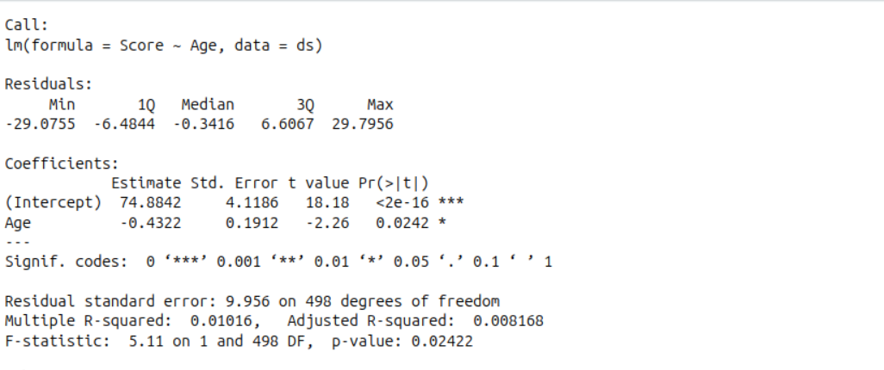
Interpretation of Output

Slide 10
Cont...
Model Summary:
Dependent variable: Score
Independent variable: Age
Coefficients:
Intercept | 74.88 | When age is 0 (theoretically), the predicted score is 74.88. This is the baseline.
Age | -0.43 | For each additional year in age, the average score decreases by 0.43 points, holding all else constant.

Slide 11
Cont...
Significance:
The p-value for Age is 0.0242, which is less than 0.05 → it is statistically significant.
That means there's evidence of a negative relationship between age and score.

Slide 12
Visualizing Regression Line
Add regression line to scatter plot:
plot(ds$Age, ds$Score,main="Age vs Score with Regression Line",
xlab="Age",ylab="Score",pch=19)
abline(model1, col="red", lwd=2)

Slide 13
Multiple Regression
Use multiple predictors:
model2 <- lm(Score ~ Age + Gender + Programme, data=ds)
summary(model2)
Note: Convert categorical variables using factor() if not already.

Slide 14
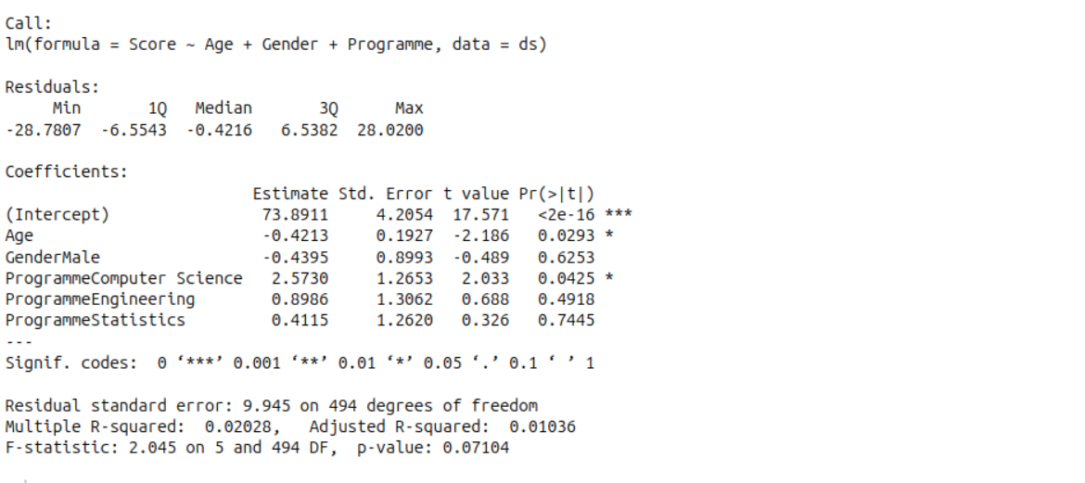
Interpretation of Output

Slide 15
Model Summary Interpretation
Intercept(73.8911):
This is the baseline predicted score when: Age = 0 (theoretical, not practical in this context),Gender = Female (since Male is coded as a dummy variable), Programme = Business (because it's the reference category — other programs are compared to it).

Slide 16
Cont...
Predicted Score = 73.8911
– 0.4213 × Age – 0.4395 × GenderMale
+2.5730×ProgrammeComputerScience
+ 0.8986 × ProgrammeEngineering
+ 0.4115 × ProgrammeStatistics
So, a female Business student aged 0 (theoretically) would have a predicted score of 73.89.

Slide 17
Predictor Interpretations
Predictor | Meaning
Age (-0.4213) | For each additional year of age, the predicted score decreases by 0.42 points. This is statistically significant (p = 0.0293).
GenderMale (-0.4395) | Males score 0.44 points lower than females, but this difference is not statistically significant (p = 0.6253).
Programme: Computer Science (+2.57) | Computer Science students score 2.57 points higher than Business students, and this is statistically significant (p = 0.0425).
Programme: Engineering (+0.90) | No significant difference from Business students (p = 0.4918).
Programme: Statistics (+0.41) | Also no significant difference (p = 0.7445).

Slide 18
Homework Assignment
Load the sample_students.csv or choose any other dataset you like.
Plot histograms, boxplots, and scatterplots.
Fit and visualize a simple regression.
Fit and interpret a multiple regression.

