Slide 1
Training: Visualization Techniques with R
Lackson David
Software Developer & Data Scientist
https://ladam.me
lacksinho@gmail.com

Slide 2
Objectives
Learn data visualization using base R (no ggplot2).
Perform linear regression in R.
Interpret regression results using visual outputs.

Slide 3
Introduction to Base R Visualization
Base R plotting functions:
plot()
hist()
boxplot()
barplot()
Example:
hist(ds$Score, main="Distribution of Scores", xlab="Score", col="skyblue")

Slide 4
Histogram
Visualizing the distribution of students' scores:
hist(ds$Score,
breaks=20,col="lightgreen",
main="Histogram of Student Scores",
xlab="Scores")

Slide 5
Plotbox
Comparing scores by gender:
boxplot(Score ~ Gender, data=ds,
col=c("orange", "cyan"),
main="Scores by Gender",
ylab="Score")

Slide 6
Scatter Plot
Exploring relationship between Age and Score:
plot(ds$Age, ds$Score,
main="Age vs Score",
xlab="Age",
ylab="Score",
pch=19,
col="blue")

Slide 7
Bar Chart
Visualizing Categorical Data: programme_counts <- table(ds$Programme)
barplot(programme_counts, main = "Number of Students per Programme", col = "skyblue", xlab = "Programme", ylab = "Number of Students")

Slide 8
Introduction to Regression
Linear regression helps model relationships.
Syntax in R: lm(dependent ~ independent, data=…).
Example:
model1 <-lm(Score ~ Age,data=ds)
summary(model1)

Slide 9
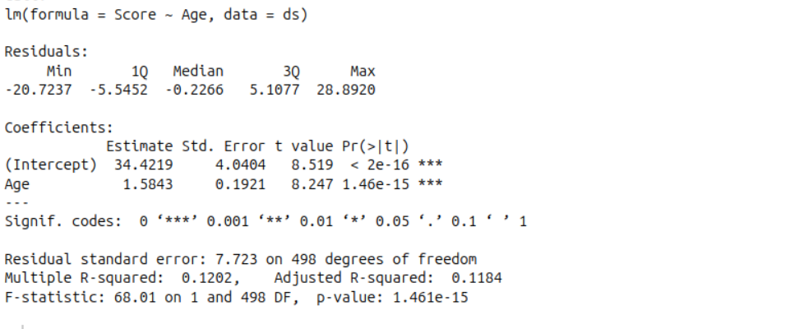
Interpretation of Output

Slide 10
Cont...
Model Summary:
Dependent variable: Score
Independent variable: Age
Coefficients:
Intercept | 34.42 | When age is 0 (theoretically), the predicted score is 34.42. This is the baseline.
Age | 1.58 | For each additional year in age, the average score increases by 1.58 points, holding all else constant.

Slide 11
Cont...
Significance:
p-value for Age: 1.46e-15 (which is < 0.001), marked as ***. This means the relationship between Age and Score is highly statistically significant.
That means there's evidence of a positive relationship between age and score.

Slide 12
Visualizing Regression Line
Add regression line to scatter plot:
plot(ds$Age, ds$Score,main="Age vs Score with Regression Line",
xlab="Age",ylab="Score",pch=19)
abline(model1, col="red", lwd=2)

Slide 13
Multiple Regression
Use multiple predictors:
model2 <- lm(Score ~ Age + Gender + Programme, data=ds)
summary(model2)
Note: Convert categorical variables using factor() if not already.

Slide 14
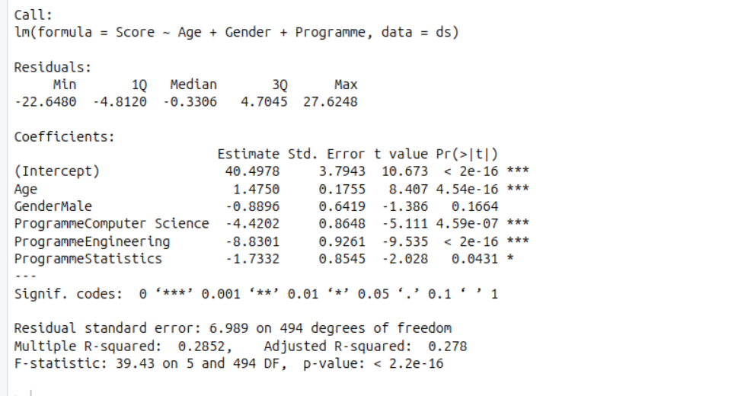
Interpretation of Output

Slide 15
Cont...
Predicted Score=40.4978+1.4750×Age−0.8896×GenderMale
−4.4202×ProgrammeComputerScience
−8.8301×ProgrammeEngineering
−1.7332×ProgrammeStatistics
So, a female Business student aged 0 (theoretically) would have a predicted score of 40.4978.

Slide 16
Predictor Interpretations
Predictor | Meaning
Age (1.48) | For each additional year in age, the score increases by 1.48 points, holding gender and programme constant (significant, p < 0.001).
GenderMale (-0.89) | Male students score 0.89 points lower than female students, controlling for age and programme (not statistically significant, p = 0.166).
Programme: Computer Science (-4.42) | Students in Computer Science score 4.42 points lower than those in Business (significant, p < 0.001).
Programme: Engineering (-8.83) | Students in Engineering score 8.83 points lower than those in Business (very significant, p < 0.001).
Programme: Statistics (-1.73) | Students in Statistics score 1.73 points lower than those in Business (marginally significant, p ≈ 0.043).

Slide 17
Homework Assignment
Load the sample_students.csv or choose any other dataset you like.
Plot histograms, boxplots, and scatterplots.
Fit and visualize a simple regression.
Fit and interpret a multiple regression.

