Slide 1
GO Template
Project
Lib
config-map-gen.tpl
Python Template
Project
Lib
config-map-template.yaml
config-map-gen.py
App
config-maps.yaml
App
config-maps.yamp

Slide 2
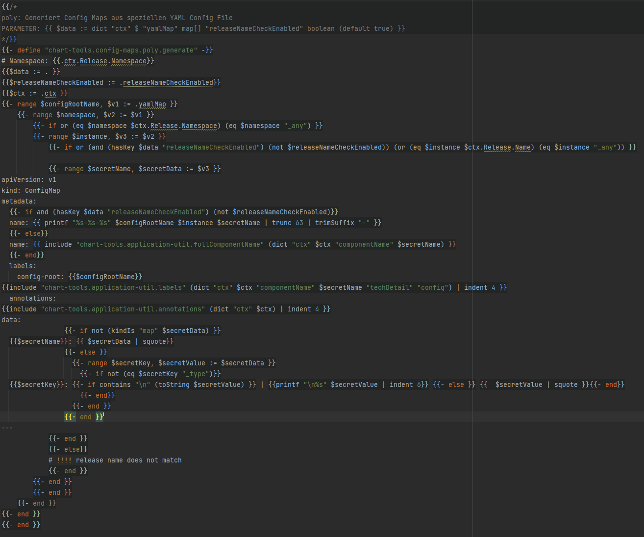
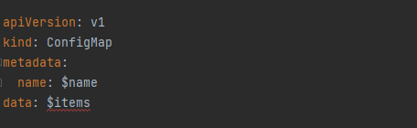
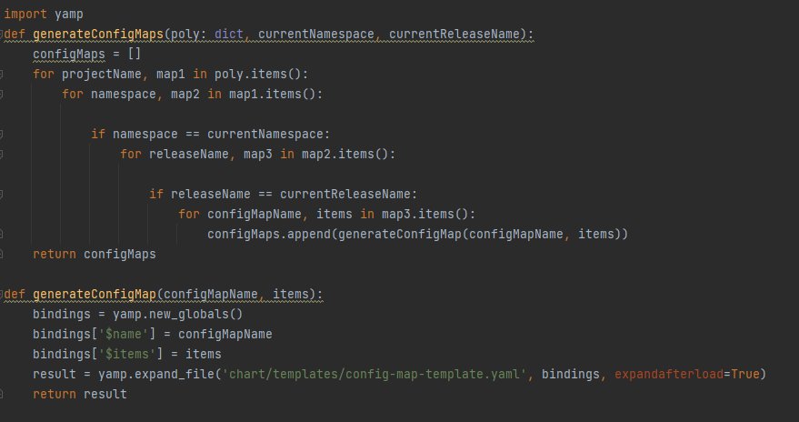
GO Template
Project
Lib
config-map-gen.tpl
Python Template
Project
Lib
config-map-template.yaml
config-map-gen.py
App
config-maps.yaml
App
config-maps.yamp

Slide 3
GO Template
Project
Lib
config-map-gen.tpl
App
config-maps.yaml
Python Template
Project
Lib
config-map-template.yaml
config-map-gen.py
App
config-maps.yamp

Slide 4
GO Template
Project
Lib
config-map-gen.tpl
Python Template
Project
Lib
config-map-template.yaml
config-map-gen.py
App
config-maps.yaml
App
config-maps.yamp

Slide 5
GO Template
Project
Lib
config-map-gen.tpl
Python Template
Project
Lib
config-map-template.yaml
config-map-gen.py
App
config-maps.yaml
App
config-maps.yamp

Slide 6

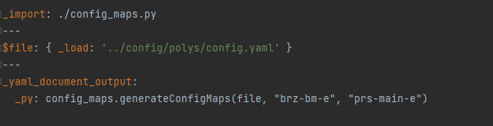
GO Template
Project
Lib
config-map-gen.tpl
Python Template
Project
Lib
config-map-template.yaml
config-map-gen.py
App
config-maps.yaml
App
config-maps.yamp

