Slide 1
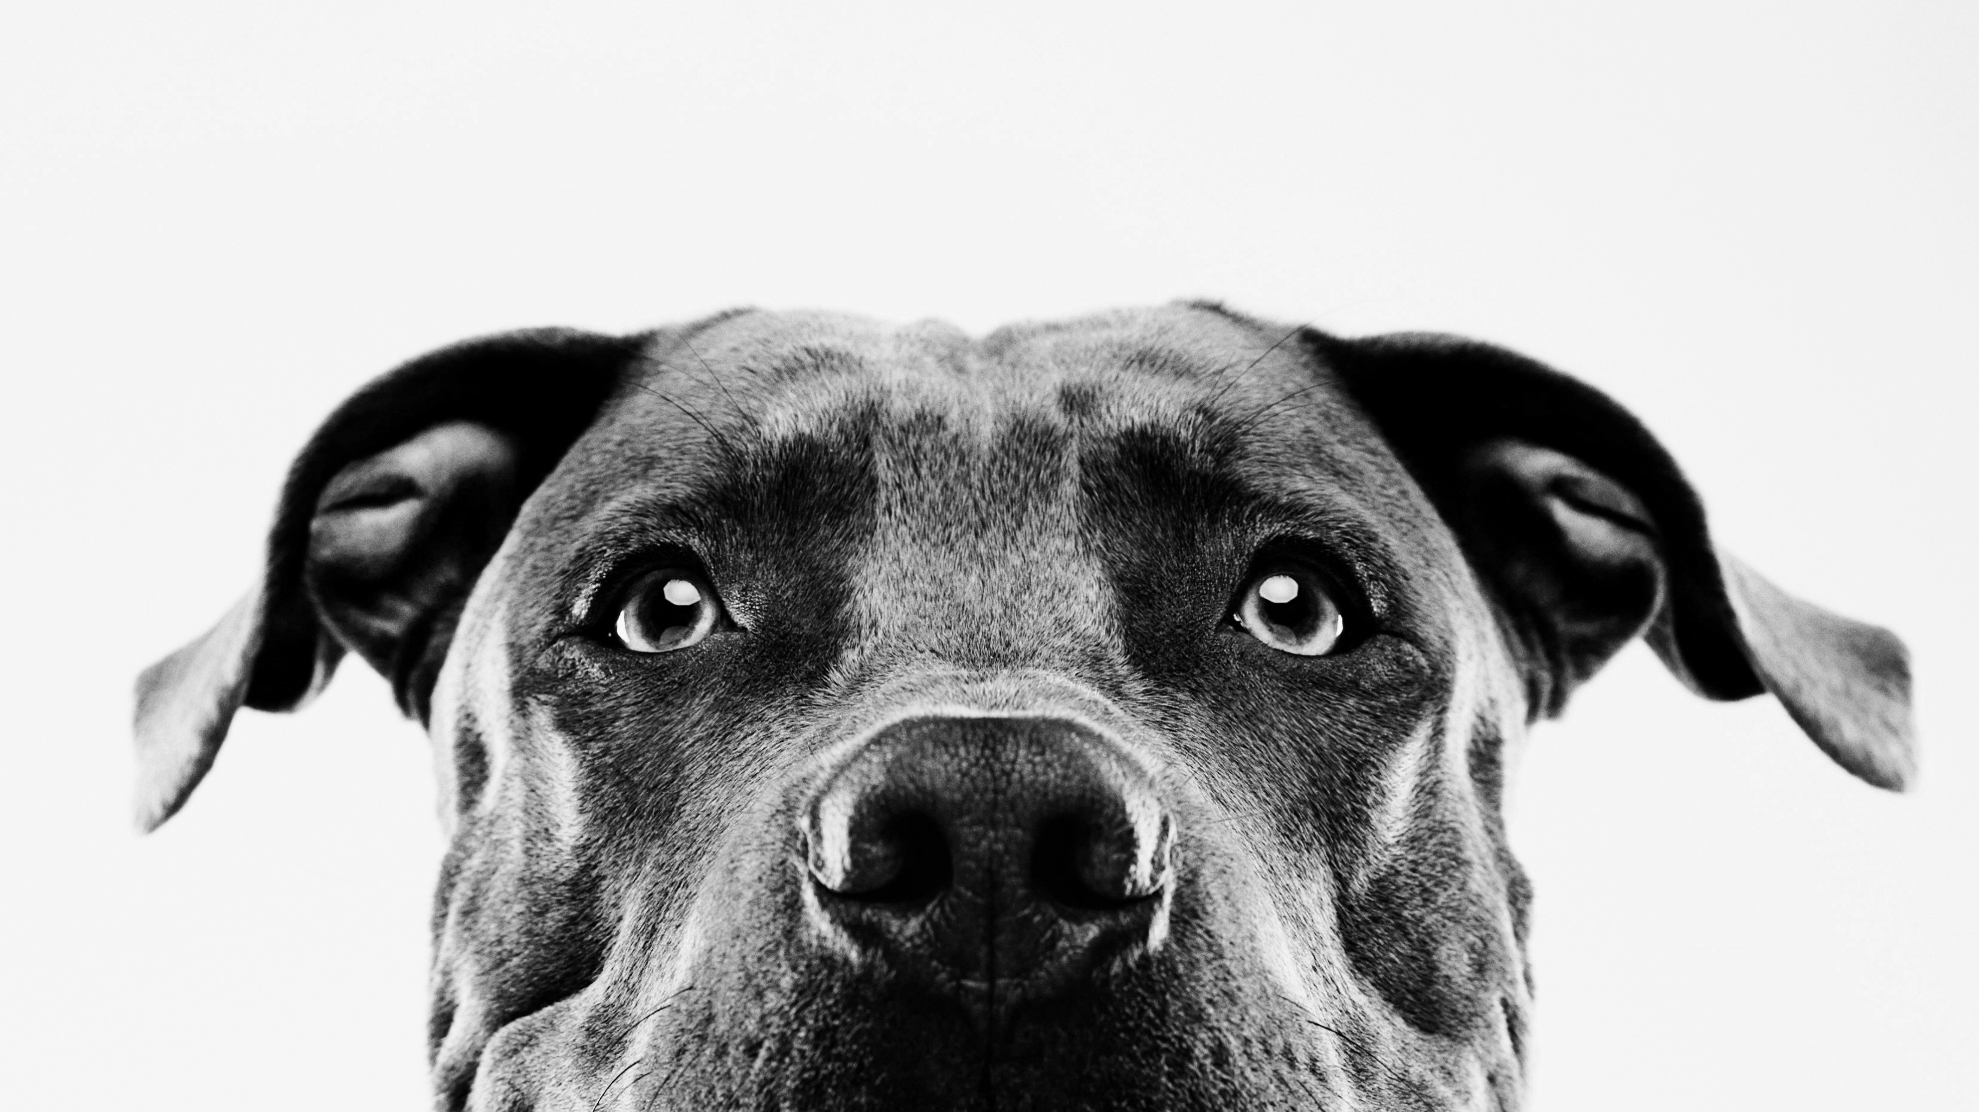
One way anova
Week 2

Slide 2
Announcements
Slack or registration issues?
Don’t forget CITI training and HW 1c
If you were registered in the course later, extension for HW 1a

Slide 3
motivation
Often, we want to compare groups
2 questions
Is difference statistically significant?
Is the difference large?

Slide 4
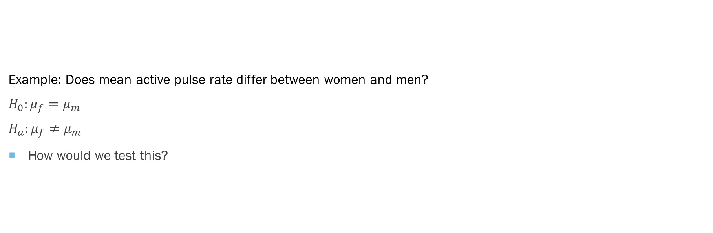
example
Example: Does mean active pulse rate differ between women and men?
$$H_{0}:μ_{f}=μ_{m}$$
$$H_{a}:μ_{f}≠μ_{m}$$
How would we test this?

Slide 5
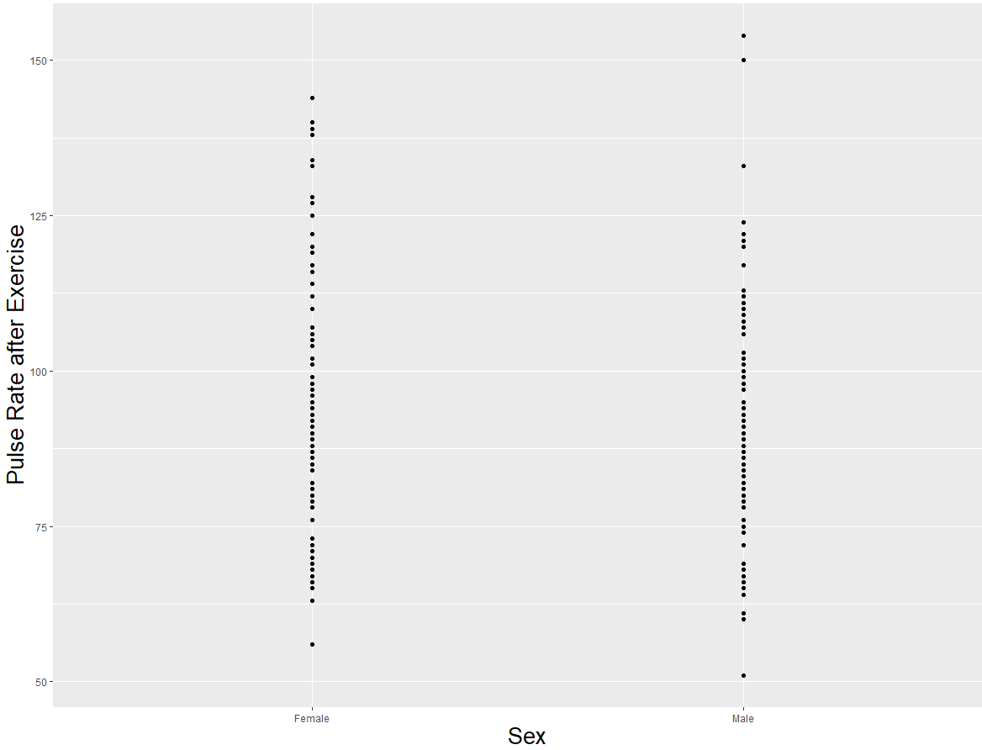
Plot Data

Slide 6
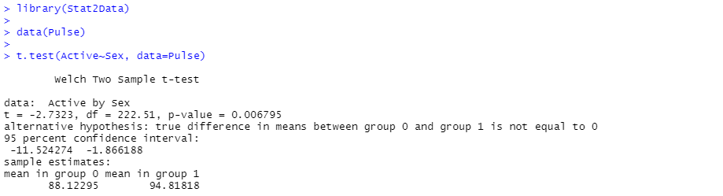
T-test
What do we conclude?

Slide 7
Can we make causal claims about the relationship between Sex and Pulse rate after exercise? Why or why not?

Slide 8
Is it an experiment or observational?
Can you “assign” a treatment
Can it be randomly assigned
Do units come in with condition?
Example- collecting data on those diagnosed with depression
Important for conclusions
Does the sample of eligible people reflect the overall population?
Internal vs external validity
Confounding factors- factors that may be influencing relationship between IV and DV

Slide 9
Correlation does not equal causation!
In small groups- fill out google slide
Theory matters!

Slide 10
terms
Units- what are your observations? Humans, plants, individuals, states, companies, etc.
Balanced designs: do all groups (treatments) have same number of observations
Unbalanced if not
Explanatory factor- condition that determine groups
Example: are you given a placebo or medication
Levels- different groups
Response/DV- outcome you measure after treatment

Slide 11
In small groups
I design a study to test the relationship between hydration and exam test scores. I randomly assign 90 smith students to three groups (30 per group): 1 group is given a bottle of water during the exam, one a cup of coffee, and one group nothing. I have the groups come in to take the exam at 9 am, 11 am, and 1 pm respectively and collect data on their final score for the exam (a scale from 0-100).
In groups
Is this experimental or observational?
If not experimental, what would have to change to make it experimental?
If experimental, is it balanced? What is the treatment? How many levels are there?
Are there confounding factors?
If so, what should we change about the design?

Slide 12
IN small groups
I design a study to understand test whether a new energy supplement is working as expected. I randomly sample responses from customers to ask them their self-reported energy levels, and then randomly sample from people who have not taken the supplement to ask the same. I compare self-reported levels of energy and find that those taking the supplement report significantly higher levels of energy.
In groups
Is this experimental or observational?
If not experimental, what would have to change to make it experimental?
If experimental, is it balanced? What is the treatment? How many levels are there?
Are there confounding factors?
If so, what should we change about the design?

Slide 13
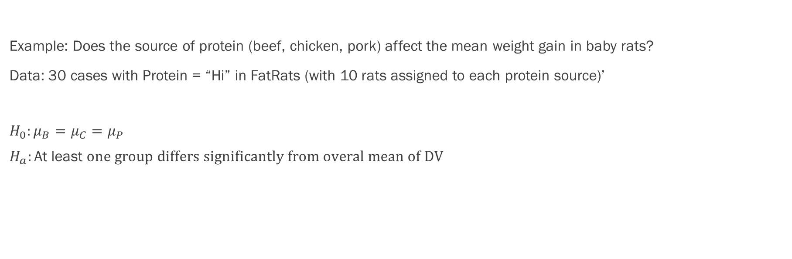
Often, we have more than 2 groups
Example: Does the source of protein (beef, chicken, pork) affect the mean weight gain in baby rats?
Data: 30 cases with Protein = “Hi” in FatRats (with 10 rats assigned to each protein source)’
$$H_{0}:μ_{B}=μ_{C}=μ_{P}$$
$$H_{a}:\text{At} \text{least} one group differs significantly from overal mean of DV$$

Slide 14
Anova
Compares differences in group means across multiple groups
Do groups all have the same mean?
If yes- then experimental factor has no explanatory power
Incorporates
Variability within group
Variation between groups
One-way Anova
Single factor/IV
Works the same way for experimental or observational data- question of what we can conclude

Slide 15
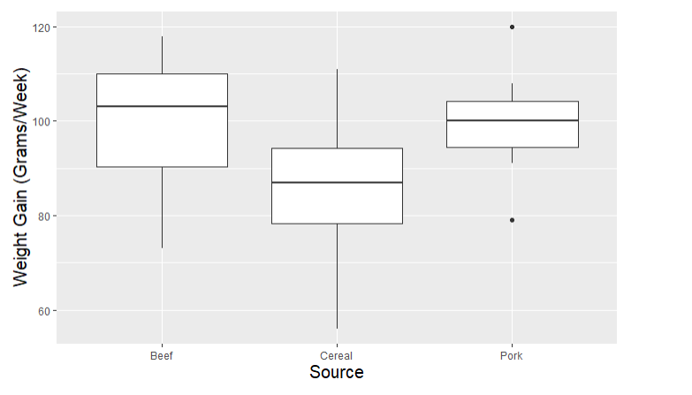
Plot the data

Slide 16
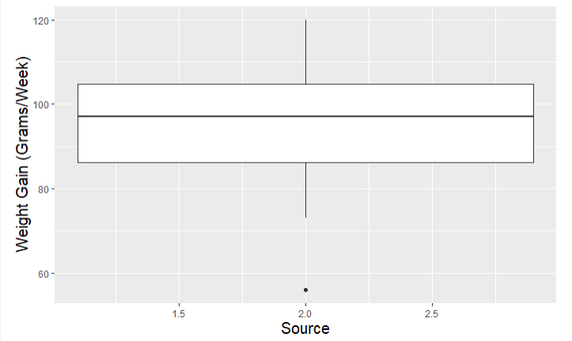
Logic of Anova visualized

Slide 17
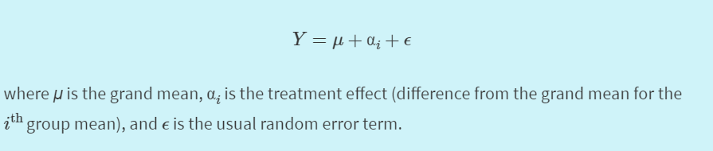
One-way Anova model
What happens to the model if the treatment effect is insignificant?
In other words
DV=grand average + treatment effect + error

Slide 18
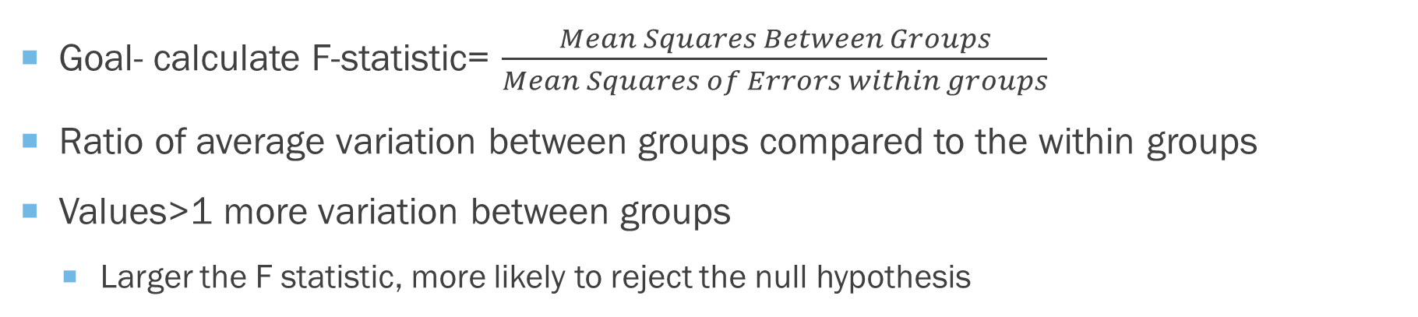
ANOVA
Goal- calculate F-statistic= $\frac{Mean Squares Between Groups}{Mean Squares of Errors within groups}$
Ratio of average variation between groups compared to the within groups
Values>1 more variation between groups
Larger the F statistic, more likely to reject the null hypothesis

Slide 19
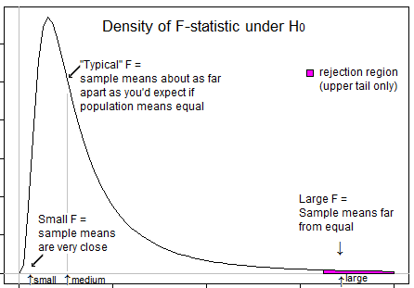
F-statistic

Slide 20
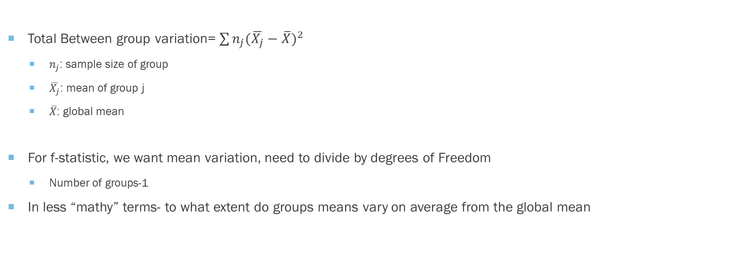
Between group Variance
Total Between group variation= $\sum{n_{j}(\overline{X_{j}}−\overline{X})^{2} }$
$n_{j}$: sample size of group
$\overline{X_{j}}$: mean of group j
$\overline{X}$: global mean
For f-statistic, we want mean variation, need to divide by degrees of Freedom
Number of groups-1
In less “mathy” terms- to what extent do groups means vary on average from the global mean

Slide 21
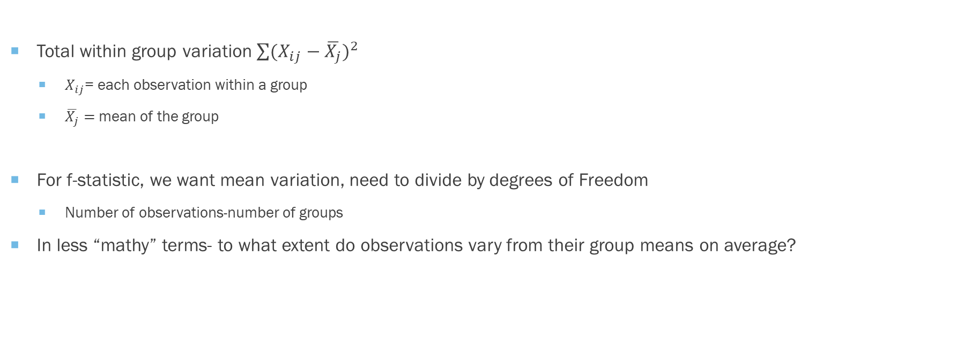
Within group variation
Total within group variation $\sum{(X_{ij}−\overline{X_{j}})^{2} }$
$X_{ij}$= each observation within a group
$\overline{X_{j}}=$mean of the group
For f-statistic, we want mean variation, need to divide by degrees of Freedom
Number of observations-number of groups
In less “mathy” terms- to what extent do observations vary from their group means on average?

Slide 22
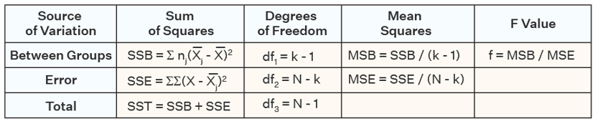
Pieces visualized- we can calculate manually in R

Slide 23
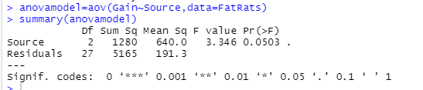
Back to our example on Rat weight gain what do we conclude?

Slide 24
Time for Work in R
Work on Homework 1c

