Slide 1

Week 1- Intro and What Is a Statistical Model
SDS 290
Scott LaCombe

Slide 2
Todays Plan
Introductions
Course overview
CITI training set up

Slide 3
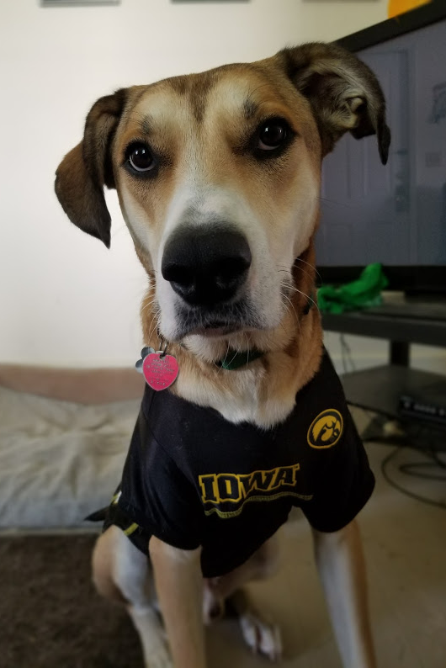
A Little About Me
Joint GOV/SDS Position
Graduate from University of Iowa
Originally From Kansas City, Mo
I focus on State Politics and networks of public policies
Teaching Assistant: Gollum LaCombe

Slide 4
Introductions (in small groups)
Name
Major
Year at Smith
Most recent show/movie you’ve been obsessed with

Slide 5
Goals of this course
Understand fundamentals of experimentation and observational research
Learn about how to design and implement survey experiments
Implementing ANOVAs and similar models
Use software and data to answer real world questions about the world around us

Slide 6
Quick note on R and Stats Background
Assumption- you’ve taken an introductory stats class
Demonstrate familiarity with descriptive statistics, normal/t distribution, hypothesis testing, p-values, and confidence intervals
We will be using R extensively in this class
Will start slow, but quickly build
If you are unfamiliar with R, I strongly suggest working through first 4 chapters of ModernDive (see syllabus)
Talk with me, go to stats Tas
SDS 100

Slide 7
Tips for Learning this semester
Office hours:
Mondays: 2-3, Wednesdays 11-12, Thursdays 4:15-5:15
Complete readings before class
Use office hours and tutors
Post on slack
If you have a question, someone else probably does too
Also counts toward participation
Keep me in the loop if you are struggling inside/outside class
Much easier to give extensions before due date than after
Notes:
Make a note about children, dogs, others. Not a problem, just please mute your microphone so it doesn’t distract the class.
I’m not holding it against you if you mute your camera, but if you are comfortable I greatly appreciate cameras on. Let’s me know what you are learning

Slide 8
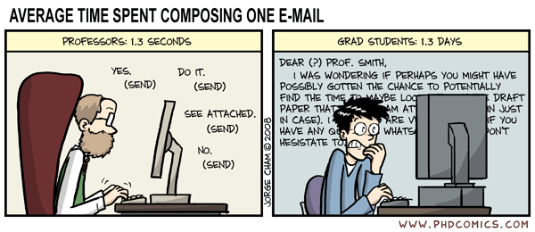
Slack Chanel & Moodle

Slide 9
A note on course Delivery and Participation
Will record lectures, no remote option
Welcome to “zoom-in” classmate
Participation and attendance contribute to course participation grade
If you can’t make it to class, email me and post something on slack.
In person R labs are critical to your learning
I’m trying to be as flexible as possible, extending the same to you
In person attendance expected, but if you are feeling sick, close exposure, watch recording and get notes from a friend

Slide 10

Syllabus Walkthrough

Slide 11
Basic Structure of Course
Lecture with periodic group discussion/prompts
Weekly(ish) homework assignments, due Fridays at 11:59 PM
Periodic R workshops to build programming skills
2 exams
2 mini projects- will talk about more next week
1 mini project solo
1 in groups of 3
Design and implement survey

Slide 12

Questions?

Slide 13
Before we get started with content…
By tomorrow- Fill out introductory survey
For next Friday
CITI training
Intro to R lab
Don’t put off! Citi training takes a bit of time

Slide 14
What is a statistical model?

Slide 15

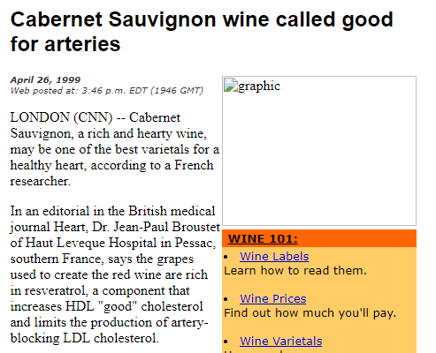
Problem we face today- so much data!

Slide 16
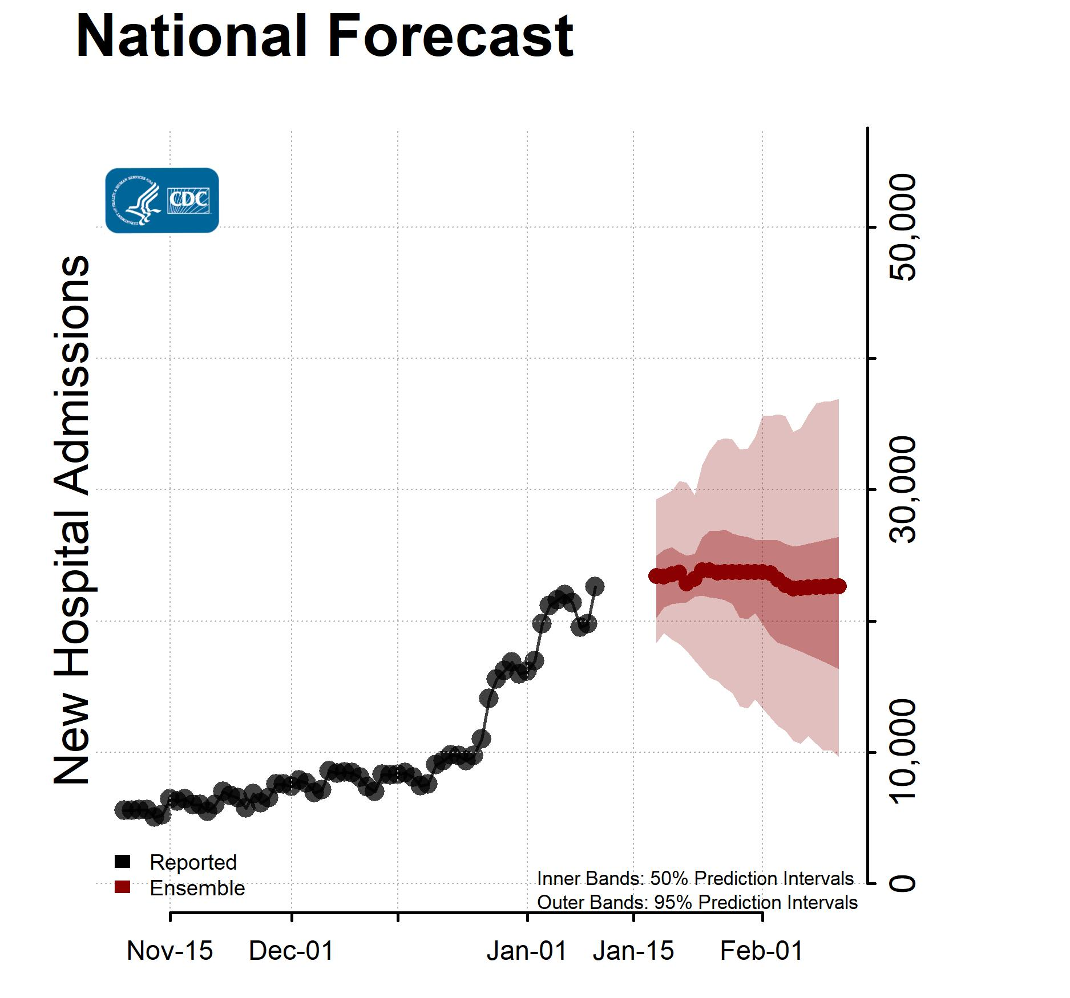
Our goal
With so much info, how to separate out the signal from the noise?
Our approach- Modeling
Simplification of complex processes to use data to better understand the world around us
All models are wrong, some are better than others
World is complex, shouldn’t forget that
Uncertainty is central

Slide 17
Goal of modeling
Prediction
Classification
Evaluating a treatment
Testing a theory
Summarizing a pattern
Improving a process
Making a decision

Slide 18
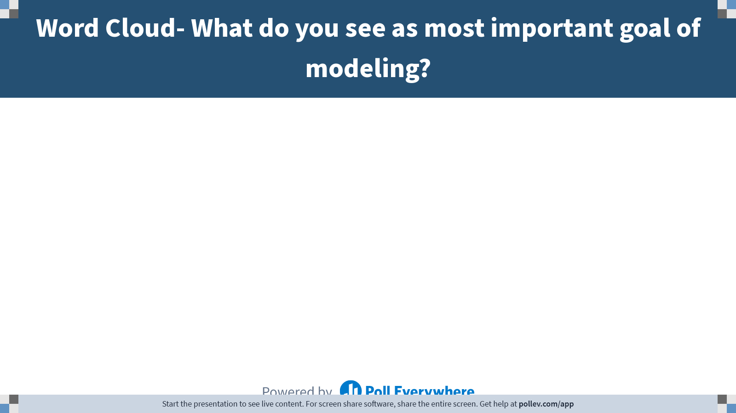
Notes:
Poll Title: Do not modify the notes in this section to avoid tampering with the Poll Everywhere activity. More info at polleverywhere.com/support Word Cloud- What do you see as most important goal of modeling? https://www.polleverywhere.com/free_text_polls/1JykVBVoSV9TKYm8kOKsp

Slide 19
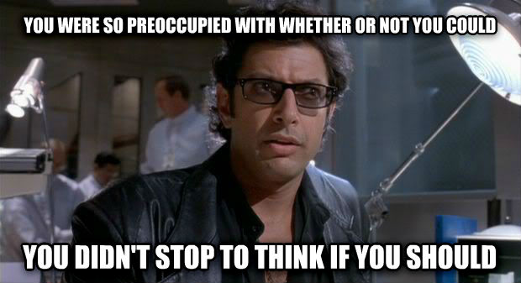
What should our goal be?- small groups

Slide 20
Model basics
Y=model+error
Y
Dependent variable, response variable, outcome
Thing we are trying to explain/model
Model
Explanatory variables, independent variables
Error
Residuals, difference between predicted and observed

Slide 21
Other important terms
Sample vs Population
Statistic vs Parameter
Inference
Parameter estimate
Causal inference
Role of experimentation vs observation
Covariates

Slide 22
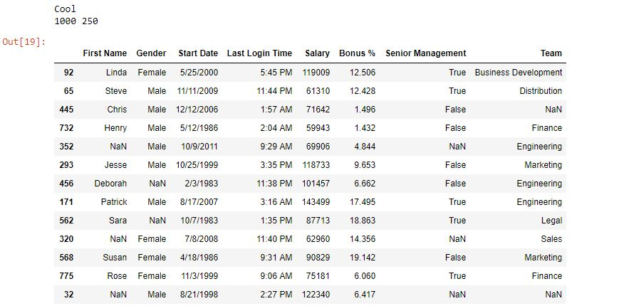
Data
Cases
Unit of analysis
Variables
Types of variables
Quantitative/continuous
Categorical
Ordinal vs nominal
binary

Slide 23
What types of variables are these?
Race
Education level
Income (in dollars)
left-handed/non-left handed
Voter turnout
Letter grade in a course

Slide 24
Modeling Process- 4 steps
Choose a form for the model
Fit the model
Assess the Model
Address research question
Theory comes first

Slide 25
Our plan
Anova- Analysis of Variance
Response variable Quantitative
Explanatory variable typically categorical
Fundamentals of experimentation
Later in semester- Causal inference with observational data

