Slide 1
Git Workshop
Part 1 of 2
Setup, Clones, Commits and Branches

Slide 2
Workshop Agenda
Part 1 – This Deck
  Installation and Setup
  Concepts
  Repository Initialization
  Clone
  Basic Lifecycle
  Logs
  Introduction to Branches
Part 2 – Another Deck
  Merging Branches
  Remote Repositories
  Tags
  Hosting Services
    GitHub
    AWS CodeCommit
  Signing Commits
This is a "presentation-ification" of the single-page workshop available at
https://www.workshops.lacounty-isab.org/

Slide 3
Installation
Documentation and install images for most platforms:
https://git-scm.com/.
  Bookmark this for your documentation.
  Download free e-book.
  Watch videos.
  Site includes references to GUI clients. This workshop will only work with the command line client.
Windows Installation Options
  Line endings
  SSH Client
  Bash Shell
  Make sure git is in your PATH variable.
Check your installation:
$ git --version
git version 2.20.1

Slide 4
First Time Setup
Git configuration scope options:
  --local: (default) applies to a particular repository
  --global: applies to all repositories for current user
  --system: applies across all users
For first configuration, set the following at global scope.
  user.name
  user.email
Exercise 1 – Setup
Create a new directory on your file system in which to perform the activities for the workshop. This directory will be called GitWorkshop for the rest of this workshop.
Open a command line terminal to GitWorkshop.
Verify your Git version with git --version. If this fails, you need to fix problems with your PATH or the installation.
Set your name and email in the global scope using the following commands.
Clone the ISAB repository for this workshop to your workstation.
git config --global user.name "John Doe"
git config --global user.email "jdoe@somewhere.gov
git clone https://github.com/lacounty-isab/workshops isabrepo
This will clone the Git repository hosted on GitHub to your local file system into a new directory named isabrepo. If you omit the isabrepo parameter, the new directory will default to the base name of the repository, in this case workshops.

Slide 5
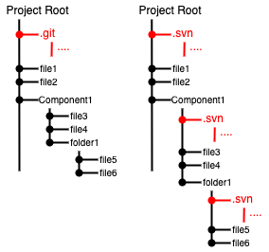
Repository Initialization
Exercise 2 – init
From the clone of the workshops repository, copy the isabrepo/git/samples directory to GitWorkshop. After this, you should have a copy named GitWorkshop/samples.
Change to GitWorkshops/samples directory in your command line. This is a directory of files from which we aim to create a new Git repository.
Run git status. It returns a message that simply means we are not in the context of a Git repository.
Run git init. This will create an empty local repository.
None of the files in this directory have been placed in the new repository. That will come later. On Windows, the new .git folder is harder to verify. On Linux and macOS it's apparent with ls -a.
A Git repository can be created
  through clone (previous slide)
  running init
Running init
  creates an empty local repository
  the entire repository is added to a folder named .git.
  compare with SVN.
GitWorkshop/samples$ git status
fatal: not a git repository (or any of the parent directories): .git
GitWorkshop/samples$ git init
Initialized empty Git repository in GitWorkshop/samples/.git/
Git creates a single folder at the root of the working copy. SVN, CVS and others add folders recursively throughout the entire tree. This can be a mess to clean.

Slide 6
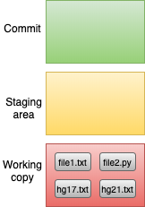
Repository Initialization
Exercise 2 – init (continued)
Run git status.
The remark "nothing added to commit" is alluding to the staging area. In Git there are three states in which a version of a file can occupy: the working copy, the staging area, and a commit. These are shown in the figure to the right.
The working copy of a file is the one in your directory that you can see and edit. The staging area is a version of a file that is to be committed in the next commit action. Committed versions of the file are in the commit state. These are preserved in the commit history.
GitWorkshop/samples$ git status
On branch master
No commits yet
Untracked files:
(use "git add <file>..." to include in what will be committed)
file1.txt
file2.py
hg17.txt
hg21.txt
nothing added to commit but untracked files present (use "git add" to track)
The three logical boxes above are created with the git init command. At the beginning, all files only exist as part of the working copy.

Slide 7
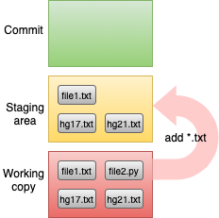
Repository Initialization
6. Commit all the *.txt files, but delay the *.py and *.md file.
GitWorkshop/samples$ git add *.txt
GitWorkshop/samples$ git status
On branch master
No commits yet
Changes to be committed:
(use "git rm --cached <file>..." to unstage)
new file: file1.txt
new file: hg17.txt
new file: hg21.txt
Untracked files:
(use "git add <file>..." to include in what will be committed)
file2.py
The add command adds files and changes to the staging area.
Note the change in the status message. The status of the files went from "untracked" to "to be committed." These are the files that will be added to the repository.

Slide 8
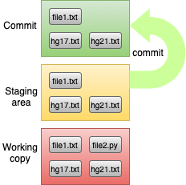
Repository Initialization
7. Run the commit command.
GitWorkshop/samples$ git commit -m "Initial version."
[master (root-commit) 79647d7] Initial version.
3 files changed, 47 insertions(+)
create mode 100644 file1.txt
create mode 100644 hg17.txt
create mode 100644 hg21.txt
The commit command adds all changes that have been accumulating in the staging area to a commit. There are now files "in the repository."
This command will commit the changes with the message "Initial version.". This avoids a vi session for those of you not familiar with the vi editor. But it limits you to commit messages that are a single line.
At the end of this exercise we still have one untracked file. There is no harm in having files in the directory that are not part of the repository. We can commit them later or never commit them.
GitWorkshop/samples$ git status
On branch master
Untracked files:
(use "git add <file>..." to include in what will be committed)
file2.py
nothing added to commit but untracked files present (use "git add" to track)

Slide 9
Clone
The clone command copies a repository from one location to another location. We used it in the first exercise to clone the remote workshop repository to our local workstation. We can also clone locally within a single file system.
Exercise 3 – Local Clone
In your command line, change to the GitWorkshop directory. There should be two subdirectories: isabrepo and samples. Each of these directories holds a Git repository.
Clone the samples directory locally.
Change to the samples2 folder and list the directory.
Note there is no Python script since we did not commit it to the original repository.
Delete the .git folder. Now it's no longer a Git repository. But you still keep your working copy.
Change back to the GitWorkshop directory and clone the ISAB repository locally.
Make a bare clone of the ISAB repository. A bare repository is one with no working copy, just the repository itself.
GitWorkshop/samples2$ rm -rf .git
GitWorkshop/samples2$ git log
fatal: not a git repository (or any of the parent directories): .git
GitWorkshop/samples2$ ls
file1.txt hg17.txt hg21.txt
GitWorkshop$ git clone isabrepo repo1
Cloning into 'repo1'...
done.
GitWorkshop$ ls repo1
crypto/ ds/ octotrooper.png regex/
distributions/ git/ readme.md
git clone samples samples2
GitWorkshop$ cd samples2
GitWorkshop/samples2$ ls -a
./ ../ .git/ file1.txt hg17.txt hg21.txt
GitWorkshop$ git clone --bare isabrepo repo2
Cloning into bare repository 'repo2'...
done.
GitWorkshop$ ls repo2
HEAD config hooks/ objects/ refs/
branches/ description info/ packed-refs

Slide 10
Clone Notes
Bare clones are typically used for hosting on servers. One can fetch from any repository. But only a bare repository may be pushed to from another clone.
Note how fast the clone operation is locally.
Local clones are a good way to experiment with new commands without damaging your current repository. Just create a clone and test the new command there.
The remote clone operation compresses objects before transmission. It's very efficient.
Step 4 showed how easy it is to strip the repository away from a working copy. Look back at the diagram after Exercise 1 to compare the same task with SVN. This shows how easy it is to
  turn a set of working files into a Git repository
  remove the Git repository for a working set of files.
Git is very agile in this sense. Adding or removing a repository for a working set is quick and easy.

Slide 11
Basic Lifecycle
Once you have a local copy of the repository, the basic lifecycle run as follows.
checkout – change to a branch; often create a new one.
edit – edit working copy
stage – add the changes to a staging area
commit – commit changes to repository
repeat – steps 2 through 4
push – synchronize commits to a remote repository
In the case of a local-only repository, there is no Step 6.
The following conventions apply to Git Comments
The first line should be a brief summary with fewer than 50 characters and end with a period. That's because many reporting tools summarize Git commit comments by using the first line only. These reports look nicer if the summary is short.
If there is more detail to provide, start the detail on the third line. Leave the second line blank.
Comment lines started with the third line have no conventions for length. But generally it's good to keep them under 100 characters.
Generally you do not need to provide
the date – this is provided automatically
the author – this defaults to the committer.
the changed files – this is obtainable through other Git commands. But you're welcome to list them in the Git comment in order to provide notes about their respective changes.
The basic lifecycle will be reinforced in Exercise 4 staring on the next slide.

Slide 12
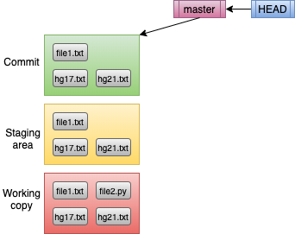
Exercise 4 – Second Commit
In this exercise we're going to reinforce the basic lifecycle with another commit. We'll continue using the GitWorkspace/samples directory. At this point, we should have the the configuration on the right.
As we progress through the exercise, we'll track two pointer objects that are important for understanding branches: master and HEAD.
master – represents a branch. There is nothing special about this branch or its name, other than Git creates one for us with each new repository. It is, however, commonly retained and used. It's a pointer to a commit object, usually the last one in a sequence of commit objects representing a branch.
HEAD – is a bookmark of sorts. It helps Git determine where to apply its commands. Since we intend for our commands to apply to a particular branch, HEAD usually references a branch pointer rather than directly to a commit. Hence it's usually a pointer to a pointer.
We're going to simulate to edits in this exercise:
Change a file that has already been committed.
Add the Python file that was excluded before.

Slide 13
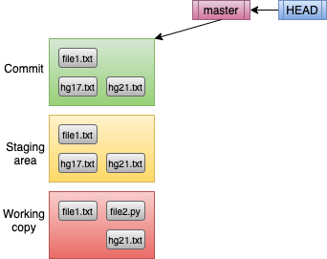
Exercise 4 – Oops
Change back to GitWorkspace/samples directory. Let's simulate an accidental deletion.
Delete hg17.txt. This deletes the working copy only.
Verify the status.
Of course, hg17.txt still exists. The following command will restore hg17.txt from the staging area to the working copy
and verify the status.
Open hg17.txt inside a text editor.
Delete the first two lines so that the first line is "Chapter 17". Then change "Hitch Hiker's" to "Hitchhiker's". Save the file and close the editor.
Even after removal from the working copy, hg17.txt still exists in the staging area and as a commit.
It's easily restored with the checkout command.
git status
git checkout -- hg17.txt
Note on Double-Dashes
In Step 3, double-dashes seperate the checkout command from the name of the file. In this instance, it's optional. In general, it is used to separate the name of the branch (which comes first) from the name of the file. Both parameters are optional. Without double-dashes, Git will search for a branch named hg17.txt. Not finding one, it will then interpret hg17.txt as a file or directory name. Using double-dashes forces this interpretation.
Double-dashes are required when a branch namd conflicts with a directory or file name.
From: <http://www.p2r.se/music/disaster.htm>
Chapter 17
The Hitch Hiker's Guide to the Galaxy notes that
**Disaster Area**, a plutonium rock band from the

Slide 14
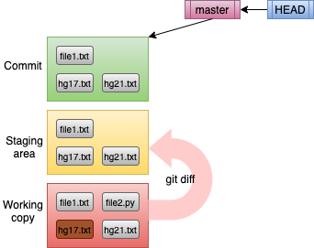
Exercise 4 – Diff
Run the diff command to verify your changes.
GitWorkshop/samples$ git diff
diff --git a/hg17.txt b/hg17.txt
index d330bb2..1e9969d 100644
--- a/hg17.txt
+++ b/hg17.txt
@@ -1,8 +1,6 @@
-From: <http://www.p2r.se/music/disaster.htm>
-
Chapter 17
-The Hitch Hiker's Guide to the Galaxy notes that
+The Hitchhiker's Guide to the Galaxy notes that
**Disaster Area**, a plutonium rock band from the
Gagrakacka Mind Zones, are generally held to be not
only the loudest rock band in the Galaxy, but in
Reading diff Output
The output from git diff is similar to the Unix diff output. They represent what must happen to convert the old copy of the file to the new copy:
lines starting with minus must be removed
lines starting with plus must be added
other lines are provided for context. In the example above, we see the first two lines removed; the "Hitchhiker" line was changed.
The git diff command, by default, compares the working copy of the file to the staging area (not the committed copy).

Slide 15
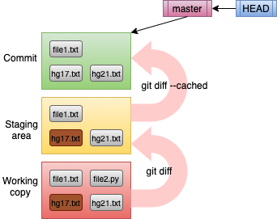
Exercise 4 – Add
After verifying the change, add hg17.txt to the staging area.
Try the diff command again. It should show no changes. That's because it only compares the staging area to the working directory copy. If your change has already been added to the staging area, it is consistent with the working copy. To check the difference between the staging area and the latest commit, add the --cached flag.
We'll use a short cut to add the Python program.
This says add everything (recursively) starting with the current directory (the . means current directory). In our case this is what we want.
It's always good to check the status before committing.
git add hg17.txt
Use the cached flag to diff between staging and a commit.
By default, the diff is between the workng copy and the staging area. This almost always what we want.
git diff --cached
git add .

Slide 16
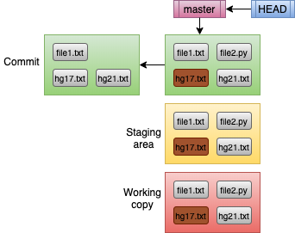
Exercise 4 – Commit
10. Run the commit.
The result is a new commit object. (There continues to be a single staging area and working copy.
A few things to note:
The master pointer automatically advances to the next commit.
Since the HEAD references master, it is implicitly advanced.
The new commit points backwards in time to the previous commit. This is another subtle but important difference between Git and tools like CVS and SVN.
git commit -m "Added Python and fixed typos."
There are now two commits. But there is still a single staging area and single working copy.

Slide 17
Git Log
The git log command displays information about commits. As simple as this sounds, there is a bewildering number of options to customize what you hide, what you see and and how you see it. Here is a basic form of the git log command.
Exercise 5 – Log Filtering
In your command line, change to the GitWorkshop/isabrepo directory. This repository has too many commits to see on a single screen.
List the last four commits.
This is the most common way to limit the output. Forgetting this option usually floods your screen as a lesson to remember it next time.
It's common to abbreviate the output to an entry per line. The --oneline option does this.
GitWorkshop/samples$ git log
commit d0d9eea64278b523f647d86c89bc2ced17e94eff (HEAD -> master)
Author: Paul Glezen <pglezen@isab.lacounty.gov>
Date: Mon Oct 12 22:15:31 2020 -0700
Added Python and fixed typos.
commit 79647d700a60bc4549ac01c7c2e3a1065394d309
Author: Paul Glezen <pglezen@isab.lacounty.gov>
Date: Mon Oct 12 21:18:20 2020 -0700
Initial version.
git log -4
Note the entries are in reverse chronological order.
Our training repository is still very small. In practice there are usually far more commits than you want to see. The following exercise provides practice in filtering log output.
git log -5 --oneline

Slide 18
Git Log
While there are many Git log options, it's too cumbersome to type more than a few. Instead, most people collect their favorite options into a Git alias. Most modern Git installations include a few log aliases out-of-the-box.
Note: Your Windows installation may not have the grep utility. In this case, just list all the aliases.
List the last four entries using the l (letter el) alias.
(Optional) Add your own alias named l.
Recall that adding --global to the config command makes it available to all your repositories. You can run this alias as
Another way to restrict the commits is through relative time.
You can also restrict to commits applied to a directory hierarchy or to a single file.
git config --global alias.l "log --graph --all --pretty=format:'%C(yellow)%h%C(cyan)%d%Creset %s %C(white)- %an, %as%Creset'"
git config --list | grep alias
$ git config --list | grep alias
alias.lol=log --pretty=format:"%h %s" --graph
alias.l=log --graph --all --pretty=format:'%C(yellow)%h%C(cyan)%d%Creset %s %C(white)- %an, %ar%Creset'
git l -4
git l --since 1.month
* 3307dd6 (HEAD -> master, origin/master, origin/HEAD) Merged remote-tracking branch origin/master. - Paul Glezen, 4 weeks ago
* f2429ae Minor updates to GPG1. - Paul Glezen, 4 weeks ago
git l -4
* 3307dd6 (HEAD -> master, origin/master, origin/HEAD) Merged remote-tracking branch origin/master. - Paul Glezen, 4 weeks ago
|\
| * 79e14d9 Distribution supplement from last year; forgot to commit. - Paul Glezen, 6 months ago
* | f2429ae Minor updates to GPG1. - Paul Glezen, 4 weeks ago
|/
* c551df5 Added workshop PDF for GPG 1. - Paul Glezen, 6 months ago
git l readme.md
* 51a6147 Added workshop PDFs for Crypto Fundamentals - Paul Glezen, 8 months ago
* eec21ef Documentation notes. - Paul Glezen, 2 years, 8 months ago
* d85ac62 Added section on data analysis workshops. - Paul Glezen, 2 years, 10 months ago

Slide 19

Branches
Git is designed to make branching easy and efficient. The key to understanding branches is to understand commit trees.
A commit tree is a DAG (Directed Acyclic Graph).
It's a graph in that it has vertices and edges (or points and lines if you prefer).
It's directed in that each edge has a direction.
It's acyclic in that you can't traverse a cycle (loop) by following edges in their prescribed direction.
A Git tree is a DAG where the vertices are commits and the directed edges represent changes between two commits.
Git arrows point to the past.
  This is the opposite of most other source control tools.
  Node B represents the beginning of a branch.
  Node D represents a merge.
DAG diagrams are good to draw on paper until you get used to thinking of them in your head.
Branches themselves don't have names. They are referenced though branch pointers. Once the pointers are gone (as in the diagram to the left), the branches are anonymous.

Slide 20
Basic Branch Scenario
Most work is committed to a branch other than master. A branch can be dedicated to a team or a single person. It usually represents a task.
Commits arrive on the master branch through a merge in three ways:
Fast-forward – In this simplest case, there were no intervening merges between branch and merge. So it's as if there was no branch at all.
Conflict Free – In this case there was an intervening merge, but the two sets of changes applied to different lines of source code, so the merge was applied automatically.
Conflicts – In this case, two changes sets attempted to change the same line of code in different ways. This must be manually resolved before the merge can complete.
The following exercise will address the first two of these. The conflict scenario will be addressed in Part 2 of this workshop.
Most work is committed to a branch other than master
  The branch can be dedicated to a team or a single person.
  It usually represents a task
Commits show up on master through a merge.
  If there have been no intervening commits, the result is a fast-forward operation (the trivial case).
  Otherwise a merge occurs
    Conflict Free – still easy
    Conflicts – conflicts require manual resolution.

Slide 21
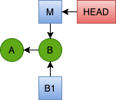
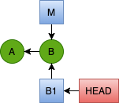

Exercise 6 – Fast Forward Merge
To prepare for this exercise, we'll create two clones of the repository. First change to the GitWorkshop directory and delete the samples2 directory we created during Exercise 3.
Create a clone and change to its directory.
Create a branch named B1 and make it the current branch.
You can use the git branch command at any point to view a list of branches. The asterisk denotes the current branch (HEAD).
GitWorkshop/samples1$ git branch
* master
GitWorkshop/samples1$ git branch B1
GitWorkshop/samples1$ git branch
B1
* master
GitWorkshop/samples1$ git checkout B1
Switched to branch 'B1'
GitWorkshop/samples1$ git branch
* B1
master
GitWorkshop$ rm -rf samples2
GitWorkshop$ git clone samples samples1
Cloning into 'samples1'...
done.
GitWorkshop$ cd samples1
GitWorkshop/samples1$ git log --oneline
10f629d (HEAD -> master, origin/master, origin/HEAD) Added Python and fixed typos.
b83eb9b Initial version.
At this point our repository is represented by this diagram.
A is the first commit
B is the second commit
M is the master branch pointer
HEAD is the current branch
Note that the git branch B1 command merely created the B1 branch (created the B1 box on the upper right), it didn't move HEAD to point to it. For that we had to issue the git checkout command.
Both these actions could have been effected with a single checkout command with the -b flag.
GitWorkshop/samples1$ git checkout -b B1
Switched to a new branch 'B1'
GitWorkshop/samples1$ git branch
* B1
master

Slide 22
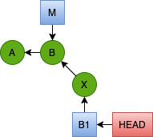
Exercise 6 – Fast Forward Merge
Edit hg21.txt. Remove the first two lines that contain a dead URL and a blank line. Save the change.
Commit this change to the B1 branch.
I drew the X commit at an angle to express my intention that this commit is a branch separate from master. But there is nothing in the graph that makes this so. I just drew it this way. Let's reconcile the logs and branch pointers.
GitWorkshop/samples1$ git status
On branch B1
Changes not staged for commit:
(use "git add <file>..." to update what will be committed)
(use "git checkout -- <file>..." to discard changes in working directory)
modified: hg21.txt
GitWorkshop/samples1$ git add .
GitWorkshop/samples1$ git commit -m "Pruned dead URL from Ch 21."
[B1 c2e8b4e] Pruned dead URL from Ch 21.
The asterisk next to B1 in the git branch -v output (below) shows that B1 is still our current branch. master is still pointing to B1. But B1 has advanced to commit X.
GitWorkshop/samples1$ git log --oneline
c2e8b4e (HEAD -> B1) Pruned dead URL from Ch 21.
10f629d (origin/master, origin/HEAD, master) Added Python and fixed typos.
b83eb9b Initial version.
GitWorkshop/samples1$ git branch -v
* B1 c2e8b4e Pruned dead URL from Ch 21.
master 10f629d Added Python and fixed typos.

Slide 23
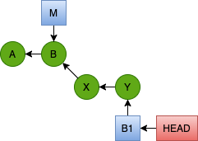
Exercise 6 – Fast Forward Merge
Edit hg17.txt. Change "songs" to "compositions" on line 17. Save the file.
Commit this second change to the B1 branch.
In the example above I show abbreviated output from the diff command. Below the log reflects that HEAD → B1 and is two steps ahead of master.
Step 8 – Create new Clone
Follow the steps below to create a new clone named samples2. Notice how branch B1 was copied, but not master. That's because HEAD → B1. We create a new local master based on the value remote/master (to be explained in Part 2). Then change back to samples1 to continue the exercise. We'll come back to samples2 in Exercise 7.
GitWorkshop/samples1$ git diff
diff --git a/hg17.txt b/hg17.txt
--- a/hg17.txt
+++ b/hg17.txt
-Their songs are on the whole very simple and mostly
+Their compositions are on the whole very simple and mostly
GitWorkshop/samples1$ git add .
GitWorkshop/samples1$ git commit -m "Songs to compositions."
[B1 81d60de] Songs to compositions.
GitWorkshop/samples1$ cd ..
GitWorkshop$ ls
isabrepo/ repo1/ repo2/ samples/ samples1/
GitWorkshop$ git clone samples1 samples2
Cloning into 'samples2'...
done.
GitWorkshop$ cd samples2
GitWorkshop/samples2$ git branch -av
* B1 81d60de Songs to compositions.
remotes/origin/B1 81d60de Songs to compositions.
remotes/origin/HEAD -> origin/B1
remotes/origin/master 10f629d Added Python and fixed
GitWorkshop/samples2$ git branch master origin/master
Branch 'master' set up to track remote branch 'master' from 'origin'.
GitWorkshop/samples2$ git branch -v
* B1 81d60de Songs to compositions.
master 10f629d Added Python and fixed typos.
GitWorkshop/samples2$ cd ../samples1
GitWorkshop/samples1$
GitWorkshop/samples1$ git log --oneline
81d60de (HEAD -> B1) Songs to compositions.
c2e8b4e Pruned dead URL from Ch 21.
10f629d (origin/master, origin/HEAD, master) Added Python and fixed typos.
b83eb9b Initial version.

Slide 24
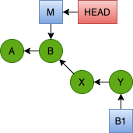
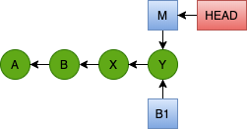

Exercise 6 – Fast Forward Merge
Now we're ready to merge our changes to the master branch. The target for a Git merge operation is always the current branch. If we want to merge B1 into master, we first have to make master the current branch. The source of the merge will be referenced in the merge command.
Change the current branch from B1 to master.
Run the merge command referencing the B1 branch.
The X and Y commits constitute the work done on the B1 branch. Since no other commits had been made to the master branch, the merge was a fast-forward merge. This happens when the merge is logically equivalent to having applied the commits directly to master without branching. In this case, there is no additional commit. The Y commit becomes the head of the branch for both master and B1.
Note that immediately after the merge, master is still the current branch. If there is no more work to be done on the B1 branch, we may delete it.
Note that "deleting the B1 branch" only amounts to deleting the B1 pointer. No commits were deleted.
GitWorkshop/samples1$ git branch
* B1
master
GitWorkshop/samples1$ git checkout master
Switched to branch 'master'
Your branch is up to date with 'origin/master'.
GitWorkshop/samples1$ git branch
B1
* master
GitWorkshop/samples1$ git branch
B1
* master
GitWorkshop/samples1$ git branch -d B1
Deleted branch B1 (was 81d60de).
GitWorkshop/samples1$ git branch
* master
GitWorkshop/samples1$ git merge B1
Updating 10f629d..81d60de
Fast-forward
hg17.txt | 2 +-
hg21.txt | 2 --
2 files changed, 1 insertion(+), 3 deletions(-)

Slide 25
End of Part 1
What you have learned:
  First time setup with git config
  Repository initialization and cloning
  Roles of the
    working copy
    staging area
    commits
  Directed Acyclic Graphs of Commits
  The Git log and diff commands.
  Branch pointers, the HEAD pointer.
  Fast-Forward Merges
Still to go (Part 2)
  More merge scenarios
  Remote repositories
  Tags
  Hosting services
Sometimes people wonder why remote repositories are not covered until Part 2, even though interacting with a remote repository is common and one of the first topics many Git newbies learn. My reasons are
Working effectively with local repositories lays the foundation for working with remotes effectively.
Lacking a sound basis for working with branch pointers and merge skills makes you dangerous to others that share your remote repository.
People in a rush to push their changes to a remote repository often mess things up for others on the team.

