Slide 1
Git Workshop
Part 2 of 3
Merge Conflicts
and
Remote Repositories

Slide 2
Workshop Agenda
Part 1 – Another Deck
  Installation and Setup
  Concepts
  Repository Initialization
  Clone
  Basic Lifecycle
  Logs
  Introduction to Branches
Part 2 – This Deck
  Merges
  Remote Repositories
  Fetch and Push
Part 3 – Another Deck
  Tags
  Hosting Services
    GitHub
    AWS
  Commit Signing
  Author Delegation
  Stashing
This is a "presentation-ification" of the HTML workshop available at
https://www.workshops.lacounty-isab.org/

Slide 3
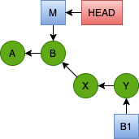
Scenario Continued
This Part 2 continues a scenerio that was started in Part 1. If you still have your files and folder from Part 1, you can skip to the next slide now. This slide explains how to recreate where we left-off from Part 1.
Change to your GitWorkshop directory. This is a directory in which we undertake these workshop exercises.
If you have a samples2 subdirectory, you may not need to follow these steps. It may have been created during your Part 1 session. If you're unsure, delete the samples2 directory.
Clone the lacounty-isab/gitwkspex6 repository to samples2.
Change to samples2.
List branches. You'll find that master is the only local branch. Create a local B1 branch from the origin/B1 remote branch*.
Part 1 ended with a merge of the situation shown on the right. It resulted in a fast-forward merge where the master branch pointer advanced to the Y node.
GitWorkshop$ git clone https://github.com/lacounty-isab/gitwkspex6.git samples2
GitWorkshop/samples2$ git branch -av
* master d0d9eea Added Python and fixed typos.
remotes/origin/B1 dbc1acc Songs to compositions.
remotes/origin/HEAD -> origin/master
remotes/origin/master d0d9eea Added Python and fixed typos.
GitWorkshop/samples2$ git branch B1 origin/B1
Branch 'B1' set up to track remote branch 'B1' from 'origin'.
GitWorkshop/samples2$ git branch -av
B1 dbc1acc Songs to compositions.
* master d0d9eea Added Python and fixed typos.
remotes/origin/B1 dbc1acc Songs to compositions.
remotes/origin/HEAD -> origin/master
remotes/origin/master d0d9eea Added Python and fixed typos.
The first exercise of this Part 2 will explore an alternative to the Part 1 ending – the consequence of adding commits to the master branch before the merge. We need the branch pointers reset to how they were before the merge updated them. Step 8 of Exercise 6 cloned the state of the repository to a samples2 directory before proceeding. If you no longer have that samples2 directory available, the steps on the right will show you how to recreate it from a repository hosted on GitHub.
* Remote branches will be covered as part of remote repositories.

Slide 4

Turn Back the Clock
Next we'll simulate a case where a commit was added to the master branch before our merge operation. To this end, let's go "back in time" by changing to our GitWorkshop/samples2 directory. We created this directory in Step 8 of the last exercise.
In GitWorkshop/samples2, B1 is still the current branch (HEAD points to it). We also confirmed this with the branch command. We changed the current branch to master using the checkout command.
After all this, we're back-in-time to before the B1 merge.
GitWorkshop/samples1$ cd ../samples2
GitWorkshop/samples2$ git log --oneline
81d60de (HEAD -> B1) Songs to compositions.
c2e8b4e Pruned dead URL from Ch 21.
10f629d (origin/master, origin/HEAD, master) Added Python and fixed typos.
b83eb9b Initial version.
GitWorkshop/samples2$ git branch
* B1
master
GitWorkshop/samples2$ git checkout master
Switched to branch 'master'
Your branch is up to date with 'origin/master'.
GitWorkshop/samples2$ git branch
B1
* master
GitWorkshop/samples2$
GitWorkshop/samples2$ git log --oneline
10f629d (HEAD -> master, origin/master, origin/HEAD) Added Python and fixed typos.
b83eb9b Initial version.

Slide 5
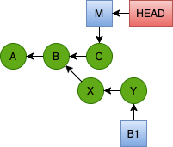
Add a Commit to Master
Edit hg17.txt. Note that the "songs" → "compositions" change on line 17 is no longer there. Edit line 10 to change
thirty-seven → forty-two
and save the file. Run the git diff command to confirm your change.
This latest change is represented as commit C in the updated diagram. When we list the log, we only see entries reachable from commit C.
GitWorkshop/samples2$ git log --oneline
4878aee (HEAD -> master) Forty-two miles.
10f629d (origin/master, origin/HEAD) Added Python and fixed typos.
b83eb9b Initial version.
GitWorkshop/samples2$ git diff
diff --git a/hg17.txt b/hg17.txt
-bunkers some thirty-seven miles from the stage,
+bunkers some forty-two miles from the stage,
Add this change as a commit.
This concept of reachable is important for understanding many Git operations. A node in the Git graph (Directed Acyclic Graph or DAG) is reachable from a point C if it may be reached from C by traversing the edges of the graph in the direction of the arrows.
In the diagram above, commits A, B and C are reachable from C. X and Y are not reachable from C.
By default, the log command only displays commits reachable from HEAD.
GitWorkshop/samples2$ git add .
GitWorkshop/samples2$ git status
On branch master
Your branch is up to date with 'origin/master'.
Changes to be committed:
(use "git restore --staged <file>..." to unstage)
modified: hg17.txt
GitWorkshop/samples2$ git commit -m "Forty-two miles."
[master 4878aee] Forty-two miles.
1 file changed, 1 insertion(+), 1 deletion(-)

Slide 6
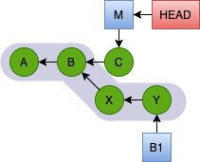
Displaying Branch Commits
By providing a branch name to the log command, we can see all log entries for commits reachable from that branch. To see the commits reachable from B1:
But all the commits reachable by any particular node is usually much more than we want. Our sample repository is small. Real life repositories have hundreds of commits. We saw earlier a common way to restrict the output is with -N where N is a number.
GitWorkshop/samples2$ git log --oneline B1
81d60de (B1) Songs to compositions.
c2e8b4e Pruned dead URL from Ch 21.
10f629d (origin/master, origin/HEAD) Added Python and fixed typos.
b83eb9b Initial version.
GitWorkshop/samples2$ git log --oneline -2 B1
81d60de (B1) Songs to compositions.
c2e8b4e Pruned dead URL from Ch 21.
The commits reachable from B1 are, following the arrows:
Y → X → B → A.
This is the order in which they are listed by the log command. This also happens to be reverse chronological order.
In the example above, we used -2 to restrict the history to two entries.
Another common inquiry is: "List the commits on a branch since the branch was created." For this kind of inquiry, certain Git command support set subtraction, denoted by the .. operator (two periods).
In this way, we can view logs from all the commits on any particular branch. We are not restricted to viewing the log history of HEAD. HEAD is simply the default.

Slide 7
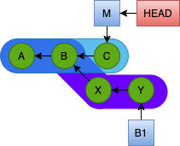
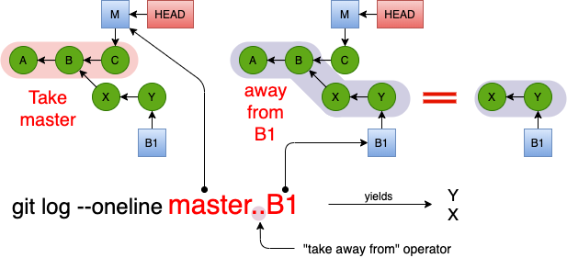
Log Set Subtraction – Two Dots
A common inquiry in a branch scenario is to list the commits that have occurred since the branch. In our current example, the branch point is node B. Node C has been added to the master branch and nodes X and Y have been added to the B1 branch.
GitWorkshop/samples2$ git log --oneline master..B1
81d60de (B1) Songs to compositions.
c2e8b4e Pruned dead URL from Ch 21.
We can ask the question in reverse: which commits have been made to master since the B1 branch? We just flip the order of the arguments in the difference operator.
But how do we obtain this information without a pretty picture drawn for us every time? The answer is set subtraction. The nodes unique to B1 are all the nodes reachable from Y minus all the nodes reachable from node C.
Take all nodes reachable from Y
away from all nodes reachable from C
. .
GitWorkshop/samples2$ git log --oneline B1..master
4878aee (HEAD -> master) Forty-two miles.
The difference operator assumes HEAD when the commit is omitted. Since HEAD is currently master, the last two commands can be abbreviated as follows.
GitWorkshop/samples2$ git log --oneline ..B1
81d60de (B1) Songs to compositions.
c2e8b4e Pruned dead URL from Ch 21.
GitWorkshop/samples2$ git log --oneline B1..
4878aee (HEAD -> master) Forty-two miles.

Slide 8
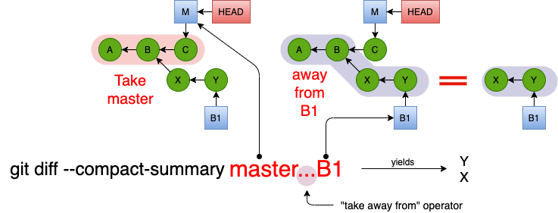

Diff Set Subtraction – Three Dots
A similar concept applies to the diff command, except the set subtraction operator is three dots instead of two.
In the example below, we can see the difference along the master branch. The branch point between B1 and master is still the same, node B. But the change is the node C we made on the master branch.
GitWorkshop/samples2$ git diff --compact-summary B1...master
hg17.txt | 2 +-
1 file changed, 1 insertion(+), 1 deletion(-)
GitWorkshop/samples2$ git diff --compact-summary master...B1
hg17.txt | 2 +-
hg21.txt | 2 --
2 files changed, 1 insertion(+), 3 deletions(-)
This shows the difference between the branch-point of master and B1 (node B) and the lastest commit on B1.

Slide 9
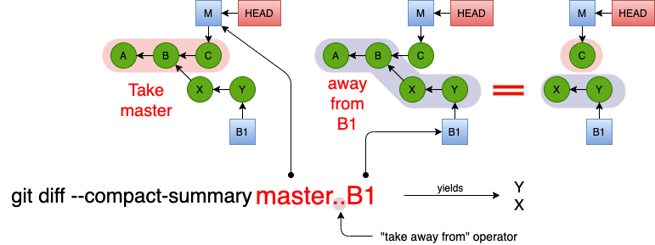
Diff Symmetric Difference – Two Dots
Set symmetric difference is not the same as set subtraction. The symmetric difference between sets A and B is their union take away their intersection:
A ∆ B = A U B – A ∩ B
The set of all elements that are in either in A or in B, but not in both.
Unlike displaying log messages, code changes have a "sign" or "direction". If you made a change by adding two lines to a file, then the reverse direction is removing those two lines from the file.
GitWorkshop/samples2$ git diff --compact-summary master..B1
hg17.txt | 4 ++--
hg21.txt | 2 --
2 files changed, 2 insertions(+), 4 deletions(-)
GitWorkshop/samples2$ git diff --compact-summary B1..master
hg17.txt | 4 ++--
hg21.txt | 2 ++
2 files changed, 4 insertions(+), 2 deletions(-)
Despite the set theory term symmetric difference, the display of the change is actually antisymmetric. It has a distinct direction which is reversed when the order of the parameters to the operator are reversed.
In the diagram, the difference with double dots shows us how to go from master to B1. That means undoing commit C (changing "forty-two" back to "thirty-seven") and then applying commits X and Y.
The opposite order means: start at Y, undo Y, undo X, and then apply C. Without the --compact-summary option, all the details of the changes are listed.

Slide 10
Exercise 7 - Merge
It's time to merge the B1 branch to master. It's hard to remember what's happened on either of these two branches since the split occurred; and that's fairly realistic. So we'll start using the git log command technique to check what has occurred on each branch before starting the merge.
Summarize commits on master since B1 split from master.
Just the one change on the one line.
Summarize commits on B1 since B1 split from master.
With our memory refreshed, we proceed with the merge task. The merge command takes a single branch name for the source of the merge. The target is always the current branch. Since we want to merge into master, we must make master the current branch.
GitWorkshop/samples2$ git checkout master
Already on 'master'
Your branch is ahead of 'origin/master' by 1 commit.
As it happened, we were already on master. But it didn't hurt to check. We've confirmed our status depicted in the diagram on the right. The merge command itself is easy.
GitWorkshop/samples2$ git log --oneline B1..master
4878aee (HEAD -> master) Forty-two miles.
GitWorkshop/samples2$ git merge B1
Auto-merging hg17.txt
Merge made by the 'recursive' strategy.
hg17.txt | 2 +-
hg21.txt | 2 --
2 files changed, 1 insertion(+), 3 deletions(-)
GitWorkshop/samples2$ git log --oneline master..B1
81d60de (B1) Songs to compositions.
c2e8b4e Pruned dead URL from Ch 21.
Run the above git merge command. Git displays an editor window with the contents prepopulated as shown below.
Replace the comment or accept it, save and quit. This creates the merge commit.
Merge branch 'B1'
# Please enter a commit message to explain why this merge is necessary,
# especially if it merges an updated upstream into a topic branch.
#
# Lines starting with '#' will be ignored, and an empty message aborts
# the commit.

Slide 11
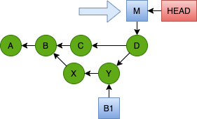
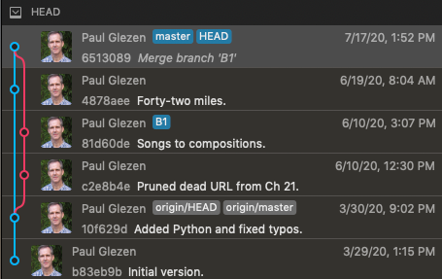
Merge Result
The merge commit is node D in the diagram below. Notice that commit D has two children: C and Y.
However, this is not apparent with the git log command we've been using.
However, by adding the --graph option to the command, we can see the relationship of both children to the last commit.
Without the graph option, the branches are flattened out. Of course, GUI tools make this visualization even nicer.
GitWorkshop/samples2$ git log --oneline
6513089 (HEAD -> master) Merge branch 'B1'
4878aee Forty-two miles.
81d60de (B1) Songs to compositions.
c2e8b4e Pruned dead URL from Ch 21.
10f629d (origin/master, origin/HEAD) Added Python and fixed typos.
b83eb9b Initial version.
GitWorkshop/samples2$ git log --graph --oneline
* 6513089 (HEAD -> master) Merge branch 'B1'
|\
| * 81d60de (B1) Songs to compositions.
| * c2e8b4e Pruned dead URL from Ch 21.
* | 4878aee Forty-two miles.
|/
* 10f629d (origin/master, origin/HEAD) Added Python and fixed typos.
* b83eb9b Initial version.
Displaying branch histories is one of the better advantages to using a GUI Git tool. Most IDEs have this capability built in or available as a free plugin.

Slide 12
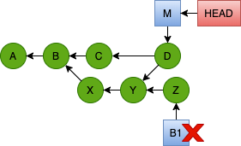
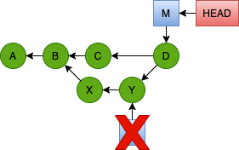
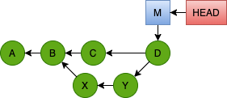
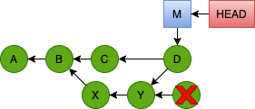
Deleting a Branch (pointer)
We're done with the B1 branch; but the pointer is still hanging around. If we want to continue to work on a B1 branch past this point, we probably want* to pick up contributions from the merge to master. To this end, we wish to remove the B1 pointer.
What if we had continued with another commit on branch B1 and then tried to delete B1?
Then there would be no easy way to reach node Z through available pointers.
GitWorkshop/samples2$ git branch
B1
* master
GitWorkshop/samples2$ git branch -d B1
Deleted branch B1 (was 81d60de).
GitWorkshop/samples2$ git branch
* master
Git will recognize this and refuse the deletion with a warning that the branch is "not fully merged". Sometimes you still want to delete such a branch (for example, you want to discard any changes you made on the branch without a merge). Then you use the same command with a capital D.
This will delete the branch pointer regardless of whether it had been merged. After this, node Z is essentially unreachable since there is no path to it through available pointers. Git will eventually delete it.
Git makes the deletion of the B1 branch pointer easy. It was pointing to node Y and there was already another element pointing to Y (namely node D). So we can always reach node Y through D if we have to; we're not losing access to it by deleting the B1 branch pointer.
git branch -D B1
There are times when we want to continue working on B1 without the master contributions. But doing this for too long increases the risk of complicating subsequent merges.

Slide 13
Merge Conflicts
We are going to introduce some changes in our files on different branches that conflict. In this context, it means that different branches change the same line of the same file in different ways. We saw earlier that neither
changing different files, nor
changing the same file on different lines
incur a conflict. The git merge command will merge these deterministically.
In the following exercise we edit two files: a plain text file and a small Python program.
To keep things distinct from Part 1, we'll create a new directory, sample3, with these files and create a new repository.
GitWorkshop/samples3$ ls
file1.txt file2.py
GitWorkshop/samples3$ git init
Initialized empty Git repository in GitWorkshop/samples3/.git/
GitWorkshop/samples3$ git add .
GitWorkshop/samples3$ git commit -m "Initial version."
[master (root-commit) 4fff5a8] Initial version.
2 files changed, 22 insertions(+)
create mode 100644 file1.txt
create mode 100644 file2.py
GitWorkshop/samples3$ git log --oneline
4fff5a8 (HEAD -> master) Initial version.
1 # This file contains mappings.
2 #
3 a1 - 20
4 a2 - 43
5
6 b1 - 39
7 b2 - 34
8 b3 - 44
9
10 c1 - 45
11 c2 - 19
1 def print_usage():
2 usage = """Usage: addAudit.py [-f] [-v] <filename ...>
3 -f - overwrite when duplicate key encountered
4 -v - verbose
5 <filename ..> the name of at least one audit file."""
6
7 print(usage)
8
9 print_usage()
file1.txt
file2.py

Slide 14
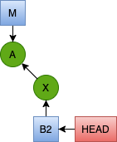
Exercise 8 – Branch B2
Create a branch B2 and edit the two files.
Create a new branch B2.
Edit file1.txt as shown on the right.
  Line 6: Add ",41"
  Line 7: Change "34" to "36"
  Line 8: Add a blank space after 44.
  Line 10: Change "45" to "55"
  Line 11: Change "19" to "29"
Edit file2.py by adding a blank space to each line of the print_usage function.
Check your work with git diff.
Add the changes to the staging area.
Commit with message "B2 changes."
This creates a new commit X referenced by branch B2 as shown in the figure above.
1 # This file contains mappings.
2 #
3 a1 - 20
4 a2 - 43
5
6 b1 - 39,41
7 b2 - 346
8 b3 – 44
9
10 c1 - 455
11 c2 - 129
GitWorkshop/samples3$ git checkout -b B2
Switched to a new branch 'B2'
file1.txt
1
2 def print_usage():
3 usage = """"Usage: addAudit.py [-f] [-v] <filename ...>"
4 -f - overwrite when duplicate key encountered
5 -v - verbose
6 <filename ..> the name of at least one audit file."""
7
8 print(usage)
9
10 print_usage()
file2.py
Note that some changes are not as easy to see with the git diff command.
Extra Credit: The edit to file2.py may seem peculiar.
What is a common cause for this?

Slide 15
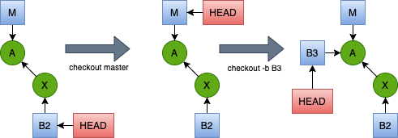
Exercise 8 – Branch B3
Now we're going switch to a new branch B3 starting from commit A just like B2 did.
Edit file1.txt.
  Line 3: change "20" to "30".
  Line 4: change "43" to "53".
  Line 6: add ",40".
  Line 7: change "34" to "35".
Edit file2.py. Change the triple-quoted string to a series of print statements.
Check your work with git diff.
Add the changes to the staging area.
Commit with message "B3 changes."
GitWorkshop/samples3$ git checkout master
Switched to branch 'master'
GitWorkshop/samples3$ git checkout -b B3
Switched to a new branch 'B3'
1 # This file contains mappings.
2 #
3 a1 - 230
4 a2 - 453
5
6 b1 - 39,40
7 b2 - 345
8 b3 - 44
9
10 c1 - 45
11 c2 - 19
file1.txt
1 def print_usage():
2 print("Usage: addAudit.py [-f] [-v] <filename ...>")
3 print(" -f - overwrite when duplicate key encountered")
4 print(" -v - verbose")
5 print(" <filename ..> the name of at least one audit file.")
6
7 print_usage()
file2.py

Slide 16
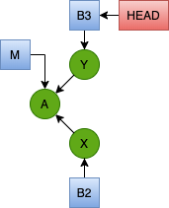
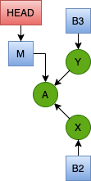
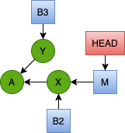
Exercise 8 – Branch master
After the B3 commit, we have the branch configuration shown to the right. Since the target of a merge is always the current branch, we're going to change back to the master branch. Then merge each of B2 and B3.
Change to the master branch.
git checkout master
This moves HEAD to the master branch.
Merge B2
git merge B2
This should be a fast-forward merge which simply advances the master branch to B2.
Finally, issue the command to merge B3. This is where the fireworks start.
What just happened here?
GitWorkshop/samples3$ git merge B3
Auto-merging file2.py
CONFLICT (content): Merge conflict in file2.py
Auto-merging file1.txt
CONFLICT (content): Merge conflict in file1.txt
Automatic merge failed; fix conflicts and then commit the result.
Git auto-merges on a line-by-line basis. When the same line is changed in two different ways, Git places "merge markers" around those lines to indicate two incompatible changes were made. They must be manually resolved.
The changes are easy to spot. They are bounded by the markers
<<<< HEAD – beginning of master
========= – separates versions
>>>>>> B2 – end of B3 version
Resolving the merge conflict amounts to choosing one or the other of these versions to keep.
1 # This file contains mappings.
2 #
3 a1 - 30
4 a2 - 53
5
6 <<<<<<< HEAD
7 b1 - 39,41
8 b2 - 36
9 b3 - 44
10 =======
11 b1 - 39,40
12 b2 - 35
13 b3 - 44
14 >>>>>>> B3
15
16 c1 - 55
17 c2 - 29
This is the HEAD (i.e. master) version of the lines (originally B2)
This is the B3 (i.e. incoming) version of the lines

Slide 17
Exercise 8 – Resolve Conflict 1
We have to decide, based on a larger perspective, how to resolve the conflicts. We could
pick the left side (master branch version)
pick the right side (B3 branch version)
choose something completely different from either side based on some knowledge we might have.
These decisions are carried out in the following manner.
Edit the lines within the merge markers based on your decisions
Delete the merge marker lines and save the file.
Add the file to the Git staging area.
This last step is how Git knows when we've completed the merge activity for the file. We repeat steps a, b and c for each file in which a merge conflict occurred.
Looking at file1.txt in the previous slide, things aren't that bad. The top (only changed on B2) and the bottom (only changed on B3) were auto-merged. Only the middle third, where both B2 and B3 changed lines, requires resolution.
Edit the lines of file1.txt.
  For entry b1, branch B2 added 41 while branch B3 added 40 to the value. Let's make the decision to add both so that line 7 has b1 – 39,40,41. Notice how we're implicitly making lines 7 – 9 our "definitive copy."
  For entry b2, branch B2 changed the value to 36 which branch B3 changed it to 35. Let's decide to keep 36 so that line 8 remains unchanged.
  Entry b3 is tricky. It looks the same in both lines 9 and 13. Recall that branch B2 erroneously added a space at the end of the line. In this case, we wish to accept the B3 line 13 which left the line unchanged. Remove the last space on line 9.
6 <<<<<<<•HEAD␊
7 b1•-•39,41␊
8 b2•-•36␊
9 b3•-•44•␊
10 =======␊
11 b1•-•39,40␊
12 b2•-•35␊
13 b3•-•44␊
14 >>>>>>>•B3␊
6 <<<<<<<•HEAD␊
7 b1•-•39,40,41␊
8 b2•-•36␊
9 b3•-•44␊
10 =======␊
11 b1•-•39,40␊
12 b2•-•35␊
13 b3•-•44␊
14 >>>>>>>•B3␊

Slide 18
Exercise 8 – Resolve Conflicts 2
Delete the merge markers. Lines 7 – 9 are now in the form we want to keep. We can delete lines 11 – 13 as well as the merge markers on lines 6, 10 and 14. Then save the file.
Add file1.txt to the Git staging area.
git add file1.txt
Perform the same merge steps a, b and c for file2.py. This is a simpler case where we wish to only accept the B3 version. The B2 version had simply added an extra space on each line, which is not uncommon for some editors. Simply delete lines 2 – 9 and line 14. Then save the file and add it to the staging area.
1 def print_usage():
2 <<<<<<< HEAD
3 usage = """Usage: addAudit.py [-f] [-v] <filename ...>
4 -f - overwrite when duplicate key encountered
5 -v - verbose
6 <filename ..> the name of at least one audit file."""
7
8 print(usage)
9 =======
10 print("Usage: addAudit.py [-f] [-v] <filename ...>")
11 print(" -f - overwrite when duplicate key encountered")
12 print(" -v - verbose")
13 print(" <filename ..> the name of at least one audit file.")
14 >>>>>>> B3
15
16 print_usage()
6 <<<<<<< HEAD
7 b1 - 39,40,41
8 b2 - 36
9 b3 - 44
10 =======
11 b1 - 39,40
12 b2 - 35
13 b3 - 44
14 >>>>>>> B3
6 b1 - 39,40,41
7 b2 - 36
8 b3 - 44
1 def print_usage():
2 print("Usage: addAudit.py [-f] [-v] <filename ...>")
3 print(" -f - overwrite when duplicate key encountered")
4 print(" -v - verbose")
5 print(" <filename ..> the name of at least one audit file.")
6
7 print_usage()

Slide 19
Exercise 8 - Commit
With both file conflicts resolved and added to the Git staging area, we can now create the merge commit. It should be like any other commit; the hard work is over.
Verify the branch activity using git log.
git commit -m "Merge branch B3"
GitWorkshop/samples3$ git log --oneline --graph
* 55a29e6 (HEAD -> master) Merge branch B3
|\
| * 17c3dc5 (B3) B3 changes.
* | fd4d195 (B2) B2 changes.
|/
* cce1b27 Initial version.
And that's all there is to it. It's just a matter of recognizing the merge markers and resolving the merge the proper way.
Note the merge-marker technique only works with text files. This technique does not work for binary files, such as images, executables, compressed archives, etc. Teams must take care not to changes these files concurrently. They cannot easily be merged.

Slide 20
Remote Repositories – Terms
A Git clone is another copy of the current repository.
Sometimes it's called a remote repository. It's remote in the sense that it's in a separate directory. It doesn't have to be on a separate machine. We saw examples early in Part 1 where we created multiple remote repositories on the same machine with the clone command. The clone command is the typical way to create a remote repository. The term clone can refer to the remote repository, or it can refer to the Git command.
A clone is not a strict copy. By default, the clone command only copies commits reacheable by the master branch. Additional branches may be cloned through additional commands.
In this presentation, we'll use the term clone as
  a Git command clone using monospace font,
  a noun – referring to a clone of a repository
  a verb – the act of creating a clone with clone.
A Git remote is an alias for a reference to a remote repository location.
It saves from having to type the full remote URL each time it is referenced.
It simply maps a name to a URL. It does not confirm or deny the existence of a repository at that URL.
A repository created as a clone is automatically configured with a remote named origin referencing the source repository.
GitWorkshop$ git clone https://github.com/lacounty-isab/workshops myrepo
Cloning into 'myrepo'...
Resolving deltas: 100% (280/280), done.
GitWorkshop$ cd myrepo
GitWorkshop/myrepo$ git remote -v
origin https://github.com/lacounty-isab/workshops (fetch)
origin https://github.com/lacounty-isab/workshops (push)
The remote name, origin, is configured for fetch and push (more on these commands later). This is done for convenience since one often wishes to perform synchronization operations after a clone.
No remote entries initially exist for new repositories.

Slide 21
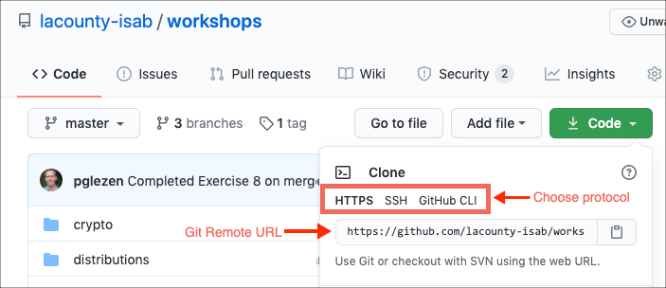
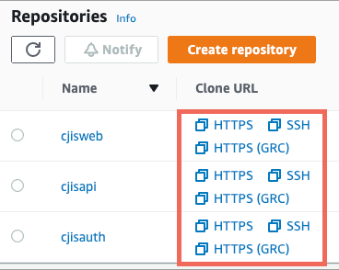
Remote Command
The git remote command is used to add, view, rename and remove remote entries. By default the command will list the names of remotes. Add -v to see the full entry. Below are examples using the repository we clone in the previous slide.
GitWorkshop/myrepo$ git remote
origin
GitWorkshop/myrepo$ git remote -v
origin https://github.com/lacounty-isab/workshops (fetch)
origin https://github.com/lacounty-isab/workshops (push)
GitWorkshop/myrepo$ git remote rename origin github
GitWorkshop/myrepo$ git remote -v
github https://github.com/lacounty-isab/workshops (fetch)
github https://github.com/lacounty-isab/workshops (push)
GitWorkshop/myrepo$ git remote remove github
GitWorkshop/myrepo$ git remote -v
GitWorkshop/myrepo$ git remote add origin https://github.com/lacounty-isab/workshops
GitWorkshop/myrepo$ git remote -v
origin https://github.com/lacounty-isab/workshops (fetch)
origin https://github.com/lacounty-isab/workshops (push)
Most Git hosting services provide the remote URL on the repository page. The figure above shows GitHub. The figure to the right shows AWS CodeCommit.

Slide 22
Remotes
Protocols
Git supports several protocols for communicating between a Git server listener and a Git client.
local – In this case there is no network activity; the Git client works with both repositories on your workstation.
git – This is a proprietary protocol that is rarely used anymore. The advantage is that it works with little configuration. The drawbacks are that it is neither secure nor firewall friendly.
ssh – This tunnels the Git protocol over SSH. This has the benefit of encrypting the connection and it is very firewall friendly. The drawback is that it requires each client to install an SSH certificate on the server.
https – This mode acts like an HTTPS server. The user must be authenticated on the first request. But usually the credentials can be cached and reused later.
These days, Git hosting services take care of the security configurations, making the bottom two options the most common.
Bare Repositories
We briefly discussed bare repositories in Part 1. A bare repository has no working copy, just the repository itself. All server copies are bare repositories since you can only push a commit to a bare repository. You can pull from a non-bare; but it's an error to push to one.
A naming convention for directories containing a bare repository is to add .git to the end. It's unusual to add extentions to folder names, so this makes the folder's use clear.
Even though most Git hosting services implement this convention, they still allow us to leave the .git off the end of our remote URL definitions. However, for the local folders we use in our exercises, the Git client will be more strict.
Remote Branch References
We reference a local branch simply by its name. Remote branches are prefaced by their remote name. If the remote name is origin, then a reference to the master branch would be origin/master.

Slide 23
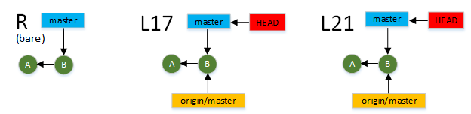
Tracking Branches
A tracking branch tracks a branch in a remote repository. It's important to understand the limitations to remote branch tracking. This will be one of the goals of the next exercise.
Exercise 9 – Preparation
We're going to simulate a remote repository for the next exercise. But it should be emphasized that the "simulation" is only in regard to the network connection. In every other way, it will be a legitimate remote. Git does not treat remote repositories on separate machines differently than it does remote repositories on the local machine.
Clone our sample repository to a new directory samples8.
This creates the source for our scenario.
Create a bare repository to represent the shared server repository.
The "samples Remote" will hence be known as sR.
Clone sR to sL17 and sL21.
GitWorkshop$ git clone https://github.com/lacounty-isab/gitwkspex6 samples8
GitWorkshop$ git clone --bare samples8 sR
GitWorkshop$ git clone sR sL17
Cloning into 'sL17'...
done.
GitWorkshop$ git clone sR sL21
Cloning into 'sL21'...
done.
After these three preparation steps, you should have three new directories: sR, sL17 and sL21, corresponding to the three DAGs shown on the left.

Slide 24
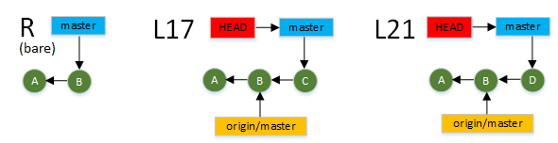
Exercise 9 – L17
First we simulate the user at repository sL17.
Change to the sL17 directory.
Change "songs" to "compositions" on line 17 of hg17.txt like we did before.
Add and commit the change.
The listing above shows three commits in the log in reverse chronological order. These represent:
C – 8e5d42c – the commit we just made
B – d0d9eea – the newest commit on the server
A – 79647d7 – the initial commit
List the branch pointer locations.
Verify that
master – points to C
origin/master – the tracking branch still points to B
Note: We're ignoring the right-side of the figure for now.
GitWorkshop$ cd sL17
GitWorkshop/sL17$ vi hg17.txt
GitWorkshop/sL17$ git add .
GitWorkshop/sL17$ git commit -m "Songs to Compositions in hg17.txt"
GitWorkshop/sL17$ git log --oneline
8e5d42c (HEAD -> master) Songs to Compositions in hg17.txt
d0d9eea (origin/master, origin/HEAD) Added Python and fixed typos.
79647d7 Initial version.
GitWorkshop/sL17$ git branch -av
* master 8e5d42c [ahead 1] Songs to Compositions in hg17.txt
remotes/origin/HEAD -> origin/master
remotes/origin/master d0d9eea Added Python and fixed typos.

Slide 25
Exercise 9 – L21
Now let's assume L21 does the same thing in their local repository. Then we get the figure on the right. We're not going to simulate L21 yet; instead, we're going to stick with L17 and show why things go wrong.
The next step for L17 is to push the commit to the remote R. It's important to understand that we cannot push to a remote unless the remote tracking branch is consistent with the remote branch. In the diagram to the right,
remote tracking branch is the yellow box labelled origin/master in L17.
remote branch is the blue box master in R.
Presently, they both point to commit B, which makes them consistent. But this is not obvious to L17. Perhaps someone pushed a commit to R since we last checked. In order to check, L17 should refresh the remote tracking branch to make sure it is accurate. Then push the update.
Refresh tracking branch.
Once we see the branch is consistent, we push the change.
GitWorkshop/sL17$ git fetch origin master
From /Users/pglezen/lac/sessions/GitWorkshop/sR
* branch master -> FETCH_HEAD
GitWorkshop/sL17$ git log --oneline
8e5d42c (HEAD -> master) Songs to Compositions in hg17.txt
d0d9eea (origin/master, origin/HEAD) Added Python and fixed typos.
79647d7 Initial version.
GitWorkshop/sL17$ git push origin master
... d0d9eea..8e5d42c master -> master
GitWorkshop/sL17$ git log --oneline
8e5d42c (HEAD -> master, origin/master, origin/HEAD) Songs to Compositions in hg17.txt
d0d9eea Added Python and fixed typos.
79647d7 Initial version.

Slide 26
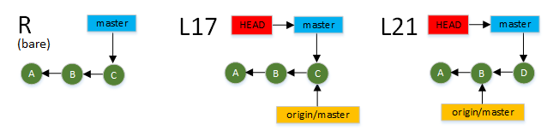
Exercise 9 – First Commit
But this doesn't bid well for L21. An attempt to refresh from R will show more than just that L21 is out of date. It will show that the master sequence of R (C, B, A) is incompatible with the master sequence of L21 (D, B, A). At this point L21 is stuck and can no longer work with the master branch.
This is what happens when two developer try to commit to the same branch without proper synchronization/communication. In fact, you don't even need two developers. The same developer with a clone of the repository on different workstations can encounter the same problem.
This problem can be reduced by remembering to update the remote tracking branch with a fetch before each commit.
But there is still a possiblity that in the small amount of time between the tracking branch update and the commit, another commit will be made. The true way to avoid this problem is to limit master branch commits to a single person or to a small group of people who communicate well. Everyone else commits using different branches that are merged to master. This eliminates the race conditions.
The rest of this exercise will be demonstration of this practice. We'll go back in time and designate L17 as the owner of the master branch. As such, L17 is also responsible for merging other branches into master.
Change to the L21 clone directory and create a new i42 branch.
GitWorkshop/sL17$ cd ../sL21
GitWorkshop/sL21$ git branch -a
* master
remotes/origin/HEAD -> origin/master
remotes/origin/master
GitWorkshop/sL21$ git checkout -b i42
Switched to a new branch 'i42'
GitWorkshop/sL21$ git branch -a
* i42
master
remotes/origin/HEAD -> origin/master
remotes/origin/master

Slide 27
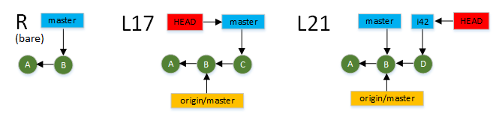
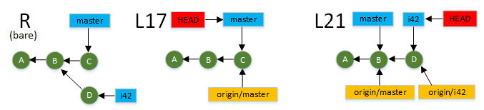
Exercise 9 – Commit to L21
Remove the first two lines from hg21.txt (which should be a URL and blank line).
Add the change to the staging area and commit.
We're now at the point where both developers have something to commit on top of the B commit. L17 commited to local master as before. But L21 commited to local i42.
Now each developer pushes his local branch to the remote server. The L17 push was done in Step 8.
We'll push the i42 branch below.
Notice that the remote tracking branch origin/i42 was created by the first git push for the branch. It tracks the remote i42 branch in R.
GitWorkshop/sL21$ git add hg21.txt
GitWorkshop/sL21$ git commit -m "Removed two lines."
[i42 02a6929] Removed two lines.
1 file changed, 2 deletions(-)
GitWorkshop/sL21$ git log --oneline
02a6929 (HEAD -> i42) Removed two lines.
d0d9eea (origin/master, origin/HEAD, master) Added Python and fixed typos.
79647d7 Initial version.
GitWorkshop/sL21$ git push origin i42
...
To GitWorkshop/sR
* [new branch] i42 -> i42
GitWorkshop/sL21$ git branch -a
* i42
master
remotes/origin/HEAD -> origin/master
remotes/origin/i42
remotes/origin/master

Slide 28
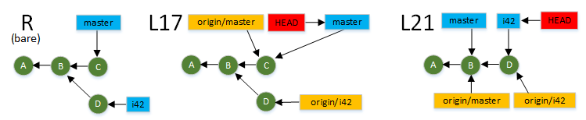
Exercise 9 – Fetch
Another important point is that the local master branch point has not changed in the L21 repository. It's outdated (which is fine); but not in conflict.
Note also that at this point in time all three repositories, the two local ones and the shared remote, have different sets of commits. This is not a problem so long as branches are used in this way.
At this point the developer for L21 informs the master owner (L17) that branch i42 is available in the shared remote for merging into master.
L17 fetches the i42 branch.
GitWorkshop/sL21$ cd ../sL17
GitWorkshop/sL17$ git branch -a
* master
remotes/origin/HEAD -> origin/master
remotes/origin/master
GitWorkshop/sL17$ git fetch origin i42
. . .
From GitWorkshop/sR
* branch i42 -> FETCH_HEAD
* [new branch] i42 -> origin/i42
GitWorkshop/sL17$ git branch -a
* master
remotes/origin/HEAD -> origin/master
remotes/origin/i42
remotes/origin/master
The listing above and diagram below shows how the additonal remote tracking branch is added to the L17 repository.
It's important to understand that while the i42 branch code has been added to the repository, is nowhere to be seen in our working copy, which still reflects master.

Slide 29
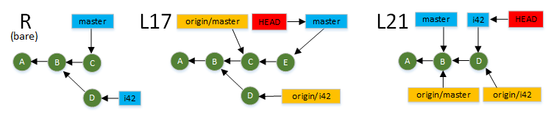
Exercise 9 – Another Commit
The L17 developer has fetched the i42 branch, but will not work with it yet; and that's perfectly fine. Fetching the content of other branches does not disrupt our working copy activity.
Still in the L17 repository, edit hg17.txt: change the text on Line 10 from thirty-seven to forty-two.
Add and commit the change to master.
The last commit is E on the diagram. The L17 local master is now one commit ahead of the remote tracking branch master. The log listing in Step 15 and the figure both show the four commits of the L17 local master branch.
-bunkers some thirty-seven miles from the stage,
+bunkers some forty-two miles from the stage,
GitWorkshop/sL17$ git commit -m "37 to 42"
[master 01a19f8] 37 to 42
1 file changed, 1 insertion(+), 1 deletion(-)
GitWorkshop/sL17$ git log --oneline
01a19f8 (HEAD -> master) 37 to 42
8e5d42c (origin/master, origin/HEAD) Songs to Compositions in hg17.txt
d0d9eea Added Python and fixed typos.
79647d7 Initial version.

Slide 30
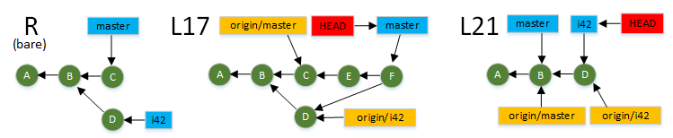
Exercise 9 – Merge
Developer L17 is now ready to merge the changes from branch i42. Note that we have no local i42 branch. All we have is the remote tracking branch. But that's fine since we're only reading from it as the source of the merge.
Merge the i42 branch from origin/i42 into master.
The comment is included in the merge command for this slide; it's common to leave it off and enter it interactively.
The DAG for L17 is reflected in the git log command if we include the --graph option.
GitWorkshop/sL17$ git log --oneline --graph
* 82b8b8f (HEAD -> master) Merged i42 to master.
|\
| * 02a6929 (origin/i42) Removed two lines.
* | 01a19f8 37 to 42
* | 8e5d42c (origin/master, origin/HEAD) Songs to Compositions in hg17.txt
|/
* d0d9eea Added Python and fixed typos.
* 79647d7 Initial version.
GitWorkshop/sL17$ git branch -a
* master
remotes/origin/HEAD -> origin/master
remotes/origin/i42
remotes/origin/master
GitWorkshop/sL17$ git merge origin/i42 -m "Merged i42 to master."
Merge made by the 'recursive' strategy.
hg21.txt | 2 --
1 file changed, 2 deletions(-)
Be sure you can identify the following in both the figure the left and the log output above:
The merge commit F (82b8b8) is the new HEAD of the master branch.
The remote tracking branch for master is behind local for L21, but still accurately reflects the state of the remote R.
In fact, this local activity has resulted in no changes to any remote tracking branches.

Slide 31
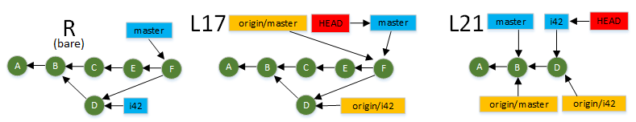
Exercise 9 – Push
L17 pushes the result of the merge to the shared remote R.
From the L17 log, the git push is reflected only in the movement of the tracking branch pointer.
The remote R now has the two new commits from L17 along with the fact that commit F is a merge of commits D and E.
It is now the responsibility of L17 to notify L21 (and anyone else) of the availability of the merge.
GitWorkshop/sL17$ git push origin master
. . . .
GitWorkshop/sL17$ git log --oneline --graph
* 82b8b8f (HEAD -> master, origin/master, origin/HEAD) Merged i42 to master.
|\
| * 02a6929 (origin/i42) Removed two lines.
* | 01a19f8 37 to 42
* | 8e5d42c Songs to Compositions in hg17.txt
|/
* d0d9eea Added Python and fixed typos.
* 79647d7 Initial version.

Slide 32
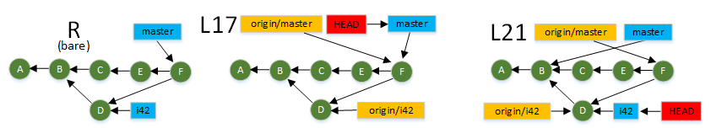
Exercise 9 – Fetch from Remote
The L21 developer's work has been merged into the master branch by the L17 developer and pushed to the shared remote repository R. But this is still not visible to the L21 developer until refreshed from the remote master.
Change to the L21 repository and fetch the updated master branch from R.
However, close inspection of the log outputs show that some branch pointers have moved around. Let's compare the figures. Below is the situation before the fetch, reproduced from the last slide.
And this is the situation after the fetch.
The L21 situation looks a lot different in the figure. But it's consistent with the log output. The current branch is still i42 and origin/master is no longer reachable from i42; though local master (which is now 3 commits behind) is still reachable. Both log output shows D → B → A.
GitWorkshop/sL17$ cd ../sL21
GitWorkshop/sL21$ git log --oneline --graph
* 02a6929 (HEAD -> i42, origin/i42) Removed two lines.
* d0d9eea (origin/master, origin/HEAD, master) Added Python and fixed typos.
* 79647d7 Initial version.
GitWorkshop/sL21$ git fetch origin master
. . . . . .
From GitWorkshop/sR
* branch master -> FETCH_HEAD
d0d9eea..82b8b8f master -> origin/master
GitWorkshop/sL21$ git log --oneline --graph
* 02a6929 (HEAD -> i42, origin/i42) Removed two lines.
* d0d9eea (master) Added Python and fixed typos.
* 79647d7 Initial version.
Note once again that the fetch did not disrupt any work L21 might have been doing. The logs before and after the fetch show the same entries.

Slide 33
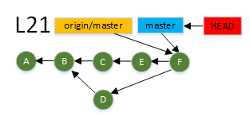
Exercise 9 – Merge to Local Master
The previous slide showed L21 could fetch all the merge activity without disrupting local activity. But now it's time to refresh the merge to our local master. As always with a merge, the first step is to change to the target branch.
Change to local master branch.
It tells us master is behind by 4 commits. But the good news is that it can be fast-forwarded; otherwise we have to "merge the merge", which we wouldn't do because we're not suppose to be contributing commits directly to master.
Merge from the remote tracking branch.
All merges to master should be fast-forward for developers who do not commit directly to master.
Remove the local and remote i42 branch pointer.
GitWorkshop/sL21$ git checkout master
Switched to branch 'master'
Your branch is behind 'origin/master' by 4 commits, and can be fast-forwarded.
(use "git pull" to update your local branch)
Checkout master
Merge origin/master
Delete i42
GitWorkshop/sL21$ git merge origin/master
Updating d0d9eea..82b8b8f
Fast-forward
GitWorkshop/sL21$ git branch -d i42
Deleted branch i42 (was 02a6929).
GitWorkshop/sL21$ git branch -d -r origin/i42
Deleted remote-tracking branch origin/i42 (was 02a6929).
Note that deleting a remote branch requires the -r flag.

Slide 34
Pull
If L21 had already been on the master branch to begin with, the two steps
git fetch origin master
git merge origin/master
could have been combined into a single command.
git pull origin master
The git pull command combines the fetch and merge commands into a single operation.
End of Part 2

