Slide 1
Purpose and proposed specification
28-bit RSA encryptor
Algorithm | Square-and-multiply One shared modular multiplier
Widths | N and c: 28 bits e and m: 14 bits
Valid inputs | 1 < N < 2^28 0 ≤ m < min(N, 2^14) 0 ≤ e < 2^14
Edge case | e = 0 returns 1 mod N No invalid-input error pin
Clock target | 10 MHz, unvalidated
c = m^e mod N
Build an RSA accelerator.
The STM32 prepares inputs
and verifies the ciphertext.
Demonstration only.
Not secure real-world encryption.
Yaron Jing and Derek
Verification: compare against software, including e = 0
Notes:
Source: final RSA Encryptor Proposal, rsa_encryptor_proposal(2).md, supplied by the user. https://chatgpt.com/api/library/files/libfile_9c46f1f1fba88191a398699b58bfcd80/download
The clock frequency is a target, not a measured or verified performance claim. Valid inputs are the proposed operating domain.

Slide 2
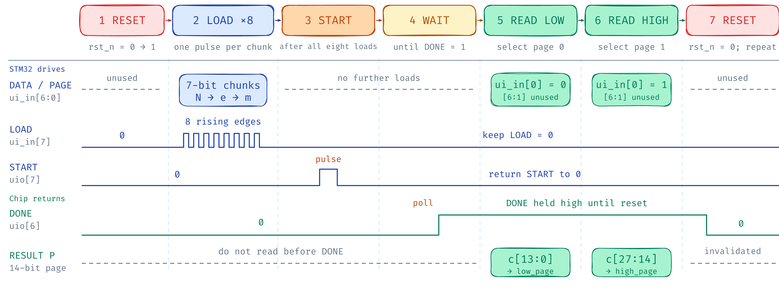
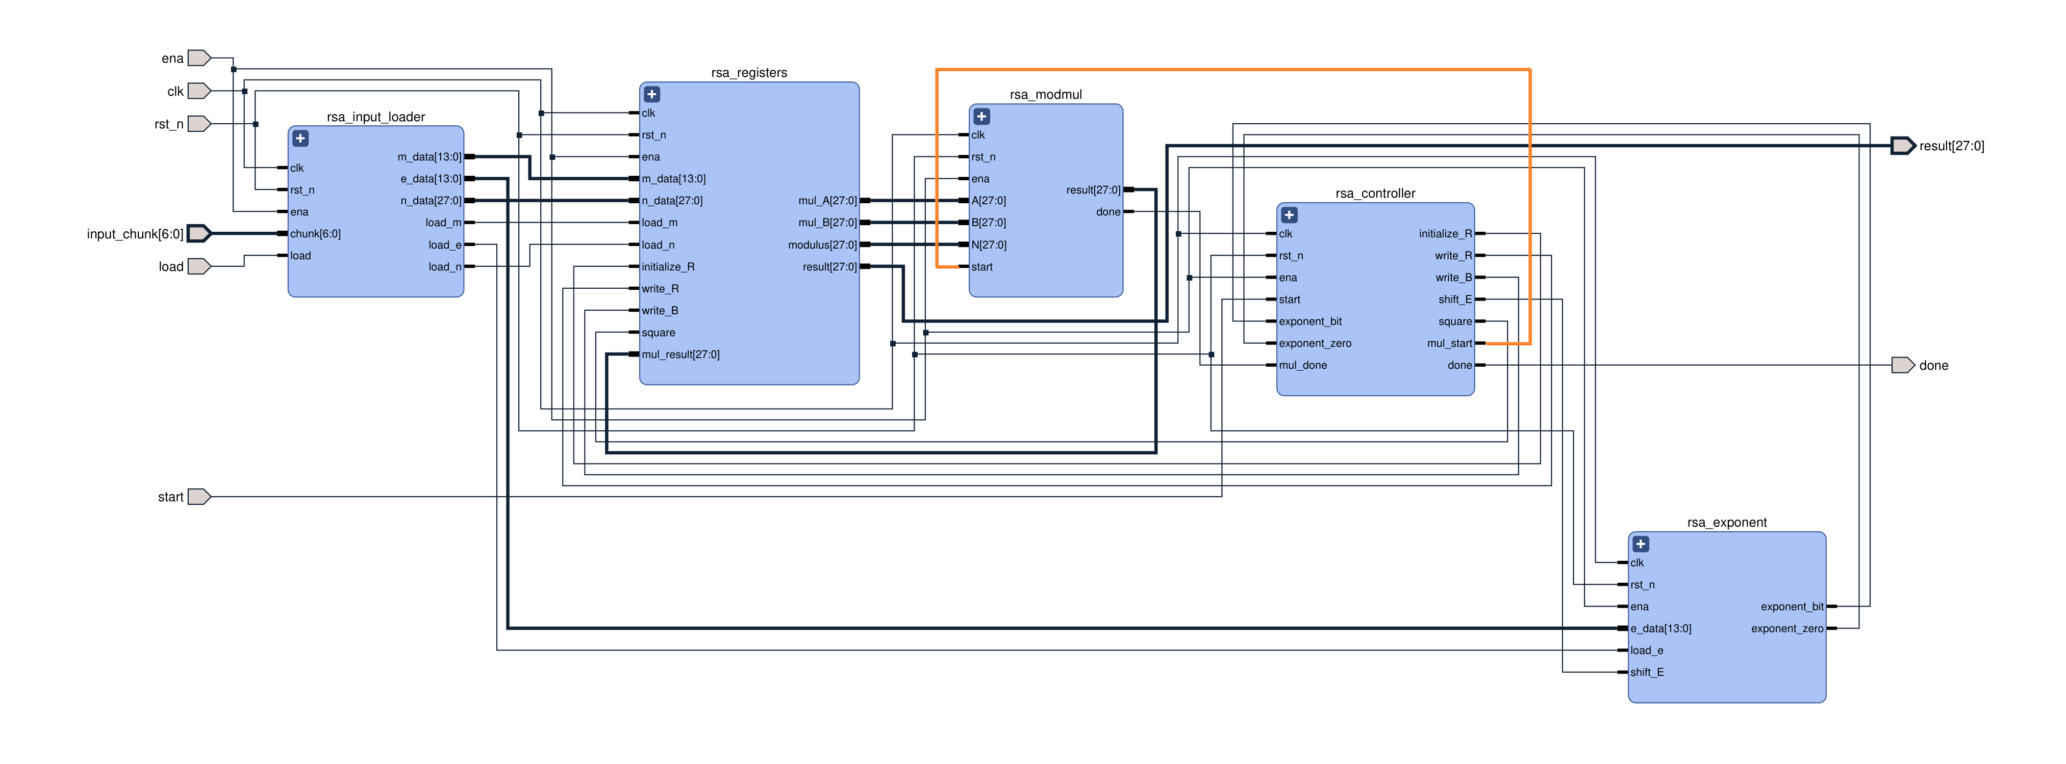
I/O flow and system diagram
Notes:
Source: final RSA Encryptor Proposal, rsa_encryptor_proposal(2).md, supplied by the user. https://chatgpt.com/api/library/files/libfile_9c46f1f1fba88191a398699b58bfcd80/download
Diagram: user-approved rsa_transaction_pin_flow.png, version 2. https://chatgpt.com/api/library/files/libfile_1e21123226c48191a1cf1d06b6437ca5/download
The original flow and signal lanes are shown. The input order and readback wiring from the lower portion are repeated as editable text. Eight loads: N[6:0], N[13:7], N[20:14], N[27:21], e[6:0], e[13:7], m[6:0], m[13:7]. Reset with LOAD and START low. After the eight loads, keep LOAD low, pulse START, and wait for DONE. After DONE, ui_in[0] selects page 0 or page 1. c = low_page | (high_page << 14). Reset before the next transaction. RTL ena is internal design selection, not an MCU GPIO. Keep the design selected for each transaction. Sequence diagram, not cycle timing.
Source: final RSA Encryptor Proposal, rsa_encryptor_proposal(2).md, supplied by the user. https://chatgpt.com/api/library/files/libfile_9c46f1f1fba88191a398699b58bfcd80/download
System diagram: rsa_compact_14.pdf, supplied by the user. https://chatgpt.com/api/library/files/libfile_fa74729a410081918c8cefc8c9d8cd93/download
The diagram shows 28-bit modulus, datapath, and result buses, with 14-bit message and exponent inputs.

Slide 3
Timeline and responsibilities
Oct 1–7 | Finalize widths, protocol and CDC plan. Build loader, registers and multiplier.
Oct 8–14 | Integrate controller and exponent logic. Complete unit and end-to-end simulation.
Oct 15–21 | Synthesis and GF180 physical flow. Check area/timing. Build STM32 demo.
Oct 22–28 | Resolve physical and verification failures. Review DRC/LVS. Finish documentation.
Oct 29–30 | Joint regression, design review and submission-package freeze.
Oct 31 | Buffer for final corrections.
Yaron Jing
Input loader, Tiny Tapeout
wrapper/pins, STM32 firmware
Derek
Modular multiplier,
exponent block, controller
Both
Software comparison, chip–STM32
integration, CDC and clock-speed
tests, documentation
Proposed October 2026 plan. Fabricated hardware arrival is outside this schedule.
Template by Slidesgo. Icons by Flaticon. Infographics and images by Freepik.
Notes:
Source: final RSA Encryptor Proposal, rsa_encryptor_proposal(2).md, supplied by the user. https://chatgpt.com/api/library/files/libfile_9c46f1f1fba88191a398699b58bfcd80/download
This is the proposed October 2026 plan and work split, targeting a verified design and submission package before November. Fabricated hardware arrival is outside the schedule.
Template attribution: This presentation template was created by Slidesgo, and includes icons by Flaticon, and infographics & images by Freepik. https://slidesgo.com/

