Slide 1
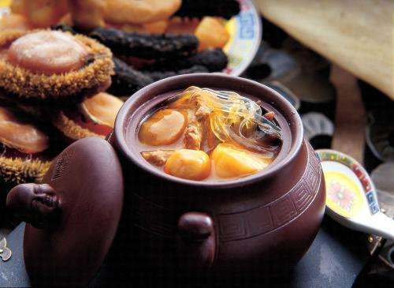
Fotiaoqiang
One of the most famous Fujian cuisines

Slide 2

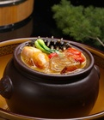
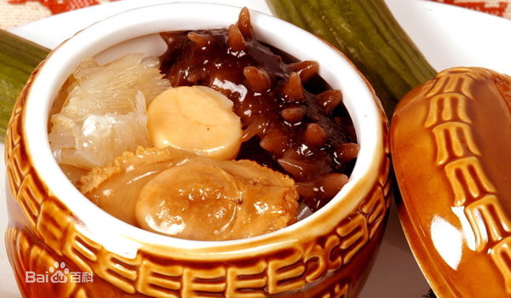
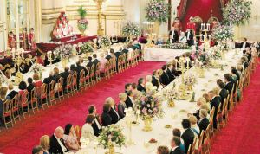
What is it?
Fotiaoqiang/Mantan Fragrance / Fushouquan
Fujian Cuisine Department.
beggars

Slide 3
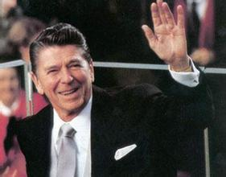

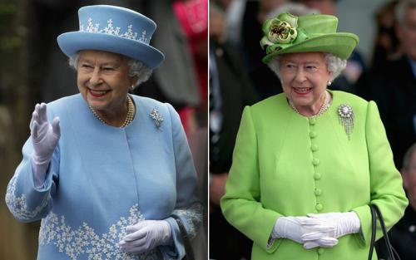
Who has eaten Buddha Jumping Wall?
Prince Sihanouk
President Reagan
Queen Elizabeth

Slide 4
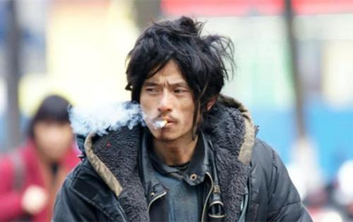
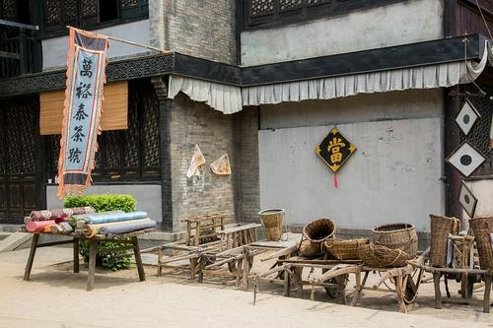
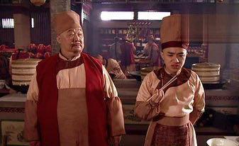
What is its origin?

Slide 5
Thank You!

