Slide 1
Continual Learning Agent from Scratch
Aquincum Institute of Technology, 2023 Spring Semester
László Freund, Anna Székely, Prabhudesai Aryan
Project presentation - 18.05.2023

Slide 2
Continual learning – a striking challenge for state-of-the-art ML agents
Continual learning: learning from a not i.i.d., non stationary, not balanced dataset – as natural agents do.
Catastrophic forgetting
Possible solutions: “Remind” the model for previous tasks
Retrieval based solutions
Generative solutions
Inspiration:
Continual Learning with Deep Generative Replay
Shin, H., Lee, J. K., Kim, J., & Kim, J. (2017).
Online Continual Learning with Maximally Interfered Retrieval
Aljundi, R., Caccia, L., Belilovsky, E., Caccia, M., Lin, M., Charlin, L., & Tuytelaars, T. (2019).

Slide 3
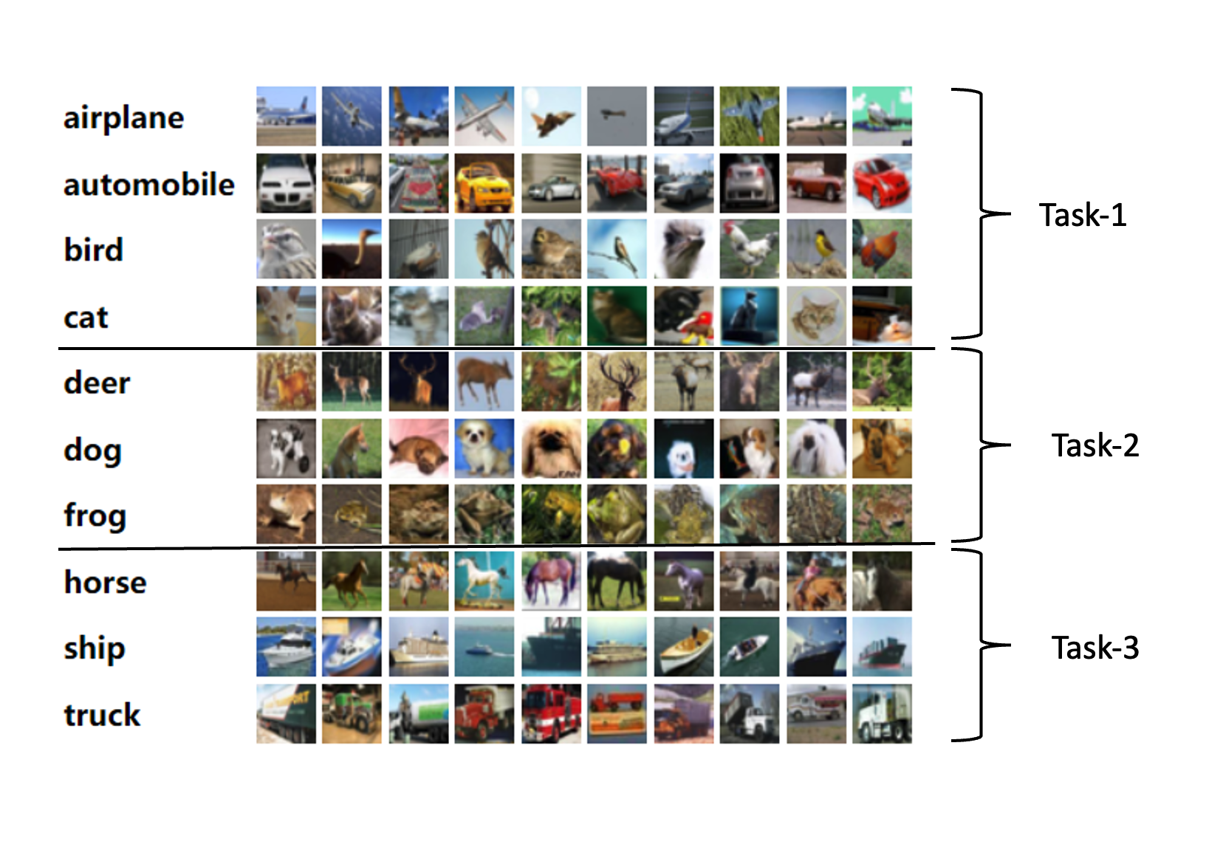
Data and expectations
Data
Cifar-10 cut into sub-tasks
Sequential training on tasks
Expectations
1) forward transfer: the learned tasks should contribute to the better acquisition of the new task.
2) backward transfer (or the lack of forgetfulness): training on new tasks should improve, but at least keep classification performance on previous tasks.

Slide 4
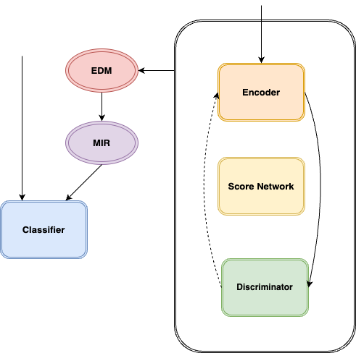
Proposed solution
Network architecture:
Classifier (Performance evaluated on it)
Generator (auxiliary architecture that supports the classifier’s performance, made of several subparts)
Encoder (encodes into latent space)
Discriminator (predicts if an image is real/fake)
Score Based Diffusion model (iterative refinement of noise based on learnable score function)
EDM *
Guided Diffusion (diffusion guided by Discriminator)
‘“What makes the image more realistic”
MIR **
Retrieve samples with the most interference
*Refining Generative Process with Discriminator Guidance in Score-based Diffusion Models (DG)
**Online Continual Learning with Maximally Interfered Retrieval

Slide 5
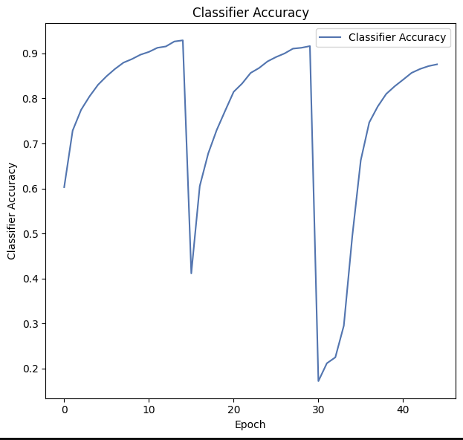
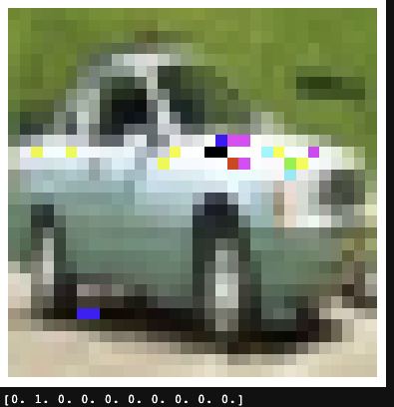
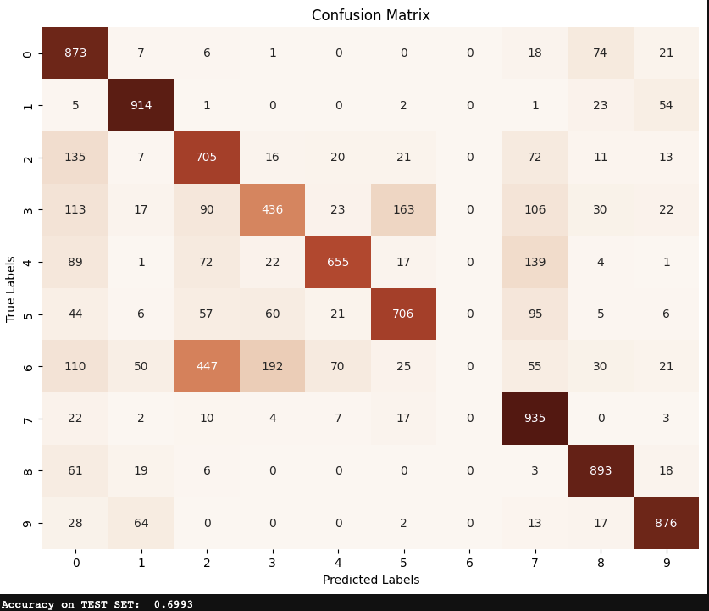
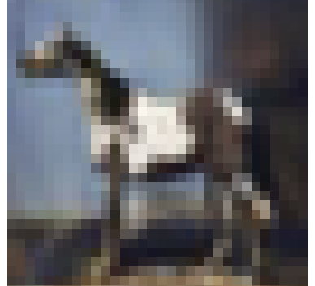
Results
I’m not in the dataset?

Slide 6
Thank you for your kind attention! Questions?

