Slide 2
Web Camp Keynote
[Speaker]
[Company]
Email: [Email]
Twitter: [Twitter]
Notes:
Session goals:
Explain what will be covered for the day
Explain four foundational topics everyone needs to be familiar with to get started
Visual Studio 2015
ASP.NET Core (previously know as ASP.NET 5)
Package Managers – what they are, how they fit in with ASP.NET
Azure – easy to sign up, activate MSDN benefits

Slide 3
Today’s Agenda
Session | Start | End
Keynote | 8:30 | 9:00
Introduction to ASP.NET and Visual Studio 2015 Web Tools | 9:00 | 10:45
Break | 10:45 | 11:00
Building Web Applications using the latest ASP.NET technologies | 11:00 | 12:15
Lunch | 12:15 | 1:15
Building web front ends for both desktop and mobile using the latest web standards | 1:15 | 2:15
API Services for both web and devices | 2:15 | 3:15
Break | 3:15 | 3:30
Running, improving and maintaining a site in the real world | 3:30 | 4:30
Wrap Up | 4:30 | 5:00

Slide 4
The foundation: tools & frameworks
Visual Studio 2015
ASP.NET Core
Azure
Package Managers

Slide 5


Visual Studio 2015: The editor for serious web dev
HTML5 / CSS3 standards and smarts
JavaScript language features
Page Inspector + Browser Link
One code editor for client and server
Web Extension Pack
(we’ll look at Visual Studio Code, too…)

Slide 6

NuGet: The smart, easy way to manage .NET dependencies
Before NuGet:
Find the latest release
Install and configure in your project
Handle dependencies and versions
Updates with dependency checking
Common list of installed packages
Simplified uninstalls
Streamlined deployment with Package Restore

Slide 7
Visual Studio 2015 and ASP.NET Core: Support for npm, bower, gulp, grunt, etc.
npm
bower
grunt
gulp

Slide 8



ASP.NET 4.6 and ASP.NET Core 1.0
ASP.NET 4.6
ASP.NET Core 1.0
.NET Framework 4.6
.NET Core 1.0
.NET framework libraries
.NET core libraries
Compilers and runtime components (.NET Compiler Platform: Roslyn, C#, VB, F# Languages, RyuJIT, SIMD)
Notes:
Key message: Differentiate the purpose and scenarios between .NET Framework and .NET Core. They Key point on .NET Core is that it’s self-contained and specialized on specific workloads. Make sure that we make the point that BOTH are valid. There is no decrease in investment on the .NET Framework side.
Transition. There is a common shared layer to these 2 pieces

Slide 9
What about ASP.NET 5?
ASP.NET Core 1.0 was previously called ASP.NET 5
It was renamed in January 2016
Announcement post
More details
You’ll still see it referred to as ASP.NET in Visual Studio and in some docs
Will be updated in next ASP.NET Core Release Candidate

Slide 10
ASP.NET Core 1.0 Roadmap
Milestone | Release week
Beta6 | 27 Jul 2015
Beta7 | 2 Sep 2015
Beta8 | 15 Oct 2015
RC1 | Nov 2015
RC2 | TBD
1.0.0 | TBD 2016
https://github.com/aspnet/home/wiki/roadmap

Slide 11

.NET 2016 – 10K foot view
WPF
Windows Forms
ASP.NET (4 & 5)
ASP.NET Core 1.0
Universal Windows Apps
Core CLR
.Net Native
.NET Framework 4.6
.NET Core 1.0
Full .NET Framework for any scenario and
library support on Windows
Modular libraries & runtime optimized for server and cloud workloads
Common
Runtime Components
Compilers
NuGet packages
Next gen JIT (RyuJIT)
SIMD
.NET Compiler Platform (Roslyn)
Languages innovation
.NET Core 1.0 Libraries
.NET Framework 4.6 Libraries

Slide 12
ASP.NET 2016 in a Nutshell
Visual Basic 14
Visual Basic 14 (coming soon)
C#
Web
Forms
MVC 5.x
Web API 2.2
ASP.NET Core features: MVC + Web API
ASP.NET 4.6 System.Web
ASP.NET Core 1.0
Core CLR
.Net Native
.NET Framework 4.6
.NET Core 1.0
Full .NET Framework for any scenario and
library support on Windows
Modular libraries & runtime optimized for server and cloud workloads

Slide 13
Deploying ASP.NET Apps to the Cloud with Azure
Microsoft Azure Web Sites (10 free!)
Fast site creation and deployment
Nothing new to learn
Easy to scale

Slide 14
Microsoft Azure signup
demo…
http://aka.ms/webcamps-azure
Notes:
http://aka.ms/webcamps-azure

Slide 15
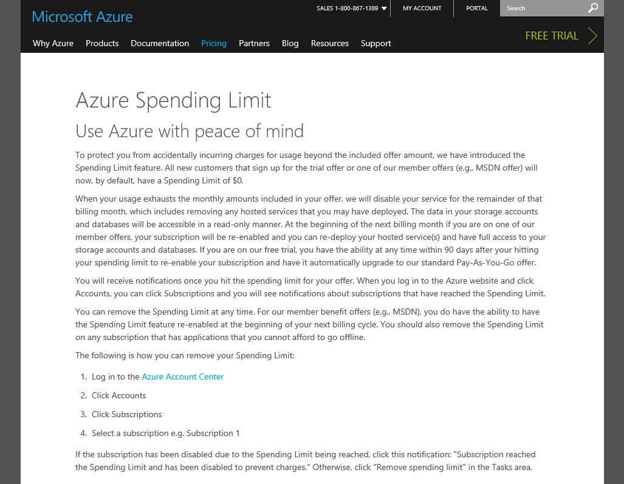
https://azure.microsoft.com/pricing/spending-limits/

Slide 16
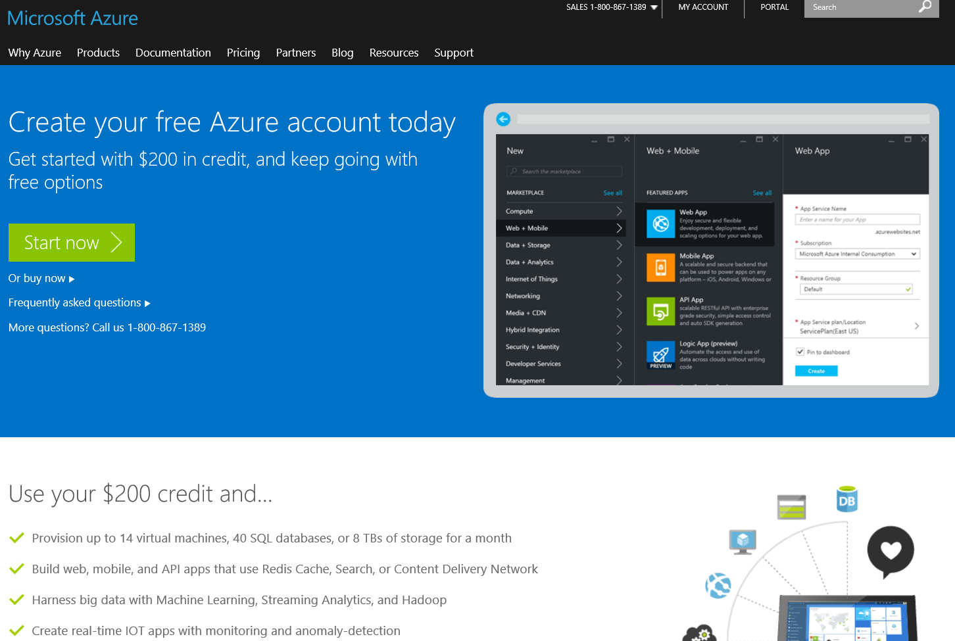
Notes:
https://azure.microsoft.com/en-us/documentation/articles/billing-buy-sign-up-azure-subscription/

Slide 17
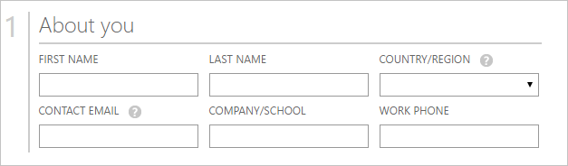
Azure: Quick signup...
Notes:
https://azure.microsoft.com/en-us/documentation/articles/billing-buy-sign-up-azure-subscription/

Slide 18
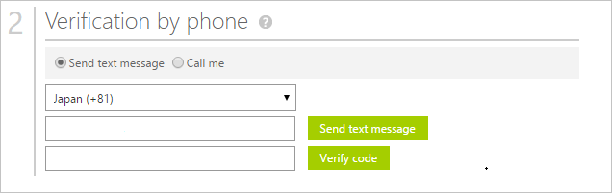
Notes:
https://azure.microsoft.com/en-us/documentation/articles/billing-buy-sign-up-azure-subscription/

Slide 19
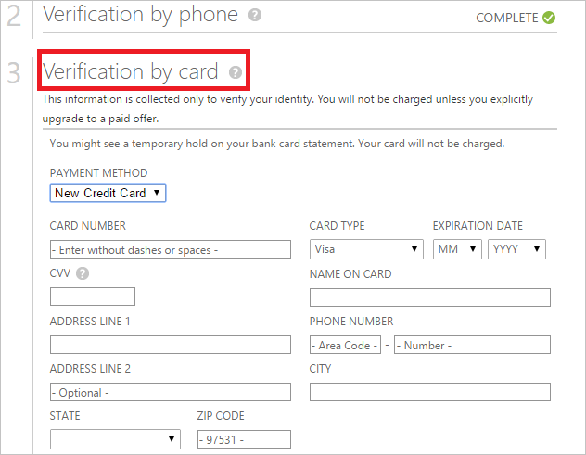
Notes:
https://azure.microsoft.com/en-us/documentation/articles/billing-buy-sign-up-azure-subscription/

Slide 20
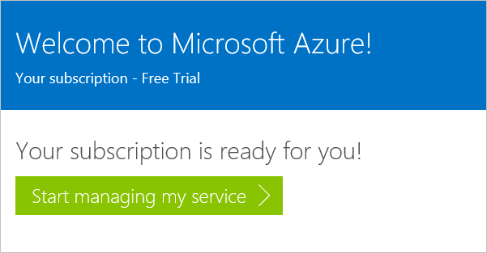
Notes:
https://azure.microsoft.com/en-us/documentation/articles/billing-buy-sign-up-azure-subscription/

Slide 21
33%
25%
NO
DISCOUNT RESERVED WEB SITES CLOUD SERVICES, HDINSIGHT
CREDIT CARD REQUIRED
DISCOUNT VIRTUAL MACHINES
$150
$100
$50
MONTHLY CREDIT
VISUAL STUDIO ULTIMATE WITH MSDN
MONTHLY CREDIT
VISUAL STUDIO PREMIUM
WITH MSDN
MONTHLY CREDIT
VISUAL STUDIO PROFESSIONAL WITH MSDN
Notes:
https://azure.microsoft.com/en-us/pricing/member-offers/msdn-benefits-details/

Slide 22
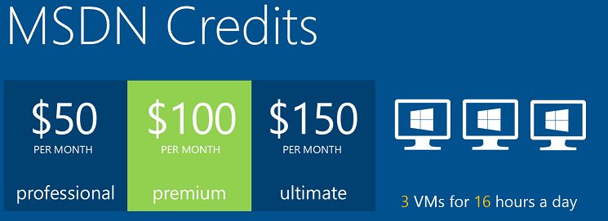
Microsoft Azure

Slide 23
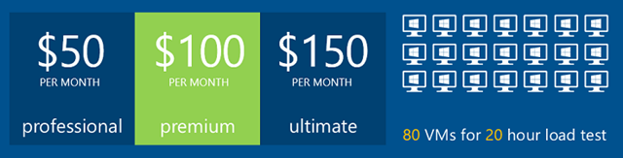
Microsoft Azure

Slide 24

Microsoft Azure

Slide 25

Microsoft Azure

Slide 26
Resources
Feedback and questions http://asp.net
http://get.asp.net
http://docs.asp.net
http://azure.microsoft.com
http://aka.ms/webcamps-training-kit
http://aka.ms/webcamps-azure (free trial)

