Slide 2
What’s next
[Speaker]
[Company]
Email: [Email]
Twitter: [Twitter]

Slide 3
Today’s Agenda
Session | Start | End
Keynote | 8:30 | 9:00
Introduction to ASP.NET and Visual Studio 2015 Web Tools | 9:00 | 10:45
Break | 10:45 | 11:00
Building Web Applications using the latest ASP.NET technologies | 11:00 | 12:15
Lunch | 12:15 | 1:15
Building web front ends for both desktop and mobile using the latest web standards | 1:15 | 2:15
API Services for both web and devices | 2:15 | 3:15
Break | 3:15 | 3:30
Running, improving and maintaining a site in the real world | 3:30 | 4:30
Wrap Up | 4:30 | 5:00

Slide 4
Agenda
What we covered today
Top resources for more info
Your homework assignments

Slide 5
What we covered

Slide 6
The foundation: tools & frameworks
Visual Studio 2015
ASP.NET Core
Azure
Package Managers

Slide 7



ASP.NET 4.6 and ASP.NET Core 1.0
ASP.NET 4.6
ASP.NET Core 1.0
.NET Framework 4.6
.NET Core 1.0
.NET framework libraries
.NET core libraries
Compilers and runtime components (.NET Compiler Platform: Roslyn, C#, VB, F# Languages, RyuJIT, SIMD)
Notes:
Key message: Differentiate the purpose and scenarios between .NET Framework and .NET Core. They Key point on .NET Core is that it’s self-contained and specialized on specific workloads. Make sure that we make the point that BOTH are valid. There is no decrease in investment on the .NET Framework side.
Transition. There is a common shared layer to these 2 pieces

Slide 8
What we learned today
Introduction to ASP.NET Core and Visual Studio Web Tools
Building Web Applications using ASP.NET Core
Building web front ends for both desktop and mobile using the latest web standards
API Services for both web and devices
Running, improving and maintaining a site in the real world
Notes:
Note: Should add other key scenarios we won’t be covering in depth

Slide 9
Top resources for more info

Slide 10
ASP.NET Questions
http://www.asp.net/feedback
Twitter - @aspnet
Facebook - /ASPNET
G+ - ASP.NET

Slide 11
Web Camps
http://www.devcamps.ms
http://aka.ms/webcamps-training-kit

Slide 12
Microsoft Azure
http://azure.microsoft.com

Slide 13
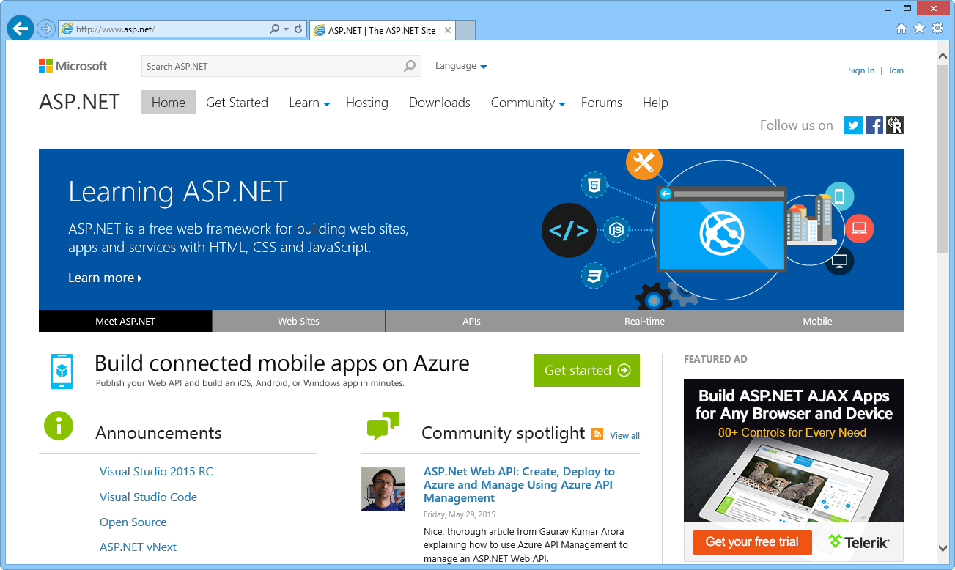
ASP.NET site

Slide 14
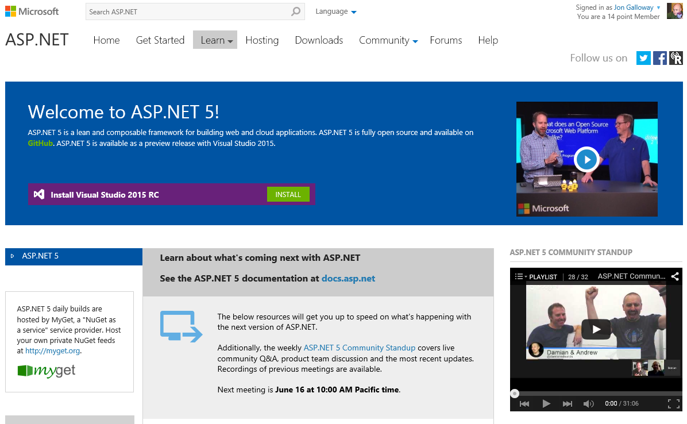
http://www.asp.net/vnext

Slide 15
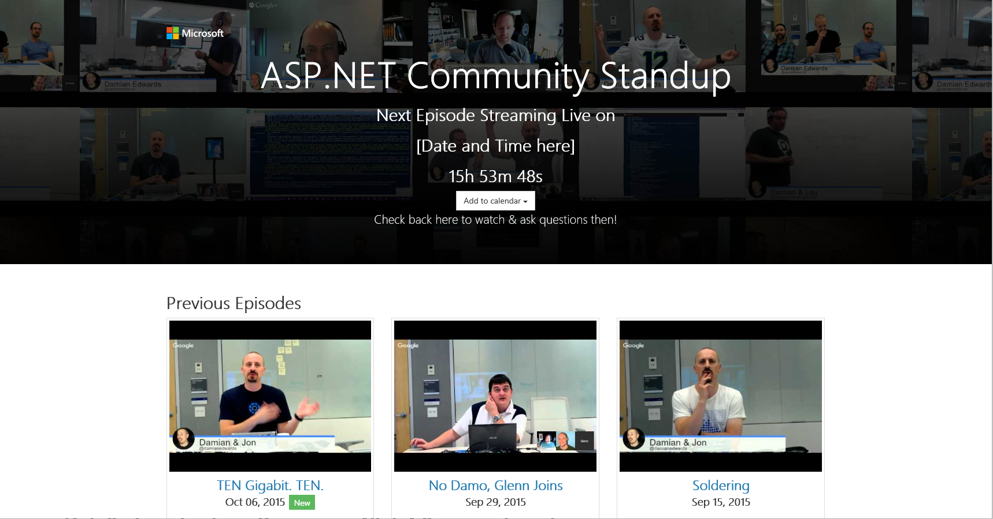
http://live.asp.net

Slide 16
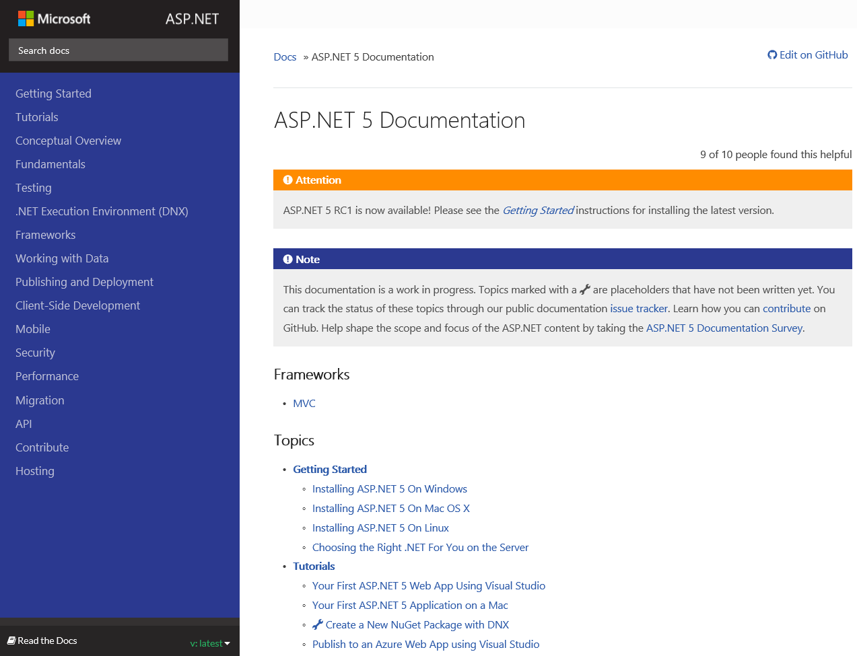
http://docs.asp.net

Slide 17
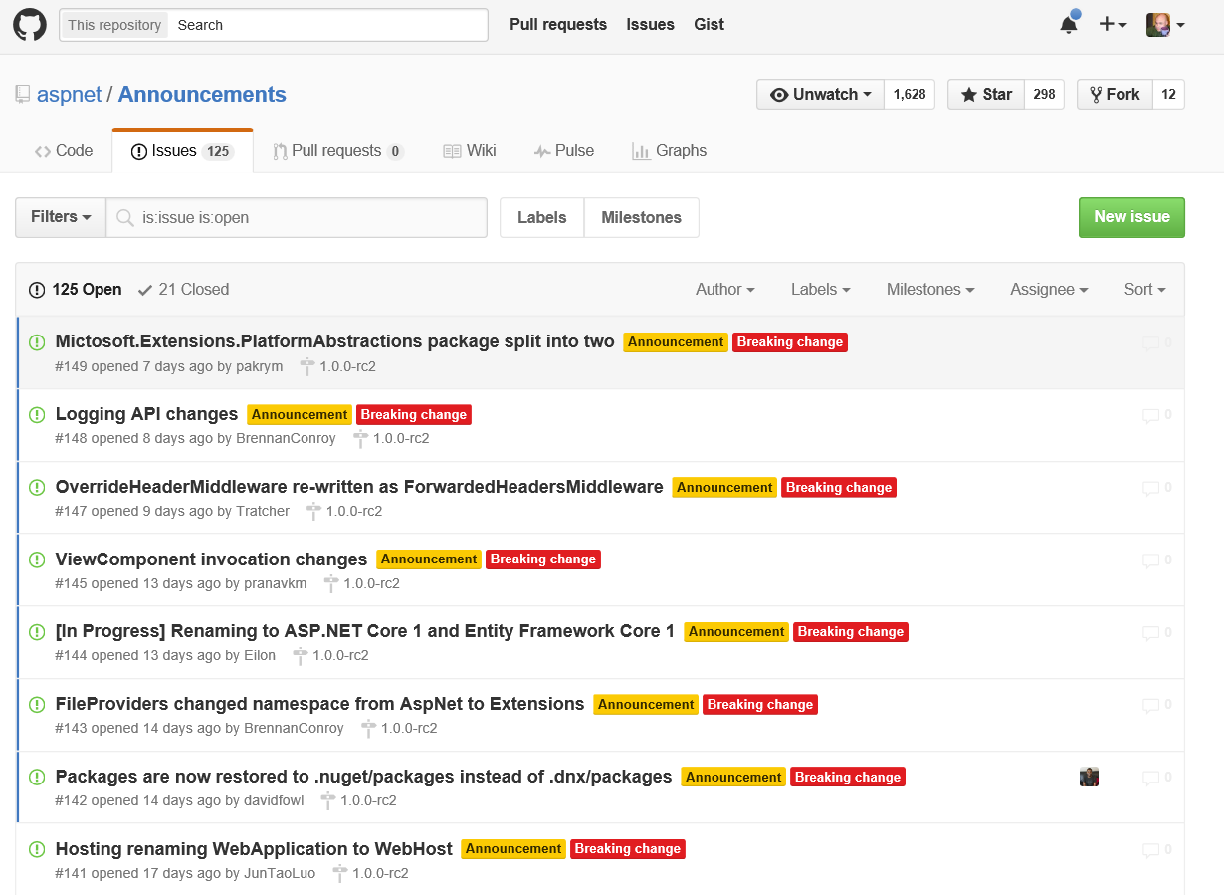
https://github.com/aspnet/announcements/issues

