Slide 1
Identifying and Discussing
Drivers and Barriers of a Job System for the Virtual Agile Workforce
of the Future
SDM paper 1
From : David Richter, Victoria Reibenspiess, Andreas Eckhardt

Slide 2
Lada Phonrungwong
61605041@kmitl.ac.th
Identifying and Discussing Drivers and Barriers of a Job System for the Virtual Agile Workforce of the Future
From : David Richter, Victoria Reibenspiess, Andreas Eckhardt
Pub : SIGMIS-CPR, June 2018

Slide 3
OUTLINE
INTRODUCTION
METHODOLOGY
Approach chosen
Search Terms
Article Inclusion Criteria
RESULTS
Flexible
Leadership
Virtual Work

Slide 4
INTRODUCTION

Slide 5
INTRODUCTION
Just like society is always developing and thus changing,
the work environment cannot stop or reach the end of its development
Term “agile”
Scrum, probably the best-known agile software development
technique in use today
Agility can be outlined as being
observant, anticipating, adaptable, flexible and decisive
To answer the research question, we apply a literature review.

Slide 6
“ How can companies prepare for,
sustainably react on and work with the agile workforce? ”
Apply a literature review !!

Slide 7
METHODOLOGY

Slide 8
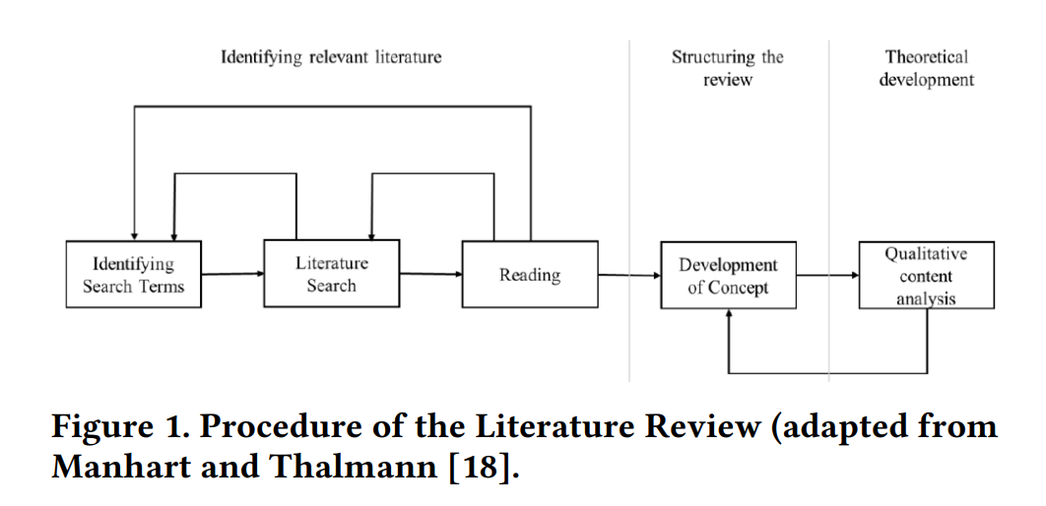
METHODOLOGY
To answer the research question, we apply a literature review.

Slide 9
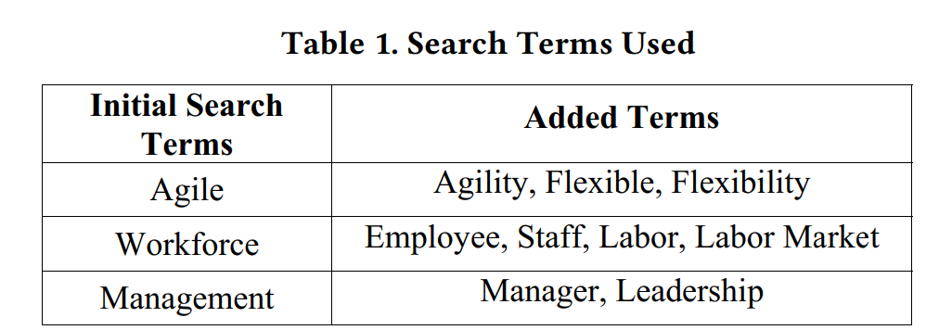
METHODOLOGY

Slide 10
Article Inclusion Criteria
The German Academic Association for Business Research (VHB)
429 journals were chosen as basis for the review -> agile involve
No limiting parameters were applied to the facts of where …
Articles had to be in English language, as is the lingua franca of today’s science
To answer the research question, we apply a literature review.

Slide 11
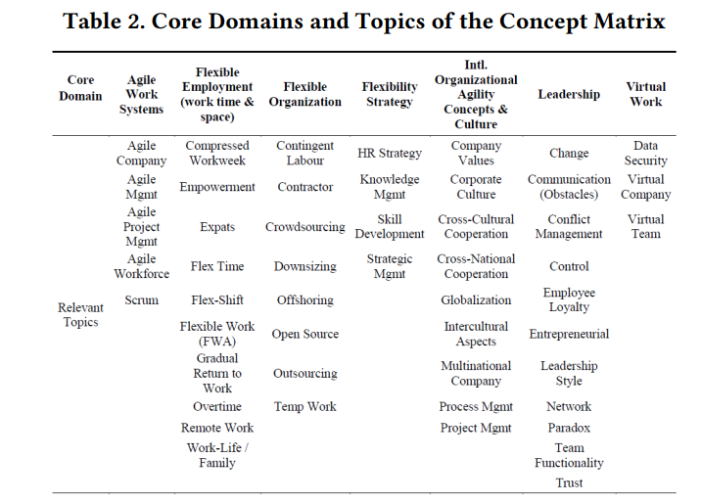
METHODOLOGY
Structuring the Review

Slide 12
266 articles
191 articles
After applying the aforementioned classification
considered relevant

Slide 13
RESULTS

Slide 14
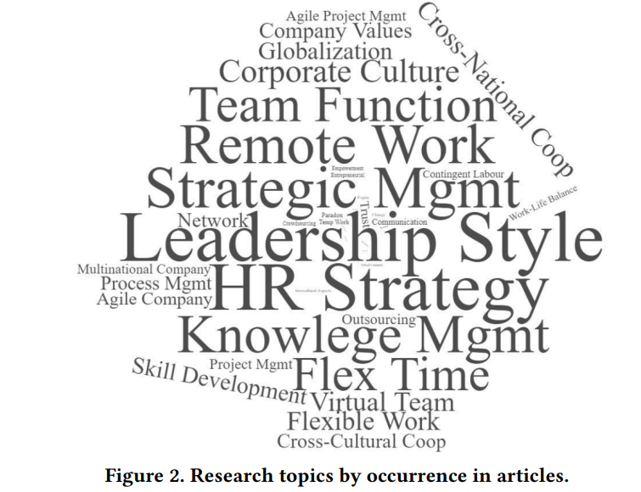
RESULTS
To answer the research question, we apply a literature review.

Slide 15
Flexible Organization
The most important topic observable in the articles is outsourcing
There is no more distinction between outsourcing in the home country of an organization and outsourcing to different parts of the world
With 14 total articles relating to this topic, 7.3% of articles had an outsourcing topic

Slide 16
Flexible Organization
The second important topic in this domain is “non-standard” employment practices, such as temp work, outsourcing or contracting.
Ten articles (5.2%) had a distinct relation to this topic
The topic of temp work is also a stand-alone, as six articles took a closer look at this phenomenon

Slide 17


Flexible Organization
Crowdsourcing, observed in five articles (2.6%), is a topic with a potentially higher relevance for the future and in the context of workforce agility
Crowdsourcing = Crowd + Outsourcing

Slide 18
Leadership
The most dominant topic in this cluster is the leadership style (67 total articles).
Leadership styles are vital in how to manage change processes and lead change to a successful and sustainable implementation of new processes, models, or structures

Slide 19
Leadership
The topic with the second most articles assigned is team functionality
(48 overall articles, 25%).
Similar to the leadership style argument,
the functioning of teams and a healthy relationship among team members is a prerequisite for the successful implementation of changes
Further, the cluster trust is a multi-faceted topic that can be applied, for example, in the complex and challenging case of virtual team members, especially in the creation phase

Slide 20
Leadership
The remaining three topics :
paradox (6 articles total),entrepreneurial (5 articles) and change (4 articles)
Paradox stands for the situation, that in a dynamic and competitive environment contradictory demands occur that a company needs to fulfill.
Entrepreneurial , often found in regard to start-ups and their attitudes and articles,
that entrepreneurial approaches are needed within companies and departments and the entrepreneurial mindset is pictured as a driver to achieve agile innovation.
Change has been mentioned across all domains, but is often treated as implicit.

Slide 21
Virtual Work
The dominating topic in this cluster is that of virtual teams (26 articles in total).
While the technological issues are mainly solved,
questions in regard to the integration of virtual teams into existing work processes or topics relating to the social factor, such as communication between team members, cross-cultural issues or knowledge sharing are still of ongoing importance.
A phenomenon that, in part, can only exist thanks to virtual teams is that of virtual companies (3 articles).

Slide 22
Virtual Work
Mullenweg and his company Automattic
are considered a prime example of a virtual company,
it does still have a postal address and an “automattic lounge” in San Francisco.
A topic that is connected especially with work in the virtual space is
that of data security (1 article)

Slide 23
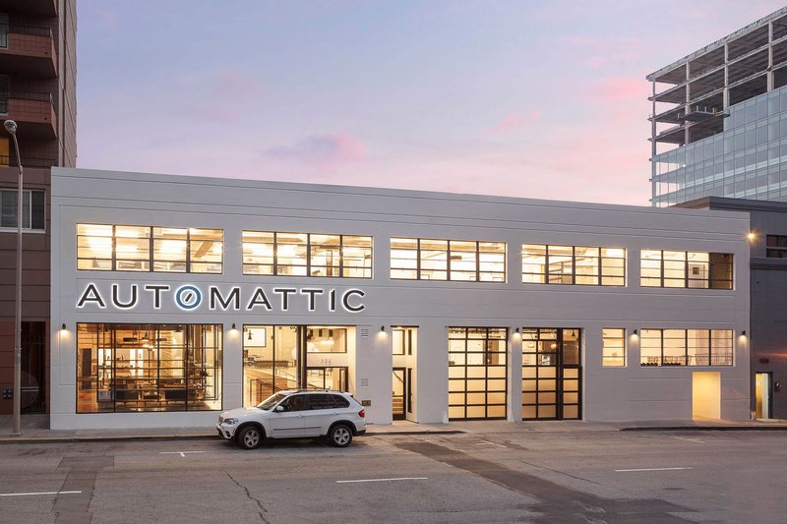

Slide 24

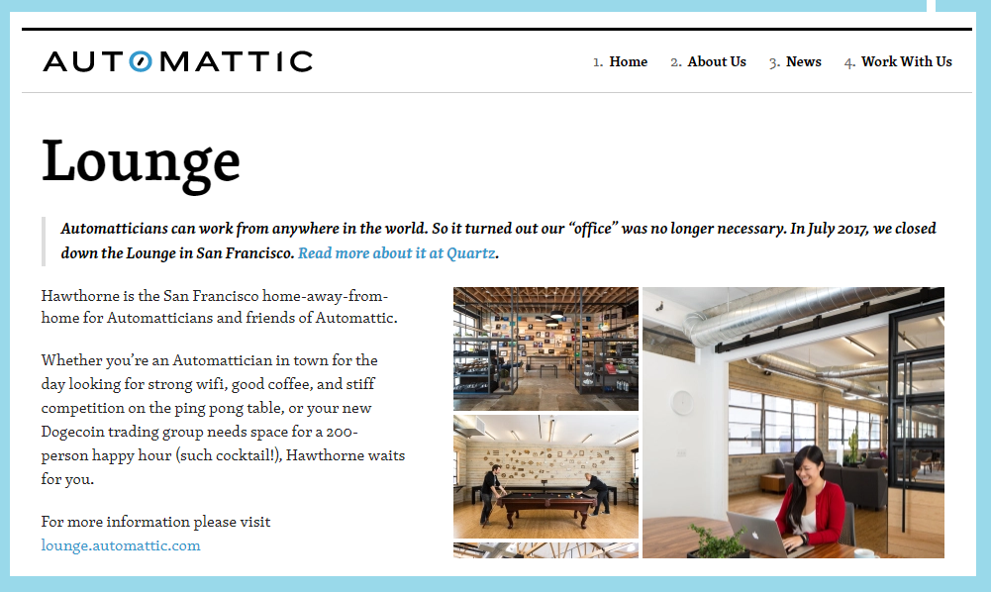

Slide 25
Summary
...that sharing employees’ values has already become more important for their employment decision than the amount of their salary
“people are an organization’s most valuable resource and […] a manager’s job is to prepare and free people to perform”

Slide 26

Q & A
Last Slide

