Slide 1
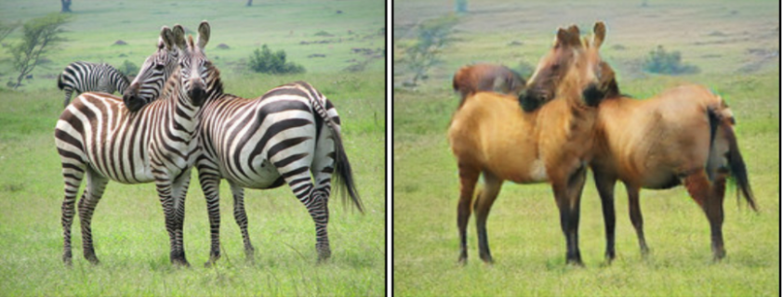
CYCLE GAN ++
GNR638 Course Project
Instructor : Prof. Biplab Banerjee, IIT BOMBAY
Team Members:
Shreya Laddha (180070054)
Anurag Kumar (18D070006)
Hitul Desai (18D070009)
Harsh Pal (18D070012)

Slide 2
Contents
Introduction
Approach
Dataset
Improvisation
Workflow
Inferences
Contributions
References

Slide 3
Introduction
The Cycle Generative Adversarial Network, or CycleGAN, is an approach to training a deep convolutional neural network for image-to-image translation tasks.
It is basically a generator model for converting images from one domain to another domain.
Unlike other GAN models for image translation, the CycleGAN does not require a dataset of paired images.This allows the development of a translation model on problems where training datasets may not exist, such as translating paintings to photographs.
The goal of the image-to-image translation problem is to learn the mapping between an input image and an output image using a training set of aligned image pairs.
However, obtaining paired examples isn't always feasible. CycleGAN tries to learn this mapping without requiring paired input-output images, using cycle-consistent adversarial networks.

Slide 4
Approach
Firstly, we focus on the implementation of original CycleGAN as was proposed in the paper as it is. The point of this is to set a benchmark to test our improvements against.
Next we modify the loss functions and the regularization term with 4 different combinations.
Then we train the GAN for all the different scripts for identical sets of hyperparameters and compare performances.

Slide 5
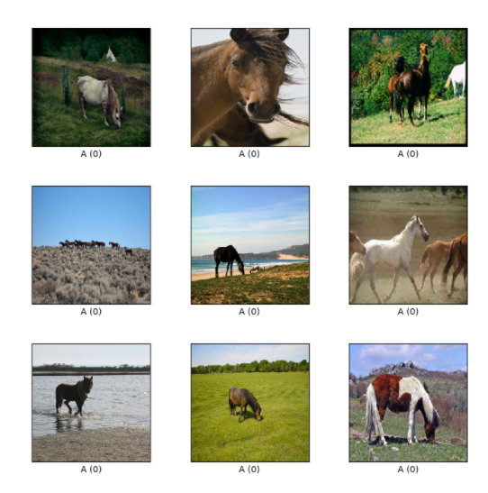
Dataset
We made use of the Horse2Zebra dataset of Keras
Contains pictures of :
1067 horses pictures in trainA
1334 zebra pictures in train
120 horses pictures in testA
140 zebra pictures in test
https://www.kaggle.com/arnaud58/horse2zebra

Slide 6
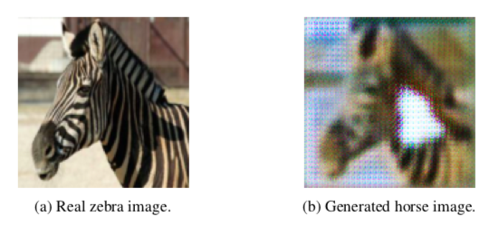
Improvisation
The shortcomings of CycleGAN that we focussed on was this:
----Generators quickly learn near-identity mapping at training epoch 3

Slide 7
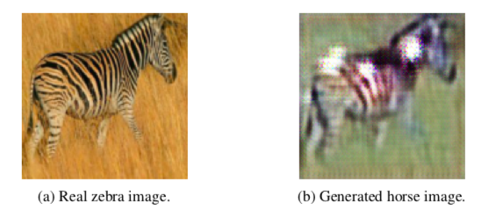
Improvisation
Generator quickly learns horse image, primarily from the background and not the horse- zebra subject transform.

Slide 8
Improvisation
Generally horses are found in green fields and zebras in dry grasslands (yellow). So this colour combination is what turns out to be the dominant transform. So, the model quickly learns the the background transformation and converges, not learning the actual horse to zebra transforms.
We introduce a regularization term in the cycle loss function which restrains the model from learning the background quicky and focuses more on pixel wise transform.
By and large we have employed two main (different) regularization terms
Cycle consistency on discriminator CNN feature level
SSIM loss (Structural similarity index measure)

Slide 9
Improvisation
Total list of improvisations implemented
Regularization term of SSIM loss only
Regularization term of L1 norm + Regularization term of L2 norm
Regularizations of SSIM + L1 + L2 norms
Cycle consistency loss (feature extraction term on last layer of discriminator)
Label Smoothening of real images in discriminator loss in all the above implementations
(*Note: These are the changes made that are different/additional to the original paper)

Slide 10
Inferences
The whole point of our improved version model was for to restrict the model from focussing on the background by addition of SSIM regularization loss and feature extraction based cycle consistency loss terms (separately)
This can be seen as follows;

Slide 11
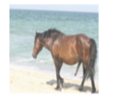
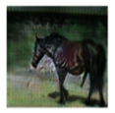
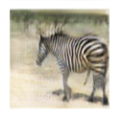
Inferences
----->
(Input Image) Generated Image(Without Modification)
-----> Generated Image (with modification)

Slide 12
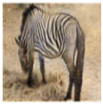
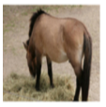
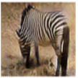
Inferences
Generated Image(without
modifications)
Generated Image (With
Modifications)

Slide 13
Inferences
We have been able to achieve some improvements for some cases, while there have been some poor images (compared to original version) also.
Regularization term implies it takes longer for Generator to converge and more time to produce comparable/better images
Qualitative and human evaluation shows promising results
A lot more time and computation resources, potentially make way for more improvements(Validation over gamma )

Slide 14
Contributions
Shreya Laddha (180070054) - Ideation, Theory Research, Working Framework Design and Report Preparation.
Anurag Kumar (18D070006) - Ideation, Mathematical Modelling ,Data Visualization and Code Deployment.
Hitul Desai (18D070009) - Loss Function Analysis, Mathematical Modelling, Working Framework Design and Code Deployment.
Harsh Pal (18D070012) - Theory Research, Loss Function Analysis, Data Visualization and Report Preparation.

Slide 15
References
https://openaccess.thecvf.com/content_ICCV_2017/papers/Zhu_Unpaired_Image-To-Image_Translation_ICCV_2017_paper.pdf
https://github.com/junyanz/CycleGAN
https://github.com/Tandon-A/CycleGAN_ssim
https://ssnl.github.io/better_cycles/report.pdf
https://www.tensorflow.org/tutorials/generative/cyclegan
https://keras.io/examples/generative/cyclegan/
https://towardsdatascience.com/cyclegan-how-machine-learning-learns-unpaired-image-to-image-translation-3fa8d9a6aa1d
https://jonathan-hui.medium.com/gan-cyclegan-6a50e7600d7
https://machinelearningmastery.com/cyclegan-tutorial-with-keras/

